Slide 1
State Poverty Levels against SNF Medicare Payments
A deep dive into SNF Payments and lengths of stay for 2015 by Medicare
By Andrea Fox

Slide 2
Statistical Question and Hypothesis
Statistical Question:
Do states with a higher poverty level receive higher payments, but also experience higher average lengths of stay in Skilled Nursing Facilities?
Hypothesis:
Medicare and Medicaid have a reputation on paying less than the original bill, but I wonder how much that changes based on location. For my project I found a great dataset within the Skilled Nursing Facility (SNF) space that got me wondering how much payments and even average length of stay (ALOS) can change for Medicare based on state (1). I took it one step further and decided to explore this based on state poverty level. In my mind this makes sense because I would expect states with a higher poverty level to have higher ALOS, and Medicare to foot the bill more so healthcare debt does not skyrocket.

Slide 3
Variables
State
State – This is the variable I want to use to compare with the others.
Total
Total Stays – Total number of stays by State for each SNF Facility
Average
Average Length of Stay (ALOS) – Shows the ALOS for each State by SNF Facility
Total
Total SNF Charge Amount – Total amount that has been charged for the SNF stay
Total
Total SNF Medicare Allowed Amount – Total amount that Medicare would normally allow for this particular SNF stay
Total
Total SNF Medicare Payment Amount – Total amount paid by Medicare

Slide 4
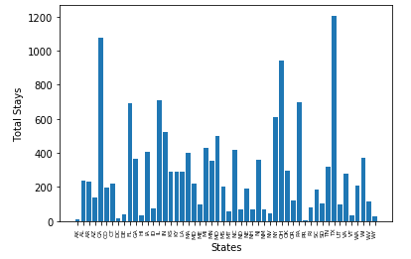
Histogram for Total Stay

Slide 5
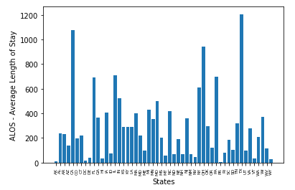
Histogram for Average Length of Stay (ALOS)

Slide 6

Histogram for total SNF Charge Amounts

Slide 7

Histogram for total SNF Medicare Allowed Amount

Slide 8
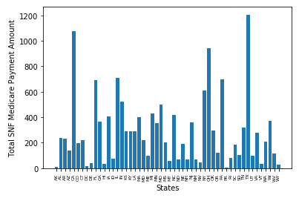
Histogram for Total SNF Medicare Payment Amount

Slide 9
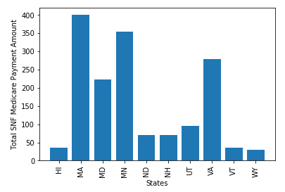
Medicare payments by State for the Top 10 richest states

Slide 10
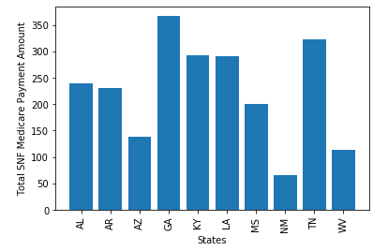
Medicare Payments by State for the Top 10 poorest states

Slide 11
Means for both Top 10 Richest and Poorest States
Top 10 Poorest States
Top 10 Richest States
ALOS: 28.398583444001787
Total_Stays: 152.5303231518371
Total_SNF_Charge_Amount: 2,554,947.0305444887
Total_SNF_Medicare_Allowed_Amount: 1,798,458.7853032316
Total_SNF_Medicare_Payment_Amount: 1,433,852.9008410801
ALOS: 24.930276381909586
Total_Stays: 193.61934673366835
Total_SNF_Charge_Amount: 3,200,958.601130653
Total_SNF_Medicare_Allowed_Amount: 2,337,887.547110553
Total_SNF_Medicare_Payment_Amount: 1,964,713.5207286433

Slide 12
Modes for both Top 10 Richest and Poorest States
Top 10 Poorest States
Top 10 Richest States
ALOS: 24.7
Total_Stays: 54
Total_SNF_Charge_Amount: 1,285,345
Total_SNF_Medicare_Allowed_Amount: 16,713
Total_SNF_Medicare_Payment_Amount: 16,713
ALOS: 27.9
Total_Stays: 41
Total_SNF_Charge_Amount: 32,780
Total_SNF_Medicare_Allowed_Amount: 8,085
Total_SNF_Medicare_Payment_Amount: 7,298

Slide 13
Variances for both Top 10 Richest and Poorest States
Top 10 Poorest States
Top 10 Richest States
ALOS: 68.77578187201979
Total_Stays: 15,736.384708974409
Total_SNF_Charge_Amount: 5,623,483,212,041.551
Total_SNF_Medicare_Allowed_Amount: 2,020,443,323,151.9412
Total_SNF_Medicare_Payment_Amount: 1,413,914,389,107.5964
ALOS: 35.72965473186174
Total_Stays: 26,876.121511075104
Total_SNF_Charge_Amount: 8,729,218,038,835.195
Total_SNF_Medicare_Allowed_Amount: 4,243,200,134,351.357
Total_SNF_Medicare_Payment_Amount: 3,072,859,242,841.49

Slide 14
Standard Deviations for both Top 10 Richest and Poorest States
Top 10 Poorest States
Top 10 Richest States
ALOS: 8.293116535538362
Total_Stays: 125.4447476340656
Total_SNF_Charge_Amount: 2,371,388.4565885765
Total_SNF_Medicare_Allowed_Amount: 2,020,443,323,151.9412
Total_SNF_Medicare_Payment_Amount: 1,189,081.3214862961
ALOS: 5.977428772629729
Total_Stays: 163.93938364857635
Total_SNF_Charge_Amount: 2,954,525.010697184
Total_SNF_Medicare_Allowed_Amount: 2,059,902.9429444866
Total_SNF_Medicare_Payment_Amount: 1,752,957.284944927

Slide 15
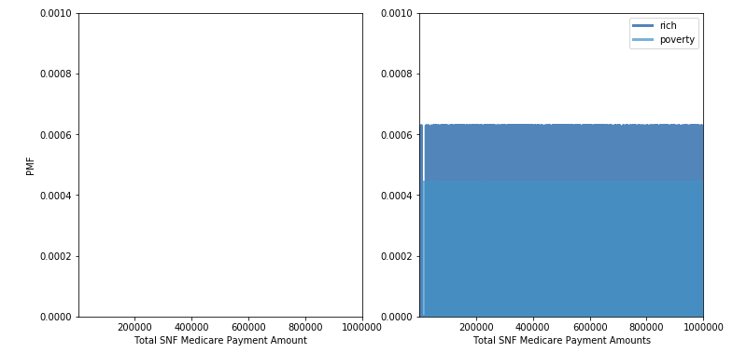
PMF- Comparing SNF Medicare Payments by the top 10 richest and poorest states

Slide 16
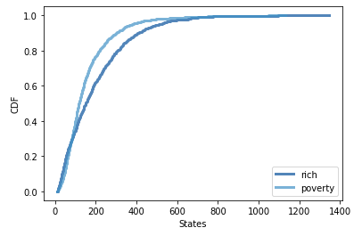
CDF – Comparing Total_Stays by top 10 richest and poorest states

Slide 17
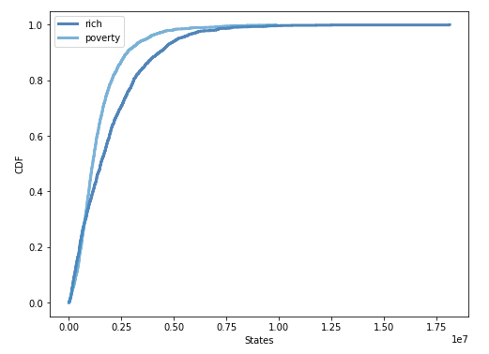
CDF – Comparing Total SNF Medicare Payments by top 10 richest and poorest states

Slide 18
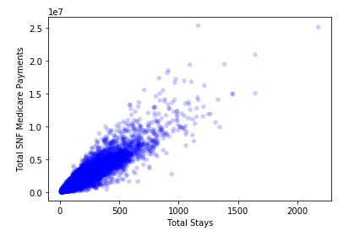
Scatterplot comparing total stays by total SNF Medicare payments
Correlation: 0.923813174241657
Spearman Correlation: 0.9432738926903175

Slide 19
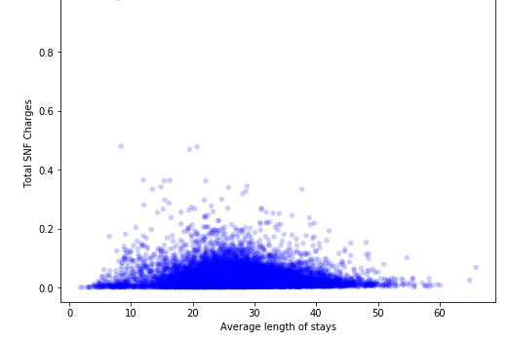
Scatterplot comparing ALOS by total SNF charge amounts
Correlation:-0.08268280147548872
Spearman Correlation: -0.0321250560528255

Slide 20
Hypothesis Tests
DiffMeansPermute for total SNF Medicare Payment Amounts by top 10 richest and poorest states
Output = 0.0
CorrelationPermute by ALOS against total SNF Medicare Payment Amounts
Output = 0.65
T-Test for total SNF Medicare Payment Amounts by top 10 richest and poorest states
Pvalue = 1.181091692388514e-28

Slide 21
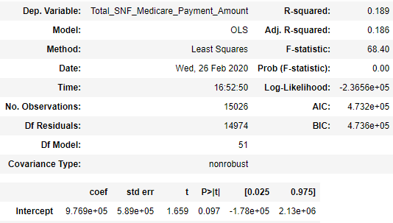
Regression Analysis – Total SNF Payments by State

Slide 22
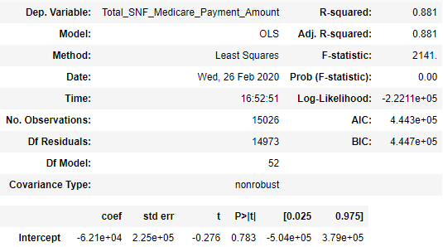
Regression Analysis – Total SNF Payments by State and Total Stays

