Slide 1
predicting Hospital readmissions to prevent them: Intermediate results
Jolene Branch, Andrea Fox, & sam sears
DSC630 Predictive analytics, Bellevue university

Slide 2
Background of the problem
Before hospitalization:
Inadequate social and medical resources
After hospitalization:
Suboptimal care transitions
Inadequate social and medical resources
Vicious cycle of readmission
Notes:
Might scrap this entire slide. An 'executive level audience with minimal knowledge of the topic' won't care anyway.
Is the 'Business Understanding' slide enough?
We can still cover the background in the final paper if we want.

Slide 3
Business understanding for preventing readmissions
Excessive cost to patient and third-party payers
Bed capacity crises
Additional construction
Need to prioritize or restrict care
Reduces future Medicare payments to the facility
Weakens relationship with community

Slide 4
Data understanding
UCI Machine Learning Repository – readmissions for diabetic patients (Beata, 2014)
1999-2008
130 hospitals
50+ features
Categorical
Target variable = readmitted
Mean readmission rate = 11.2%

Slide 5
Data preparation - Initial
Removal of hospice patients and deaths
Kept top 10 medical specialties and converted less frequent values to 'other' due to skewed distribution
Filling Nan values with 'UNK' (unknown)
One-hot encoding of categorical variables to be able to use sklearn algorithms
Binned age in years to intervals of 10
Converting weight variable to binary 'has_weight' due to lots of missing values
Created binary target feature using a derived variable based on "Readmission within 30 days - Yes/No?"

Slide 6
Data preparation – subsequent iterations
Update to only look at admissions that lasted longer than 1 day
Binning of (previously used) ICD-9 billing/diagnostic codes to diagnostic code category
Skipped one-hot encoding of categorical variables and used H20 random forest classifier
Notes:
Mention removal of hospice patients here?
Derived binary target feature.

Slide 7
modeling
Split data into three sets: 15% test, 15% validation, and 70% training
Balanced training set to have 50% positive and 50% negative to account for an uneven distribution
Scaled training and validation data inputs using sklearn StandardScaler()
Training data fit and validation data tested on 7 different classification models
K-Nearest Neighbor, Logistic Regression, Stochastic Gradient Descent, Naïve Bayes, Decision Tree, Random Forest, and Gradient Boosting

Slide 8
evaluation
Compared AUC, Accuracy, Precision, and Recall scores between train and validation for generalization and between models for performance
Overall, scores were similar between both except for Precision, as expected, because the train data set was balanced, and the validation data set was not.
Ex. Logistic Regression Precision for train 0.6457909029192125, while validation was 0.18695452457510336
Created cost function to better compare models
Cost per prediction = (($14,400 x false negatives) + ($1,780 x false positives)) / number of predictions

Slide 9
Cost Function
False Positive
Treat someone as if they are going to require readmission – by keeping him/her an additional day in the hospital.
For this project, the cost of a false positive was the cost of keeping a patient an additional day in the hospital. Average cost for non-profit facility is $2653. Cost for for-profit is $2093. Average for the two is $2373 x 75% (estimated cost to the hospital) = $1780 for an additional hospital day as the cost to the hospital. (Elflein, 2020)
False Negative
Thought someone would not be readmitted and did not take additional action to prevent, but he/she actually was readmitted
Average cost for readmission (any diagnosis) in 2016 was $14,400. (Bailey, 2019)

Slide 10
Cost- Baseline
Always predict negative (not readmitted)
Accuracy: 88.3%
Cost per prediction: $1,691.99
Always predict positive (readmitted)
Accuracy: 11.7%
Cost per prediction: $1,570.85
Random guess
Accuracy: 50%
Cost per prediction: $1,631.42

Slide 11
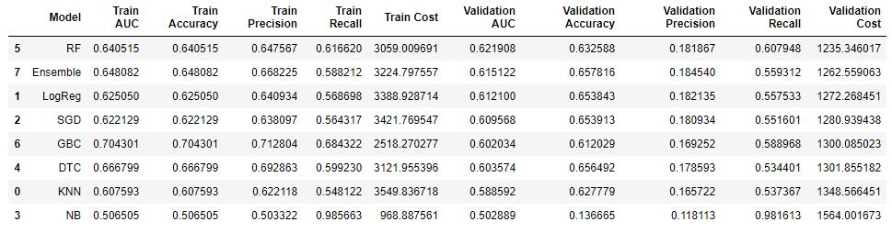
Results
Random Forest Classifier cost per prediction was $335.50 less than the best baseline predictor of always predicting positive.
Notes:
The Validation cost of 1235.346017 means the hospital would incur $1,235.35 per prediction if they used this model for each patient, given that the false positive and false negative costs were accurate.

Slide 12
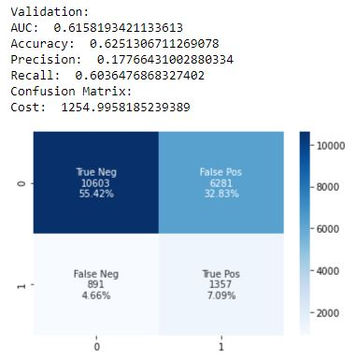
Results – H20
We hypothesized one-hot encoding of categorical variables created a more sparce dataset that affected decision trees poorly. Therefore we used the H20 random forest classifier which did not require one-hot encoding.
All measures of performance were slightly worse using the H20 model. Additional hyperparameter tuning is necessary.

Slide 13
Plans to complete the analysis
Continue parameter tuning efforts
H2O Random Forest parameters
H20 Random Forest tuning
Review what others have used as the cost of a false positive for this dataset

Slide 14
references
Bailey, M., Weiss, A., Barrett, M., & Jiang, J. (2019, February). Characteristics of 30-Day All-Cause Hospital Readmissions, 2010-2016. Retrieved from https://www.hcup-us.ahrq.gov/reports/statbriefs/sb248-Hospital-Readmissions-2010-2016.jsp#:~:text=The%20highest%20average%20readmission%20cost%20was%20for%20congenital,for%20pregnancy%2Fchildbirth%20%28%247%2C000%29%2C%20followed%20by%20mental%2Fbehavioral%20disorders%20%28%248%2C200%29
Beata Strack, Jonathan P. DeShazo, Chris Gennings, Juan L. Olmo, Sebastian Ventura, Krzysztof J. Cios, and John N. Clore, “Impact of HbA1c Measurement on Hospital Readmission Rates: Analysis of 70,000 Clinical Database Patient Records,” BioMed Research International, vol. 2014, Article ID 781670, 11 pages, 2014.
Elflein, J. (2020, May 12). Inpatient day hospital costs in the U.S. by type 2018. Retrieved from https://www.statista.com/statistics/630443/inpatient-day-hospital-costs-in-us-by-nonprofit-or-profit/
Long, A. (2020, January 30). Using Machine Learning to Predict Hospital Readmission for Patients with Diabetes with Scikit-Learn. Retrieved from https://towardsdatascience.com/predicting-hospital-readmission-for-patients-with-diabetes-using-scikit-learn-a2e359b15f0

