Slide 1
THE MOVE BUTTON
Group 5: Girish, Angela, Dale, Eric, Karthik
Behavior Change Support for Health

Slide 2
The Why?
People are hurting at work -- High Cost
1.3 billion a year in business services for repetitive motion injuries (2019) ¹
What do we know?
Breaks are important and beneficial
Sitting too long is negative on your health
Good ergonomics helps other KPI’s: business process efficiency, higher sense of community, overall wellness, corporate climate ²
Training alone is not effective without regular reinforcement ²
Existing support tools such as sit-stand desks, stretching programs, break timing software and so on are not fully utilized
Behavior change is hard
1 Liberty Mutual Workplace Safety Index. https://viewpoint.libertymutualgroup.com/article/top-10-causes-disabling-injuries-at-work-2019/ Accessed 02/22/2020
2 Robertson, m. m.et al. (2008). Flexible workspace design and ergonomics training: Impacts on the psychosocial work environment, musculoskeletal health, and work effectiveness among knowledge workers. Applied Ergonomics, 39(4): 482–494.

Slide 3
The Solution: The Move Button
Tool to support and maintain behavioral change forming healthy habits
Positive reinforcement through reminders
More visible than email
Encourages engagement – simple interface
Lower cost than other types of training
Personalized to way person works (activities, schedule)
Versatile on both mobile and desktop
Scalable
Unique tools that uses social support
Social support is important for behavioral change ¹
Peer-support to do activities together
Future state
1 Ajzen, Icek (1991). "The theory of planned behavior". Organizational Behavior and Human Decision Processes. 50 (2): 179–211.

Slide 4
Strategy
B2B
Direct to companies (decision makers: Health/safety, HR)
License to insurers to brand as product for clients (similar to current telematics apps)
Subscription based model
As third party we protect employee privacy to increase adoption
Incentivize group participation
Provide group level data
Company can model with other KPI’s (employee engagement, lost days)
Track behavioral changes over time (unique)
Lower costs than current training and consulting options

Slide 5
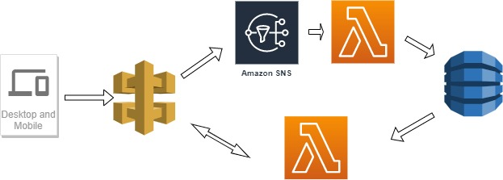
INFRASTRUCTURE
AWS Services:
API Gateway
SNS
Lambda
Dynamo DB
Low infrastructure with high margin:
Assuming 40,000 users (8 events a day)
$40/month cost for all Amazon services

