Slide 1
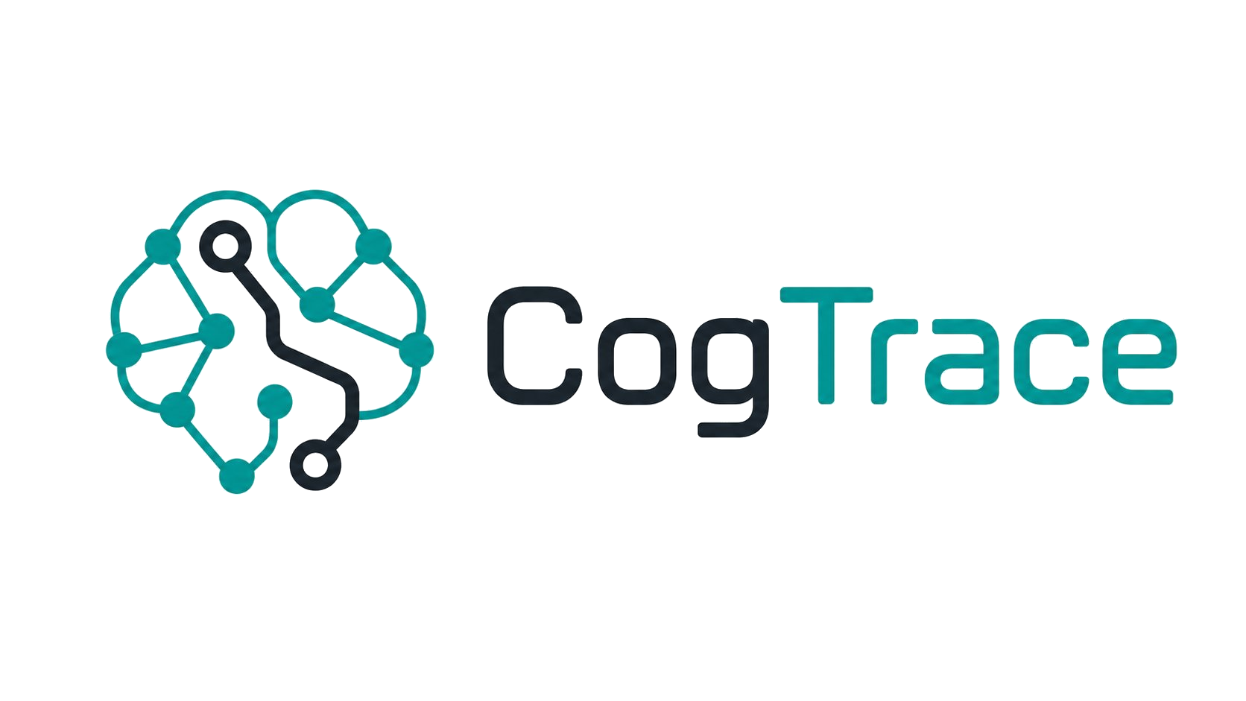
CogTrace treats AI decisions as part of a structured work system, not a loose org chart of 'software engineer' and 'QA' agents.
It organizes behavior from mission goals down to tool calls — and turns each decision into a rich W&B Weave trace.
Trace decisions. See why.
AHA for Agents
🏆 Most Sophisticated Harness · Best Use of W&B Weave

Slide 2
The problem with AI org charts
software engineer
Which layer broke?
?
Bad tool call at execution? Wrong constraint? Goal never specified? The role-based model has no answer.
QA tester
Everything escalates
product manager
↗
Without constraint structure, any ambiguity flows back through humans — or gets swallowed silently.
DevOps
Black-box failure
○
They know their role.
But not why.
You see the final answer. You don't see where in the reasoning hierarchy it went wrong.

Slide 3
Architecture: five abstraction layers
L5
Functional Purpose
Goal Governor
Mission objectives, ethical bounds, success criteria
L4
Abstract Function
Constraint Reasoner + MECC
Invariants, conservation constraints, safety predicates
L3
Generalised Function
Workflow Orchestrator
Standard operational patterns, fallback chains
L2
Physical Function
Capability Router
Tool specs, API contracts, model capabilities
L1
Physical Form
Execution Substrate (LangGraph)
HTTP calls, file I/O, LLM invocations
LangGraph is only at L1 — the architecture lives above the runtime

Slide 4
Core idea
Harness structure from ecological psychology
Affordances
Abstraction levels
Distributed cognition
Capabilities are framed as action possibilities relative to constraints, not generic tools waiting for prompts.
The harness distinguishes purpose, invariants, operational patterns, capabilities, and execution substrate.
No single component holds the whole picture — the system constructs the answer across coordinated layers.

Slide 5
MECC: Means-Ends Consistency Checker
The harness's core primitive — a cross-layer admissibility gate
MECC(A, L) = permitted(A, L) ∧ (∀k ≥ L: ¬violates(A, Cₖ)) ∧ (∃g ∈ G: advances(A, g))
MECC fires before:
Policy evaluator vs. MECC
Any external API call
A policy evaluator checks rules at one layer.
MECC enforces the full hierarchy at runtime — an action is only admissible if it passes constraints at all layers at or above its origin layer, and if it advances at least one system goal.
This is what makes CogTrace more than a workflow runner.
Any verdict emission
Any escalation trigger
Any proposed agent action

Slide 6
Three proof cases — one harness
Citations are the demo vehicle. The architecture works across any domain.
Citation Integrity
Sensor Escalation
Destructive Action Gate
primary demo
multi-agent coordination
admissibility check
DOI resolution, title match, year, venue. Three failure modes: VALID / FABRICATED / MISMATCHED. Motivated by the May 2026 Lancet audit of 2.5M biomedical papers.
Three independent sensor agents (seismic, tsunami, impact) reconcile USGS earthquake events. Cross-sensor MECC resolves contradictions. LLM assessor fires only on genuine ambiguity.
Hard L4 constraints block irreversible operations (DROP TABLE, DELETE). Borderline cases escalate to L5 for human approval. Architecture first — no execution engine needed.
Layers: L2 – L5
Layers: L2 – L5
Layers: L4 – L5

Slide 7
Distributed cognition — not a single orchestrator
Parser
Sees: raw text
Doesn't know: know if citations are real
Only the system together produces the answer.
Retriever
Sees: API responses
The architecture makes distributed cognition visible rather than hiding it inside a single orchestrator.
No single agent holds the full picture — the MECC sees constraints, not actions; the assessor sees claim pairs, not APIs.
This is why CogTrace is not just another agent app.
Doesn't know: know the claims
Verifier
Sees: metadata matches
Doesn't know: know semantic support
Assessor
Sees: claim-source pairs
Doesn't know: know API availability
MECC
Sees: all constraints
Doesn't know: execute any action

Slide 8
W&B Weave — every decision traced
Span events emitted:
What judges see in Weave
layer_transition
Source / target layer, trigger
Each pipeline run = root span with full child tree
mecc_evaluation
Action, layer, constraints checked, pass/fail
Every MECC span carries ah_layer, ah_layer_name, mecc_action
agent_output
Agent name, layer, confidence, proposed action
Filter by ah_layer_name to see all checks at one abstraction level
constraint_violation
Policy ID, severity, escalation target
Evaluations tab: verdict_correct, constraint_fired, pipeline_health scorers
scenario_complete
Totals, latency, cost
Human feedback (👍/👎) logged per run to classic dashboard

Slide 9
The AHA moment isn't the output.
It's seeing which layer of reasoning produced it.
Architecture first. Scenario second.
Today: citation integrity, sensor escalation, destructive action gate.
Tomorrow: any domain, any harness, same architecture.
CogTrace — AHA for Agents

