Slide 1
Moffat Bay Lodge
CSD-460
Bravo Team
5/6/26

Slide 2
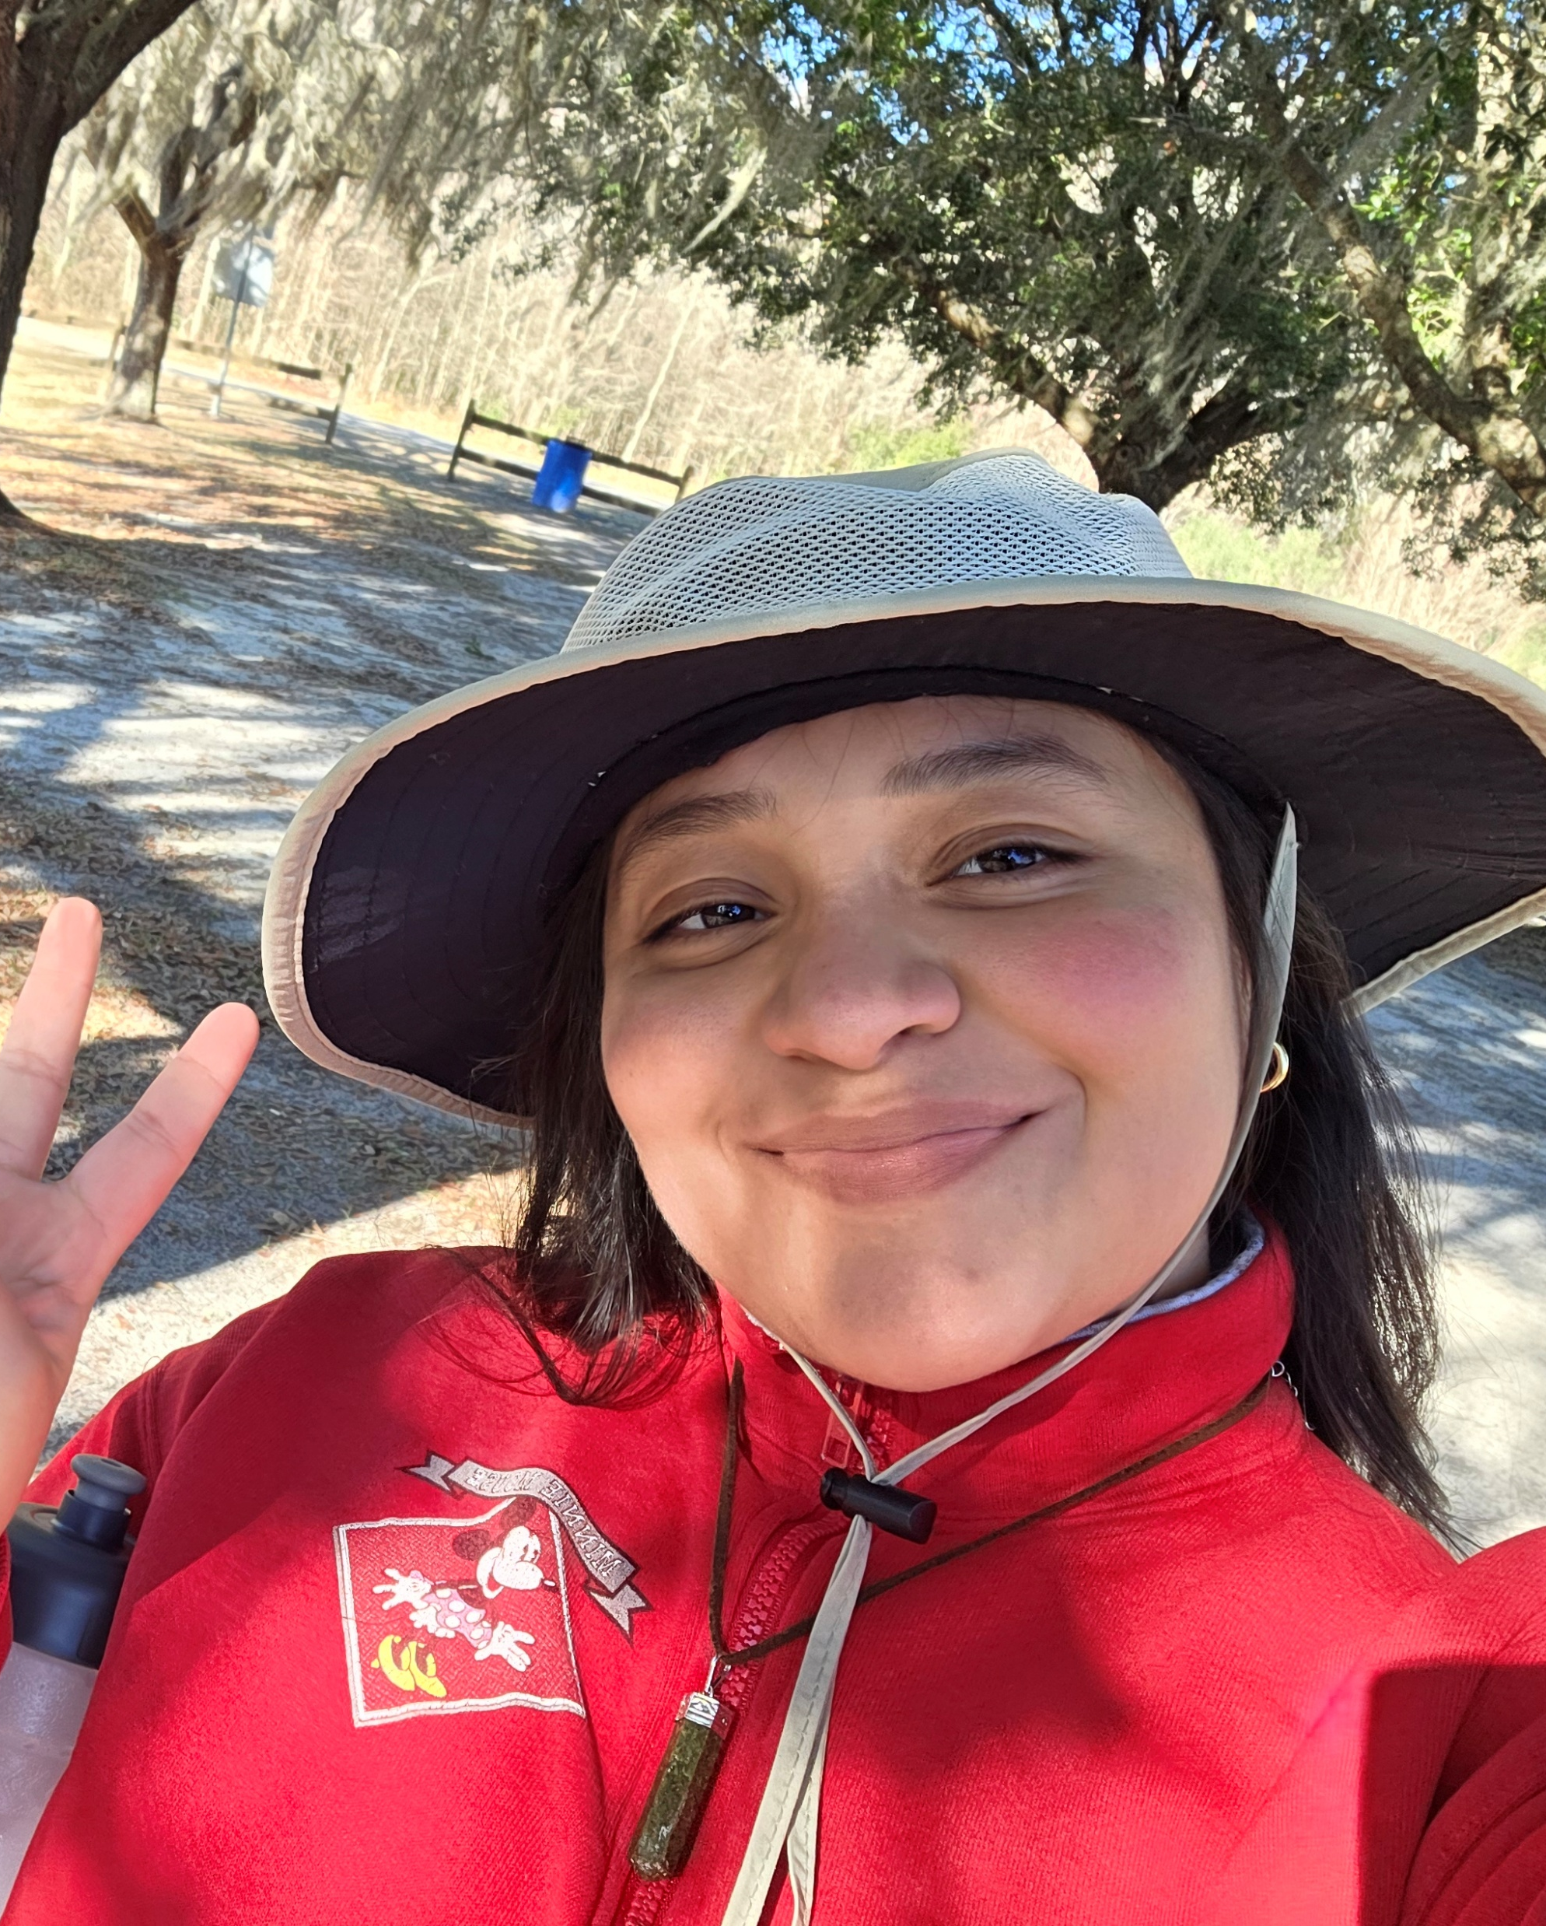
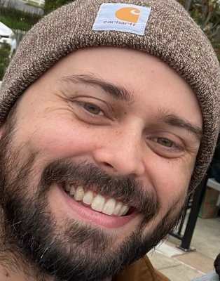
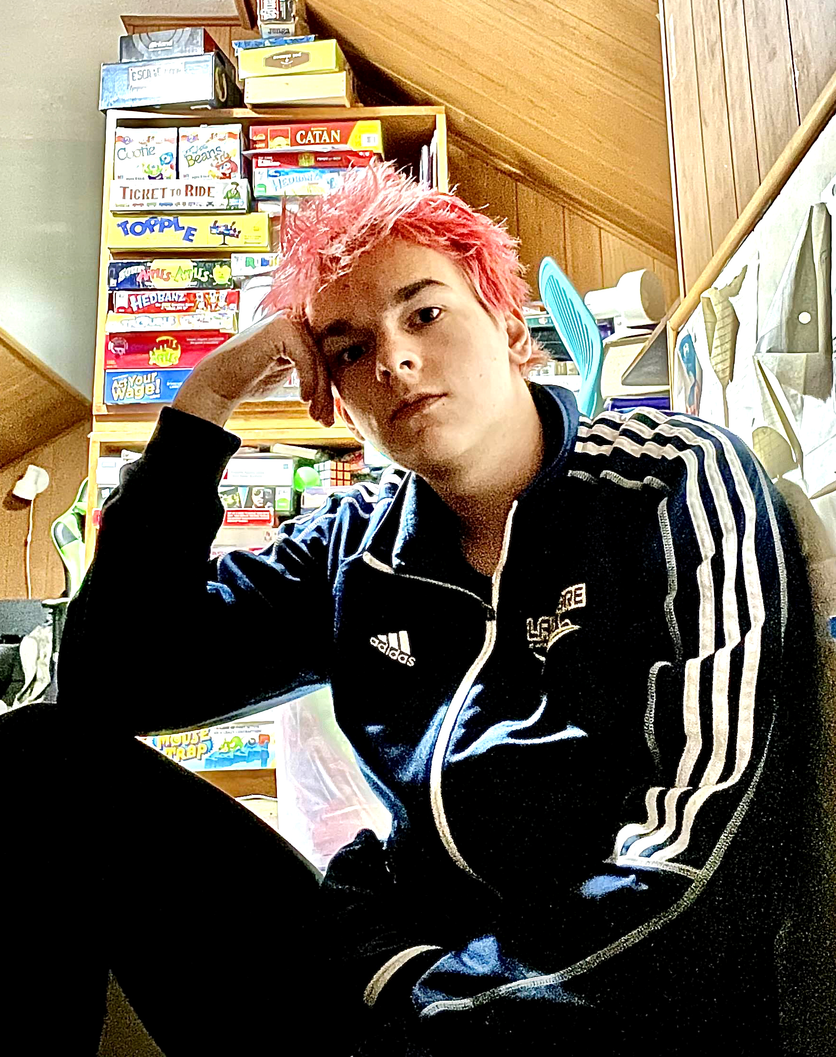
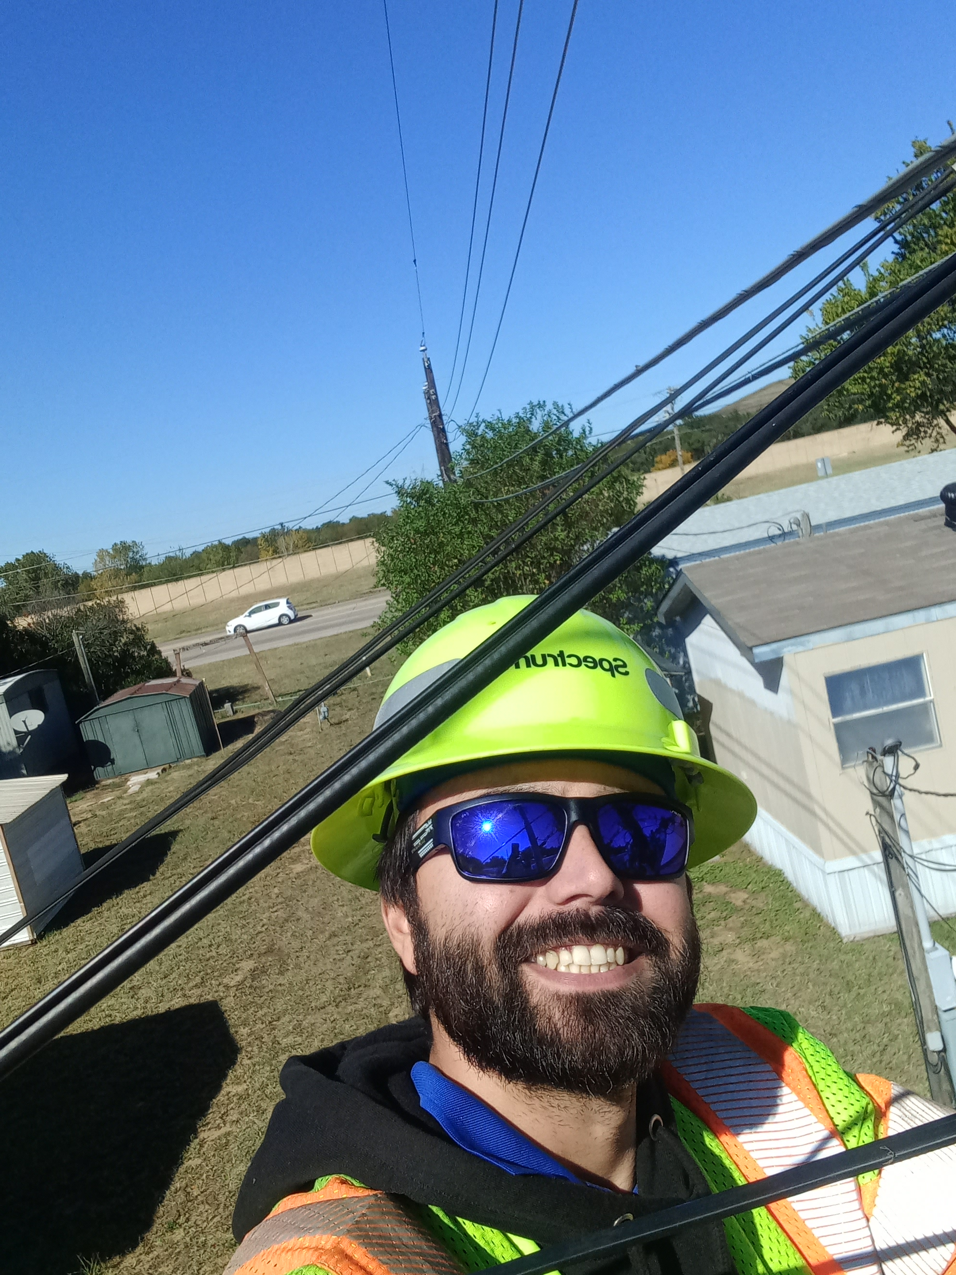
Meet the Team
Angela Vargas
Zachary Anderson
Tevyah Hanley
Cameron Mendez

Slide 3
About us
Angela Vargas is a software development student based in Loveland, Colorado, currently working as a Micromaintenece Tech for Target. She has experience with IT and in computer mechanics.
Tevyah Hanley is a software development student based in Columbus, Ohio, currently working in IT. He is building experience in both frontend and backend development.
Cameron Mendez is a software development student based in Fort Worth, Texas, currently working in FO Network Design. Developing hands on experience in all aspects of the software development lifecycle.
Zachary is a software development student based in Modesto,California. He currently is working outside of the IT profession but hopes witha degree in the field to transfer into it. The experience from this program has been incredibly beneficial to his skills.

Slide 4
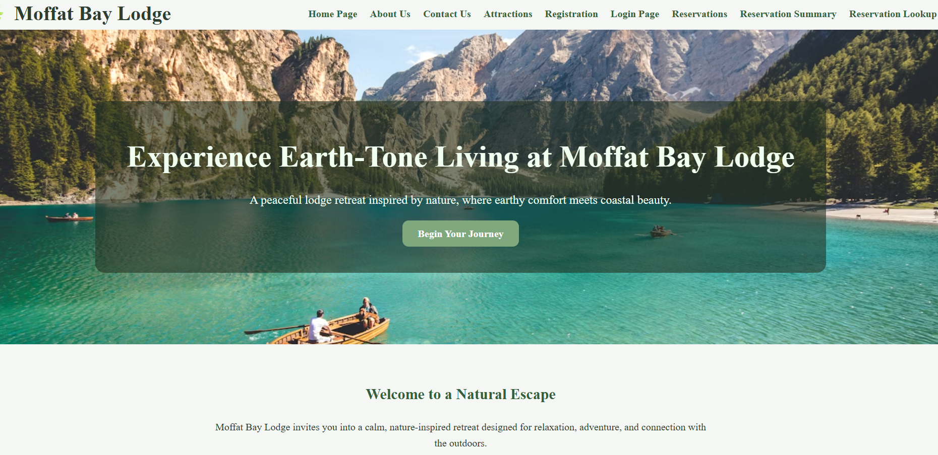
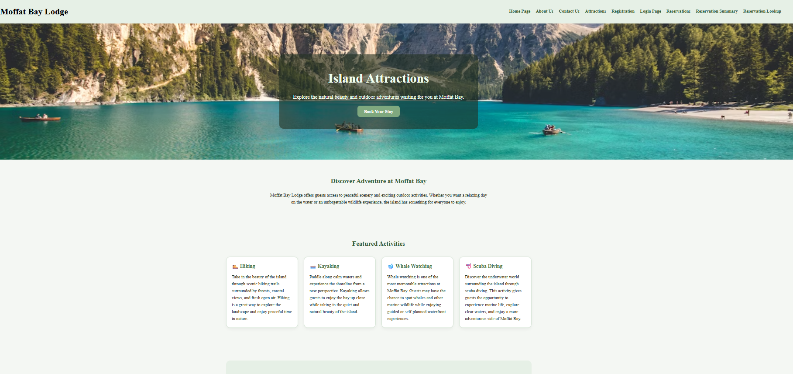
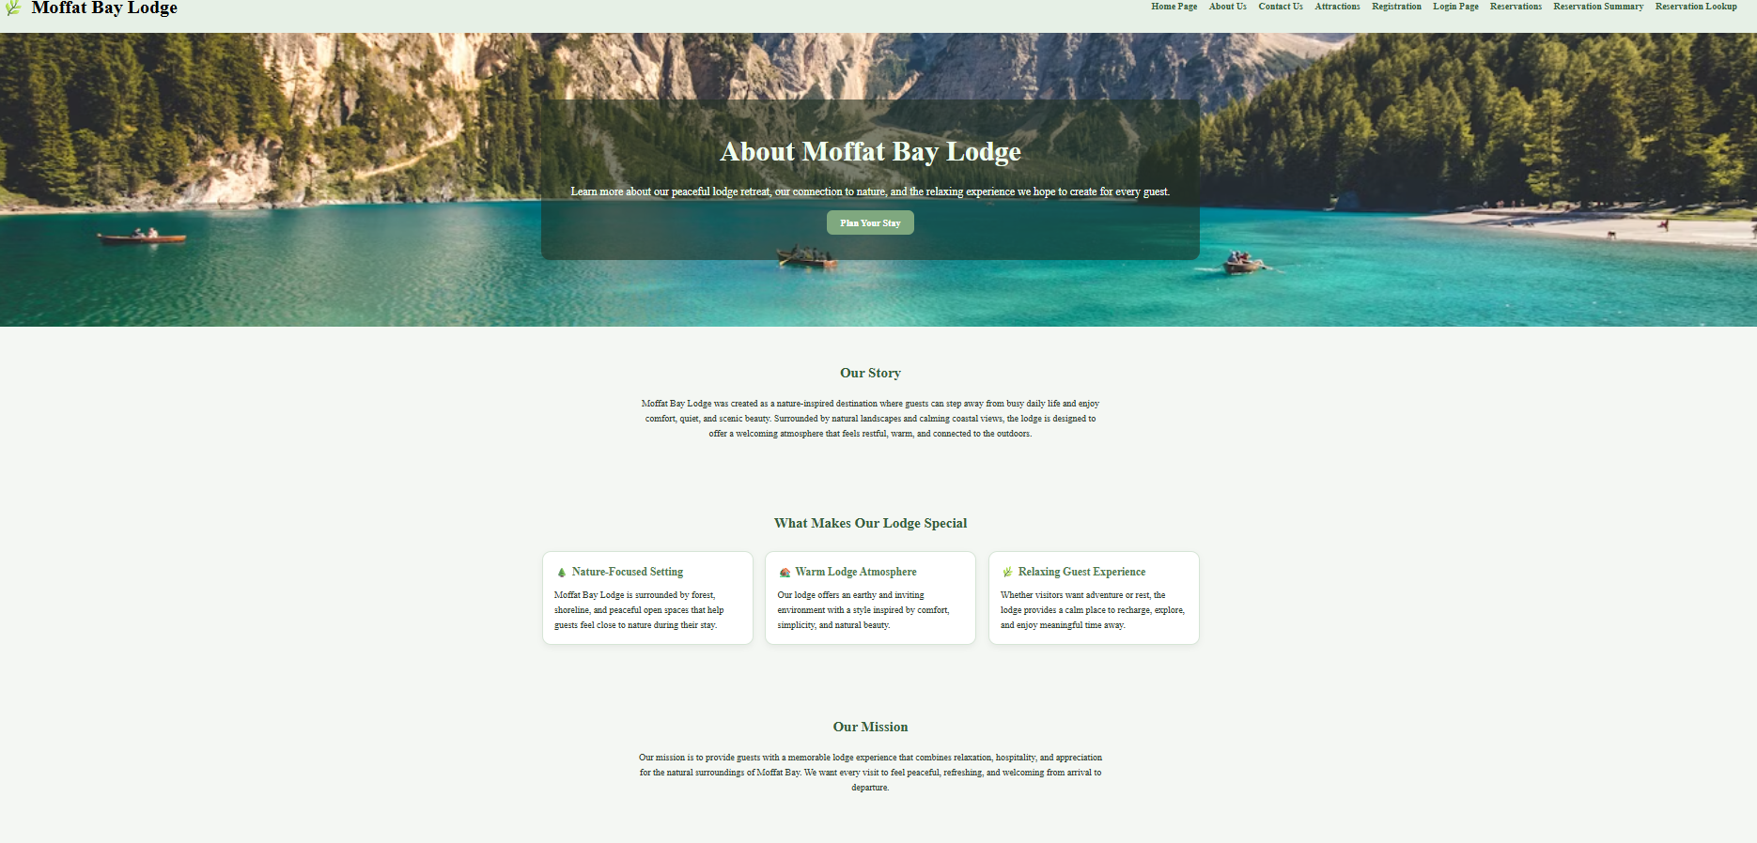
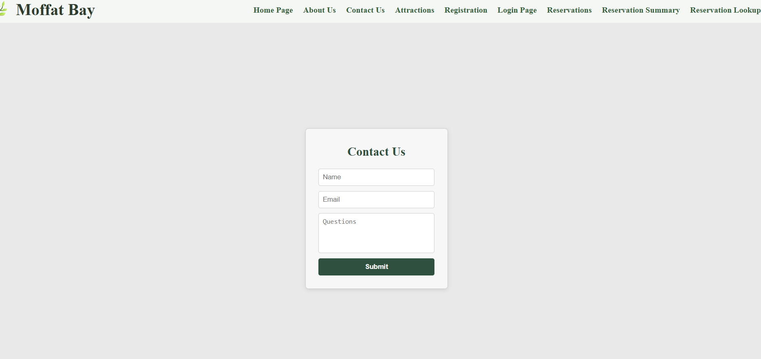
Sample Prototype
Landing
About Us
Attractions
Contact Us

Slide 5
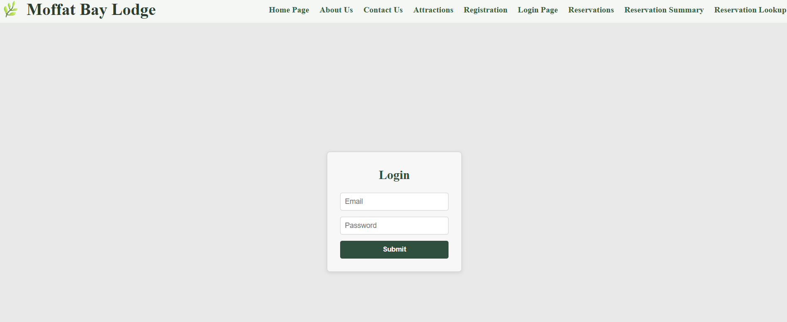
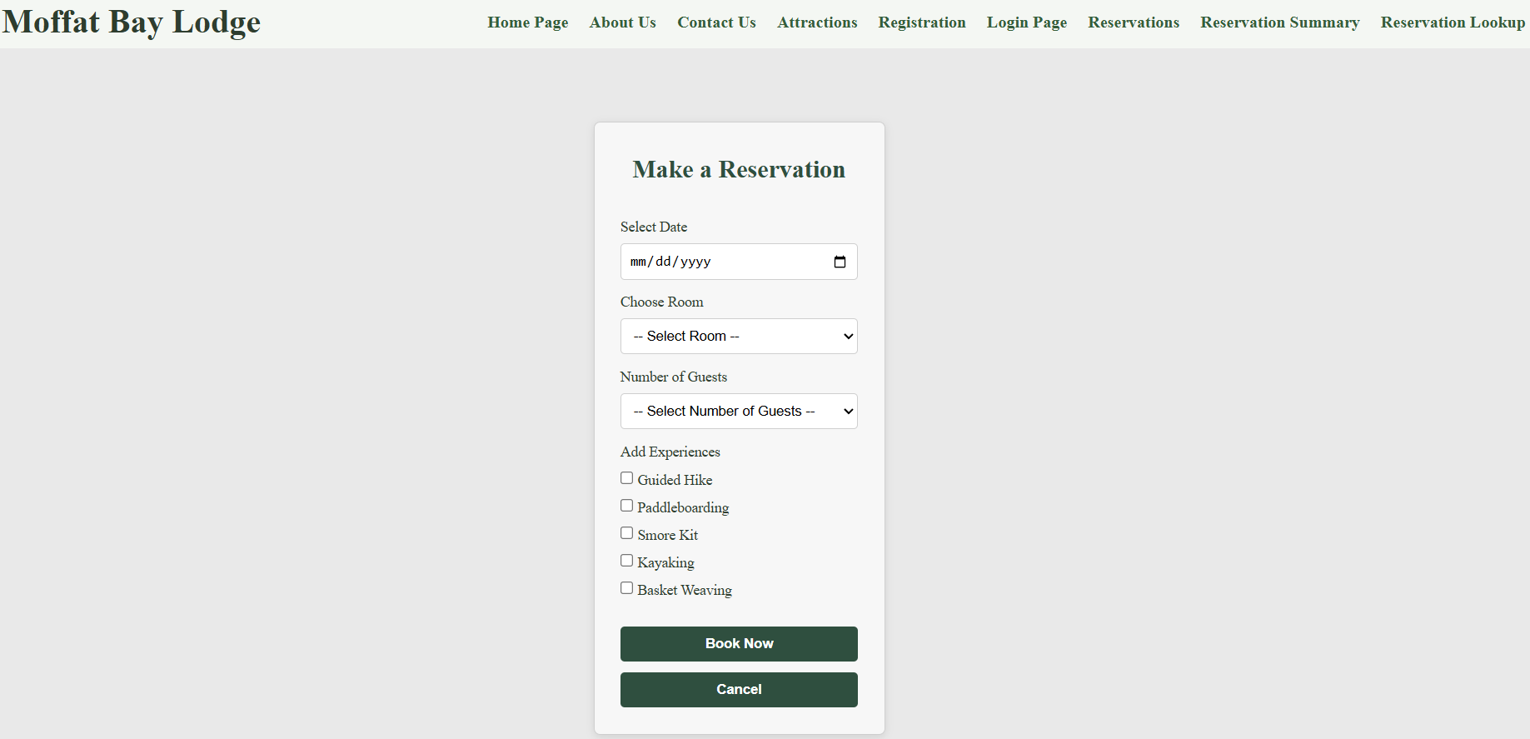
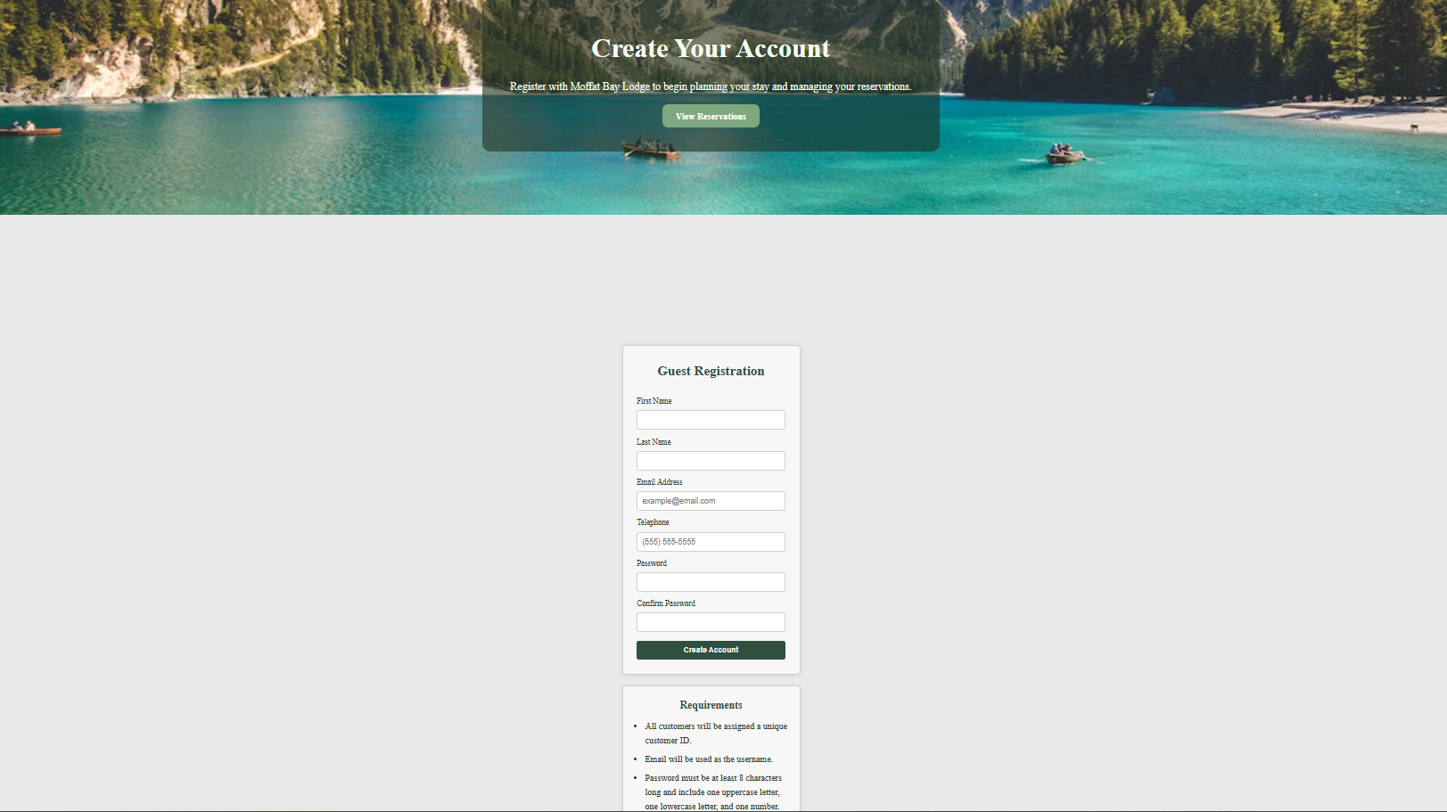
Sample Prototype cont.
Login
Registration
Reservation

Slide 6
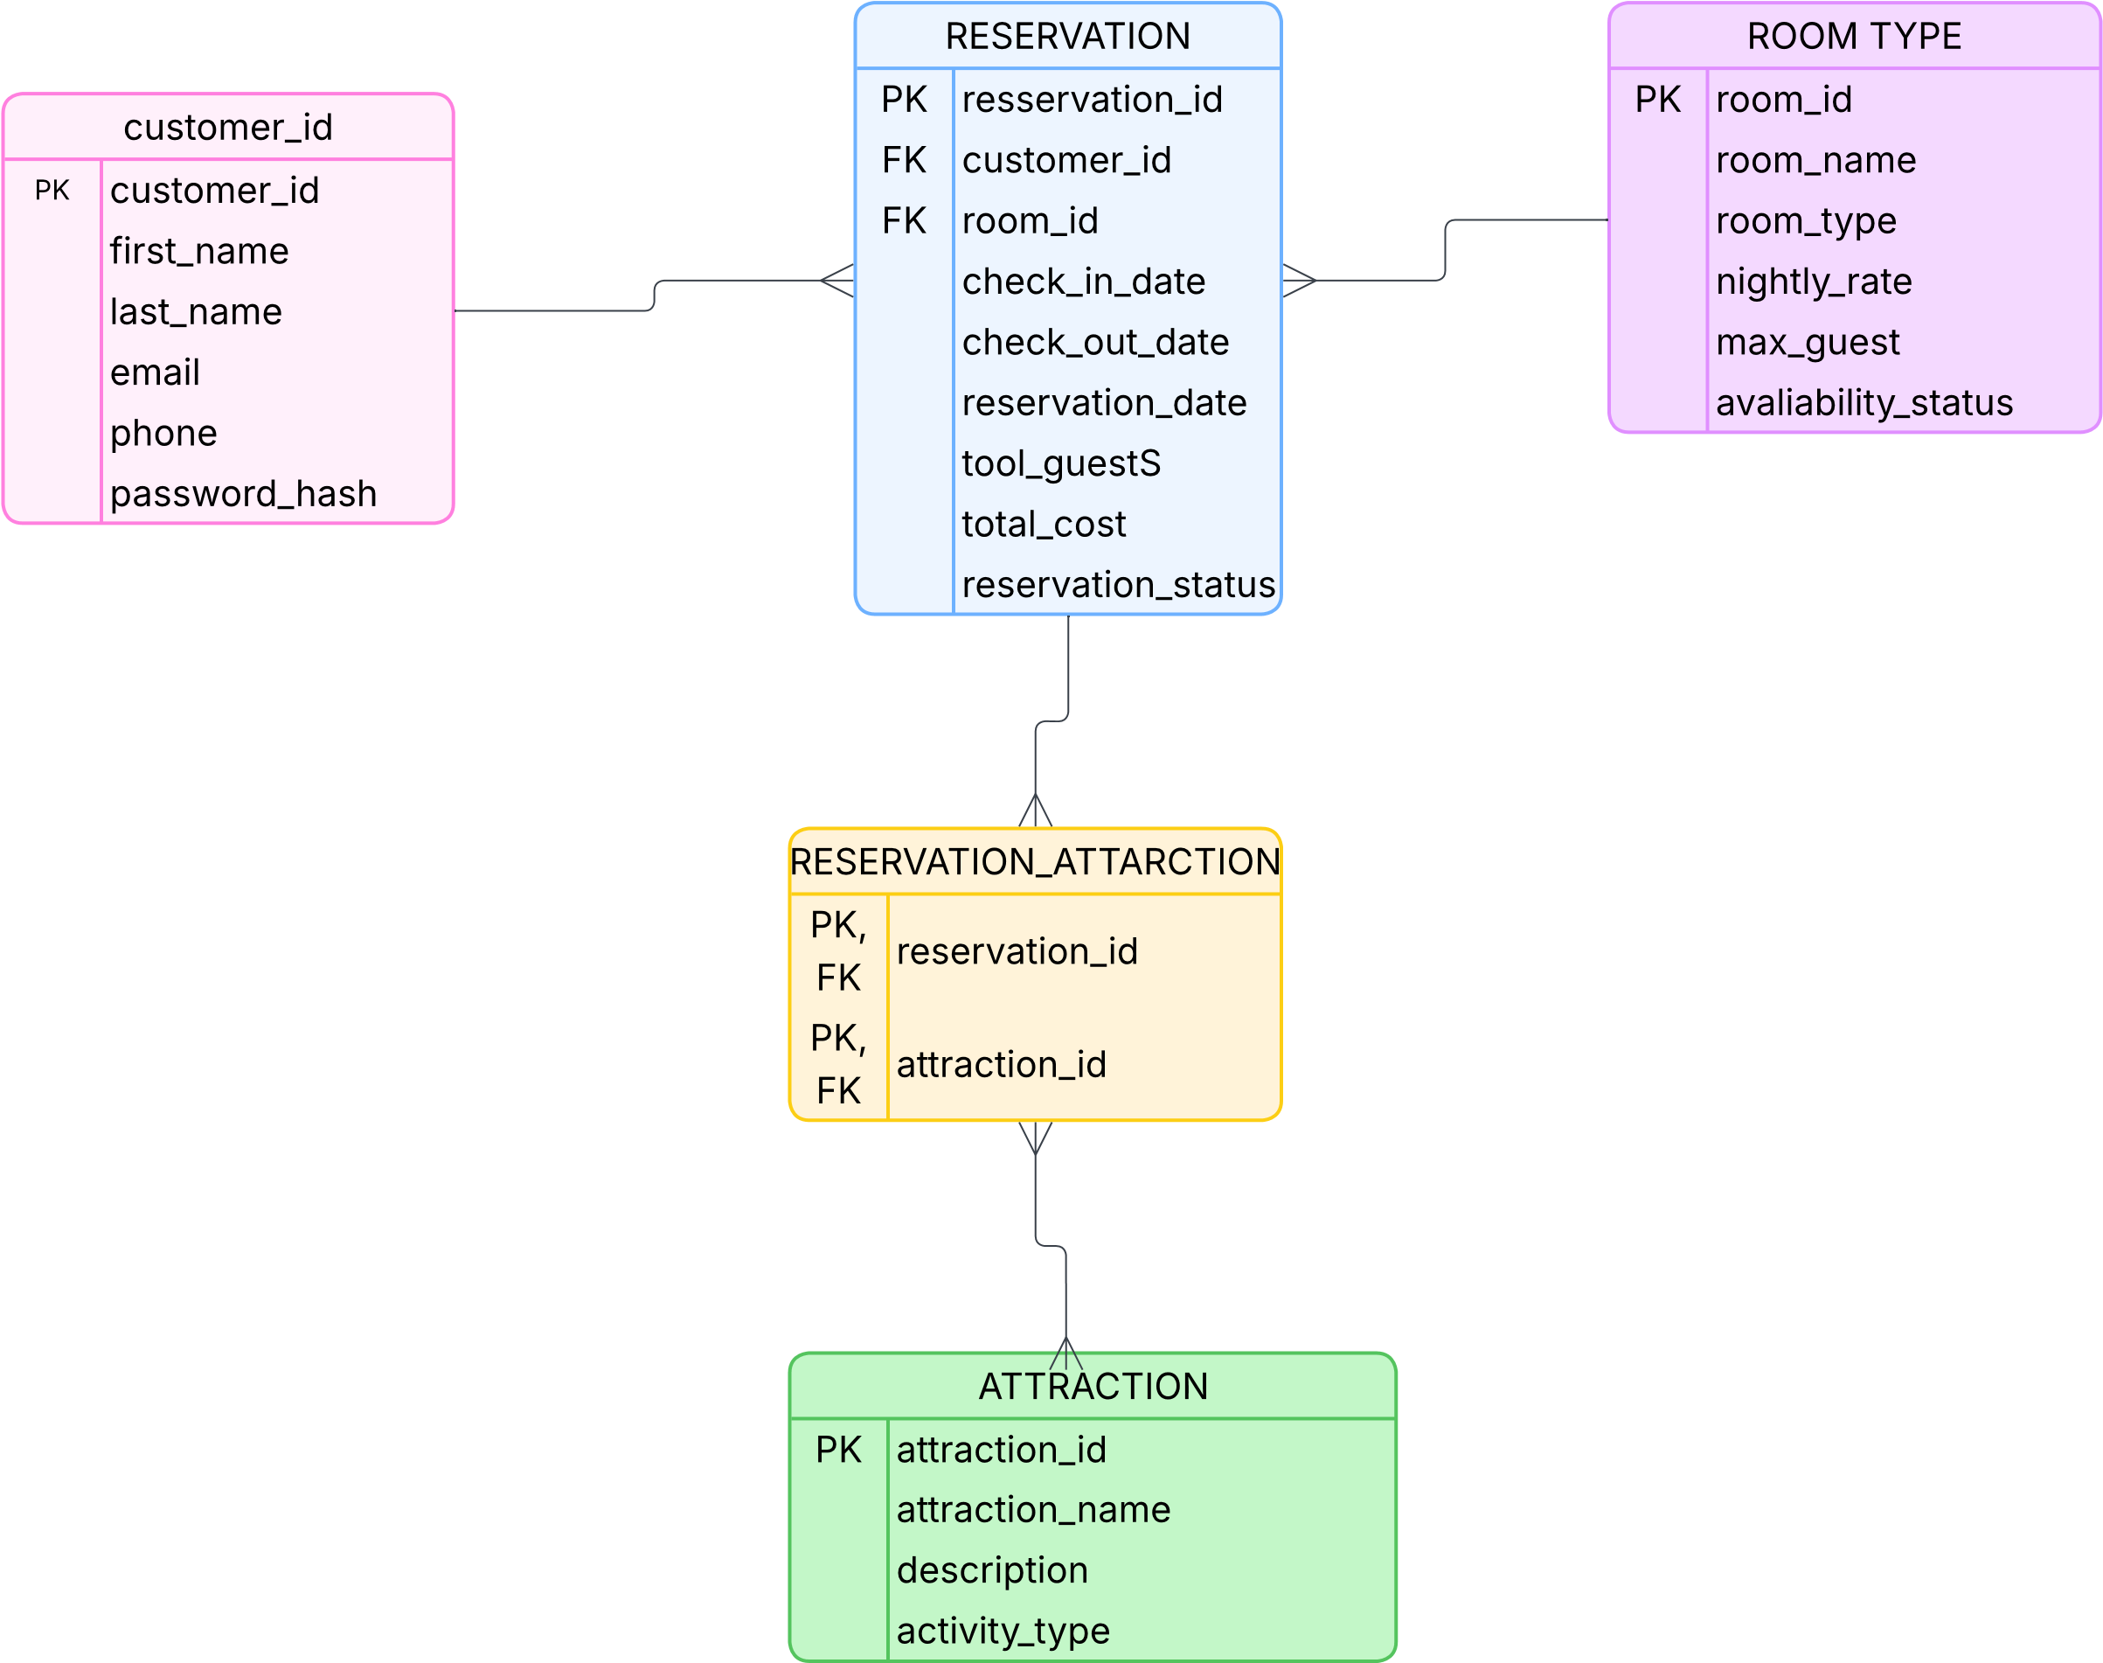
ERD

Slide 7
Test Cases
Successful Reservation
Peer Tester – Cameron Mendez
Dev. –Zachary Anderson
Successful Reservation w/ Attractions
Peer Tester – Cameron Mendez
Dev. Zachary Anderson
This is a major part of the full site. Testing this feature involved making sure the page opened, buttons worked, and even that the database interacted with it. We started by opening the page (ensuring we are logged in) and filling out the form. When the reservation is made, we can then check the database to make sure that the reservation shows up.
This feature is an important part of the reservation system because it allows users to add attractions to their stay. Testing this feature involved making sure the page loaded correctly, the attraction options displayed properly, and the form submitted successfully. We began by opening the page while logged in, selecting attractions along with reservation details, and submitting the form. After the reservation was completed, we checked the database to confirm that both the reservation and selected attractions were stored correctly.

