Slide 1
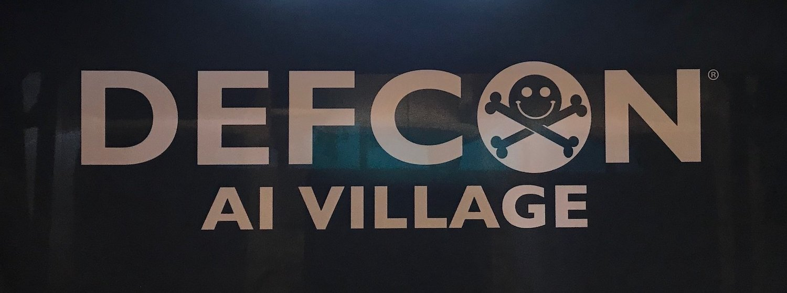

Fighting Malware with
Deep Learning
Angelo Oliveira | @ang3loliveira | www.angeloliveira.net | alpha@angeloliveira.net

Slide 2
# whoami
Ethical Hacker @ TOTVS
Former C/C++/Java Software Engineer
Independent Malware + AI Researcher
PhD student

Slide 3
The Gap
My
Research!
State-of-the-art
Machine Learning
Deep Learning
Malware Analysis

Slide 4

Filling the Gap

Slide 5
Filling the Gap
Build your own baseline models “from the scratch” as a starting point for doing research
Build simple, working models using the techniques you want to learn and research

Slide 6
Static, Dynamic or Both?
Static Analysis: What can we learn from a malware instance without running it?
  Signatures (hashes, part of the code, etc)
  Executable file content and structure: PE headers
    pypi.org/project/pefile/
    Cuckoo Sandbox (cuckoosandbox.org)
Dynamic Analysis: What can we learn from a malware instance by running it?
  Behaviors (API Calls, I/O, traffic, etc)
  Cuckoo Sandbox (cuckoosandbox.org)

Slide 7
We need malware, lots of malware
Malware
  VirusShare.com: ~34M malware examples labelled with VirusTotal!
Goodware
  Executable files in Windows directories
  portableapps.com: ~1.5K goodware examples
  Local Agent

Slide 8
Pipeline
Download from VirusShare
<PE files>
1 month
Cuckoo Sandbox
<JSON reports>
4 months (8 VMs)
Preprocessing, Cleaning
Min. feature Eng.
<JSON to CSV>
1 month
Deep Learning Models
Development, Training,
Evaluating, Testing
1 month

Slide 9
“Natural” Use Cases
Raw PE
PE imports
PE sections header
API calls
MLP
CNN
RNN

Slide 10
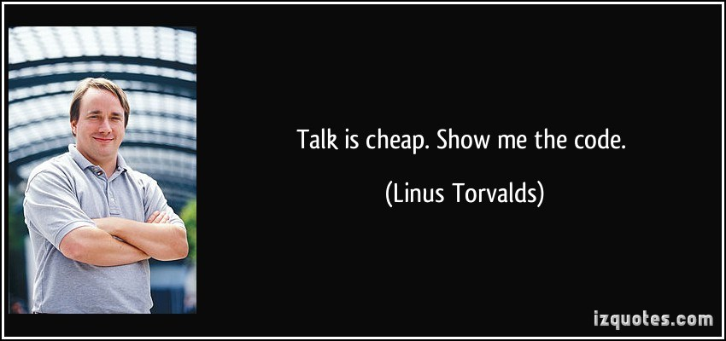

Slide 11
My Research
Malware behavior (Dynamic Analysis)
  Specialized data augmentation methods
  Specialized representation learning techniques
Improvements in detection of zero-days, polymorphic and metamorphic malware

Slide 12
THANK YOU! :)
Slides and Jupyter Notebooks will be available at github
Datasets will be available at kaggle
@ang3loliveira
Angelo Oliveira | @ang3loliveira | www.angeloliveira.net | alpha@angeloliveira.net

