Slide 1
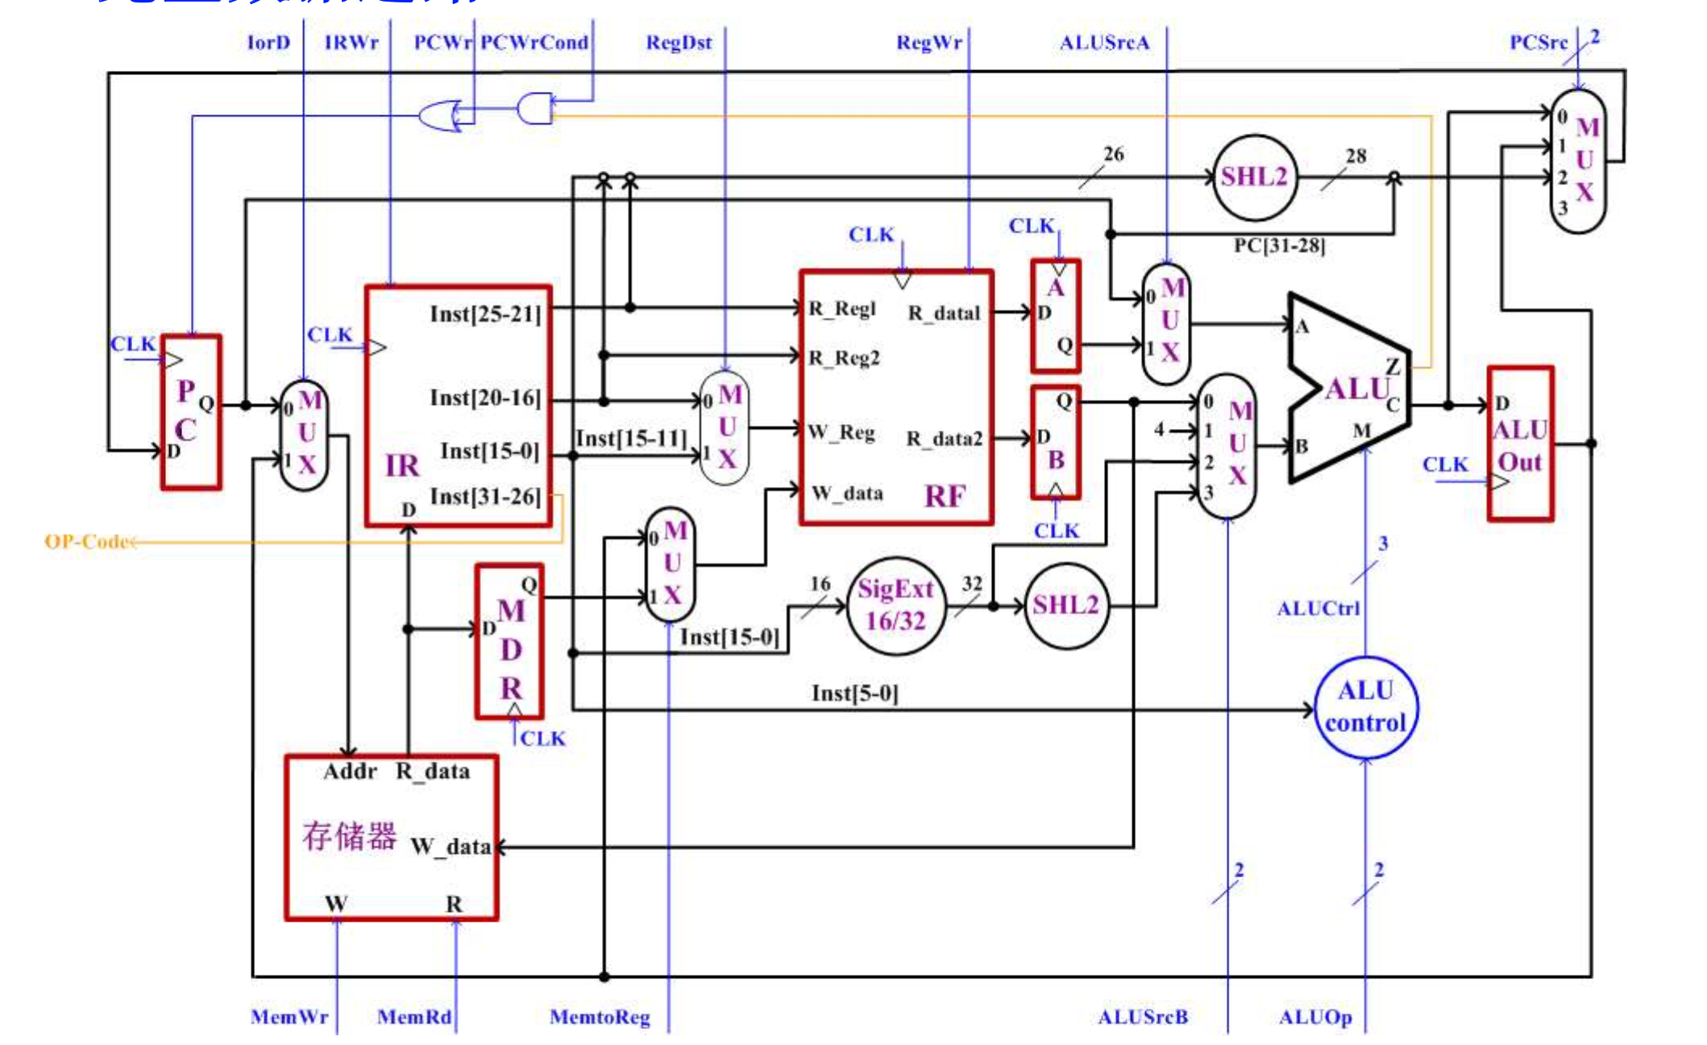
Func
Inst[5-0]

Slide 2
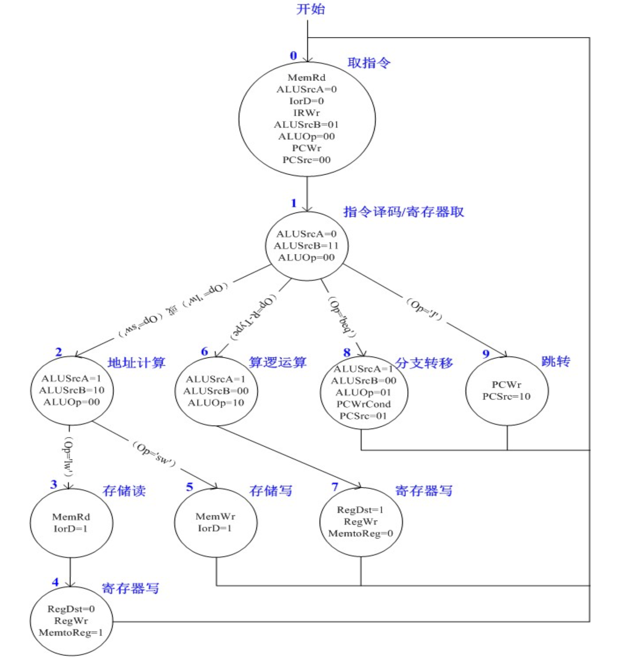
11
RegDst= 0
RegWr = 1
MemtoReg = 0
13
PCWr=1
PCSrc=11
ALUSrcA= 1
ALUSrcB= 10
ALUOp = 00
12
JR
ADDI
ALUSrcA= 1
ALUSrcB= 10
ALUOp = 11
10
ANDI
NOOP

