Slide 1
Work Health and Safety

Slide 2

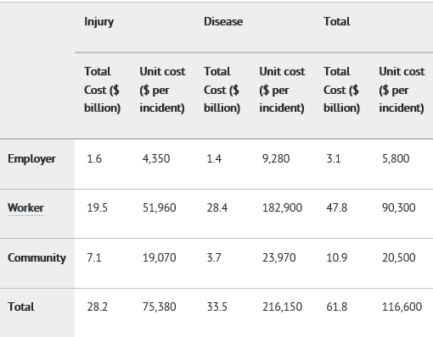
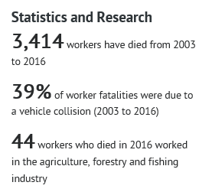
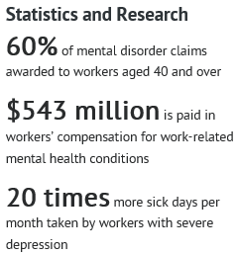

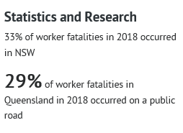
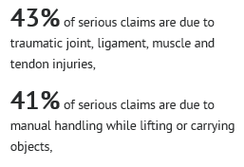
Statistics

Slide 3
What is Health and Safety
Australian law ensures that no worker is disadvantaged when they acquire injury at work
Any organisation that conducts business in Australia must ensure that all employee must have the right to a safety workplace. A system must be in place to promote health and safety; a worker injured at work must have the right to treatment, compensation and rehabilitation

Slide 4
Benefits of a Healthy Workforce
Injury and chronic disease negatively affects worker productivity and workplaces bear a number of associated costs.
Health and wellbeing programs can improve performance and productivity and reduce indirect costs from:
• absenteeism • staff turnover • workers’ compensation • disability and early retirement
There is strong evidence that shows that good worker health and wellbeing boosts organisational health and business performance.

Slide 5
Where can you find WHS information?
Facility's WHS policies and procedures
Safe Work Australia

Slide 6
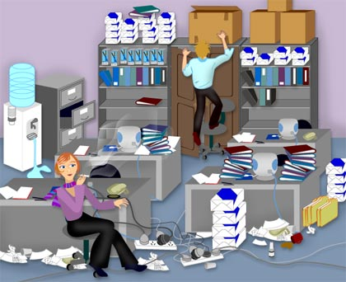
Are you able to identify WHS issues?

Slide 7
Employer’s Responsibilities
CONSULT with workers/representatives
• IDENTIFY hazards
• ASSESS likelihood of risks
• CONTROL risks
• PROVIDE information, instruction, training and supervision to workers
REPORT all injuries, fatalities and near misses to prevent future incidents
• EVALUATE and regularly review health, safety and welfar

Slide 8
Employee’s Responsibilities
protect their own health and safety
avoid adversely affecting the health and safety of others
use equipment provided, including PPE when required
OBEY instructions from employer
COMPLY with approved OH&S commission policies
ENSURE that alcohol or drug consumption does not endanger others

Slide 9
Fire
Think PASS
Think RACE
P
R
Pull the pin of the fire extinguisher
Rescue clients on immediate danger
A
A
Aim at the base of the fire
Aim at the base of the fire
S
C
Squeeze the extinguisher handle
Squeeze the extinguisher handle
S
E
Sweep the entinguisher from side to side
Sweep the entinguisher from side to side

Slide 10
Electricity
Electrical equipment must be maintained in good working order and should be grounded; otherwise, it presents a physical hazard; remove equipment that is not in proper working order and notify appropriate staff.
Check electrical cords and outlets for exposed, frayed, or damaged wires.
Never use electrical appliances near sinks, bathtubs, or other water sources.
If a client receives an electrical shock, turn off the electricity before touching the client.

Slide 11
Shift Work and Fatigue
As a Registered Nurse, how will you manage changes of shifts and tiredness?

Slide 12
Manual Handling
any activity requiring the use of force exerted by a person to lift, lower, push, pull, carry or otherwise move, hold or restrain a person, animal or thing

Slide 13



Slide 14
Manual Handling Principles
comply with facility policy and procedure
maximise patient independence
work close to patients body
minimise forward, lateral and twisting movements
push/pull rather than lift
use bed mechanics
use patients body movements

Slide 15
Can you name some manual handling equipment you can use in your workplace?

Slide 16
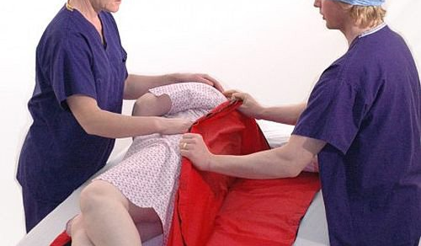
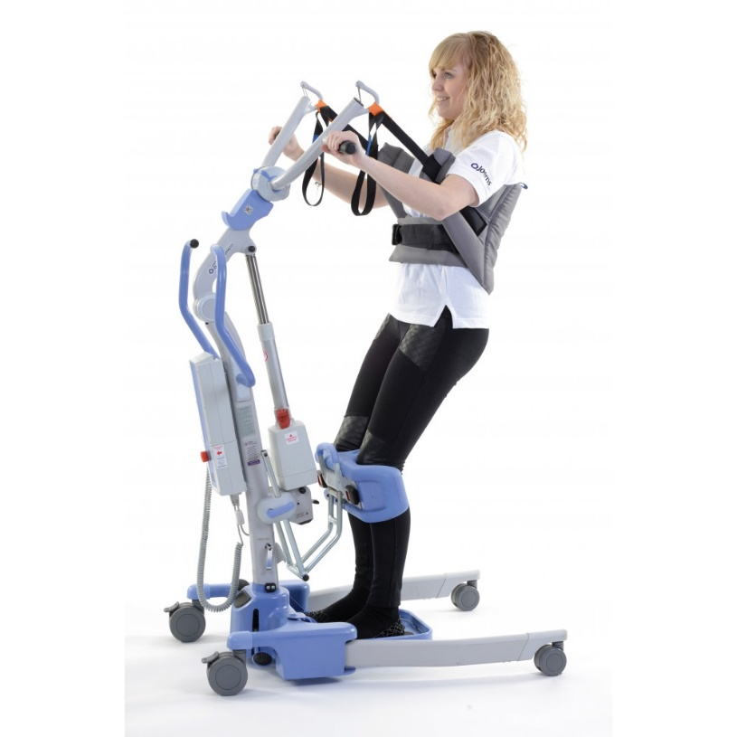
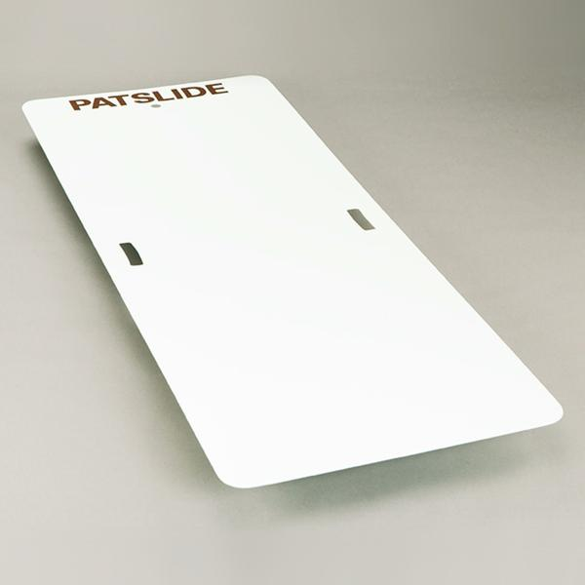
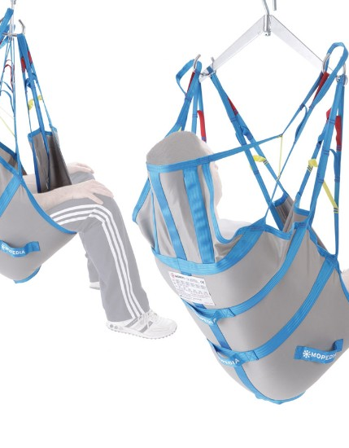
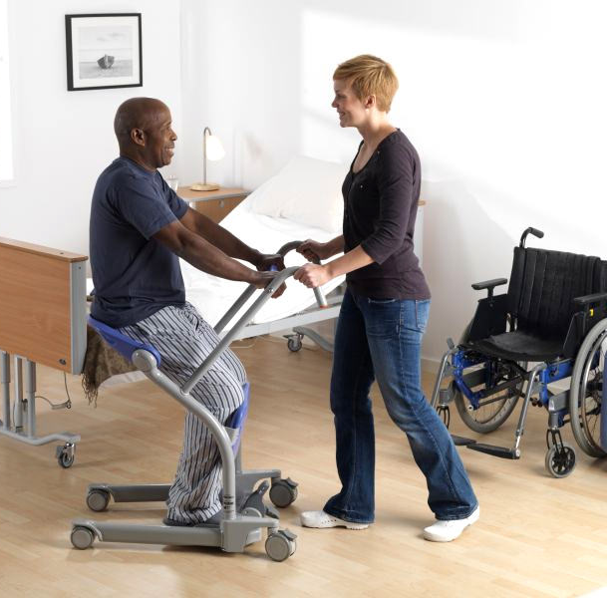
Equipment commonly used.. Can you name some more?

Slide 17
Assessment of Competencies
Your competency will be assessed on the use of these equipment during your face to face training

