Slide 1

Infection Prevention and Control

Slide 2

Definition
Infection control refers to procedures and activities that maximize prevention and minimise the risk of transmission of infectious diseases.
Successful infection prevention and control is critical in preserving a safe work environment. The fundamental elements to successful infection control management involve, identifying hazards, classifying any associated risks and implementing suitable control measures.

Slide 3
Key Components National Standards - 3
Hand Hygiene
Moments of hand hygiene
Social, clinical, surgical HH
ABHR
Transmission based precautions and PPE
Standard
Contact
Droplet
Airborne
Aseptic Technique
Standard
Surgical
Antimicrobial Stewardship
MROs
Roles and responsibilities of healthcare workers

Slide 4
Hand Hygiene
Hand hygiene is a general term applied to the use of soap or solution (non-antimicrobial or antimicrobial) and water, or a waterless antimicrobial agent to the surface of the hands, to clean them, avoiding the transmission of harmful germs.
Hand hygiene has been recognised the single important measure to prevent and control infectious diseases in the community and can significantly reduce the burden of disease.

Slide 5
Soap and Water vs. ABHR
Can you name some difference between the use of soap and ABHR?
You are required to do further readings if you do not have a solid knowledge about this topic.

Slide 6
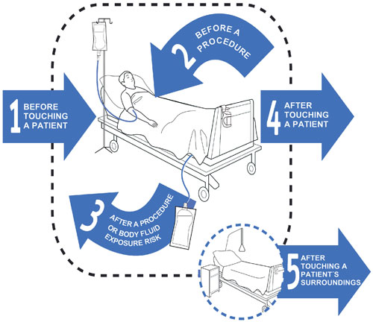
The 5 moments of Hand Hygiene
Site some examples as to when do you apply handwashing based on the moments

Slide 7
Different types of hand hygiene
Type | Product | Duration | Parts of hand covered
Social Domestic, community Eating, toilet, cleaning, before or after work | Soap and water ABHR | 20 secs-30sec | All parts of the hands including wrist
Clinical Clinical procedure – vital signs, PA, bed making, admission, non invasive | Antibacterial soap ABHR | 60 seconds | All parts of the hands including wrist
Surgical Operation, invasive | Chlorhexidine based hand rub Betadine solution Allergy/sensitivity – inform IPC nurse | 3-5 minutes Surgical scrub Increased or more friction | Clinical+ up to the elbow

Slide 8
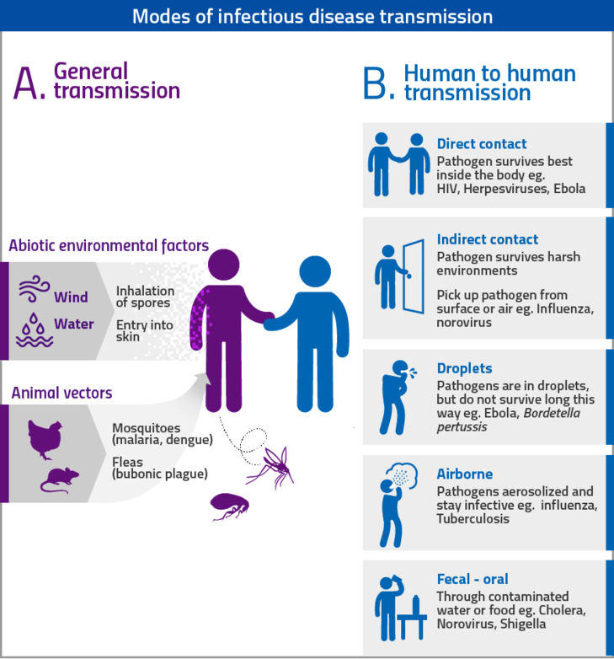
Modes of Transmission

Slide 9
Precautions
Challenge!
Standard
Contact
Droplet
Airborne
Personal Protective Equipment
Donning – Gown Resp Eye Gloves
Doffing – Gloves Eye Gown Resp
COVID - GGER
Name at least 3 diseases where you require standard, contact, droplet and airborne precautions.

Slide 10
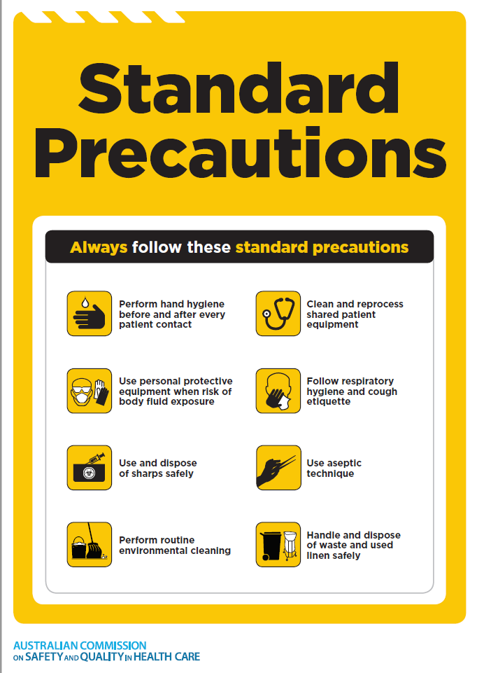

Slide 11
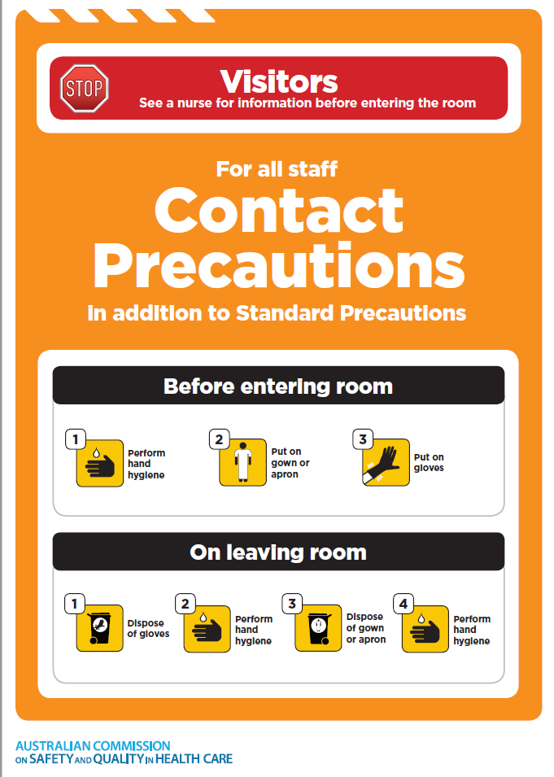

Slide 12
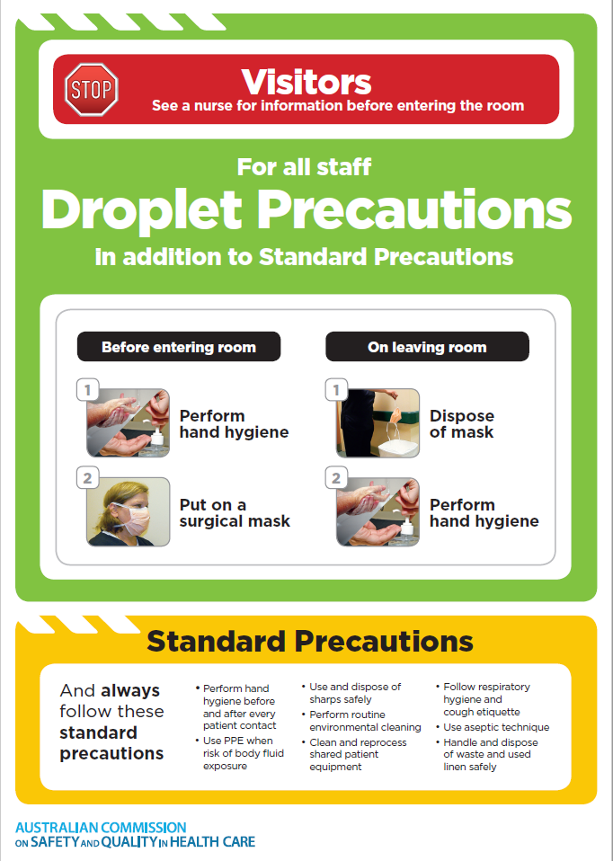

Slide 13
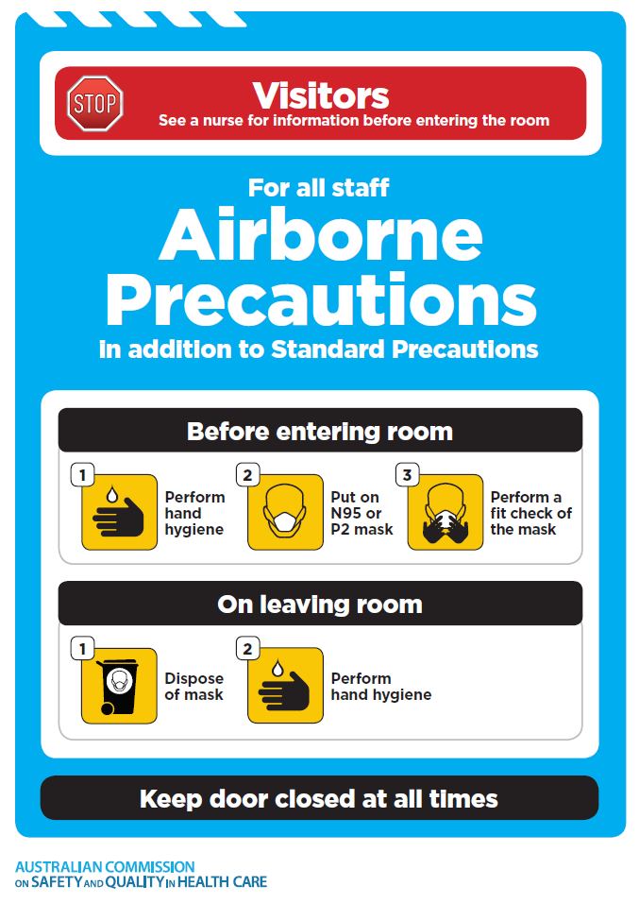

Slide 14
Aseptic Practice
Are a set of practices and procedures that are performed under carefully controlled circumstances, with the intention to eliminate pathogenic contaminants.
There are three recognised techniques:
1. Sterile technique: is the complete absence of microorganisms. Near sterile techniques can only be achieved in controlled environments such as specially equipped operating theatres (laminar flow) or pharmacies (clean room).
2. Aseptic Technique: to minimise the contamination of a key site, equipment or the immediate environment by pathogenic organisms.
3. Clean Technique: is the removal of visible contamination or debris. e.g. cleaning a grazed area on a patient’s knee.

Slide 15
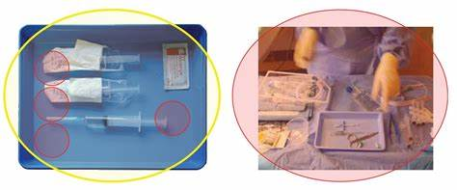
Standard vs Surgical ANTT

Slide 16
Antimicrobial Stewardship
Antimicrobial stewardship (AMS) is defined as an ongoing effort by a health service organisation to optimise antimicrobial use among patients ‘to improve patient outcomes, ensure cost-effective therapy and reduce adverse sequelae of antimicrobial use (including antimicrobial resistance).

Slide 17
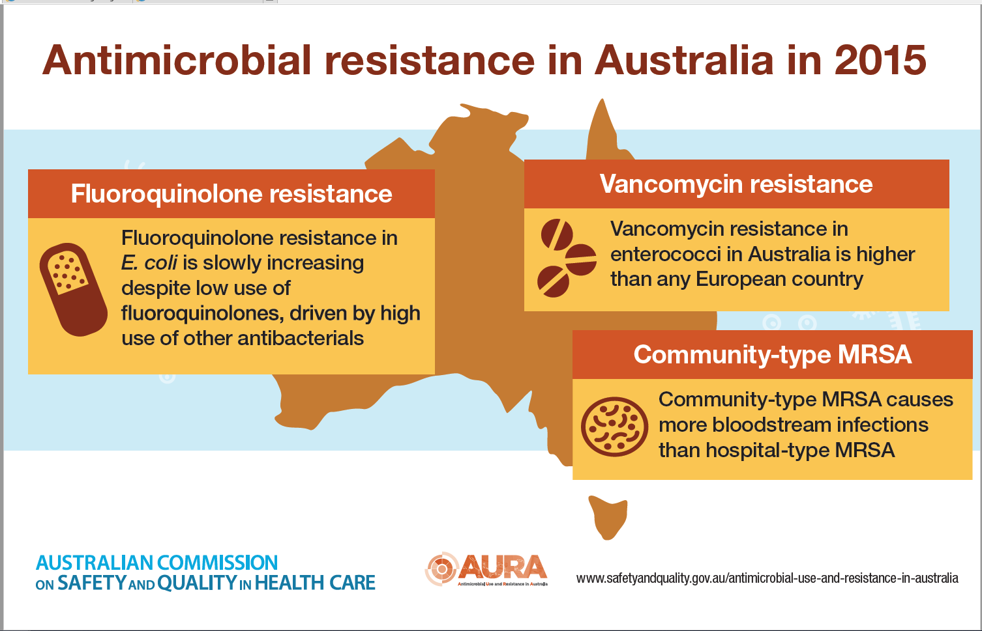

Slide 18
Other MROs
Challenge!
Identify each MRO by:
Definition
Medication of choice
Diagnostic Test
Contact Precaution used
MRSA
VRE
CRE
ESBL
C. Diff

