Slide 1
Customer Segmentation using RFM Model
Angad Ripudaman Singh Bajwa

Slide 2
Table of contents
01
02
03
04
05
06
Introduction
EDA
Data Modelling
To the dataset and problem statement
Exploratory Data Analysis and understanding of data
Data modelling approach and segmentation approach
RFM Modelling
Insights
Additional work
RFM Modelling to the above dataset and customer types
Insights of each customer segment from RFM model
Champions, potential customers and those who need attention

Slide 3
01
Introduction

Slide 4
Dataset Understanding
The dataset consist of 5000 customers and their order history to the different products of the company.
Different attributes like total orders, total revenue as well carriage and shipping costs for each customer are included.
The orders for each customer are also further divided into a daily, weekly and hourly basis to further study customer ordering patterns and behavior.
We observe that the customer id has no duplicates and none of the entries in any attribute are null.
The data is well cleaned and ready to be analysed.

Slide 5
02
EDA

Slide 6
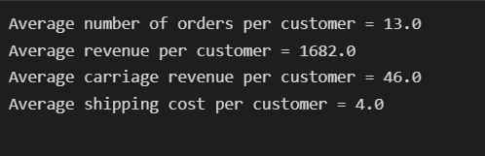
EDA
We first calculate the average number of orders, revenue per customer, carriage revenue and shipping cost per customer.

Slide 7
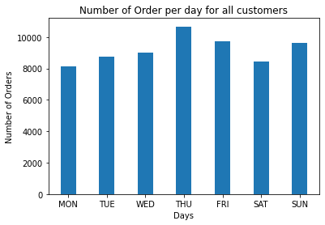
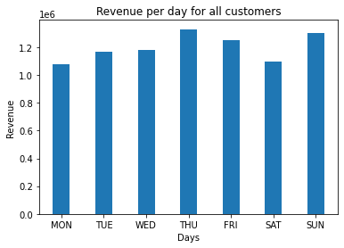
Daily Analysis
On comparing the number of orders per day for all customers we get the following plots

Slide 8
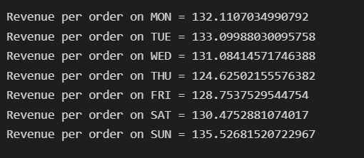
From the above two plots if we try to calculate the revenue per order on each day, we see the following-:
Key Insights-The most revenue is generated on Thursday for the company.
Even though the total number of orders and total revenue is the highest on Thursday, the average revenue per order is lowest on Thursday. This indicates that products of lower prices are purchased on this day.
The most expensive products are bought on Sundays as the revenue per order is highest on this day.

Slide 9
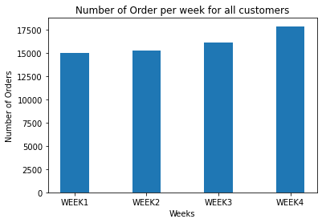
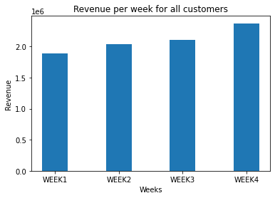
Weekly Analysis
On comparing the number of orders per week for all customers we get the following plots

Slide 10
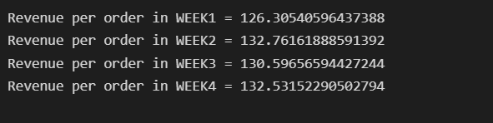
From the above two plots if we try to calculate the revenue per order in each week, we see the following-:
Key Insights- Every week the number of orders and revenue show a gradually increase from the previous week. This indicates a steady growth of products purchased.
The most profitable week was week 4 for the company.
Even though the total number of orders and total revenue is more for week 3 and week 4, the average revenue per order is the highest in the second week.

Slide 11
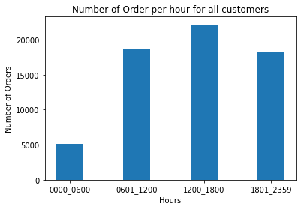
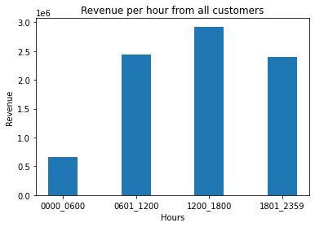
Hourly Analysis
On comparing the number of orders per hour for all customers we get the following plots

Slide 12
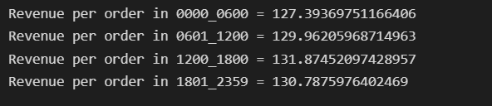
From the above two plots if we try to calculate the revenue per order in each hour , we see the following-:
Key Insights- The busiest hours for the company are from 0601 to 2400 hours.
During 1200 to 1800 hours the most revenue is generated as well the most expensive products are purchased(as revenue per order is highest).
Even though the total number of orders and total revenue during 0600-1200 and 1800-2400 are similar, the average revenue per order is more between 1800-2400 hours ( indicating more expensive product purchases ).

Slide 13
03
Data Modelling and Segmentation Approach

Slide 14
Modelling and Segmentation
The different types of segmentation used to cluster customers may involve demographic, geographic, behavioral or psychological. For the given data none of the above are provided.
Information about customer spending habits, time since last order and number of order are provided to us.
For this dataset RFM modelling works best as customers are grouped according to Recency, Frequency and Monetary value of purchases from the company. This perfectly fits the dataset provided to us.
K means clustering is another method which could be used to segment customers however for that one would require more details about the customer to segment them precisely.
RFM model can be replaced by RF, FM or RM models as well depending on the type of company.

Slide 15
04
RFM Modelling

Slide 16
RFM
For defining the RFM model we use the following attributes
DAYSSINCELASTORDER - Recency
TOTAL_ORDERS - Frequency
REVENUE - Monetary
We define a score out of 3 for each of the above attributes.
This score is calculated by dividing the range of each attribute for all customers into 3 sections. Whichever section the particular customer belongs in he or she will be provided a score based on that.
For Instance if customer A belongs in the third quartile in terms of frequency then customer A is provided a score of 3.
The same applies to monetary value as well.
For recency however, the lower the recency, the higher the score is provided as that indicates that the customer has recently purchased a product from the company.

Slide 17
RFM
Now we have provided each customer a score out of 3 for recency, frequency and monetary value.
To segment the customers we can use all these three scores and split them into different categories.
We use the following categories-
Champions
Loyalists
Potential Customers
Can’t Lose
At Risk
About to Sleep
Need Attention

Slide 18
RFM
Champions - Loyal Customers, who are the champions of all the customers with highest score of RFM.
Loyalists- Customers who have the most potential to become the Champions. They recently buy the products and they make their purchases quite frequently but not expensive products
Potential Customers - Customers whose frequency score and monetary score are slightly lower as they are newer customers who have recently shopped here
Can’t Lose - Customers who used to pay a lot of money and come to the store frequently but they did not purchase recently.
At Risk- Customers who do not come to store often and not frequently make purchases.
About to Sleep - Customers who haven't paid a visit to the store for a long time. However, once in a while, they do spend lot of money
Need Attention- Customers who the company may lose out on

Slide 19
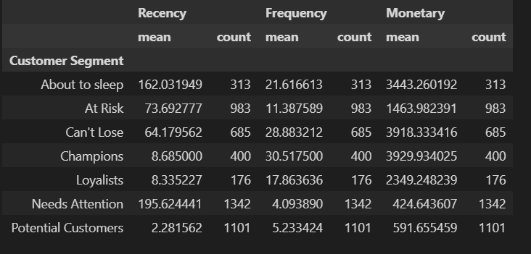

Slide 20
05
Insights

Slide 21
Champions
8% percent of the customers are champion customers
They have an average of 8 days since they last purchased an item.
They have purchased an average of about 30 items from the company with an average monetary input of about 4000.
Company Action: Reward these customers. They can become early adopters for new products and will help promote the brand.
Loyalists
4% percent of the customers are loyalists.
They have an average of 8 days since they last purchased an item.
They have purchased an average of about 17 items from the company with an average monetary input of about 2400.
Company Action: Offer Limited edition and Loyalty programs

Slide 22
Potential Customer
22% percent of the customers are potential customers
They have an average of 2 days since they last purchased an item.
They have purchased an average of about 5 items from the company with an average monetary input of about 600.
Company Action: Start building relationships with these customers by providing onboarding support and special offers to increase their visits.
Can’t Lose
14% percent of the customers are can’t lose customers
They have an average of 64 days since they last purchased an item.
They have purchased an average of about 28 items from the company with an average monetary input of about 4000. This equals that of our champion customers. They are crucial to our company.
Company Action: Bring them back with relevant promotions, and run surveys to find out what went wrong and avoid losing them to a competitor.

Slide 23
At Risk
20% percent of the customers are at risk.
They have an average of 73 days since they last purchased an item.
They have purchased an average of about 11 items from the company with an average monetary input of about 1500.
Company Action: Send them personalized reactivation campaigns to reconnect, and offer renewals and helpful products to encourage another purchase.
About to sleep
6% percent of the customers are about to sleep customers
They have an average of 162 days since they last purchased an item.
They have purchased an average of about 22 items from the company with an average monetary input of about 3400.
Company Action: Price incentives and Limited time offers

Slide 24
Need Attention
26% percent of the customers are under the need attention category.
They have an average of 196 days since they last purchased an item.
They have purchased an average of about 4 items from the company with an average monetary input of about 400.
Company Action: Higher price incentives for them
We see that one-fourth of our customers come under this category.

Slide 25
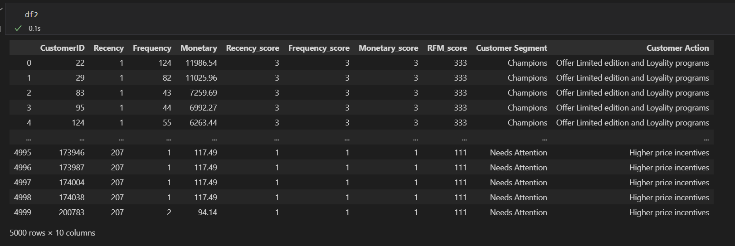
Final Output

Slide 26
The list of customers who are champions, need attention and are potential customers are stored as excel sheets in the outputs folder

Slide 27
Angad Ripudaman Singh Bajwa
Thank you!

