Slide 1
ZERO CROSSING DETECTOR
BY
ANGAD BAJWA 107118014
ANUJ SHRIVATSAV 107118016
ARPANA P.B 107118018

Slide 2

OBJECTIVES
The objective of this project is to realize the different ways of constructing a zero-crossing detector and its applications.
In this project we have explored two ways of designing a zero-crossing detector by using the ideal simulation software.
1) A zero-crossing detector using an op-amp
2) A zero-crossing detector using an optocoupler.

Slide 3
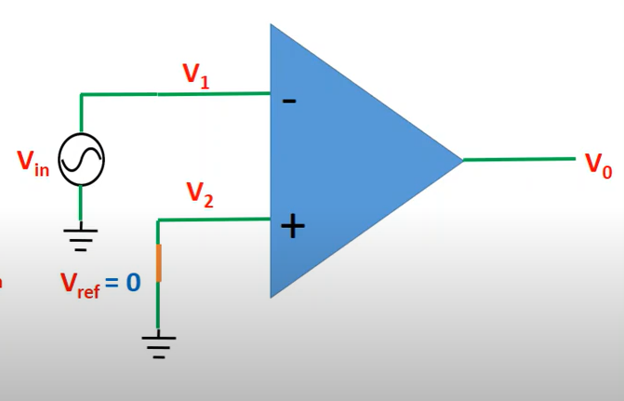
CIRCUIT DESCRIPTIONS
Case a:
A_{ol} = open loop gain
V_{in} < 0
V_{d} = V₂ - V₁
= V_{ref} - V_{in}
= 0 - V_{in}
V_{d} = -V_{in}
= +V_{in} (since V_{in}<0)
V_{out} = +A_{ol}*V_{d} > 0
Case b:
A_{ol} = open loop gain
Vin > 0
V_{d} = V₂ - V₁
= V_{ref} - V_{in}
= 0 - V_{in}
V_{d} = -V_{in}
= -V_{in} (since V_{in}>0)
V_{out} = -A_{ol}*V_{d} <0
INVERTING ZCD

Slide 4
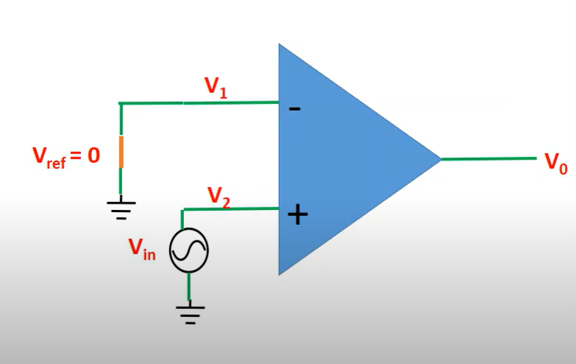
Case a:
A_{ol} = open loop gain
V_{in} < 0
V_{d} = V₂ - V₁
= V_{in} - 0
= V_{in}
V_{d} = V_{in}
= -V_{in} (since V_{in} < 0)
V_{out} = -A_{ol}*V_{d} < 0
Case b:
A_{ol} = open loop gain
V_{in} > 0
V_{d} = V₂ - V₁
= V_{in}- 0
= V_{in}
V_{d} = V_{in}
= V_{in} (since V_{in} > 0)
V_{out} = +A_{ol}*V_{d} >0
NON-INVERTING ZCD

Slide 5
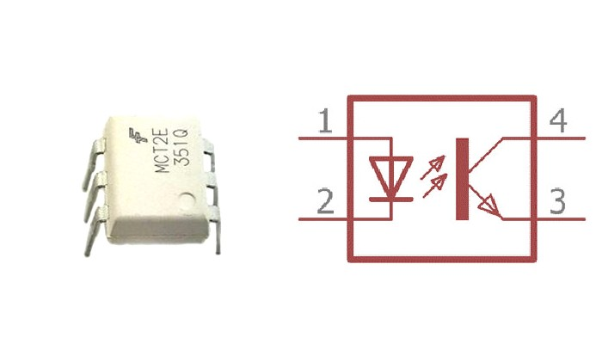
The basic design of an optocoupler consists of an LED that acts as a source producing infra-red light and a photo-transistor that detects the emitted infra-red beam. These circuits are electrically isolated from each other and they use light for their operation. It is analogous to that of a transformer. Basically current from the source signal passes through the LED and it emits an infra-red light. This emitted light falls upon the base side of the transistor and hence the BJT gets switched ON and becomes active. As it uses light for its operation and its circuits are isolated it is also called an opto-isolator.
OPTOCOUPLER ZCD

Slide 6
DESCRIPTION OF SIMULATION PLATFORM
The simulation platform we have decided to utilize for our project is LTspice XVII.
LTspice is a SPICE-based analog electronic circuit simulator computer software, produced by semiconductor manufacturer Analog Devices (originally by Linear Technology).It is the most widely distributed and used SPICE software in the industry.
LTspice provides schematic capture to enter an electronic schematic for an electronic circuit, an enhanced SPICE type analog electronic circuit simulator, and a waveform viewer to show the results of the simulation. Circuit simulation analysis based on transient, noise, AC, DC, DC transfer function, DC operating point can be performed and plotted as well as fourier analysis. Heat dissipation of components can be calculated and efficiency reports can also be generated. It has enhancements and specialized models to speed the simulation of switched-mode power supplies (SMPS) in DC-to-DC converters.
LTspice does not generate printed circuit board (PCB) layouts. While LTspice does support simple logic gate simulation, it is not designed specifically for simulating logic circuits.
It is used by many users in fields including radio frequency electronics, power electronics, audio electronics, digital electronics, and other fields.

Slide 7
DESIGN
INVERTING ZCD AND NON-INVERTING ZCD
OPTOCOUPLER ZCD
COMPONENT | VALUE | NUMBER REQUIRED
DC VOLTAGE SOURCE | 6V | 2
AC VOLTAGE SOURCE | 12V | 1
RESISTOR | 10kΩ | 3
DIODE | 1N914 | 2
OP-AMP | LM741 | 1
COMPONENT | VALUE | NUMBER REQUIRED
DC VOLTAGE SOURCE | 10V | 1
AC VOLTAGE SOURCE | 230V | 1
RESISTOR | 2.2kΩ,10kΩ | 1 each
DIODE | 1N914 | 4
OPTOCOUPLER | 4N25 | 1

Slide 8
SIMULATION RESULTS
INVERTING ZCD
NON-INVERTING ZCD
OCTOCOUPLER ZCD

Slide 9
INFERENCE
A significant inference that is evident is, a ZCD using OP-AMP is used to produce an output stage switch when the input crosses the reference.
This output of the comparator can be used in many applications like a control gate, LED indicator etc.
A ZCD identifies the transition of a signal from positive to negative and negative to positive providing a pulse that coincides with zero voltage of the signal.
We can use them in energy observation systems to measure values such as voltage, current, frequency and power factor of a system.
The zero-crossing circuit presented can be used for systems requiring sensitive and errorless measurements.

Slide 10
REFERENCES
Circuits Today- Zero Crossing Detector
Circuit Digest- Zero Crossing Detector
Learning Electronics- YouTube Channel
Electronics Tutorial-Optocoupler
El-Pro-Cus Zero Crossing Detector
Microcontrollers lab- Zero Circuit Examples and Applications
Emerging Techs- Zero Crossing Detector using optocoupler
EDN- Zero Crossing Detector
ECE Tutorials-Analog electronics/Zero-Crossing-Detector
Electronics Coach—Zero crossing detector
Microchip Developer-Zero cross detect

