Slide 1

Getting Started with NodeJS
Ram Software Engineering Labs Pvt Ltd

Slide 2
Outline
Setup Node.js
Hello Node
Modules and NPM
Accessing built-in modules
Using npm to find 3rd party modules
Maintaining projects using npm command
Creating Modules with getters and setters
Understanding module caching and scopes

Slide 3
Node.JS
A version of Chrome’s V8 Javascript runtime engine running outside the browser
Enables JavaScript to run on
Server side – HTTP server, TCP/IP Server
Desktop – Tools like CoffeeScript to JavaScript converter, SASS to CSS compiler, minify HTML, JS, graphic files
On Raspberry Pi for interacting with devices in the context of IoT

Slide 4
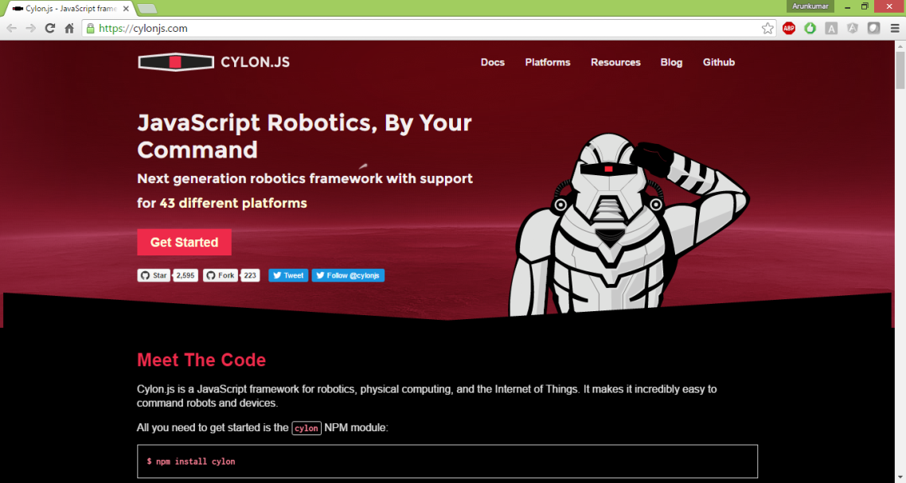
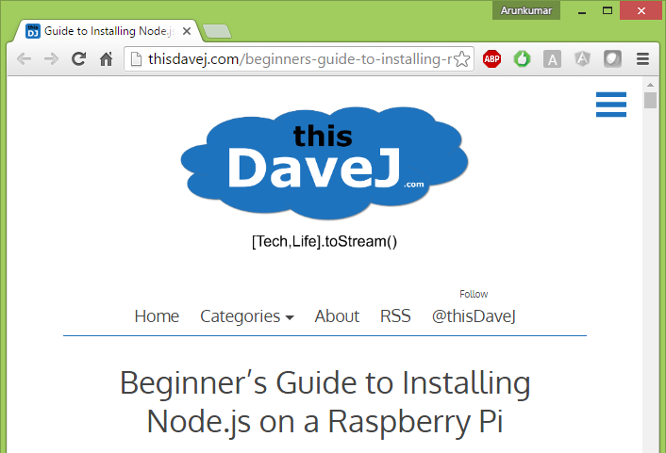
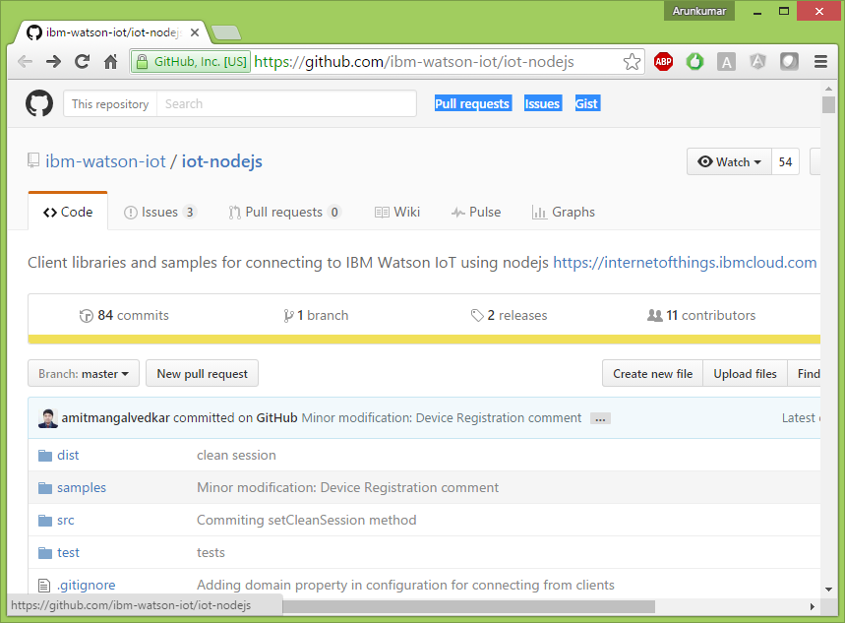
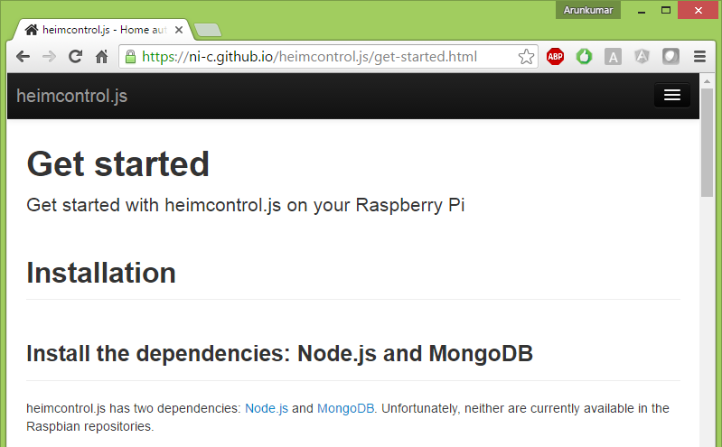
NodeJS on Robotics & IoT

Slide 5
NPM
A tool that makes installing and managing Node modules
Easy to add useful tools to toolkit
Central npm repository for all node modules
https://www.npmjs.com/

Slide 6
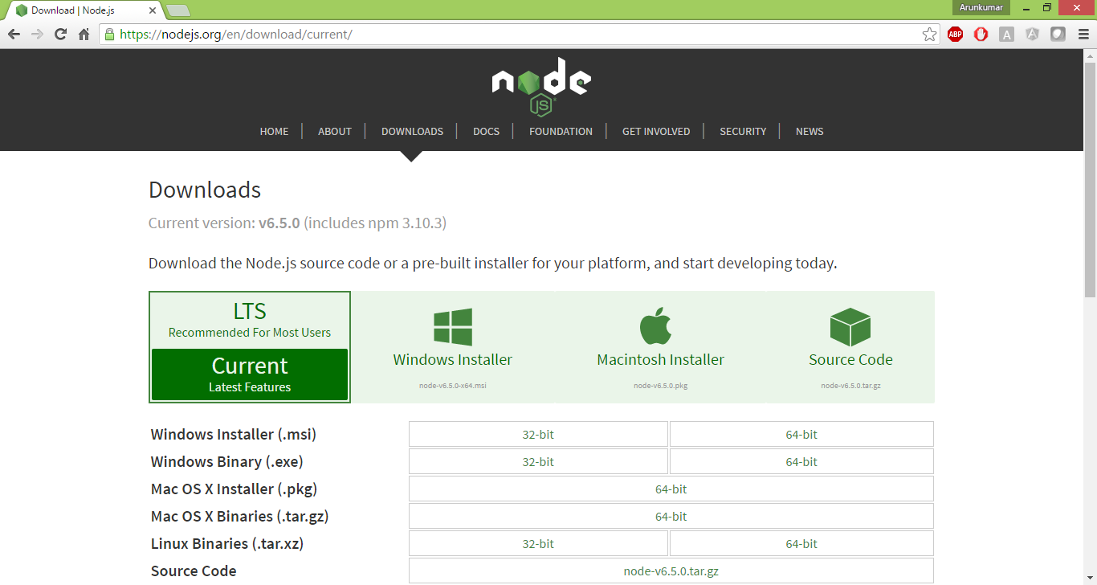
Setup Node.js from pre-built installer

Slide 7
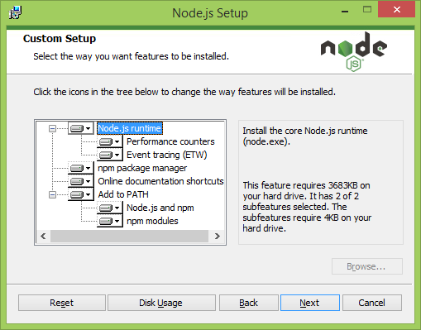
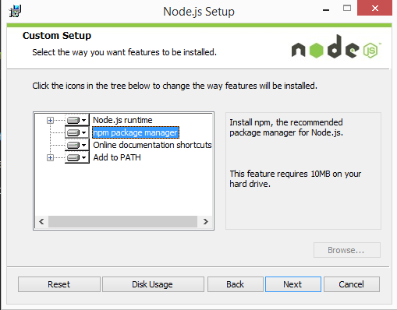
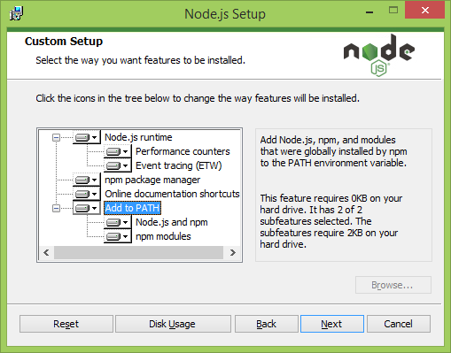
Install Node.js

Slide 8
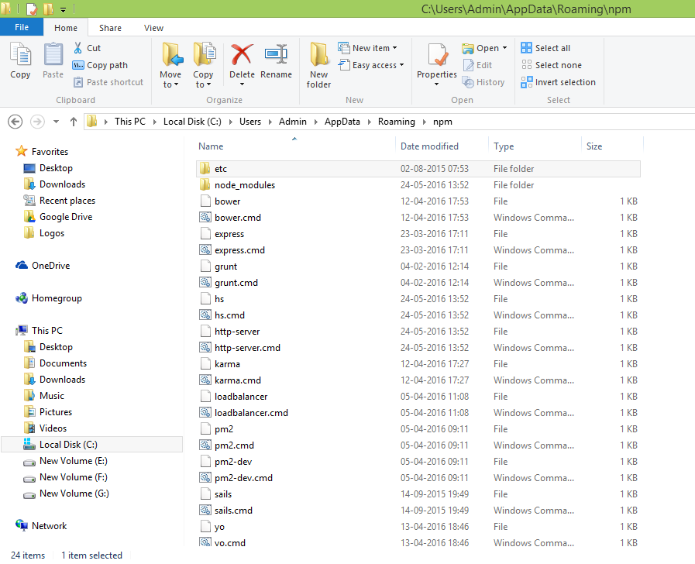
Execution Path
This “~/AppData/Roaming/npm” folder is added to PATH environment variable
All node.js applications / tools command or script file installed globally are placed here

Slide 9
Node.js Architecture – Older versions
libev
Wrapper around OS’ select() and more scalable counterparts
ev_io -> data ready to be read
ev_io -> good time to write data
libeio
Thread pool
Convenience methods for file operations
Node standard library
Javascript
Node bindings
C/C++ Addons
C
V8
Thread pool
(libeio)
Event loop
(libev)

Slide 10
Event loop
Sleep
Callbacks
Call handlers registered for events
Wait for OS events

Slide 11
Node.js Architecture – Current versions
libuv
Abstract operations
Support different non-blocking I/O Models
Focus on embeddability and performance
Node standard library
Javascript
Node bindings
C/C++ Addons
C
V8
Thread pool & Event loop
(libuv)
Also see: https://strongloop.com/strongblog/node-js-is-faster-than-java/

Slide 12

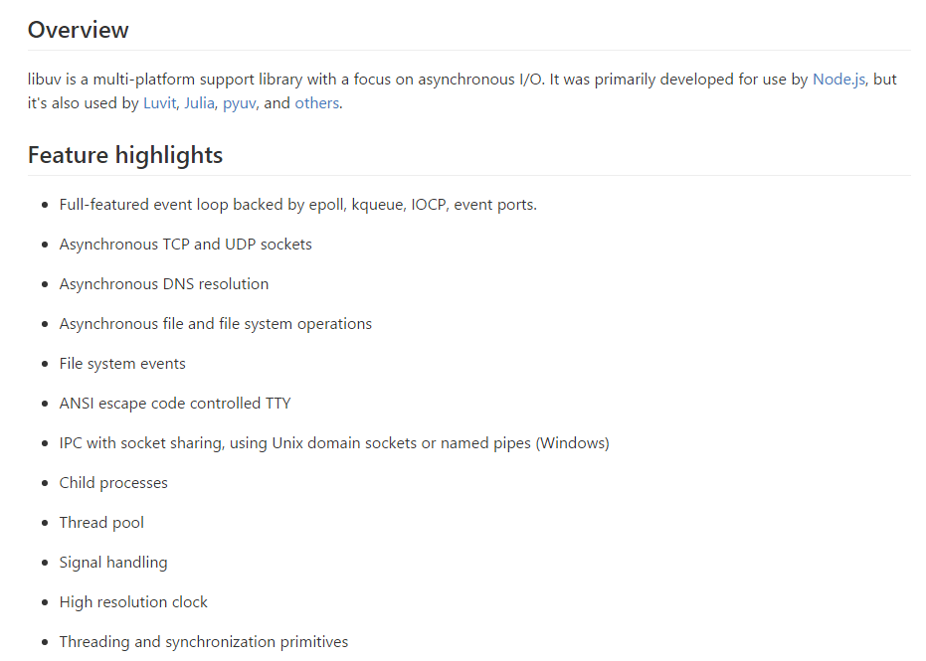
https://github.com/libuv/libuv

Slide 13
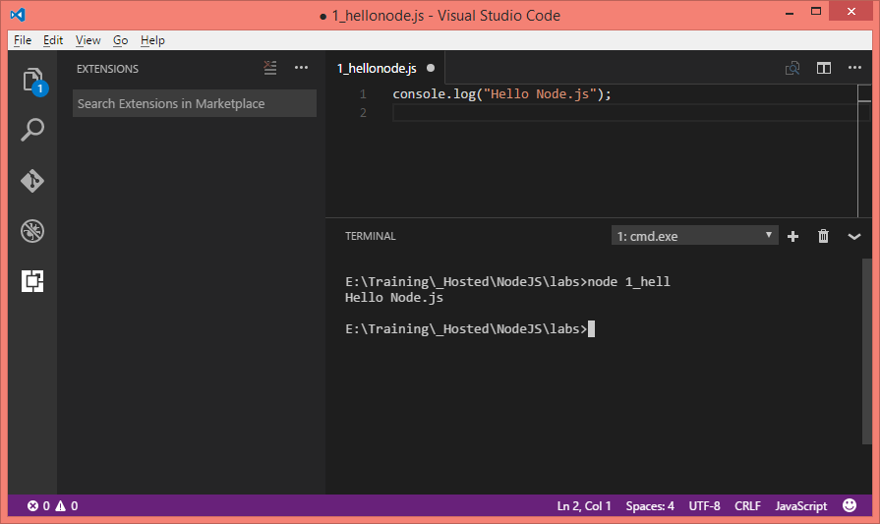
Hello Node

Slide 14
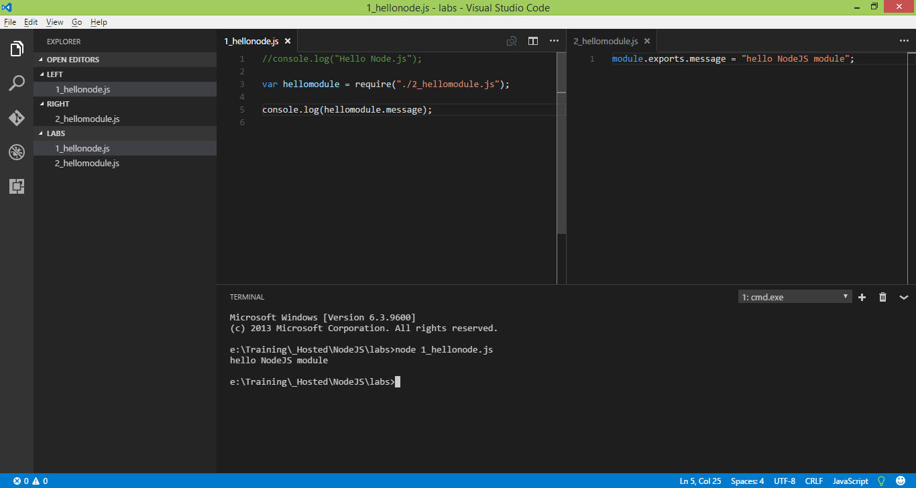
Modules and NPM

Slide 15
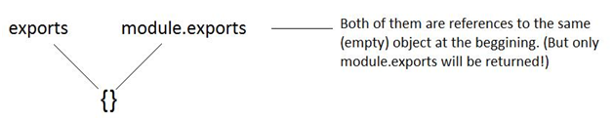
exports and module.exports

Slide 16
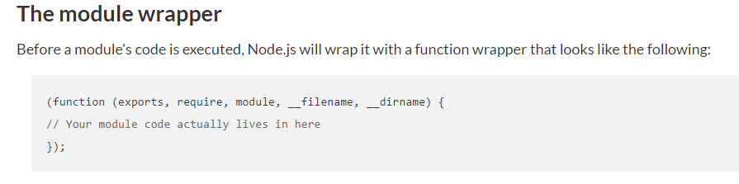

Slide 17
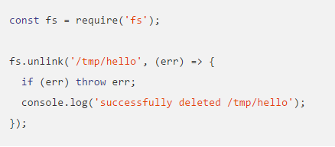
Accessing built-in modules

Slide 18
Using npm to find 3rd party modules
npm search <module name>
https://www.npmjs.com/

Slide 19
Maintaining projects using npm command
Refer to https://openclassrooms.com/courses/ultra-fast-applications-using-node-js/node-js-modules-and-npm

Slide 20
Creating Modules with getters and setters

Slide 21
Understanding module caching and scopes

