Slide 1








$$v_{1}$$
$$α$$
$$v_{0}$$
$$∆v$$
$$v_{0}$$
$$∆v$$
$$r$$
$$r$$
Notes:
Fig 12

Slide 2






$$∆v_{θ}$$
$$∆v$$
$$v_{0}$$
$$β$$
$$∆v_{r}$$
$$r$$
Notes:
Fig 12

Slide 3








Hohmann Transfer
$$v_{B_{3}}$$
B
$${∆v}_{B}$$
$$v_{B_{2}}$$
3
2
1
$$a_{1}$$
A
$$a_{3}$$
$$v_{A_{1}}$$
$${∆v}_{A}$$
$$v_{A_{2}}$$

Slide 4






Bi-elliptic Transfer
$$r_{B}$$
$$r_{C}$$
4
2
$${∆v}_{A}$$
$${∆v}_{B}$$
B
D
$$r_{A}$$
A
C
$${∆v}_{C}$$
1
3

Slide 5






Non-Tangential Transfer
$${∆v}_{B}$$
3
$$v_{B_{3}}$$
$$v_{B_{2}}$$
B
1
$$a_{1}$$
$$θ_{2}$$
2
A
$$a_{3}$$
$$v_{A_{1}}$$
$${∆v}_{A}$$
$$v_{A_{2}}$$

Slide 6
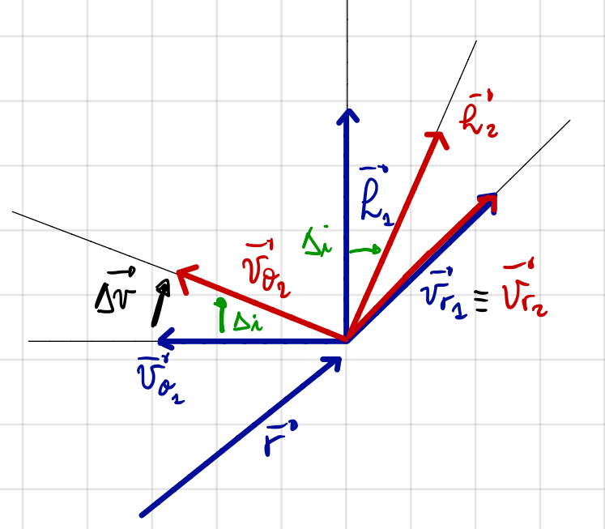









$$h_{1}$$
$$h_{2}$$
$$∆i$$
$$v_{θ_{2}}$$
$$v_{r_{1}}≡v_{r_{2}}$$
$$∆v$$
$$∆i$$
$$v_{θ_{1}}$$
$$r$$
Notes:
Fig 12

