Slide 1

Recurrent Reinforcement Learning for Lander Control during Powered Descent and Landing

Slide 2
Outline
Aim and Problems
Background
Reasoning
Implementation Details
Results
Questions

Slide 3

Aim & Problems

Slide 4
What?
Integrated Guidance and Control System using a Recurrent Reinforcement Learning Technique

Slide 5
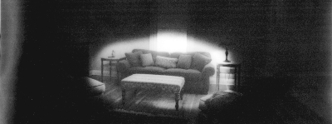
Why? 1.0
Partial Observability

Slide 6


Markovian Processes
- MDP (Markov Decision Process)
Describes a fully observable dynamical system
Observations $=$ State
- POMDP (Partially Observable Markov Decision Process)
Describes a partially observable dynamical system
Observations $≠$ State

Slide 7

Why? 2.0
Separate Guidance and Control Systems

Slide 8

Background

Slide 9

Reinforcement Learning
Properties:
Learn through interactions with an environment
Goal is defined through rewards
Use cases: robot control, business planning, guidance and control systems, industry automation, natural language processing (NLP), financial trading

Slide 10
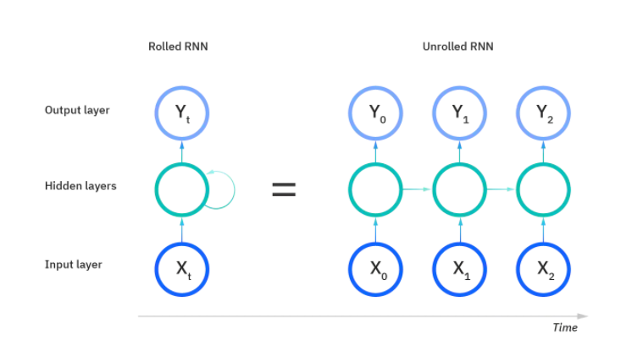
Recurrent Neural Networks
Properties:
Use sequential data or time series data
Output is dependent on the prior elements within a sequence
They have “memory”
Use cases: dynamical system modelling, language translation, natural language processing (nlp), speech recognition, and image captioning

Slide 11

Reasoning

Slide 12
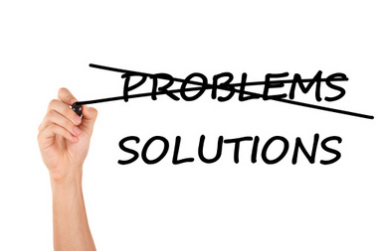
Recurrent Reinforcement Learning as a Solution
Partial Observability?
Use a RNN to approximate hidden factors of the system
Separate Guidance and Control?
Use RL algorithms to learn an optimal policy

Slide 13
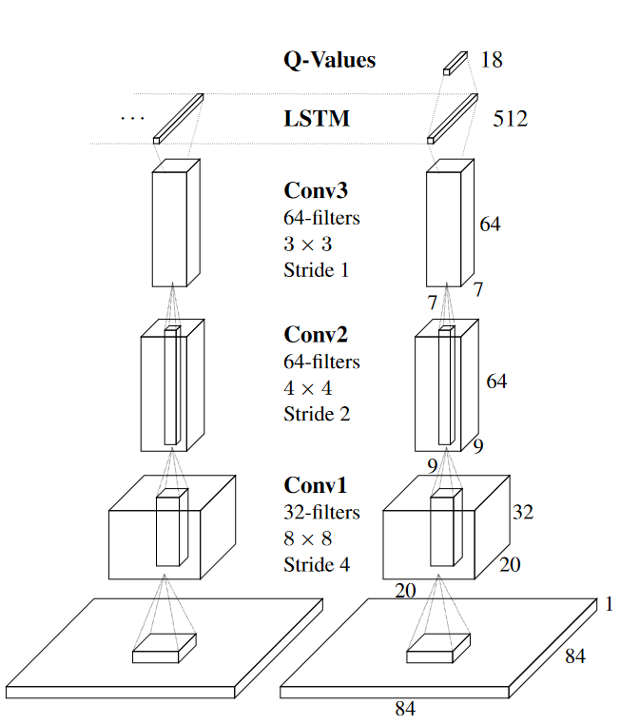
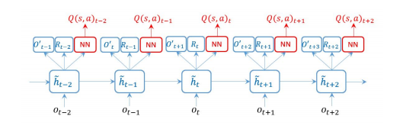
Approaches
Recurrent reinforcement learning
State space models reinforcement learning

Slide 14

Implementation

Slide 15
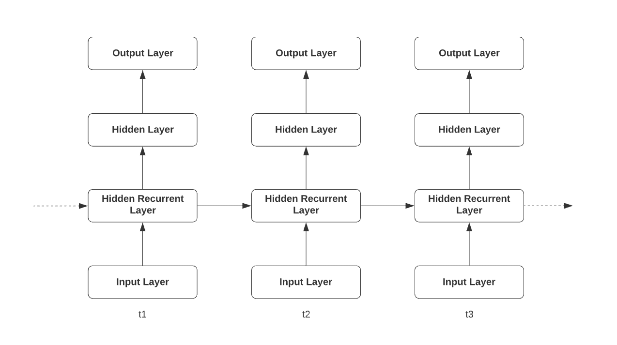
Model
Proximal Policy Optimization (PPO) Algorithm
Four Layers
One recurrent layer
Input size = Observations space size
Output size = Action space size

Slide 16
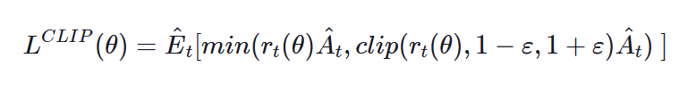
PPO
What?
Policy Gradient Method
Learn policy directly
Actor-Critic type model
Why?
State-of-the-art
Thanks to Clipped Objective Function
Works for continuous action spaces

Slide 17
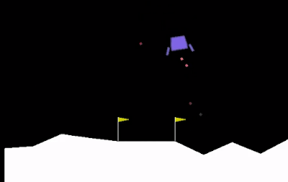

Environment
8 Observations:
$x$ coordinate of the lander
$y$ coordinate of the lander
$v_{x}$ horizontal velocity
$v_{y}$ vertical velocity
$θ$ orientation
$v_{θ}$ angular velocity
Right leg touched the ground
Left leg touched the ground
2 Actions:
Main engine power
Side engines power

Slide 18

Results

Slide 19
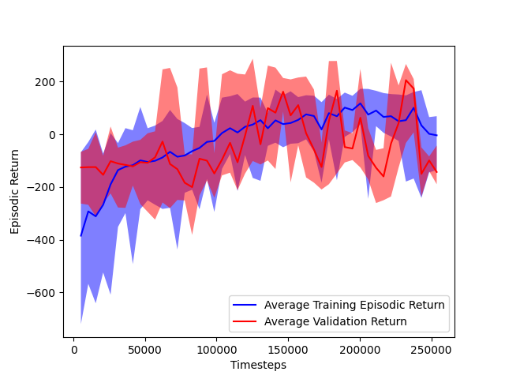
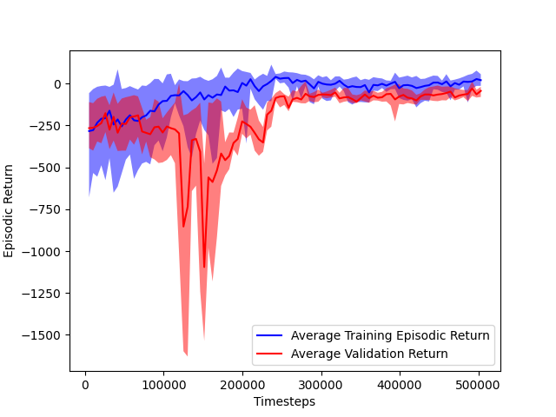
Training
250,000 timesteps model
500,000 timesteps model

Slide 20
Testing
Rewards and Accuracy 250,000 timesteps model
Mean Reward | 34.87
Median Reward | 56.27
Minimum Reward | -322.51
Maximum Reward | 273.96
Landing Accuracy | 49%
Mean Timesteps | 660
Rewards and Accuracy 500,000 timesteps model
Mean Reward | -49.75
Median Reward | -48.79
Minimum Reward | -252.02
Maximum Reward | 63.49
Landing Accuracy | 0%
Mean Timesteps | 993

Slide 21

Questions ?

