Slide 1


Diabetes is a major global health concern, affecting people of all age groups and lifestyles. With advancements in data science and medical research, it has become possible to analyze large datasets to identify patterns and risk factors associated with diabetes.
The aim of this project is to use data analysis techniques to study the relationship between health parameters such as age, BMI, glucose levels, and insulin levels, and to develop predictive models that can help in early detection and prevention.

Slide 2
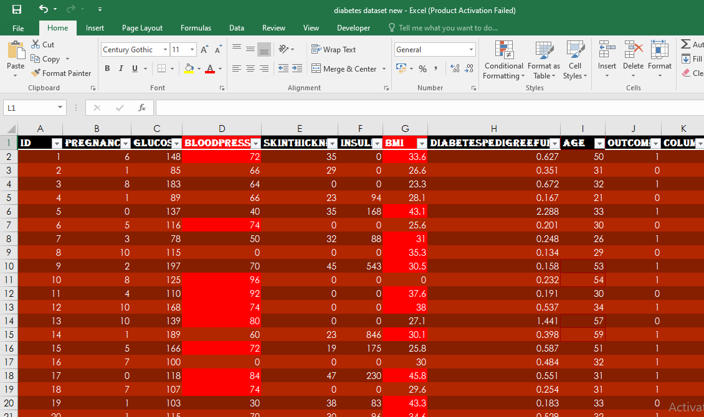
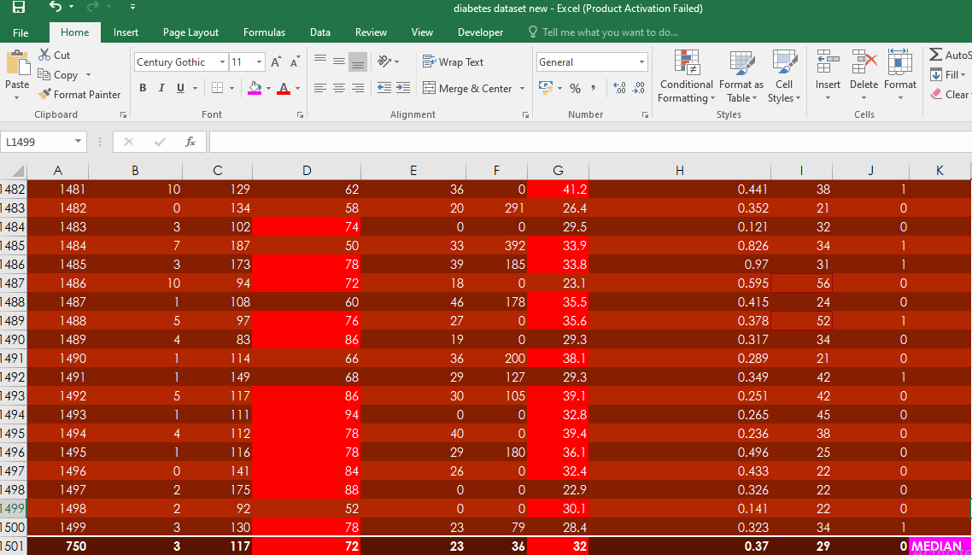
DATA CLEANING PREPARATION 1.Conditional formatting-color scales 2.Fomat Cells - Font Size

Slide 3
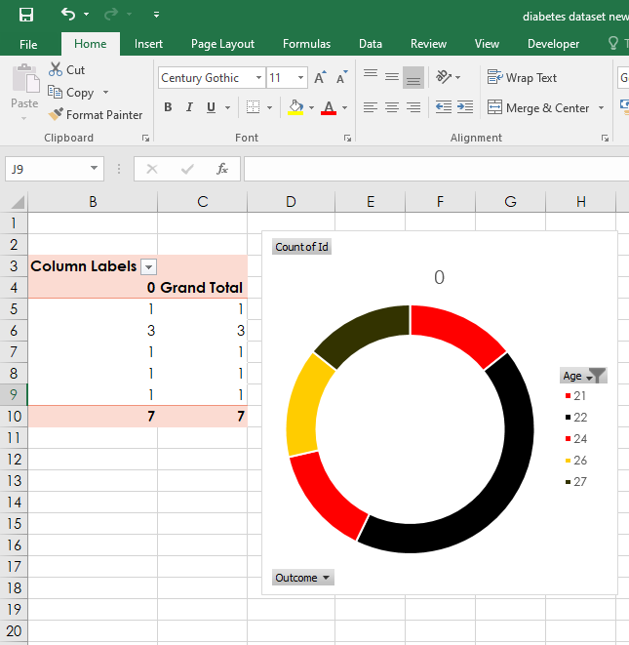
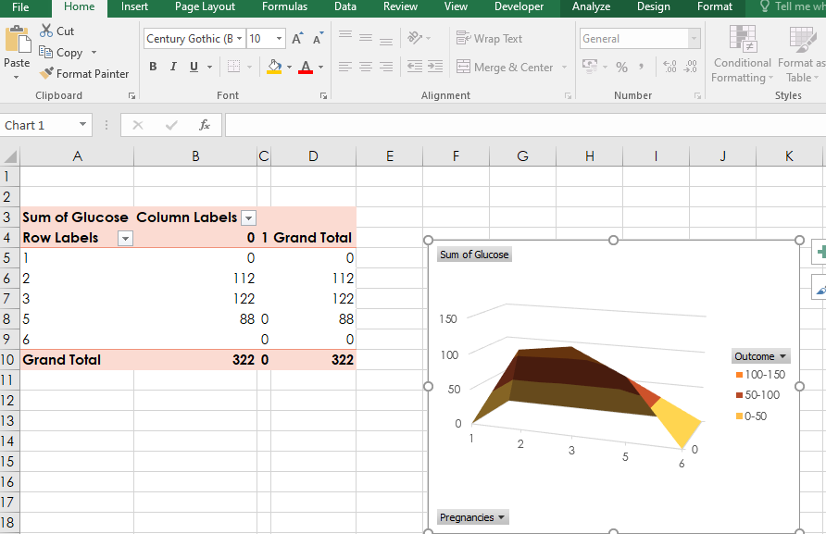
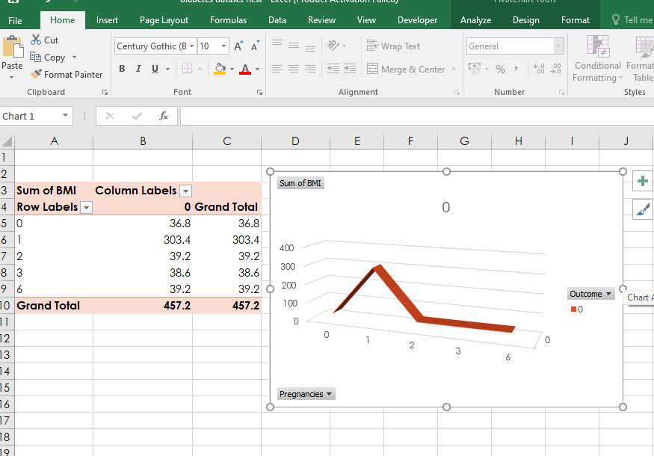
PIVOT TABLE&CHART

Slide 4
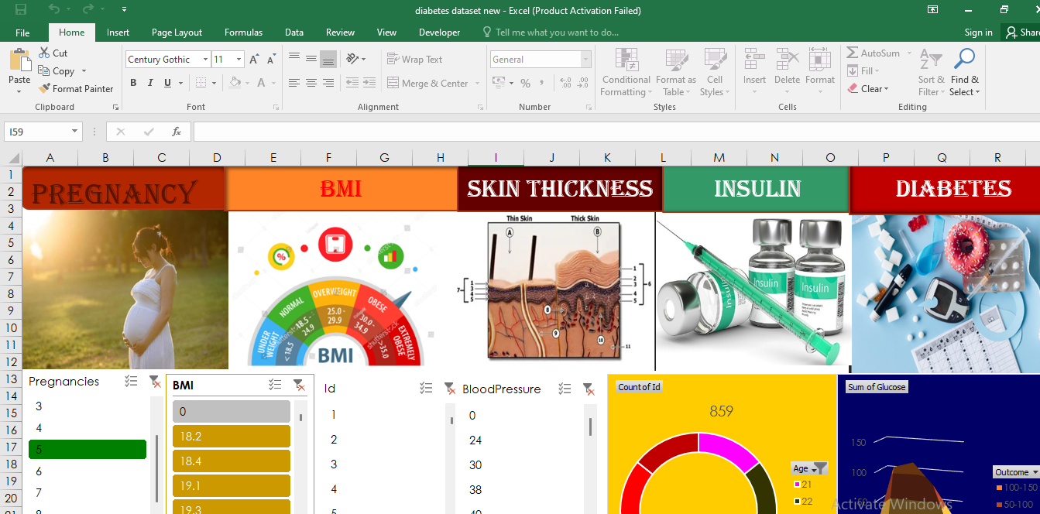
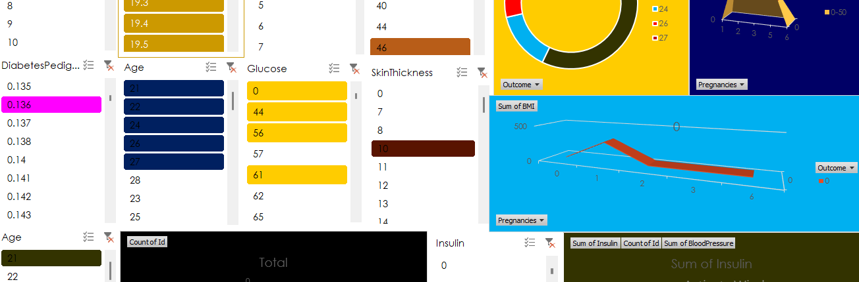
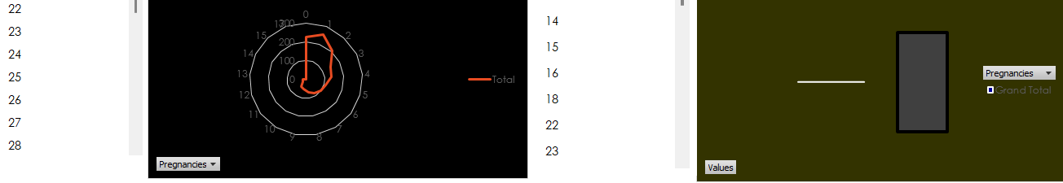
DASHBOARD CREATION

Slide 5
INTEGRATE EXCEL INTO SQL
1.Prepare your excel file
2.Save the file as CSV
3.Open SQL database
4.Right click create schema(name of the table)
5.In left side visible the table name and again right click go to table import
6.Refresh all
7.Verify data and start displaying tables and display KPI parameters via SQL code

Slide 6
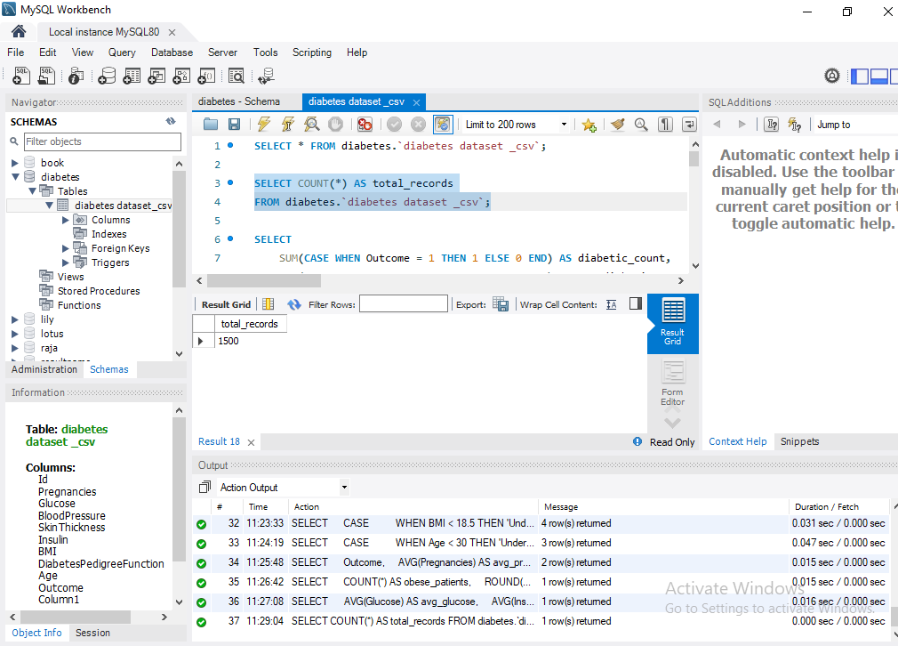
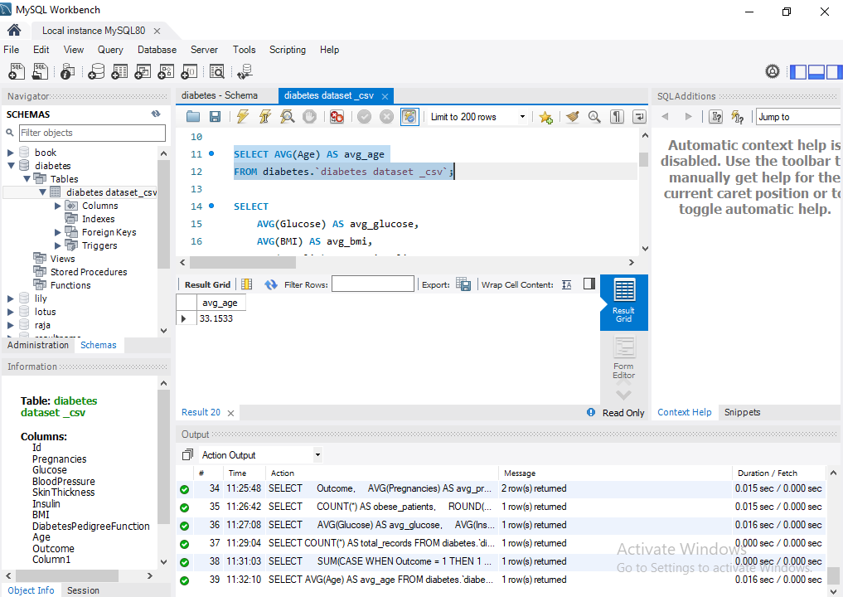
1.Total records: SELECT COUNT(*) AS total_records FROM diabetes.`diabetes dataset _csv`;
2.Average Age of Patients:
SELECT AVG(Age) AS avg_age
FROM diabetes.`diabetes dataset _csv`;

Slide 7


