Slide 1


Account Sales Performance Analysis: Key Insights
2017-2021
Angana Biswas

Slide 2
Key Insights from Sales Analysis
Sales Growth: Highlight overall sales growth trends across years.
Top Performing Accounts: the top 10 accounts contributing to sales.
Account Types: Which account types are generating the most sales.
Marketing Effectiveness: Note which marketing strategies are driving sales.

Slide 3
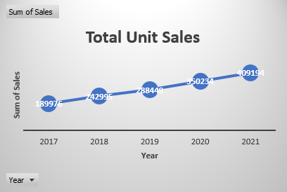
Overview of Sales Performance
Total Unit Sales: Steady growth observed over five years, from 2017 to 2021.
Trend: Sales increased from approximately 19,897 units in 2017 to 40,914 units in 2021, indicating a positive upward trend.

Slide 4
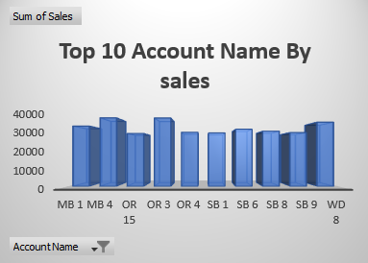
Top 10 Accounts by Sales
Top Performers: Medium Business (MB 1), Online Retailer (OR 3), and Small Business (SB 6) are among the top-performing accounts.
Sales Concentration: These accounts are crucial to overall sales performance, and their consistent high sales demonstrate strong customer relationships.

Slide 5
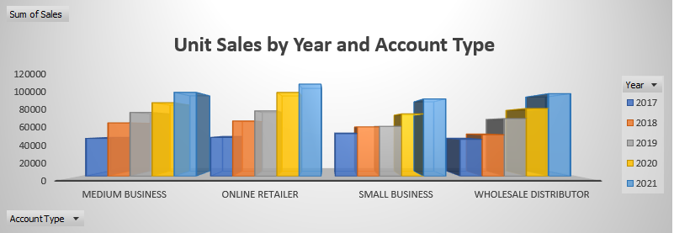
Top 10 Accounts by Sales
Top Account Types: Medium Business and Online Retailer account types show the highest sales over the years.
Yearly Trends: Significant sales growth in the Medium Business category, with a peak in 2021.

Slide 6
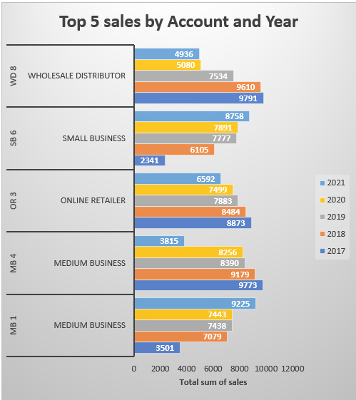
Top 10 Accounts by Sales
Top Accounts: The top accounts include various account types with consistent sales across multiple years.
Sales Growth: The Wholesale Distributor (WD 8) and Medium Business (MB 1) accounts show substantial growth, especially from 2019 to 2021.
Strategic Focus: Allocate resources to capitalize on the success of these top accounts while exploring opportunities to boost sales in underperforming segments.

Slide 7
Summary of Key Sales Insights:
Overall Sales Growth:
Insight: Steady growth in total unit sales from 19,897 units in 2017 to 40,914 units in 2021.
Action: Continue leveraging successful sales strategies to sustain this positive trend.
Top Performing Accounts:
Insight: Medium Business (MB 1), Online Retailer (OR 3), and Small Business (SB 6) are leading in sales.
Action: Focus on strengthening relationships and increasing engagement with these top accounts.
Sales by Account Type:
Insight: Medium Business and Online Retailer are the most significant contributors to sales growth.
Action: Tailor marketing and sales strategies to capitalize on these high-performing segments.
Top 5 Sales by Account:
Insight: Accounts like Wholesale Distributor (WD 8) and Medium Business (MB 1) show strong growth from 2019 to 2021.Action: Allocate more resources to these accounts while exploring growth potential in underperforming areas.

