Slide 1
Django Kickstart

Slide 2
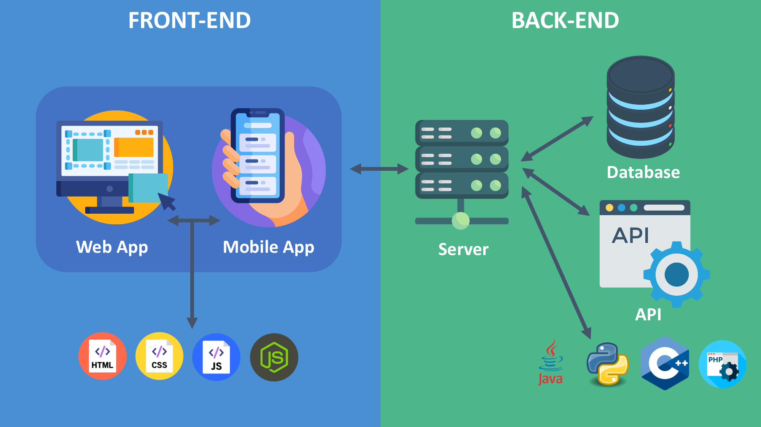

Slide 3
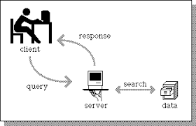
Basic Client Request and Response

Slide 4
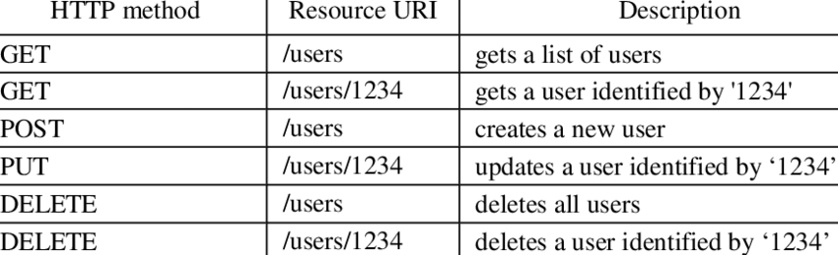
Http Method
HTTP methods are what you use to request data from an server.

Slide 5
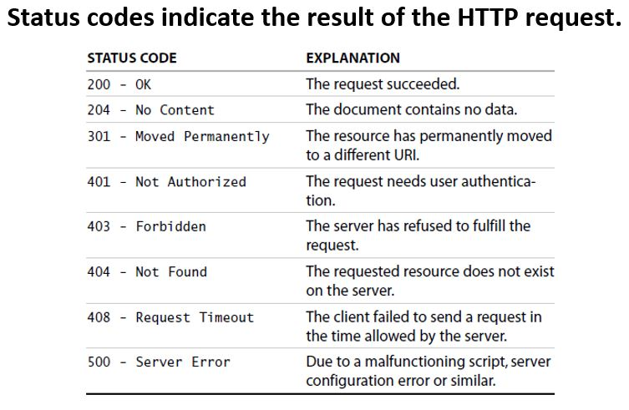
Status Code

Slide 6
What is Django?
Django is a back-end server side web framework.
Open source
Django is an python based framework

Slide 7
What is Django?
Django is a back-end server side web framework.
Open source
Django is an python based framework

Slide 8
What is Django?
Django is a back-end server side web framework.
Open source
Django is an python based framework
Click here Doc Link

Slide 9
What is Django?
Django is a back-end server side web framework.
Open source
Django is an python based framework

Slide 10
Why is Django?
Django is fast to develop websites
Django have lots of libraries
Django used as a Full stack Development and API Development
Easy to secure
Easy to scale small size to large one

Slide 11
Steps:
> vritualenv <env_name>
> source env/bin/activate
> pip install django
> pip freeze
> django-admin startproject <project_name> .
> python3 manage.py startapp <app_name>
> python3 manage.py runserver <port>

Slide 12
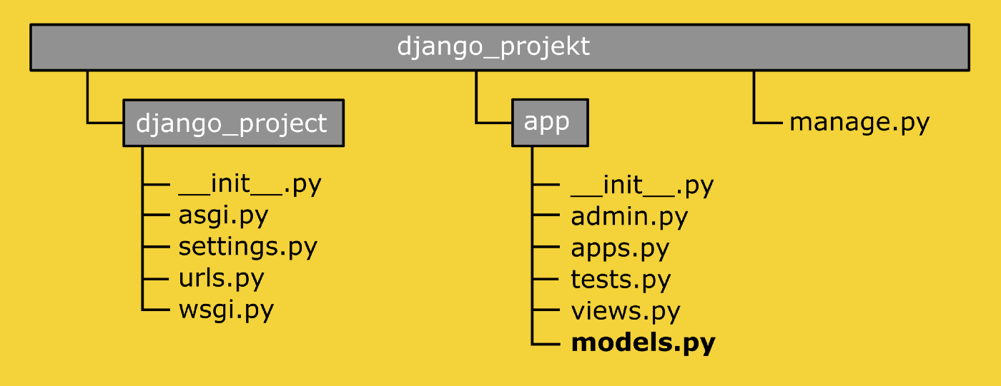
File structure
https://techvidvan.com/tutorials/django-project-structure-layout/

Slide 13
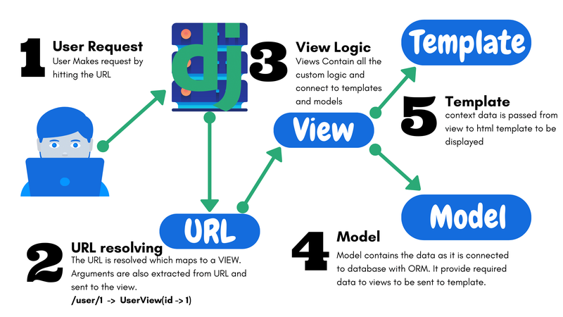
Django Flow

Slide 14
Sample Code
Flask:
from flask import Flask
app = Flask(__name__)
@app.route('/')
def hello():
return 'Hello’
Django:
Views.py (Logics)
from django.http import HttpResponse
def hello(request):
return HttpResponse("Hello")

Slide 15
urls.py (routing)
from django.urls import path
from .views import hello
urlpatterns = [
path('', hello)
]

