Slide 1

From Many Specialist Agents
to One Adaptive Agent
Feasibility, architecture & a working application · Why · What · How
UNAI (oo-NYE) · Basque “shepherd” (one who guides the many) · “one + AI” · and “Un AI” = “One AI” (un = one). A consolidation super agent.
Prepared for Ravin Angara, Bristlecone
Version 1.0 · June 22, 2026 · Companion to the Superagent Technical Specification

Slide 2
THE QUESTION — HOW POSSIBLE IS THIS?
Verdict: feasible today, and working in the app we built
4 : 1
90%
0
4–7 mo
agents → used
layer-complexity ↓
schema re-maps
payback
one UNAI ran a 4-agent workflow
70 → 7 shared layer implementations
context switching absorbed by the ontology
$18–32M three-year NPV
Why it works
~90% of what makes an agent “an agent” — perception, memory, reasoning, evidence, action, collaboration, explainability — is identical across domains.
Build those seven layers once; each new capability becomes configuration, not a multi-week engineering project.
Every primitive (Mistral Large/Small tool calling, BTP OData/BAPI as MCP tools, NATS pub/sub, Postgres+pgvector, Kubernetes) is available today — cloud-neutral and self-hostable. Remaining risk is organizational, not technical.

Slide 3
IN PLAIN TERMS
Many specialists, or one versatile worker
The old way — many specialists
UNAI — one versatile worker
Hire a separate specialist for every job
Each one is rebuilt to read your systems, keep its own memory, decide, message every other agent, and explain itself
The same plumbing, rebuilt over and over — 10 agents = 70 builds + 45 wires
One worker already owns the plumbing — the 7 shared layers
It just picks up a small playbook (tool pack) for each new job
Build the expensive 90% once; only the cheap 10% changes per task
Adding a capability = configuration, not a new agent
Result: one agent does the work of many — proven live in the app (4 agents → 1; at 10-agent scale, 70 builds → 7).

Slide 4
Architecture Analogy
12 agents (each rebuilds every cognitive task) vs 1 UNAI runtime (built once, 12 capability packs)
🚚 Traditional: 12 Agents
🍽️ UNAI: 1 Shared Runtime + 12 Packs
Each agent independently sources, preps, seasons, and tastes — full cognitive overhead, every time.
Runtime runs all cognitive tasks ONCE, then sends ready results to 12 capability packs.
🌮
Taco
🍔
Burger
🍕
Pizza
🍣
Sushi
🔍 UNAI · shared runtime
🛒 Source
🔪 Prep
🧂 Season
👅 Taste
🍗
BBQ
🥞
Crepe
🧇
Waffle
🍜
Noodle
🌮
Taco
🍔
Burger
🍕
Pizza
🍣
Sushi
🍗
BBQ
🥞
Crepe
🧇
Waffle
🍜
Noodle
🥪
Sandwich
🥟
Dumpling
🥗
Salad
🥤
Smoothie
🥪
Sandwich
🥟
Dumpling
🥗
Salad
🥤
Smoothie
48 tasks = 12 agents × 4 cognitive tasks each
16 tasks = 4 shared tasks + 12 pack calls
🚚 TRADITIONAL
48 tasks
12 agents × 4 cognitive tasks each
🍽️ UNAI
16 tasks
4 shared tasks + 12 pack calls
📉 REDUCTION
66.7%
Fewer cognitive operations
UNAI-ARCH-ANALOGY-V1

Slide 5
WHY
One agent per job does not scale
Duplicated engineering
Steady-state burden
of a 10-agent estate
1
10 agents = 70 layer implementations. Seven near-identical perception layers, memory stores, action handlers — each separately built, tested, secured.
878
Quadratic collaboration
2
Point-to-point comms scale as N×(N−1)/2. Ten agents = 45 channels; an eleventh forces edits to every existing agent.
maintenance hours / month
70
Repeated context switching
3
Every agent re-learns that MATNR means “material”, and re-maps the schema again on each move between systems of record.
layer implementations

Slide 6
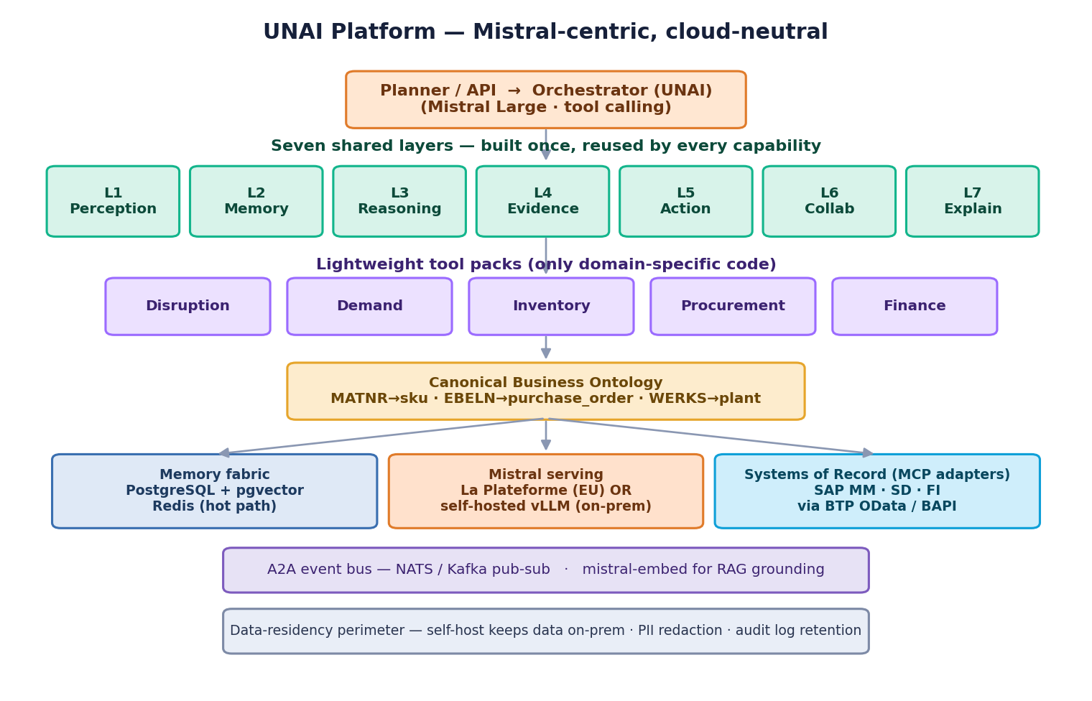
WHAT
The seven-layer UNAI
Built once, shared everywhere
7 universal layers implemented a single time
Domain logic lives only in lightweight tool packs
A canonical ontology maps every system’s native fields (MATNR→sku, EBELN→purchase_order)
Systems of record are pluggable adapters — swap SQLite for live SAP, engine unchanged
Runs on the customer’s own Kubernetes — any cloud or on-prem; self-host Mistral for full data residency

Slide 7
PROOF · MEASURED IN THE APP
Many agents collapse into one
The disruption-response run
4 capabilities — detect → re-forecast → rebalance → procure
In Gen-1, each is a whole 7-layer specialist agent
One UNAI delivered all four — a 4:1 substitution
At a 10-agent scale: 70→7 layer impls, ~90% reduction
The math: 4 agents × 7 layers = 28 builds → 7 shared layers + 4 tool packs = 11 (build the 7 once, reuse). 28−11 ≈ 60% less; 70→7 ≈ 90% at 10-agent scale. Real engine output.

Slide 8
HOW · SYSTEM-OF-RECORD SWITCHING
One concept, four dialects — mapped once
Canonical | SAP MM | SAP SD | SAP FI | Analytics
sku | MATNR | MATNR | MATKL | sku_id
plant | WERKS | WERKS | BUKRS | dc_code
on-hand qty | LABST | KWMENG | — | qty_on_hand
supplier | LIFNR | — | LIFNR | vendor_id
purchase order | EBELN | — | EBELN | po_id
The cost collapses
5 transitions across systems
Gen-1: 5 schema re-maps (one per transition, in every agent)
Gen-2: 0 re-maps — the ontology resolved each system once, reused everywhere
New-ERP onboarding: 4–6 weeks → 2–3 days (config, not code)

Slide 9
LIVE DEMO
Supplier disruption response, end to end
Port strike hits APAC supplier V-2207 (risk 0.78). One UNAI runs the full response:
1
Detect (analytics)
›
2
Re-forecast +12% (analytics + SD)
›
3
Rebalance stock (SAP MM)
›
4
Procure & reroute (MM + FI)
SKU | Qty | Supplier | Value | Conf. | Mode
FG-1001 | 1,084 | V-9001 (backup) | $46,070 | 98% | Autonomous
FG-1003 | 586 | V-3310 | $56,256 | 88% | Human appr.
Why one agent wins here
Detection, forecasting and procurement share one memory fabric
So FG-1001 auto-reroutes off the disrupted supplier — a cross-capability call
FG-1003 ($56K > $50K limit) is held for a buyer — human-in-the-loop governance
Every decision: confidence, attribution & rationale; actions persisted to SQLite

Slide 10
NOT A BLACK BOX
Built-in explainability — all seven layers, every decision
L1
L2
L3
L4
L5
L6
L7
Perception
Memory
Reasoning
Evidence
Action
Collab
Explain
6× run
7× run
1× run
5× run
3× run
4× run
5× run
Every one of the seven shared layers fired in the run — proof they are implemented once and exercised together.
Worked example — the rationale the agent recorded for the held PO
Decision Raise PO for FG-1003 (586 units, $56,256)
Confidence 88% (±12%) Primary driver stock-out revenue risk (86% of the decision)
Gate value $56,256 > $50,000 approval limit → routed to a human approver
What-if a PO at or below $50,000 would execute autonomously; this one needs a buyer’s sign-off.
Full audit trail retained for SOX · FDA 21 CFR Part 11 · Basel III.

Slide 11
COST, BENEFIT & EFFICIENCY
Build seven layers once; value compounds
~90%
layer-complexity reduction (70→7)
91%
maintenance-hour reduction (878→80)
~95%
faster new-ERP onboarding & agent build
$23M
3-year NPV (midpoint, 12% discount)

Slide 12
ROADMAP & RECOMMENDATION
A 16-week path — start with an 8-week proof
Wk 1–4
Wk 5–8
Wk 9–12
Wk 13–16
1 · Foundation
2 · First Superagent
3 · Multi-agent mesh
4 · Hardening
Read SAP S/4HANA inventory; explainable recommendation
Inventory Superagent in production; first autonomous PO
3+ capabilities collaborate; 29-sec disruption response
GA; 10K+ autonomous decisions/day at 99.9% uptime
Recommendation
Proceed with a Phase 1–2 engagement — 8 weeks, ~$800K — to put the first Inventory Optimization Superagent into production with planner oversight.
It validates the architecture, demonstrates ROI early, and de-risks the full mesh. The working UNAI Studio app already proves the substitution and context-switch collapse end to end.

