Slide 1
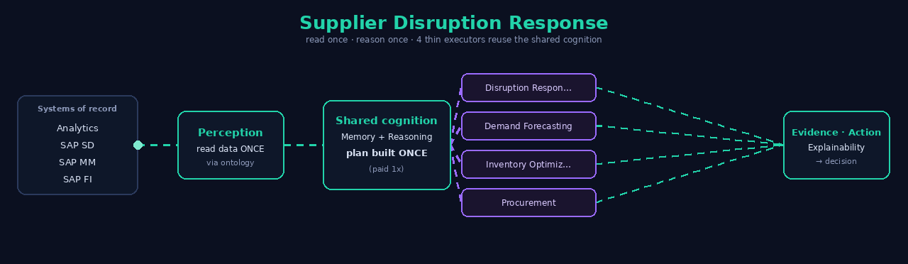
UNAI
How it works — per use case
One shared brain. Many thin executors. Read once, reason once — then reuse the cognition.
Bristlecone · UNAI Cognitive Runtime · modeled figures — not for external distribution

Slide 2
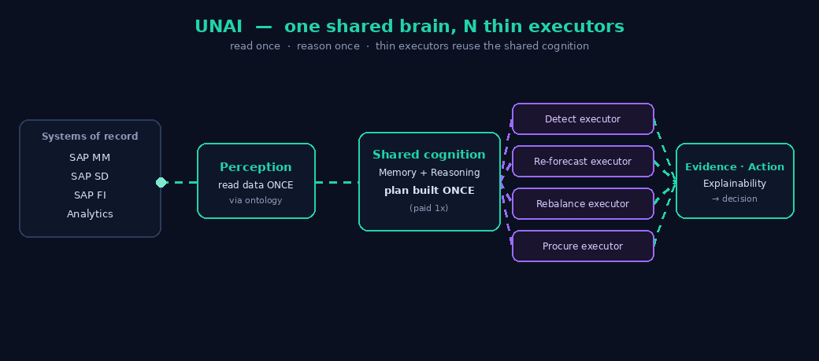
How to read these flows
1. Systems of record — SAP / Snowflake / Databricks / BigQuery — read through one canonical ontology.
2. Perception — read ONCE — The data is pulled a single time, not once per specialist.
3. Shared cognition — reason ONCE — Memory + planning happen one time. This is the expensive step, paid 1×.
4. Thin executors — Each tool pack applies a domain lens — no re-reading, no re-planning.
5. Evidence · Action · Explainability — One governed, auditable decision.
Bristlecone · UNAI Cognitive Runtime · modeled figures — not for external distribution

Slide 3
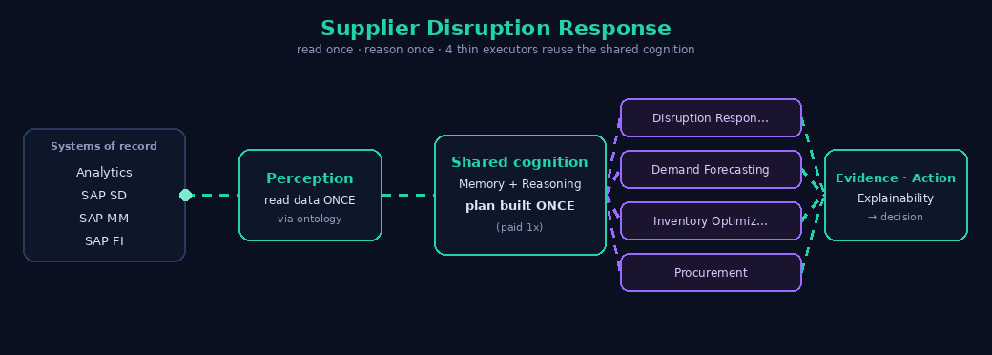
Supplier Disruption Response
reads once · reasons once · 4 thin executors reuse the shared cognition
4 specialist agents → 1 UNAI −62% tokens (modeled) one read · one plan
Bristlecone · UNAI Cognitive Runtime · modeled figures — not for external distribution

Slide 4
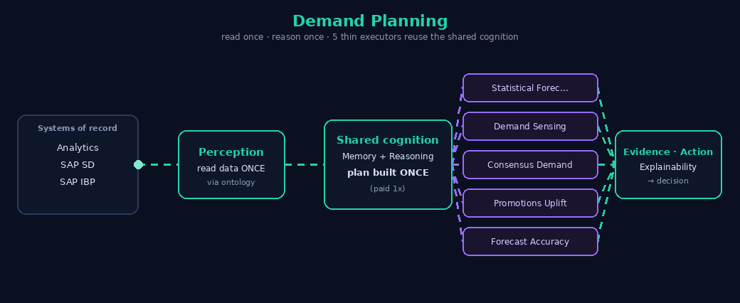
Demand Planning
reads once · reasons once · 5 thin executors reuse the shared cognition
5 specialist agents → 1 UNAI −71% tokens (modeled) one read · one plan
Bristlecone · UNAI Cognitive Runtime · modeled figures — not for external distribution

Slide 5

Inventory Optimization
reads once · reasons once · 5 thin executors reuse the shared cognition
5 specialist agents → 1 UNAI −70% tokens (modeled) one read · one plan
Bristlecone · UNAI Cognitive Runtime · modeled figures — not for external distribution

Slide 6
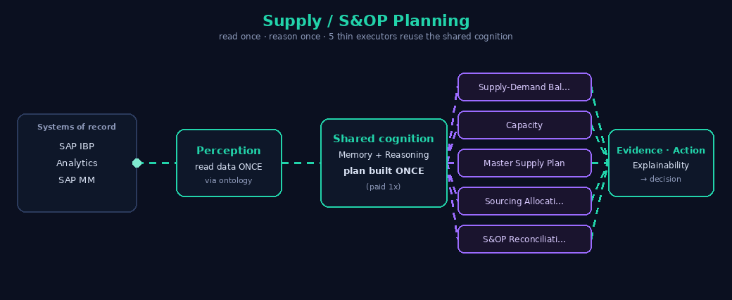
Supply / S&OP Planning
reads once · reasons once · 5 thin executors reuse the shared cognition
5 specialist agents → 1 UNAI −74% tokens (modeled) one read · one plan
Bristlecone · UNAI Cognitive Runtime · modeled figures — not for external distribution

Slide 7
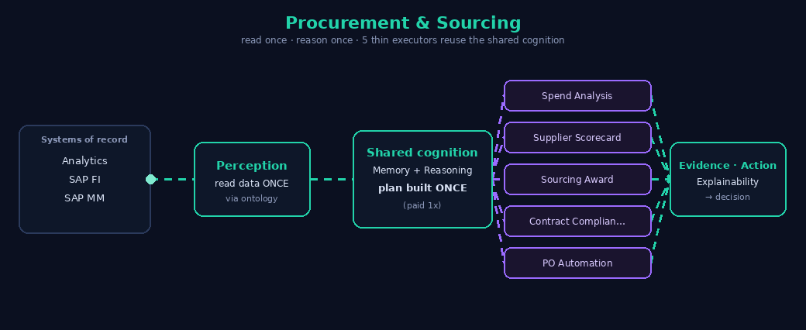
Procurement & Sourcing
reads once · reasons once · 5 thin executors reuse the shared cognition
5 specialist agents → 1 UNAI −74% tokens (modeled) one read · one plan
Bristlecone · UNAI Cognitive Runtime · modeled figures — not for external distribution

Slide 8
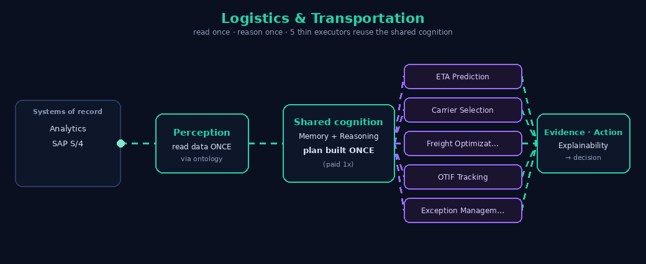
Logistics & Transportation
reads once · reasons once · 5 thin executors reuse the shared cognition
5 specialist agents → 1 UNAI −74% tokens (modeled) one read · one plan
Bristlecone · UNAI Cognitive Runtime · modeled figures — not for external distribution

Slide 9
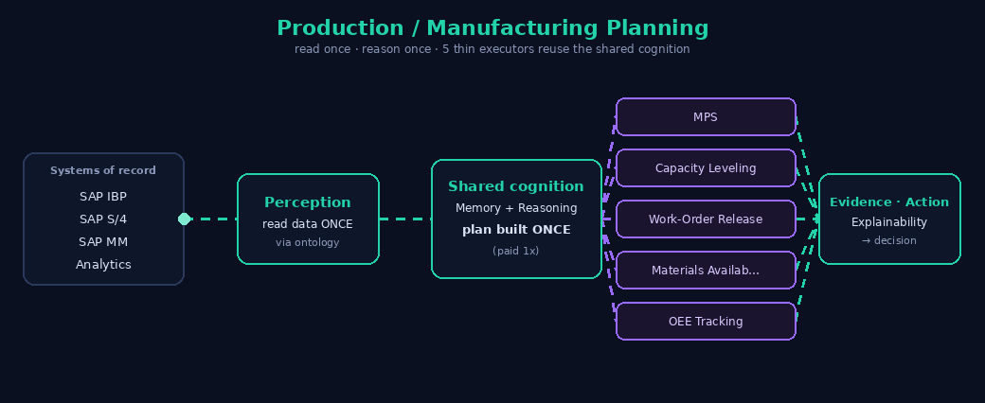
Production / Manufacturing Planning
reads once · reasons once · 5 thin executors reuse the shared cognition
5 specialist agents → 1 UNAI −70% tokens (modeled) one read · one plan
Bristlecone · UNAI Cognitive Runtime · modeled figures — not for external distribution

Slide 10
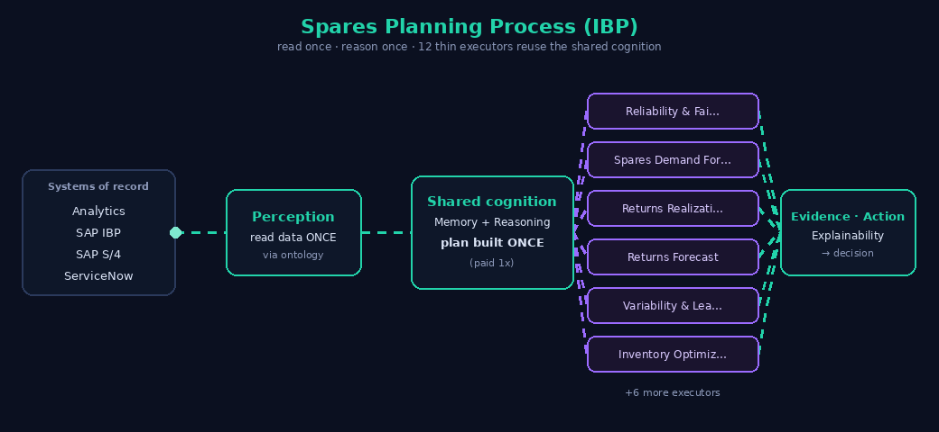
Spares Planning Process (IBP)
reads once · reasons once · 12 thin executors reuse the shared cognition
12 specialist agents → 1 UNAI −76% tokens (modeled) one read · one plan
Bristlecone · UNAI Cognitive Runtime · modeled figures — not for external distribution

Slide 11
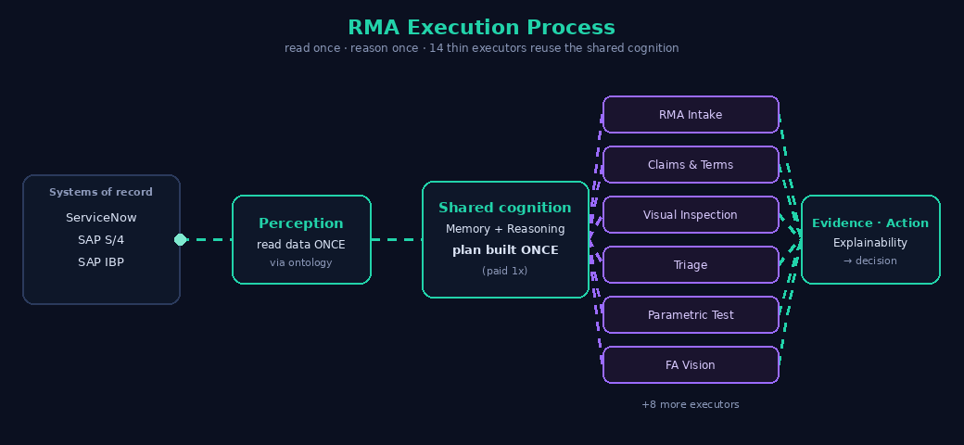
RMA Execution Process
reads once · reasons once · 14 thin executors reuse the shared cognition
15 specialist agents → 1 UNAI −82% tokens (modeled) one read · one plan
Bristlecone · UNAI Cognitive Runtime · modeled figures — not for external distribution

Slide 12
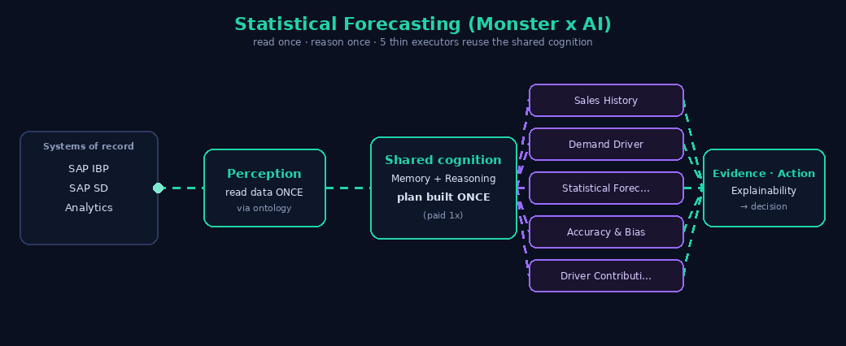
Statistical Forecasting (Monster x AI)
reads once · reasons once · 5 thin executors reuse the shared cognition
5 specialist agents → 1 UNAI −74% tokens (modeled) one read · one plan
Bristlecone · UNAI Cognitive Runtime · modeled figures — not for external distribution

Slide 13

Forecast Cannibalization (Monster x AI)
reads once · reasons once · 5 thin executors reuse the shared cognition
5 specialist agents → 1 UNAI −74% tokens (modeled) one read · one plan
Bristlecone · UNAI Cognitive Runtime · modeled figures — not for external distribution

Slide 14
One shared brain, every use case
Consolidation, not orchestration.
Every use case reads its data once and reasons once; capabilities are thin tool packs that reuse that shared cognition. Adding a capability is +1 pack, not +1 seven-layer agent. Warehouse- and model-neutral, SAP-compliant, and it now also does progressive disclosure, tier-based model routing and prompt caching — so it runs on any platform and compounds with Databricks' own cost levers.
Bristlecone · UNAI Cognitive Runtime · modeled figures — not for external distribution

Slide 15
Architecture Analogy
12 agents (each rebuilds every cognitive task) vs 1 UNAI runtime (built once, 12 capability packs)
🚚 Traditional: 12 Agents
🍽️ UNAI: 1 Shared Runtime + 12 Packs
Each agent independently sources, preps, seasons, and tastes — full cognitive overhead, every time.
Runtime runs all cognitive tasks ONCE, then sends ready results to 12 capability packs.
🌮
Taco
🍔
Burger
🍕
Pizza
🍣
Sushi
🔍 UNAI · shared runtime
🛒 Source
🔪 Prep
🧂 Season
👅 Taste
🍗
BBQ
🥞
Crepe
🧇
Waffle
🍜
Noodle
🌮
Taco
🍔
Burger
🍕
Pizza
🍣
Sushi
🍗
BBQ
🥞
Crepe
🧇
Waffle
🍜
Noodle
🥪
Sandwich
🥟
Dumpling
🥗
Salad
🥤
Smoothie
🥪
Sandwich
🥟
Dumpling
🥗
Salad
🥤
Smoothie
48 tasks = 12 agents × 4 cognitive tasks each
16 tasks = 4 shared tasks + 12 pack calls
🚚 TRADITIONAL
48 tasks
12 agents × 4 cognitive tasks each
🍽️ UNAI
16 tasks
4 shared tasks + 12 pack calls
📉 REDUCTION
66.7%
Fewer cognitive operations
UNAI-ARCH-ANALOGY-V1

