Slide 1
UNAI · UNIVERSAL SUPPLY-CHAIN AGENT
One AI that does the work of many
Collapsing many specialist agents into one governed, cloud-neutral agent —
the architecture, the proof, and the business case.
Executive Briefing · for the CEO, CFO & Chief AI Officer
Bristlecone · Research-preview demonstrator

Slide 2
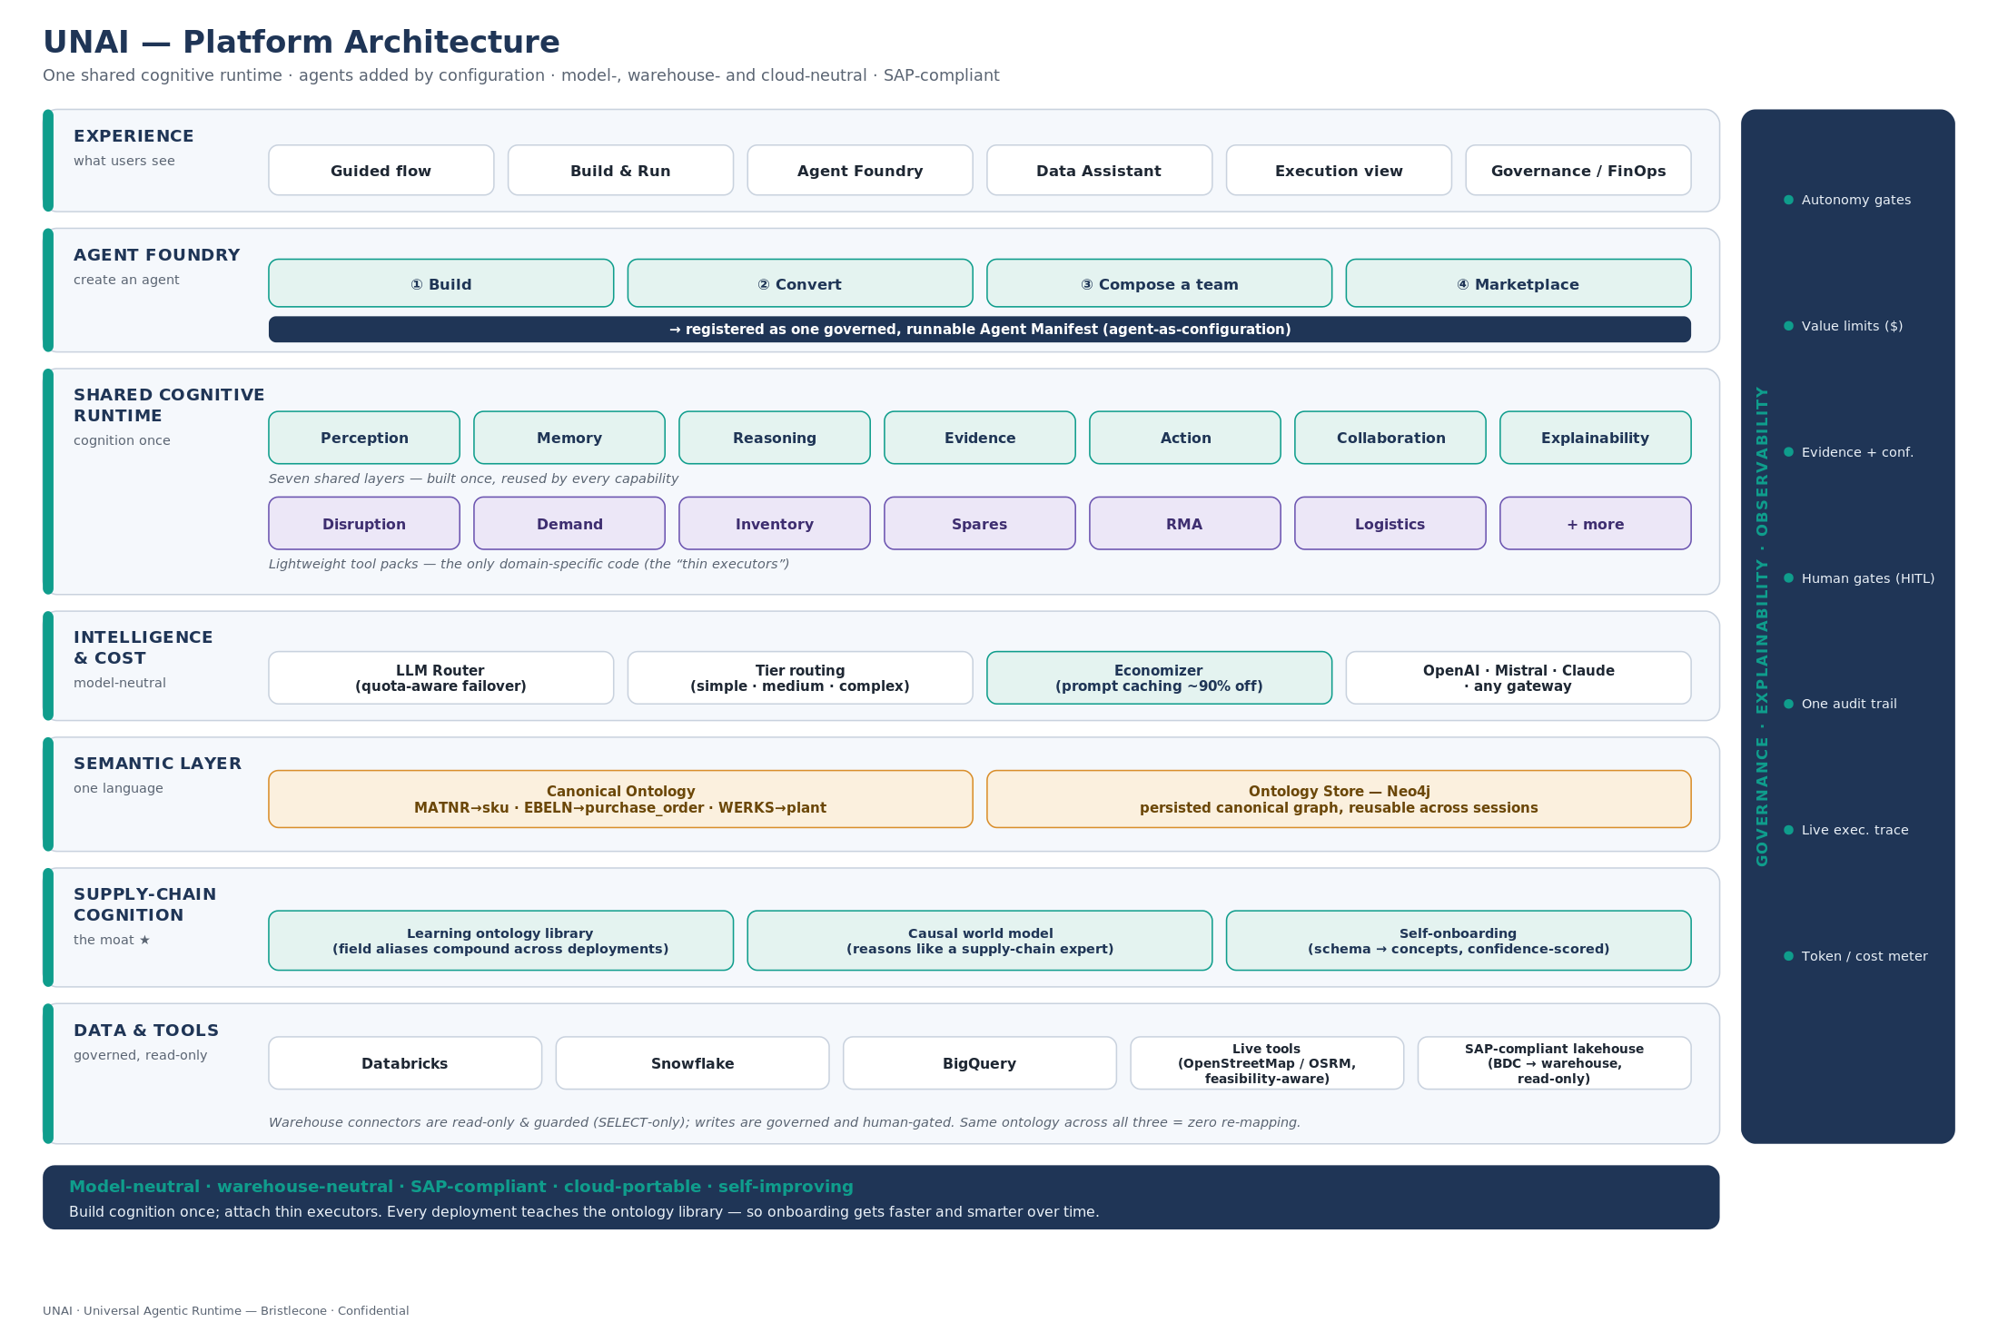
Platform Architecture
One shared cognitive runtime · a self-improving Supply-Chain Cognition Layer · model-, warehouse- and cloud-neutral · SAP-compliant

Slide 3
THE IDEA IN ONE PICTURE
12 food trucks, or 1 restaurant?
Every AI agent secretly runs the same seven subsystems — it senses data, remembers, reasons, weighs evidence, acts, coordinates and explains. The question is whether you rebuild all seven for every job, or build them once and share.
Gen-1 = 12 food trucks
UNAI = 1 restaurant
Truck 1 ·7
Truck 2 ·7
Truck 3 ·7
Truck 4 ·7
One shared kitchen · fridge · staff · till (7, built once)
Truck 5 ·7
Truck 6 ·7
Truck 7 ·7
Truck 8 ·7
+ 12 recipes (the tool packs) — a recipe reuses the kitchen:
Truck 9 ·7
Truck 10 ·7
Truck 11 ·7
Truck 12 ·7
1
2
3
4
5
6
7
8
9
10
11
12
each with its own kitchen, fridge, staff & till = 7 subsystems
recipes reuse the one kitchen — they aren't new kitchens
84
19
subsystems to build & run
things to run (7 shared + 12 recipes)
Same 12 meals — one kitchen, not twelve. Build the hard 90% once; each new dish is just a recipe. That is UNAI.

Slide 4
THE PROBLEM
Agent sprawl: cost that scales with the number of agents
The common pattern today is a new specialist agent for every task. Each one re-builds the same plumbing, re-maps every system it touches, and must be wired to the others — so cost, risk and latency grow with the count of agents, not the value delivered.
1
2
3
4
7 layers, rebuilt N times
Integration grows as N²
Re-mapping on every hop
Scattered governance & logs
Every agent re-implements perception, memory, reasoning, evidence, action, collaboration and explainability — the expensive 90%, duplicated.
Point-to-point coordination between agents scales as N(N-1)/2 — 10 agents means 45 connections to build and maintain.
Each agent re-maps each system's schema itself, so moving across SAP / lakehouse / ITSM costs integration effort again and again.
Telemetry, audit and guardrails are re-done per agent — inconsistent autonomy and a compliance headache.
Result: pilots multiply, but unit economics get worse as you scale.

Slide 5
THE APPROACH
Build the seven layers once. Add capability as configuration.
UNAI implements the seven shared layers a single time and adds each new business capability as a lightweight “tool pack,” not a new agent. A canonical ontology lets it read and write any system in one shared language — so context-switching across systems costs nothing.
The substitution principle
1
One agent, many jobs
A single substrate runs every use case — the work of many specialist agents.
L1
L2
L3
L4
L5
L6
L7
Perception
Memory
Reasoning
Evidence
Action
Collab.
Explain
Seven shared layers — built once, reused by every capability
2
Cloud- & model-neutral
Disruption
Demand
Inventory
Spares
RMA
Open-weight models (e.g. Mistral) self-hostable in your perimeter; runs on Snowflake, Databricks or OSS lakehouse via one adapter.
Lightweight tool packs — the only domain-specific code
3
Accountable autonomy
Canonical ontology · MATNR→sku · EBELN→purchase_order
Every decision carries confidence, attribution and a plain-English rationale; value/confidence gates route the rest to humans.

Slide 6
THE UPGRADE
A shared cognitive runtime — cognition once, thin executors on top
The recommended evolution of the architecture: provide perception, memory, ontology, evidence and planning ONCE per goal; lightweight domain executors sit on top. Like an OS with shared services and lightweight workers — not N agents each re-doing cognition.
Cognitive view — how one agent thinks
Platform view — how the system is built
Perception
shared · once
1
Conversation
2
Planner
Memory
shared
3
Ontology (shared meaning)
Reasoning / Planner
plan once
4
Knowledge / Evidence
Evidence
per executor
5
Specialized executors
Action / Collaboration
per executor
6
Optimization / solvers
7
Enterprise systems · SAP · lakehouse · ServiceNow
Explainability
per executor
All inside the Cognitive Runtime (UNAI); governance is cross-cutting.
Honest framing: the seven layers are our reference architecture — not an industry standard (real ones run 4–10+). This eliminates duplicated retrieval & reasoning; it is not a fixed 1/N token cut.

Slide 7
THE SAVINGS
What the upgrade buys — measured on the demonstrator
The cognition base (ontology context + one plan) is paid once per goal instead of once per specialist, and context is retrieved once then reused from cache. Savings scale with how many specialists share the work.
58%–80%
once
1 plan
+caching
fewer tokens / run
cognition base paid per goal
built per goal · context reused
prefix billed once, then cheap reads
Naive (one agent per specialist) vs UNAI shared runtime — tokens / run (modeled by the engine)
Disruption · 4 agents
15,590
6,600
Spares (IBP) · 12 agents
43,210
11,020
RMA · 15 agents
50,560
9,960
Benchmarked by token_benchmark.py (disruption flow: 3,082 → 1,452 tokens, −53%; prompt caching cuts billed input further). Single-capability goals save little — as expected. Genuine cost reduction on the shared prefix comes from prompt / KV-cache reuse where the model supports it.

Slide 8
WHERE DOES THE CONTEXT COME FROM?
Eliminating specialists doesn't lose their knowledge — it re-homes it
A common question: if you remove the specialist agents, how does one UNAI get the memory and context they had? Because the seven layers are plumbing, not the expertise — and the expertise is preserved as tool packs on one shared, shared-memory substrate.
Gen-1 specialist =
So a task's context comes from…
domain logic + its OWN private copy of all 7 layers + its OWN memory silo (can't see the others').
Perception
reads your systems via the canonical ontology — one reader, not one per agent
Shared memory
UNAI =
one store, so each capability builds on what the others just learned (specialists couldn't)
ONE shared copy of the 7 layers + ONE shared memory + the domain logic distilled into small tool packs.
Tool pack
the distilled domain know-how of the former specialist — the “recipe”
Analogy: 12 doctors who each built their own hospital → one hospital with 12 departments that share the records room. The specialties remain; they stop rebuilding the hospital, and can finally read each other's charts.

Slide 9
HOW IT WORKS
A sense → decide → act → explain loop on a governed substrate
1
2
3
4
Sense & ground
Reason & decide
Act (governed)
Oversee & explain
Read any ERP / lakehouse / ITSM into canonical concepts via the ontology — one shared language, no per-agent re-mapping.
One reasoning pass decomposes the goal and runs the right technique per step — ML, optimization, LLM or rules.
Write back to SAP / S4 / ServiceNow through one action bus — autonomous within policy, humans on the exceptions.
One trace, one metric surface, one audit trail; every decision is explainable with confidence and attribution.
Built on a memory fabric (vector + cache), an A2A event bus, and a data-residency perimeter — portable across cloud and on-prem.

Slide 10
IN YOUR LANDSCAPE
How the agent deploys and behaves — from day one
For a new customer with no agents today: we install one AI worker inside your environment, teach it your data in days, and it runs the process — transparently, within your rules, asking a human whenever it should.
1 · Lives in your tenant
2 · Learns your data (days)
3 · Runs the flow end-to-end
4 · Behaves accountably
Deployed inside your cloud / lakehouse, behind your security. Data never leaves. One agent, not a swarm.
Point it at your systems; it auto-maps their fields to one shared vocabulary. You approve the few it's unsure of.
One agent walks the whole process (e.g. RMA intake → warranty → triage → repair-vs-replace → close) — the work of a dozen bots.
Read-only first; shows confidence + reasons on every decision; acts within your policy, routes exceptions to a human; guardrails on; one audit trail.
Even with one use case you're buying a worker that owns the hard 90% once — the next process is a small add-on, not another project.

Slide 11
READS ANY SYSTEM
One canonical concept — SAP to open-source — zero re-mapping
The canonical ontology maps every system's native field names to one shared concept, once. The agent only ever asks for the concept, so it works the same across proprietary and open-source systems — and a new source is an onboarding step, not a rebuild.
Canonical concept | SAP | Databricks | ERPNext | Odoo | Apache OFBiz
sku | MATNR | sku | item_code | default_code | productId
on_hand_qty | LABST | on_hand | actual_qty | quantity | quantityOnHandTotal
unit_cost | STPRS | unit_cost | valuation_rate | standard_price | unitCost
location | WERKS | dc_code | warehouse | location_id | facilityId
supplier | LIFNR | vendor_id | supplier | seller_ids | partyId
Same request — “give me on_hand_qty” — resolves to LABST, actual_qty, quantity or quantityOnHandTotal automatically. Switching systems costs 0 re-maps.
Bring your own ontology too: UNAI can induce this from a source, or import an ontology another team already maintains and auto-align to it.

Slide 12
DATA ACCESS & COMPLIANCE (NOTE)
SAP-safe by design — read the lakehouse, don't hammer the ERP
Business platforms are restricting third-party AI agents on their systems of record. UNAI's default architecture stays on the compliant side: consume the governed lakehouse copy, run in-tenant, read-only first, gate writes through certified channels.
The restrictions (2026)
How UNAI stays compliant
SAP
Read the governed lakehouse copy (SAP BDC Connect → Databricks / Snowflake) — not SAP APIs directly
API Policy v4/2026 §2.2.2 bars third-party agents from calling SAP APIs; digital-access licensing on bot/AI-created documents; BDC data can't be redistributed.
Run in-tenant (Databricks App / SAP BDC / Snowflake Native App) — data stays in perimeter
Salesforce / Slack
Read-only first; every decision evidence-scored and gated
No using Slack/CRM data to train models; Einstein Trust Layer governs prompts; non-Agentforce agents get less context.
Writes routed through certified channels (Agent Gateway / BAPI), human-gated, with digital-access accounting
ServiceNow
Strict API rate limits & throttling on agent traffic.
MCP / A2A transport aligns with vendors' endorsed agent channels
Note: policies change quarterly — verify current SAP/vendor terms & indirect-access licensing before production. The app ships per-provider guidelines (create / use / deploy) built in.

Slide 13
PROOF — MEASURED, NOT PROMISED
A runnable demonstrator collapses many agents into one
Three supply-chain use cases run end-to-end through one UNAI — in-app on sample data or live against a real Databricks workspace. The agent count and layer-build counts below are measured from those runs.
8→2
layers→tool packs collapse (≈80% fewer builds)
0
schema re-maps — the ontology absorbs every dialect
79–92%
decisions executed autonomously, within policy
1
unified trace, metric surface & audit trail
Same use case, two data sources, identical metrics surface — feasibility is demonstrated, not asserted.

Slide 14
THE ECONOMICS
Lower cost to build, far lower cost to run
Modeled for a 10-capability estate at a blended $90/hr (editable in the demo's ROI tab). Build and run scale with tool packs, not agents.
$3.6M
~4 mo
3-year savings (Gen-1 → UNAI)
payback on migration
≈80%
$0.9M
fewer layer implementations
3-yr TCO vs $4.5M for Gen-1
Modeled (IT build & run economics). Business value — avoided stock-outs, freed working capital, faster time-to-value — sits on top and is typically several times larger.

Slide 15
VALUE BEYOND IT COST
Where the larger returns come from
Faster time-to-value
Working-capital release
Service & uptime
New ERP onboarding drops from weeks to days; a new capability ships as configuration, not a project.
Multi-echelon optimization and buy-vs-refurb netting free cash tied up in safety stock and spares.
Faster disruption response and RMA turnaround lift fill rates and mean-time-to-restore.
Governance & compliance
Data residency
Scalable economics
Uniform confidence/value gates and one audit trail lower oversight and audit cost; aligned to NIST AI RMF / EU AI Act.
Self-hostable open-weight models keep data in-perimeter — no per-cloud rebuild, no lock-in.
Each added use case reuses the substrate, so marginal cost falls as the portfolio grows.

Slide 16
POSITIONING
Where UNAI fits versus the alternatives
DIY / AGENT FRAMEWORKS
TASK-SPECIFIC TOOLS
ONE GOVERNED SUBSTRATE
Build many agents
Point copilots / SaaS
UNAI
Highest control, but cost & risk scale with agent count; duplicated layers, N² integration, fragmented governance.
Fast for one task; siloed, limited cross-system action, vendor data exposure, little portability.
One agent, shared layers, canonical ontology; cloud- & model-neutral, accountable autonomy, unified observability.
Recommended
Differentiators: canonical ontology (zero re-map), open-weight model portability, accountable autonomy, one observability surface.

Slide 17
NOT AN ORCHESTRATOR, NOT MCP
How UNAI differs — and why it complements both
These are often confused. An orchestrator coordinates many agents; MCP is a standard cable to tools. UNAI is a different thing — one agent plus shared meaning — and it can sit on top of both.
LANGGRAPH · CREWAI · AUTOGEN
MODEL CONTEXT PROTOCOL
ONE AGENT + SHARED MEANING
Multi-agent orchestrator
MCP
UNAI
Still N separate agents with a conductor routing between them. Each agent keeps its own 7 layers — duplication and N² coordination remain.
A universal cable from a model to tools & data. Standardizes transport — how you reach a system — but not meaning, memory, evidence or governance.
One substrate, capabilities as tool packs, plus a canonical ontology for zero-re-map semantics, accountable autonomy and one audit surface.
Manages the sprawl; doesn't remove it.
Moves data; doesn't reconcile it.
Uses MCP as its cable; can orchestrate internally.
In one line: an orchestrator conducts many agents · MCP is the cable to tools · UNAI is the single agent + shared meaning that can sit on top of both.

Slide 18
AGENT FOUNDRY
Not just an agent — the platform others consolidate onto
A self-service add-on that lets teams put agents onto the UNAI substrate two ways. Both produce one governed, runnable Agent Manifest (agent-as-configuration) — so you can rationalize the agent sprawl you already have.
BUILD
CONVERT
Compose a new agent
Bring your own agent
Business users pick capabilities (tool packs), connect systems through the canonical ontology (with a quality gate), set governance — and publish. No new agent code; the seven layers are reused.
Submit an existing agent — LangGraph, CrewAI, AutoGen, an MCP tool list or an OpenAI Assistant. UNAI analyses it, maps its tools to the shared layers + ontology, and emits a manifest plus a Conversion Report.
Agent Manifest
Conversion Report
Consolidation
one declarative spec — capabilities + ontology + governance — runs on the shared runtime
quantifies what's absorbed into shared layers + the Gen-1→UNAI compression, review-gated
migrate today's scattered agents onto one governed, observable substrate

Slide 19
TAKE IT ANYWHERE
Export the super-agent — runs unchanged on any cloud
A converted agent leaves as a self-owned bundle: the declarative manifest + the open runtime + adapters. One click generates a deployable package for your target — no framework lock-in, no per-cloud rewrite.
What leaves with you
Where it runs — one image, every cloud
Manifest
Docker
Kubernetes
Cloud Run
capabilities + ontology mappings + governance — the portable brain
Open runtime
Databricks App
MCP server
Local CLI
the seven shared layers; self-hostable, no lock-in
Adapters + config
Runs on AWS (ECS/EKS) · Azure (ACI/AKS/Container Apps) · GCP (Cloud Run/GKE) · on-prem Kubernetes
connect your systems via env vars — credentials never in code
One container
12-factor config
Model-neutral
Data-neutral
same image, every cloud
move clouds = env change, not code
any OpenAI-compatible gateway, or self-host
swap the adapter; ontology travels in the manifest

Slide 20
MESSAGING
What this means for each leader
C
CEO
$
CFO
AI
Chief AI Officer
STRATEGIC
FINANCIAL
TECHNICAL & GOVERNANCE
Compete on speed: ship new AI capability as configuration, not multi-month projects. One portable, governed platform — not a sprawl of pilots or vendor lock-in.
~80% fewer builds, far lower run cost, ~4-month payback and ~$3.6M 3-yr savings on a 10-capability estate — with the model fully transparent and editable.
One substrate with shared memory, canonical ontology and accountable autonomy; uniform guardrails, full observability, open-weight models self-hosted in-perimeter.
Outcome: faster transformation, defensible moat.
Outcome: lower TCO, fast, auditable ROI.
Outcome: scale safely, avoid lock-in.

Slide 21
PATH TO VALUE
A staged, low-risk rollout
Prove, then expand, then scale — read-only first, writes gated and human-approved until validated.
1
2
3
PHASE 1 · WEEKS 0–6
PHASE 2 · WEEKS 6–14
PHASE 3 · QUARTER 2+
Prove
Expand
Scale
Stand up UNAI read-only on one use case (e.g. Supplier Disruption) against your lakehouse; induce the canonical ontology; demo measured value.
Add 2–3 use cases as tool packs (Spares, RMA); enable gated write-back; wire guardrails, observability and the AI gateway.
Roll across functions on the shared substrate; self-host the model in-perimeter; new capability becomes a configuration.
Read-only first; writes gated and human-approved until validated. Risk is contained at every step.

Slide 22
PRICING
Transparent by construction — you can see the build-up
Value-based and decomposable: charge on capabilities (tool packs) in production — the thing that grows with customer value — never per agent. Every price is an addition of line items, so it's easy to justify.
How a price is built
Worked example — 10 packs
Platform base
runtime · 7 shared layers · governance · observability · support
$60k
Platform base
$60k
+ Capability packs
1 pack = 1 capability (logic + ontology + governance) on the shared layers — not a new agent. Tapered.
$25k ea
10 capability packs (tapered)
$215k
4 connectors
$40k
+ Connectors
per proprietary system; open-source connectors free
$10k ea
1M decisions
incl.
+ Autonomy usage
1M decisions bundled; metered beyond
$12k / M
List price
$327k / yr
+ Add-ons
Convert onboarding · self-host license · SAP connectors · SSO · support
varies
Anchored to value: the customer saves ≈$1.07M/yr (IT economics) — list price is ≈31% of that, and they keep the rest plus all business value.
Illustrative unit prices — set to your market.

Slide 23
PRICING TIERS
Easy to buy — T-shirt sizes are presets of the same line items
PILOT
SCALING
MULTI-FUNCTION
ORG-WIDE
Starter
Team
Business
Enterprise
~$120–150k
~$300–400k
~$0.8–1M
custom
base + 2 packs + 2 connectors + 250k decisions
5 packs + 5 connectors + 1M decisions + prod support
≤12 packs + unlimited OSS connectors + 5M decisions + SSO
unlimited + self-host license + dedicated support & security
one use case, prove value
a function going to production
an estate of use cases
regulated / global scale
Pick a size, then drill into the exact line items — easy to buy, transparent to justify. Land with one use case; expand as packs are added. (Illustrative; validate against willingness-to-pay.)

Slide 24
BRISTLECONE REVENUE
Decomposable path to $1B — subscription + services
Four reinforcing streams on one platform. The Exec · Revenue tab models the build-up; every driver is editable — the figures are an internal model.
Four reinforcing revenue streams
A modeled path to the target
Platform subscription
base + capability packs + connectors + autonomy usage
~800
~$620M
Implementation services
customers on the platform
subscription ARR
stand-up, ontology induction, integration
Agent-conversion services
~$372M
~$1B
convert existing agents onto the shared substrate
Managed run
services (SI multiple)
total, reached in ~7 years
operate, monitor and optimize the substrate
High net revenue retention as customers add packs carries the estate toward $1B. Internal model — not a forecast.

Slide 25
LEADERSHIP CASE · 1 OF 3
Why we win — a category, not a feature
UNAI is a shared cognitive runtime: cognition built once, thin domain executors on top. It CONSOLIDATES agents rather than ORCHESTRATING them — the opposite of the MCP / multi-agent pattern everyone else ships.
15 → 1
105 → 21
0
SAP-safe
agents (RMA) → one runtime
layer builds (−80%)
re-mapping (canonical ontology)
reads governed lakehouse
Consolidation, not orchestration
A structural moat: SAP-compliant + neutral
N specialist agents collapse to one runtime. Orchestrators / MCP keep N agents plus N² coordination — they manage the sprawl; UNAI removes it. That is a different category, and a harder thing to copy.
Reads the governed lakehouse copy in-tenant, read-only first — compliant with SAP API Policy v4/2026 that bars third-party agents from calling SAP APIs directly. Cloud- and model-neutral, accountable autonomy, one audit trail. Competitors that hit SAP directly can't match this posture.

Slide 26
LEADERSHIP CASE · 2 OF 3
What the customer gains — save & become more profitable
The runtime pays back on the biggest AI line (inference is ~85% of enterprise AI budgets) and on build/run cost — then drives supply-chain outcomes beyond IT.
58–80%
~$3.6M/yr
~4 mo
2–5%
fewer tokens / run
inference saved (Sonnet, real load)
payback on migration
margin uplift, 60% faster planning
Inference savings scale with the fleet
Cheaper to build, easy to justify
Sonnet 4.6 @ 100k agent runs/day ≈ $178k/yr on a light workflow; at real agent-task weight (20–50 LLM calls) ≈ $3.6M/yr, and $10M+ on frontier models at global volume. Prompt caching is additive (up to −90% on the shared prefix).
~80% fewer builds (7 shared layers + a pack per use case, not N×7) → ~$3.6M three-year build/run savings for a 10-capability estate. List price is ~31% of modeled customer value — the customer keeps the majority.

Slide 27
LEADERSHIP CASE · 3 OF 3
What Bristlecone makes — the commercial prize
Four reinforcing streams on one platform: subscription + implementation + agent-conversion + managed run. Land with a use case, expand as packs are added (high net revenue retention).
Near-term ramp — total revenue (model)
The path to $1B (~7 years)
Year 1 · prove · ~10 customers
$1B
~800
$5M
revenue in ~7 years
customers at target
Year 2 · expand · ~40
$22M
~$620M
~$372M
Year 3 · scale · ~120
subscription ARR
services (SI multiple)
$65M
~$327k average ACV, growing per account as packs are added.
The Cognitive Runtime is the wedge: consolidate agent sprawl (conversion), compound through packs (subscription) and run (managed) — SI strength monetized on a product.

Slide 28
THE ASK
Greenlight a 6-week, read-only pilot
One use case, one small team, one clear gate — the substrate is already built.
1
2
3
One use case
One small team
One clear gate
Supplier Disruption on your Databricks — measured value in six weeks.
A lead engineer + a supply-chain SME; the substrate is already built.
Decision to expand based on measured compression, autonomy and ROI.
UNAI — one AI that does the work of many.
Bristlecone · Research-preview demonstrator available to run live today.

Slide 29
How UNAI works — per use case
One shared brain. Many thin executors. Read once, reason once — then reuse the cognition.
The animations on the following slides play in Slide Show mode.
Bristlecone · UNAI Cognitive Runtime · modeled figures — not for external distribution

Slide 30
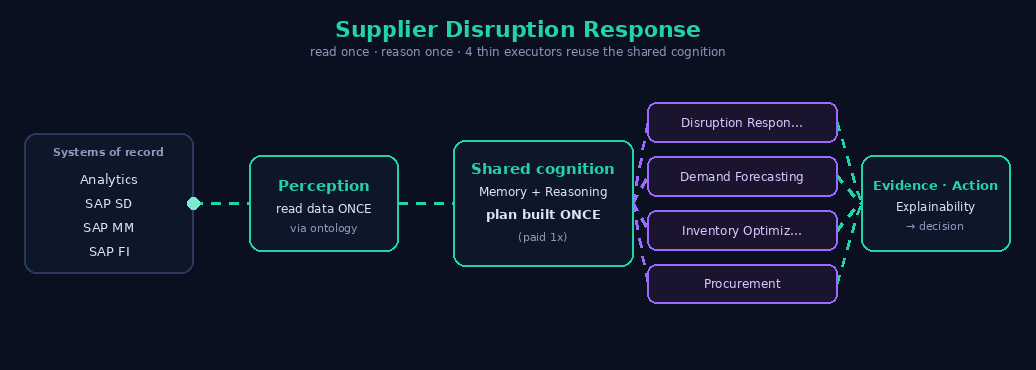
Supplier Disruption Response
reads once · reasons once · 4 thin executors reuse the shared cognition
4 specialist agents → 1 UNAI −62% tokens (modeled) one read · one plan
Bristlecone · UNAI Cognitive Runtime · modeled figures — not for external distribution

Slide 31
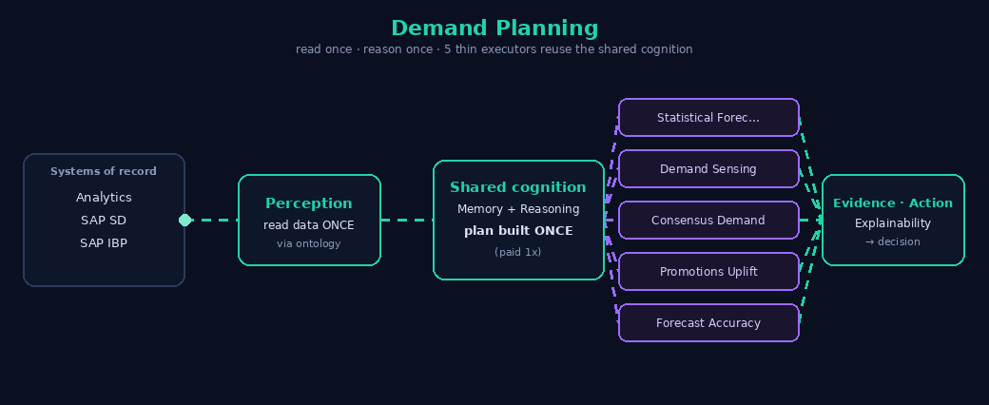
Demand Planning
reads once · reasons once · 5 thin executors reuse the shared cognition
5 specialist agents → 1 UNAI −71% tokens (modeled) one read · one plan
Bristlecone · UNAI Cognitive Runtime · modeled figures — not for external distribution

Slide 32

Inventory Optimization
reads once · reasons once · 5 thin executors reuse the shared cognition
5 specialist agents → 1 UNAI −70% tokens (modeled) one read · one plan
Bristlecone · UNAI Cognitive Runtime · modeled figures — not for external distribution

Slide 33
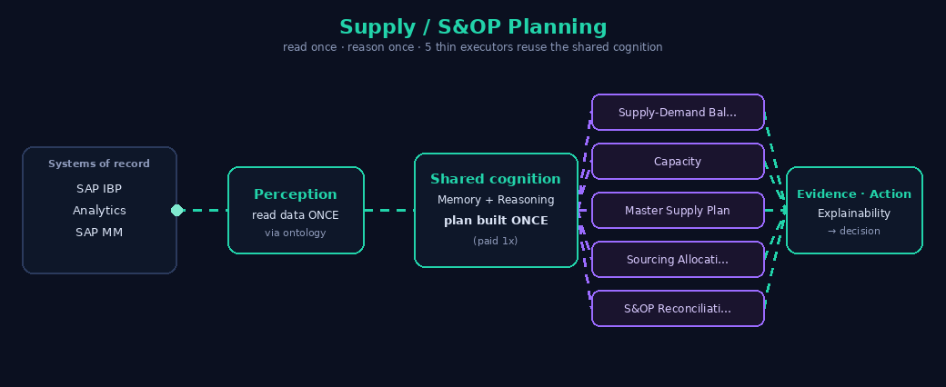
Supply / S&OP Planning
reads once · reasons once · 5 thin executors reuse the shared cognition
5 specialist agents → 1 UNAI −74% tokens (modeled) one read · one plan
Bristlecone · UNAI Cognitive Runtime · modeled figures — not for external distribution

Slide 34
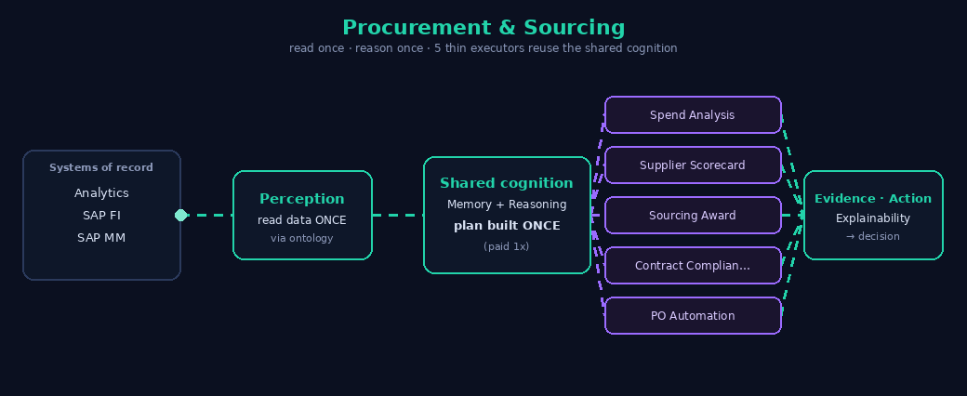
Procurement & Sourcing
reads once · reasons once · 5 thin executors reuse the shared cognition
5 specialist agents → 1 UNAI −74% tokens (modeled) one read · one plan
Bristlecone · UNAI Cognitive Runtime · modeled figures — not for external distribution

Slide 35
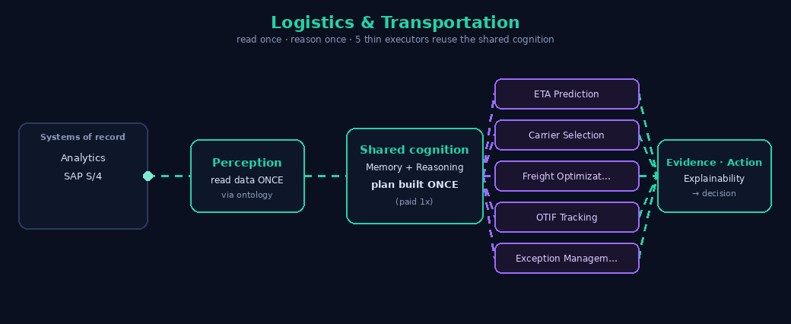
Logistics & Transportation
reads once · reasons once · 5 thin executors reuse the shared cognition
5 specialist agents → 1 UNAI −74% tokens (modeled) one read · one plan
Bristlecone · UNAI Cognitive Runtime · modeled figures — not for external distribution

Slide 36
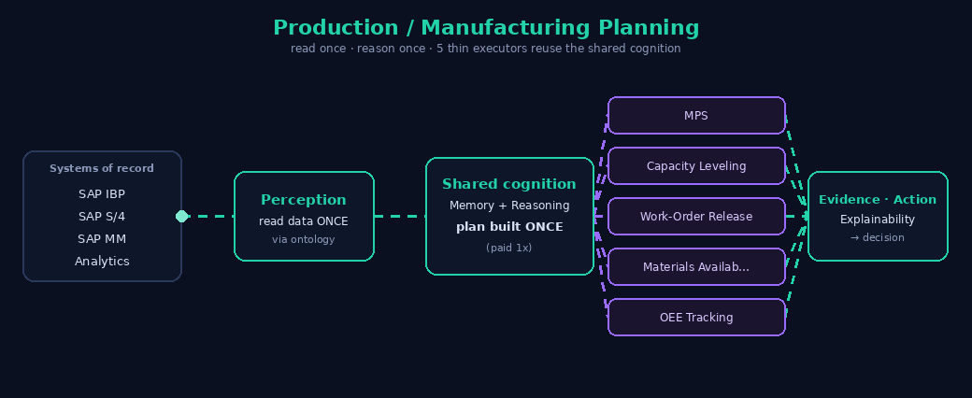
Production / Manufacturing Planning
reads once · reasons once · 5 thin executors reuse the shared cognition
5 specialist agents → 1 UNAI −70% tokens (modeled) one read · one plan
Bristlecone · UNAI Cognitive Runtime · modeled figures — not for external distribution

Slide 37
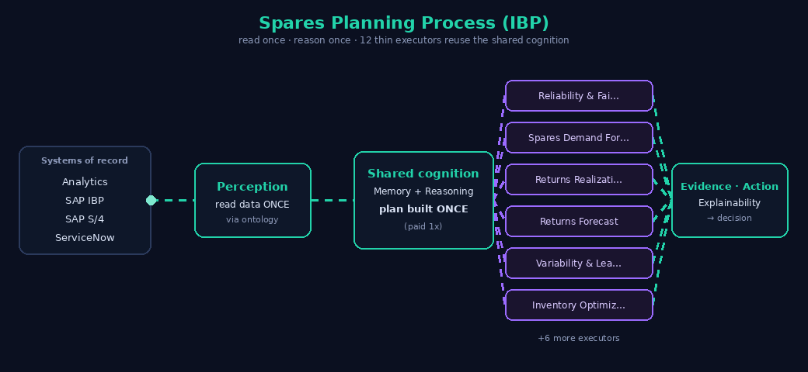
Spares Planning Process (IBP)
reads once · reasons once · 12 thin executors reuse the shared cognition
12 specialist agents → 1 UNAI −76% tokens (modeled) one read · one plan
Bristlecone · UNAI Cognitive Runtime · modeled figures — not for external distribution

Slide 38
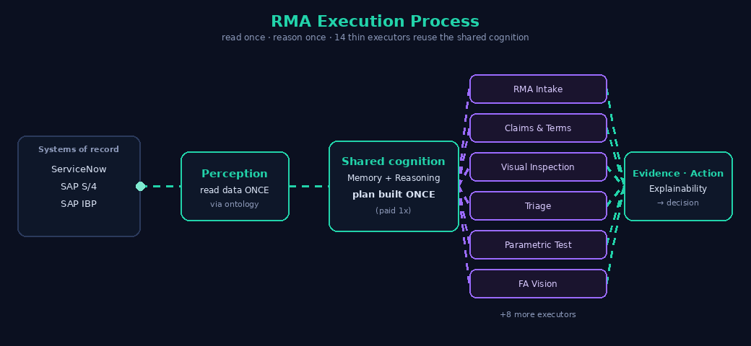
RMA Execution Process
reads once · reasons once · 14 thin executors reuse the shared cognition
15 specialist agents → 1 UNAI −82% tokens (modeled) one read · one plan
Bristlecone · UNAI Cognitive Runtime · modeled figures — not for external distribution

Slide 39
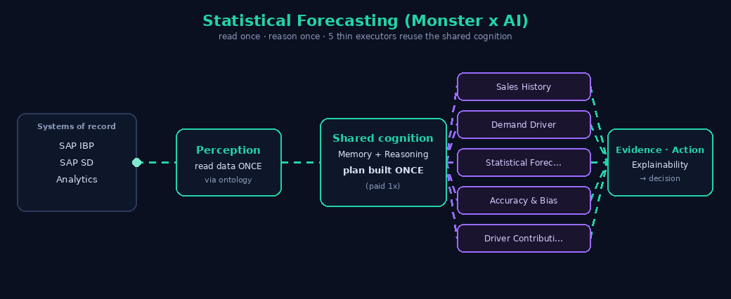
Statistical Forecasting (Monster x AI)
reads once · reasons once · 5 thin executors reuse the shared cognition
5 specialist agents → 1 UNAI −74% tokens (modeled) one read · one plan
Bristlecone · UNAI Cognitive Runtime · modeled figures — not for external distribution

Slide 40
Platform Architecture
One shared cognitive runtime · a self-improving Supply-Chain Cognition Layer · model-, warehouse- and cloud-neutral · SAP-compliant

Slide 41
Supply-Chain Use-Case Catalog
32 use cases, grounded in the SAP IBP module set — each one-click buildable on the shared runtime.
DEMAND
statistical forecasting · demand sensing · curve based forecast · outlier correction · product lifecycle planning · promotion planning · cannibalization analysis · forecast accuracy monitoring · demand planning
INVENTORY · MEIO
multi echelon inventory
MRO
mro inventory planning
RESPONSE
allocation planning
PROCUREMENT
procurement sourcing
AFTERMARKET
spares planning ibp · returns forecasting
SUSTAINABILITY
sustainability planning
DEMAND · S&OP
consensus demand sop
INVENTORY
safety stock planning · service level prediction · excess and obsolescence
SUPPLY
supply planning · net requirements planning
PRODUCTION
capacity planning · production planning
LOGISTICS
logistics transportation
AFTERMARKET · RMA
rma execution
INVENTORY · IO
inventory optimization
DDR · DDMRP
demand driven replenishment
RESPONSE · ORDER-BASED
response planning
SYNCHRONIZED PLANNING
synchronized planning
SUPPLY · RISK
disruption response
CONTROL TOWER
control tower alerts

Slide 42
Architecture Analogy
12 agents (each rebuilds every cognitive task) vs 1 UNAI runtime (built once, 12 capability packs)
🚚 Traditional: 12 Agents
🍽️ UNAI: 1 Shared Runtime + 12 Packs
Each agent independently sources, preps, seasons, and tastes — full cognitive overhead, every time.
Runtime runs all cognitive tasks ONCE, then sends ready results to 12 capability packs.
🌮
Taco
🍔
Burger
🍕
Pizza
🍣
Sushi
🔍 UNAI · shared runtime
🛒 Source
🔪 Prep
🧂 Season
👅 Taste
🍗
BBQ
🥞
Crepe
🧇
Waffle
🍜
Noodle
🌮
Taco
🍔
Burger
🍕
Pizza
🍣
Sushi
🍗
BBQ
🥞
Crepe
🧇
Waffle
🍜
Noodle
🥪
Sandwich
🥟
Dumpling
🥗
Salad
🥤
Smoothie
🥪
Sandwich
🥟
Dumpling
🥗
Salad
🥤
Smoothie
48 tasks = 12 agents × 4 cognitive tasks each
16 tasks = 4 shared tasks + 12 pack calls
🚚 TRADITIONAL
48 tasks
12 agents × 4 cognitive tasks each
🍽️ UNAI
16 tasks
4 shared tasks + 12 pack calls
📉 REDUCTION
66.7%
Fewer cognitive operations
UNAI-ARCH-ANALOGY-V1

