Slide 1
Heimdall
Sees model retirements coming, proves the replacement on your real traffic, and cuts over before anything breaks.
Bifrost track Build a Feature the Open-Source Gateway Is Missing
Tavily track Build a Stale-Answer Detector for AI Applications
Notes:
Heimdall is the watchman of the Bifrost bridge in Norse myth. This is that for the Bifrost AI gateway: it watches for model retirements.

Slide 2
The first you hear of a retirement is a 404
The gateway knows
The provider announces
Nothing connects them
Which models you depend on, how much traffic each carries, and which applications send it.
A row in a documentation table, a changelog line, an email to whoever created the account.
Bifrost classifies a retired model as model_gone only after requests have started failing.
Heimdall answers, in order: what do we depend on, what is being retired and when, is the replacement safe for our traffic, and how do we switch without an outage.
Notes:
The gap: the gateway has the dependency data, the provider has the retirement data, and nothing joins them until production fails.

Slide 3
Four steps, each on a Bifrost feature
1
2
3
4
Inventory
Radar
Rehearsal
Cutover
Which models carry traffic, and for which virtual keys.
Retirement notices from the provider's own documentation.
Real logged requests replayed against the replacement.
Safety net, canary, cut over. One reversible rule.
Gateway log aggregates
Tavily, through a Bifrost relay
Logs, virtual key, budget
Routing rules
No fork, no patched binary, no plugin to compile. It runs beside the official maximhq/bifrost image and uses only public endpoints.
Notes:
Each step maps onto an existing Bifrost capability, which is why this needs no changes to the gateway.

Slide 4
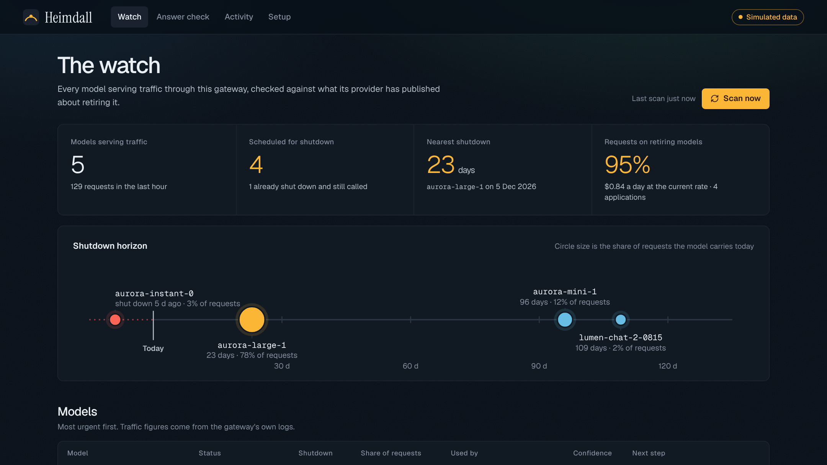
The watch: time left against traffic at stake
5 models in traffic
Read from the gateway's own logs.
4 scheduled for shutdown
One carries most of the requests and has 23 days left.
1 already shut down
A forgotten batch job is still calling it.
Simulated scenario: invented providers and pages behind a real Bifrost gateway.
Notes:
Position on the horizon is time left; circle size is share of requests.

Slide 5
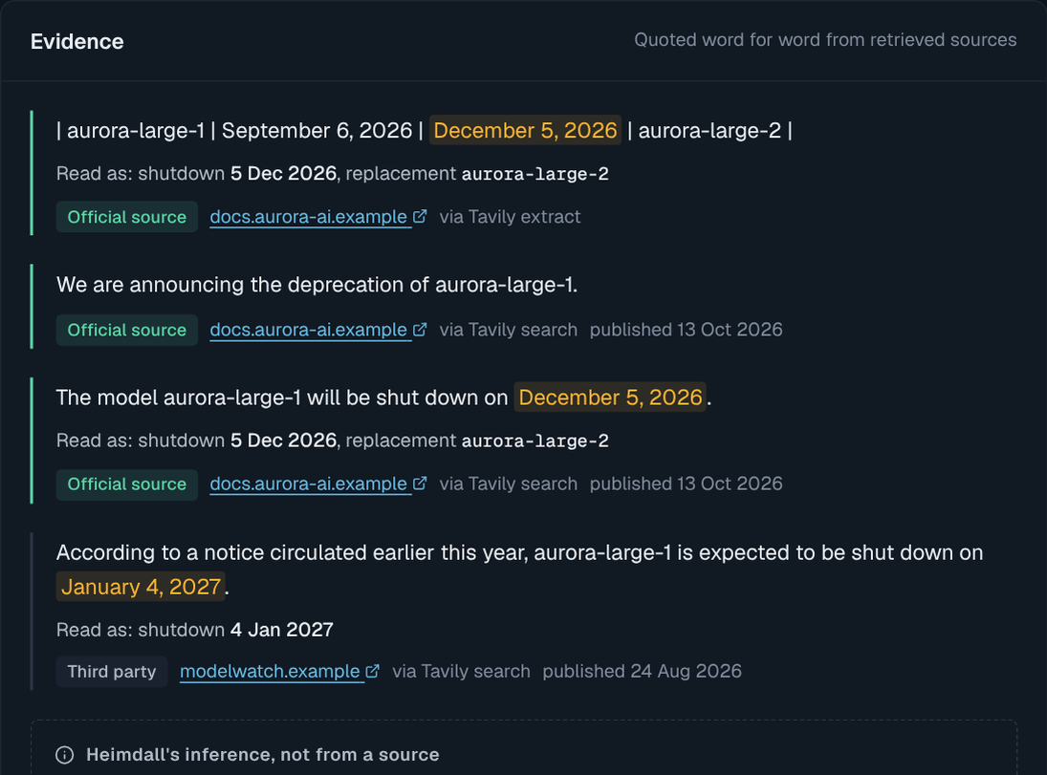
The model points at the text. Heimdall decides
1
A quote must be in the source
A paraphrase is discarded, and the discard is shown.
2
A date must be in the quote
A date the model remembers is dropped.
3
Confidence comes from the source
Never from how sure the model sounded.
4
The provider outranks everyone
Disagreement is shown, not hidden.
Each rule has a test with a model that misquotes, invents a date, or reads a neighbouring model's row.
Notes:
Language models misquote and round dates. So the model's job is narrow: point at the text. The conclusion is re-derived.

Slide 6
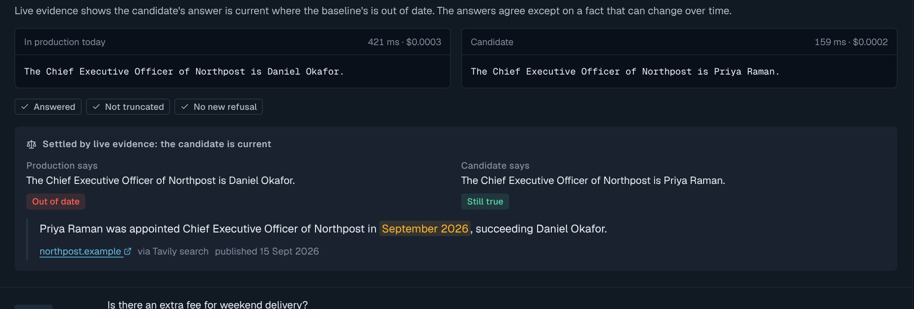
Rehearsal: your traffic, not a benchmark
40
3
−35%
6
real requests replayed
regressions, found by a parser
cost on this traffic
answers more current
The stale-answer detector, at work
When the two models disagree on a fact that changes over time, neither is assumed right. Both claims are checked against the web today.
Figures from one rehearsal in the simulated scenario. Production is untouched; replays run under a budgeted virtual key.
Notes:
Tool-call and JSON regressions are proven by parsing. The judge model handles the rest and is told not to pick a winner on time-sensitive facts.

Slide 7
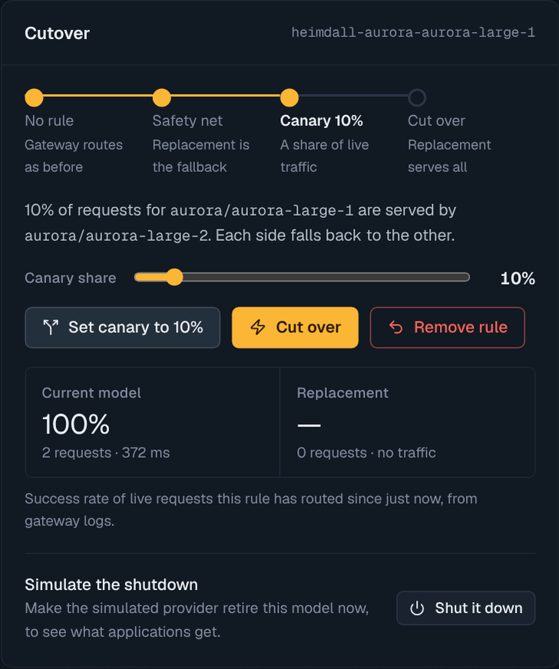
Cutover is one routing rule
Safety net
Old model 100%, replacement as fallback. A provider shutdown is served, not failed.
Canary
A weighted split on live traffic. Health is measured from gateway logs.
Cut over
Replacement 100%. Applications keep the old model name.
Removing the rule restores the gateway exactly.
Tested on a real gateway: with the model shut down upstream, the same request returns 404 without the rule and an answer with it.
Notes:
Heimdall never proxies requests. A migration is a single Bifrost routing rule it creates, updates and deletes.

Slide 8
One boundary: everything goes through Bifrost
Bifrost
Tavily
Logs and aggregates inventory, sampling, canary health
Routing rules safety net, canary, cut over, rollback
Virtual keys and budgets Heimdall's own spend is capped
Relays Tavily sits behind the gateway
Logging headers its own traffic never counts as demand
Model API shutdown_date as first-party evidence
MCP gateway three tools for agents
Extract
Provider lifecycle pages, in full.
Search, official domains
Per model, restricted to the provider's documentation.
Search, open web
Corroboration and early warning.
Search, per claim
The stale-answer detector.
Heimdall holds one virtual key and the gateway's admin login. No provider keys, no Tavily key.
Notes:
Because everything goes through the gateway, Heimdall is governed, budgeted and logged like any other consumer.

Slide 9
What is verified, and what is not yet
Verified
Not yet
End-to-end suite against a real Bifrost binary: inventory, radar, rehearsal, all cutover stages, answer check, MCP registration.
The container on the official maximhq/bifrost image.
Grounding rules, against a model scripted to misquote and invent dates.
Live-mode configuration, up to the provider boundary.
Real model providers and the real Tavily API. The build environment had no route to them.
The Tavily client is tested against the request and response shapes of Tavily's SDK.
In the simulator, the analyst is a rule-based stand-in, not a language model.
The first run with real keys is the first test of those two boundaries.
Notes:
Stated plainly so a judge knows exactly what the tests prove.

Slide 10
Try it in one command
docker build -t heimdall . && docker run --rm -p 7860:7860 heimdall
No keys: simulator mode
A real Bifrost gateway with simulated providers, a simulated web and four simulated applications. Shut a model down and watch the safety net hold.
Add keys: live
A provider key, TAVILY_API_KEY and HEIMDALL_ADMIN_TOKEN. Restart, and the same container runs against real providers and the real web.
github.com/angarkartanmay-ops/GlobalAiHack · Live demo: heimdall-sim.vercel.app
Notes:
Close on the repository and the one command.

