Slide 1
TrekHouse
Smart technology for aging in place

Slide 2
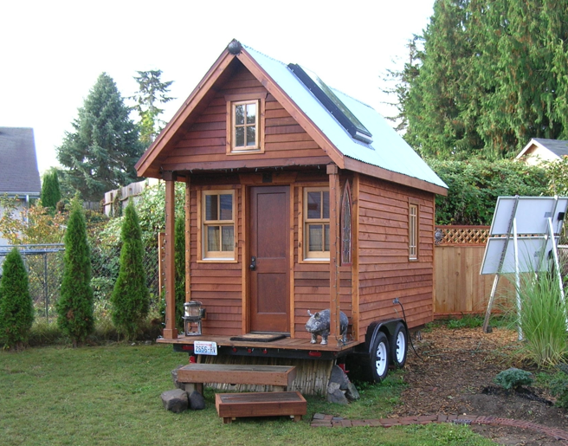
Why age in place?
A huge amount of money is spent on the last years of life. People lose their inheritances over this.
Quality of life improves significantly at home vs nursing care.
Need to make it easier to care and be cared for as we age in place.

Slide 3

Meet Eileen, age 69
Eileen is a 69 year old woman who lives in a tiny home backyard of her adult son Sam.
Eileen has is forgetful, and requires verbal reassurance throughout the day.

Slide 4

Meet Sam, Age 45
Sam is Eileen's adult son and caregiver.
He works outside of the home, and needs an easy way to stay in touch with his mother.

Slide 5
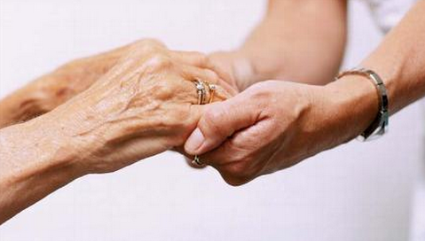
Communication
Voice-activated calling throughout the house is safer and more convenient than relying on a smart-phone
Eileen will now call Sam using her voice
Notes:
Right now I am in the kitchen, and I want to talk to my son

Slide 6
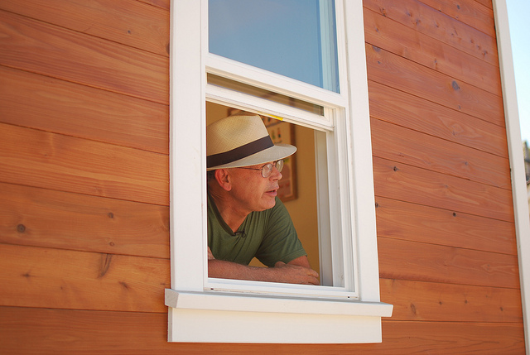
Convenience
Window and Door Voice automation
Increased flexibility
“TrekHouse, open window.”

Slide 7
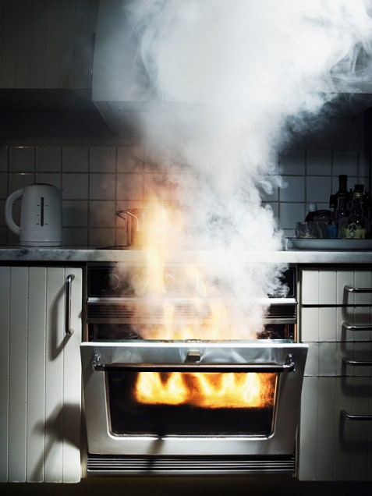
Prevention
Detect abnormalities in temperature, moisture, and humidity BEFORE they become a problem
Priority notification alert to caregiver
Caregiver environmental control and ability to provide calming interventions

Slide 8
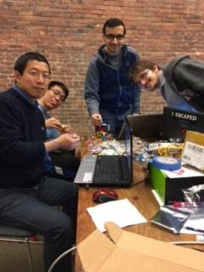
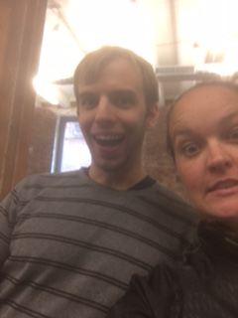
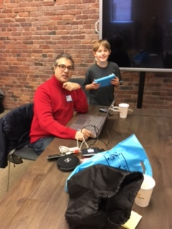
Trekhouse Team
Austin Ingraham, Senior at UW
Abdullah Syed, Genie Industries
Lin Xie, LH HIGHTECH Consulting
Daniel Blackburn, Physics PHD
Trevor Kaaihue, Junior at Seattle U
Bazil Sanderson, Junior Member
Angela Bovo, Math WizZards
Imran Peerbhai, ThinkPredict.com
Toby Liu, Hulu

