Slide 1
EMPORIUM | SOUTH REGION | CAPSTONE 2
Territory Analysis
Texas vs Florida
Sales Performance · From 2022 - 2025 · South Region
TERRITORY 1: TEXAS
TERRITORY 2: FLORIDA
Jeff "Howdy" Richards
Stores (901–911)
Lana Ilana
Stores (719–729)
11 stores · Arlington, Austin, Baytown, Beaumont, Dallas…
11 stores · Miami, Tallahassee, Jacksonville, Key West…
Analyst: Angel S. Osorio | Region Director: Andy Gisselquist

Slide 2
Executive Summary
4-year overview · 2022–2025
Total Revenue
Transactions
Avg Rev / Store
$3.42M
24,212
~$310K
TEXAS
TEXAS
TEXAS
Total Revenue
Transactions
Avg Rev / Store
$3.93M
28,616
~$357K
FLORIDA
FLORIDA
FLORIDA
Florida leads by around $510K in revenue and 4,400+ transactions. Both have the same store count. However, Texas has clear room to grow.

Slide 3
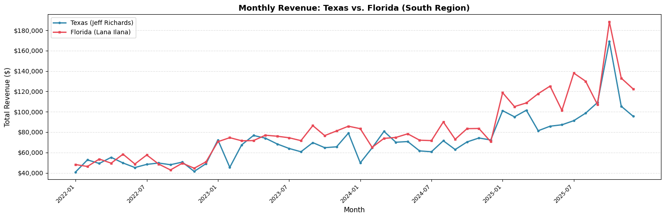
Monthly Revenue Trend
Jan 2022 – Dec 2025 · Both territories show strong 2025 acceleration
📊 2022–2023
📈 2024
🚀 2025
Modest growth
territories track closely
both around $50–75K/month
Acceleration begins
FL starts pulling ahead consistently
Both territories surge
FL peaks $188K Oct '25
TX hits $169K same month

Slide 4
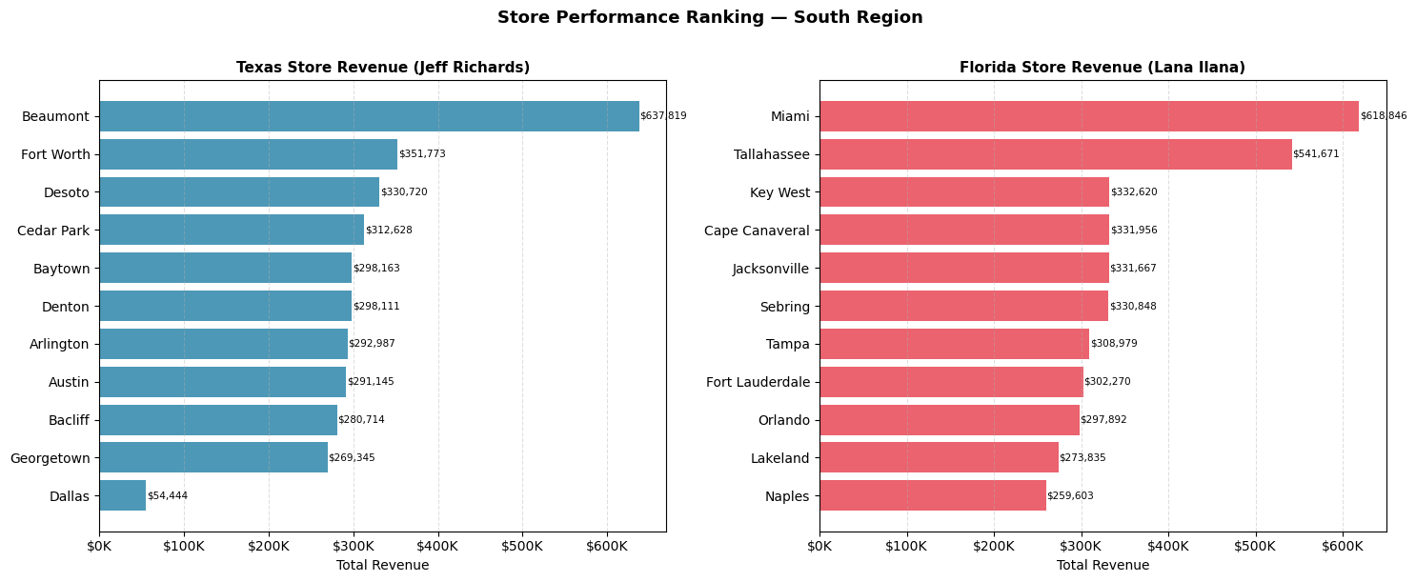
Store Performance Ranking
All 22 stores ranked by total revenue · 2022–2025
⚠️ DALLAS ALERT: $54K total revenue vs $310K territory average: the #1 growth lever in Texas Closing just half the gap adds ~$125K/yr

Slide 5
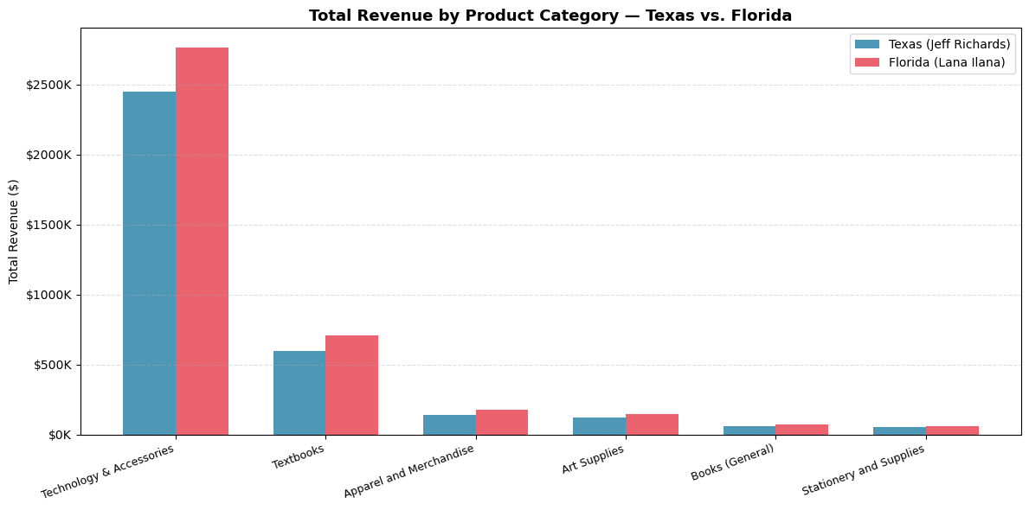
Revenue by Product Category
Technology dominates but each segment tells a different story
Tech & Accessories
~71% of all revenue. Core driver in both territories.
Textbooks
Seasonal spikes. Pre-semester Aug/Jan are key windows.
Apparel & Art Supplies
High transaction count, lower avg value but loyalty plays well here.
Stationery & Supplies
Highest transaction volume,
Lowest $/transaction → bundle upsell gold mine.

Slide 6
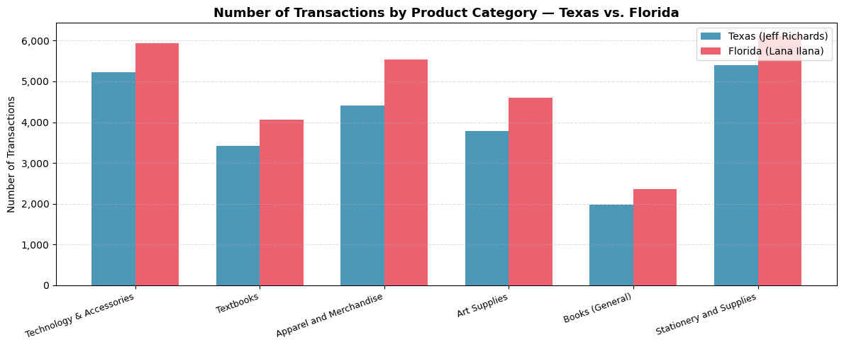
Transactions by Product Category
Volume tells a different story than revenue, but opportunity lives in the gap
Stationery leads in transaction volume
Yet it earns the least per transaction, but a clear upsell opportunity at POS
Apparel has strong foot traffic
More visits than textbooks. Perfect for impulse add-ons or loyalty sign-ups
Tech volume is also #1
Both highest revenue and transaction count
Protect & grow this category at all costs
FL outpaces TX in every category
Not just revenue. More customers are visiting Florida stores across the board
Florida leads Texas in transaction count in EVERY category, not just in Technology.
Texas needs foot traffic and loyalty initiatives, not just product mix changes.

Slide 7
Top Rewards Customers
Matched RewardsID → Customer List · Top 5 spenders per territory
TEXAS — Jeff Richards
FLORIDA — Lana Ilana
1
Nate Jacobs
$5,241
1
Stanley H.
$4,955
10 visits
10 visits
2
Christopher Moltisanti
$3,479
2
Todd Chavez
$4,549
7 visits
10 visits
3
Jodie L.
$3,465
3
Huck
$4,416
13 visits
13 visits
4
Darius
$3,400
4
John Locke
$3,632
9 visits
7 visits
5
Maeby F.
$3,128
5
Dr. Ray Flemming
$3,536
11 visits
10 visits
💡 Rewards members spend $3–5K per member. Low program penetration = untapped retention opportunity. Sign-up push at POS could dramatically lift data coverage.

Slide 8
Q1 2026 Marketing Recommendations
Four priorities ranked by revenue impact
01
Revitalize Dallas (TX)
Only $54K total vs. $310K territory avg. Investigate visibility, marketing spend, and local competition.
Matching avg adds +$250K/yr, the single highest-ROI action in the analysis.
02
Rewards Membership Acquisition Push
Low RewardsID penetration across both territories. Top members spend $3–5K+ each.
In-store sign-up campaign timed to semester starts (Aug, Jan) with instant discount incentive.
03
Pre-Semester Tech + Textbook Bundles
Aug & Jan are natural high-traffic peaks driven by textbook demand. Bundle top-selling tech accessories with required textbooks to lift basket size and introduce customers to higher margin products.
04
Stationery POS Upsell Program
Highest transaction volume, lowest revenue-per-transaction. A simple 'add a notebook/pen set to any laptop purchase' prompt at checkout can meaningfully lift category revenue without additional foot traffic.

Slide 9
THE BOTTOM LINE
Florida leads, but Texas is closing the gap.
Execute the 4 priorities:
$510K
+80%
4 Actions
Revenue gap to close
Both territories grew in 2025
Clear path to close the gap
Analyst: Angel S. Osorio | EmporiUm South Region | Region Director: Andy Gisselquist

