Slide 1
Program for the Calculation of Internal Forces and Reactions inside of Bars
BLANKENBICHLER Thomas, LEIDINGER Leo,
POPOVIC Angelo, ZBIL Thomas Presentation given at
FH JOANNEUM University of Applied Sciences
Graz, Austria, 11 June 2024

Slide 2
Overview
What are internal forces
How to calculate internal forces
Assigned task
Program structure
GUI
Calculation
Conclusions

Slide 3
What are internal forces
q(x)
M₀
q(x)
M₀
Normal Force
Shear Force
Bending Moment
Figure 1: Internal Forces
Notes:
Remote and high construction sites: rooftops, mountain peeks,
Special shape: low internal volume, narrow fuselage for good visibility, wide landing gears
Special rotor configurations: intermeshing rotors (set of two main rotors turning, with each rotor mast mounted with a slight angle to the other, which are not touching each other), single main rotor

Slide 4
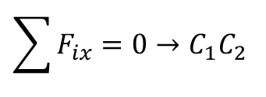
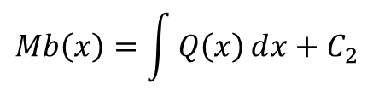
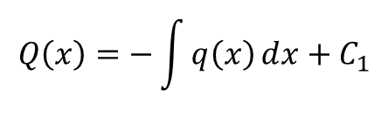
How to calculate internal forces
$$q\left(x\right)=q_{0}×\frac{1}{a}×{\left\langle x−2a\right\rangle }^{1}−q_{0}×\frac{1}{a}×{\left\langle x−3a\right\rangle }^{1}−q_{0}×{\left\langle x−3a\right\rangle }^{0}$$
$$Q\left(x\right)=−\int{q\left(x\right)ⅆx}+C_{1}$$
q(x)
M₀
$$Mb\left(x\right)=\int{Q\left(x\right)ⅆx}+C_{2}$$
Normal Force
Shear Force
Bending Moment
Figure 2: Internal Forces
Marginal conditions:
$$\sum{F_{ix}}=0→C_{1}C_{2}$$
$$Mb\left(x=0\right)=0 \&\& Mb\left(x=l\right)=0→C_{1}C_{2}$$
Notes:
Remote and high construction sites: rooftops, mountain peeks,
Special shape: low internal volume, narrow fuselage for good visibility, wide landing gears
Special rotor configurations: intermeshing rotors (set of two main rotors turning, with each rotor mast mounted with a slight angle to the other, which are not touching each other), single main rotor

Slide 5
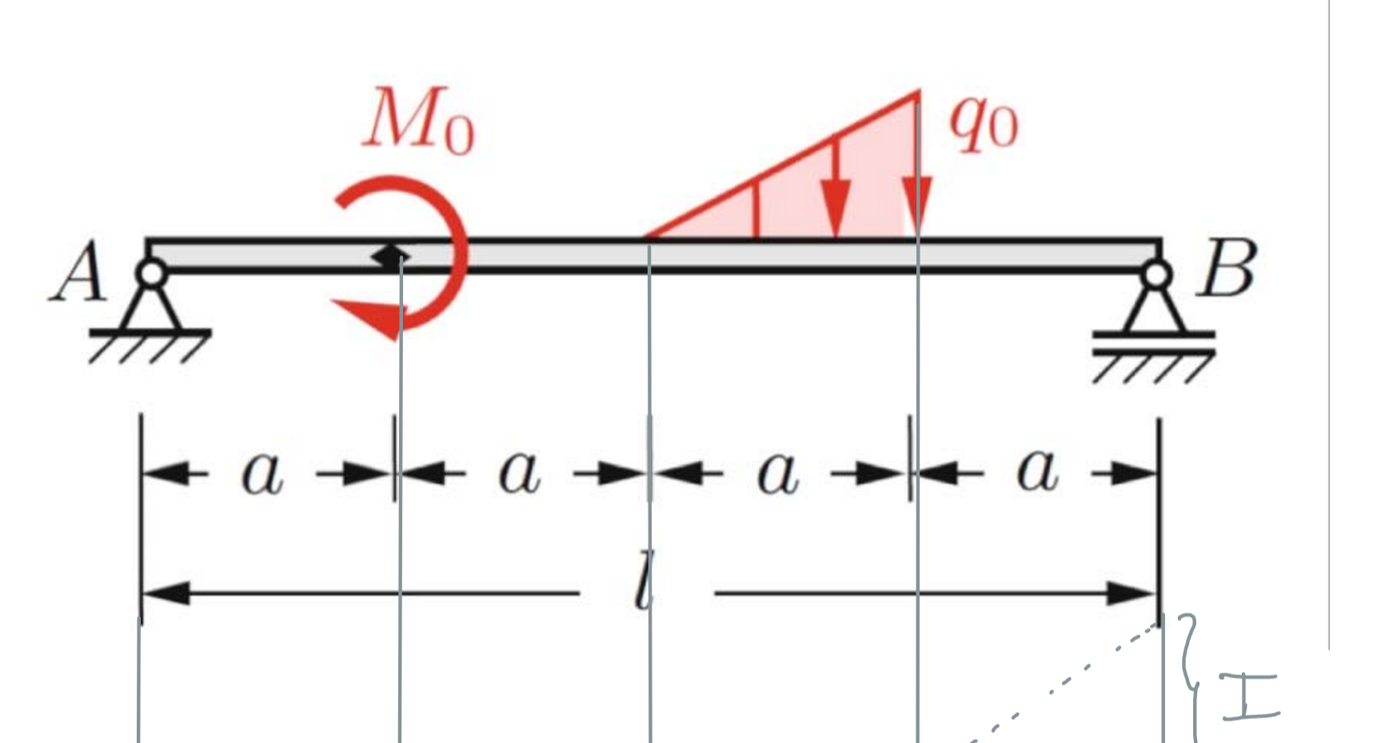
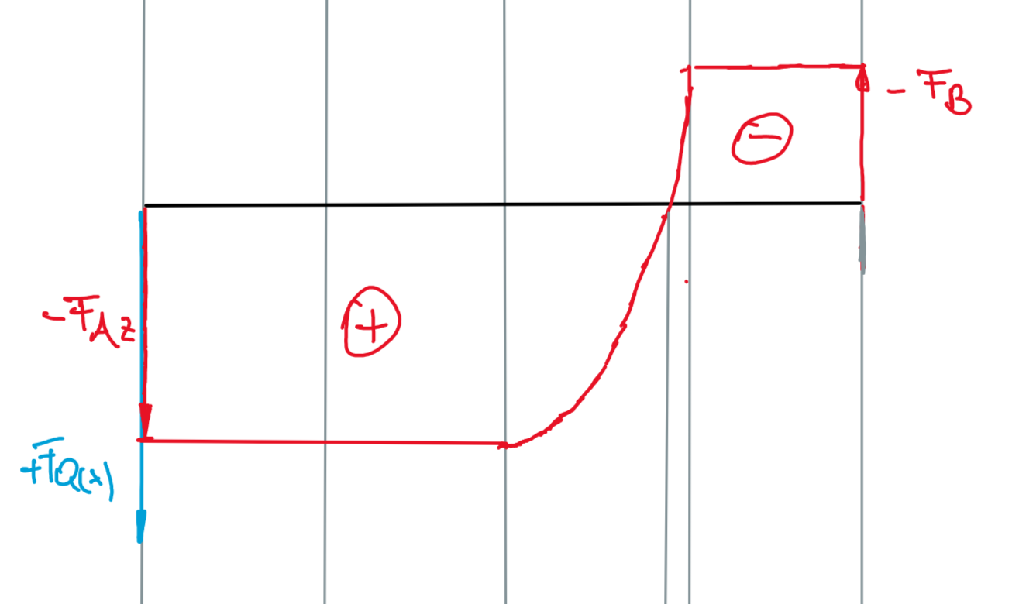
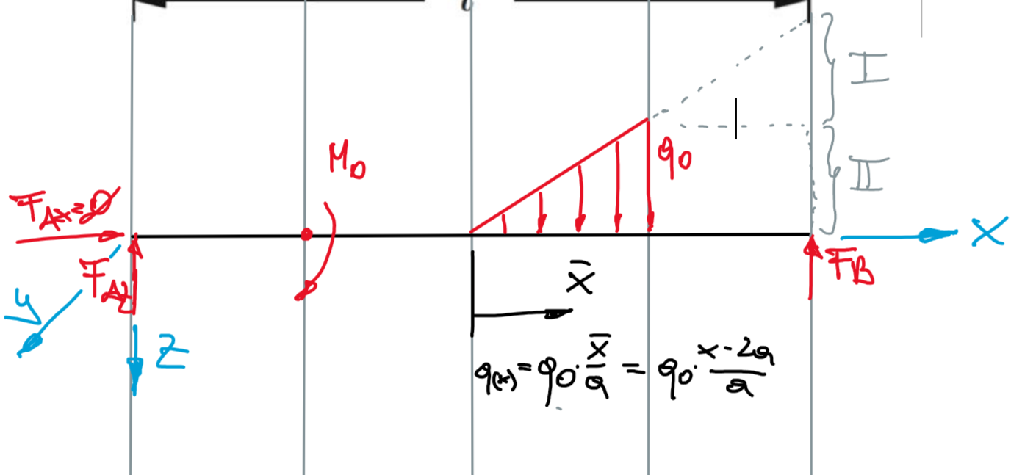
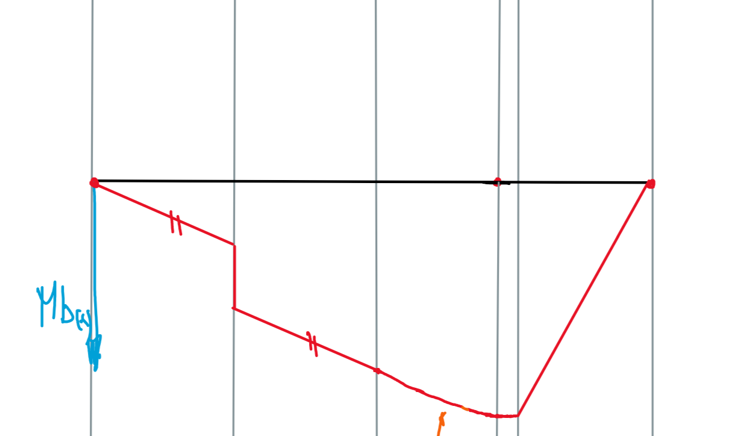
How to calculate internal forces
Notes:
Remote and high construction sites: rooftops, mountain peeks,
Special shape: low internal volume, narrow fuselage for good visibility, wide landing gears
Special rotor configurations: intermeshing rotors (set of two main rotors turning, with each rotor mast mounted with a slight angle to the other, which are not touching each other), single main rotor

Slide 6
Assigned Task
Calculation of inner forces - typical tasks performed in lessons of statics
Different types of bearings
Different types of loads
Beam joints
Graphically display the internal forces

Slide 7
Program Structure
GUI
Calculation
Graphical display of the bar
Graphical display of bearings and forces acting on the bar
User interface with input fields
Display of the calculated data
Handover the data from the GUI to the calculation
Assembly the formulas out of the input values
Additional calculation to ensure the marginal conditions
Calculation of the Bearing Forces

Slide 8
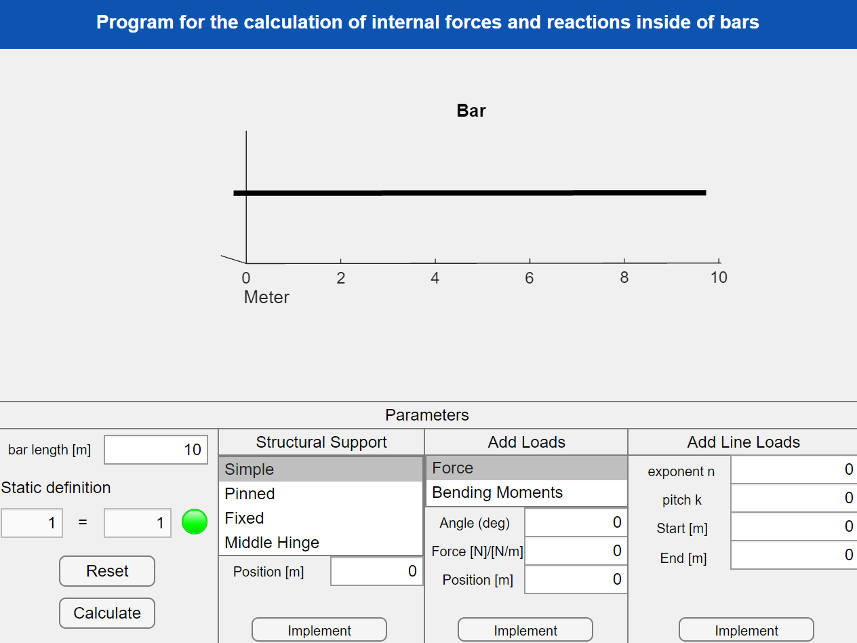
GUI
Figure 3: GUI – First Version
Notes:
Remote and high construction sites: rooftops, mountain peeks,
Special shape: low internal volume, narrow fuselage for good visibility, wide landing gears
Special rotor configurations: intermeshing rotors (set of two main rotors turning, with each rotor mast mounted with a slight angle to the other, which are not touching each other), single main rotor

Slide 9
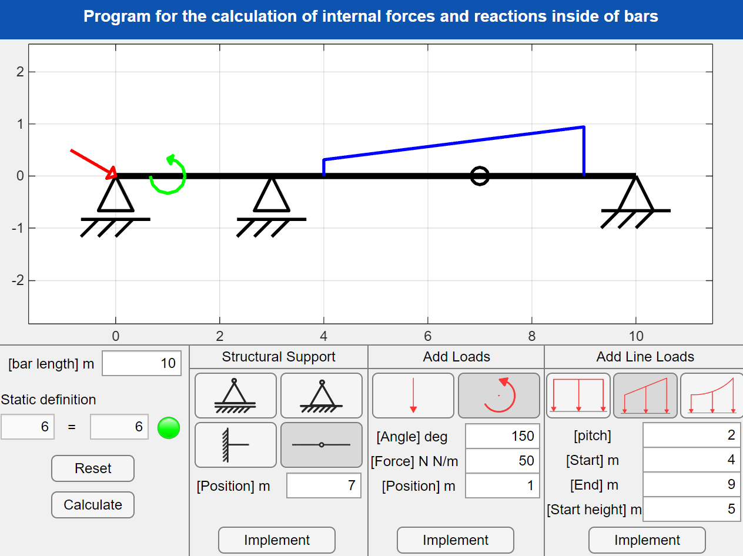
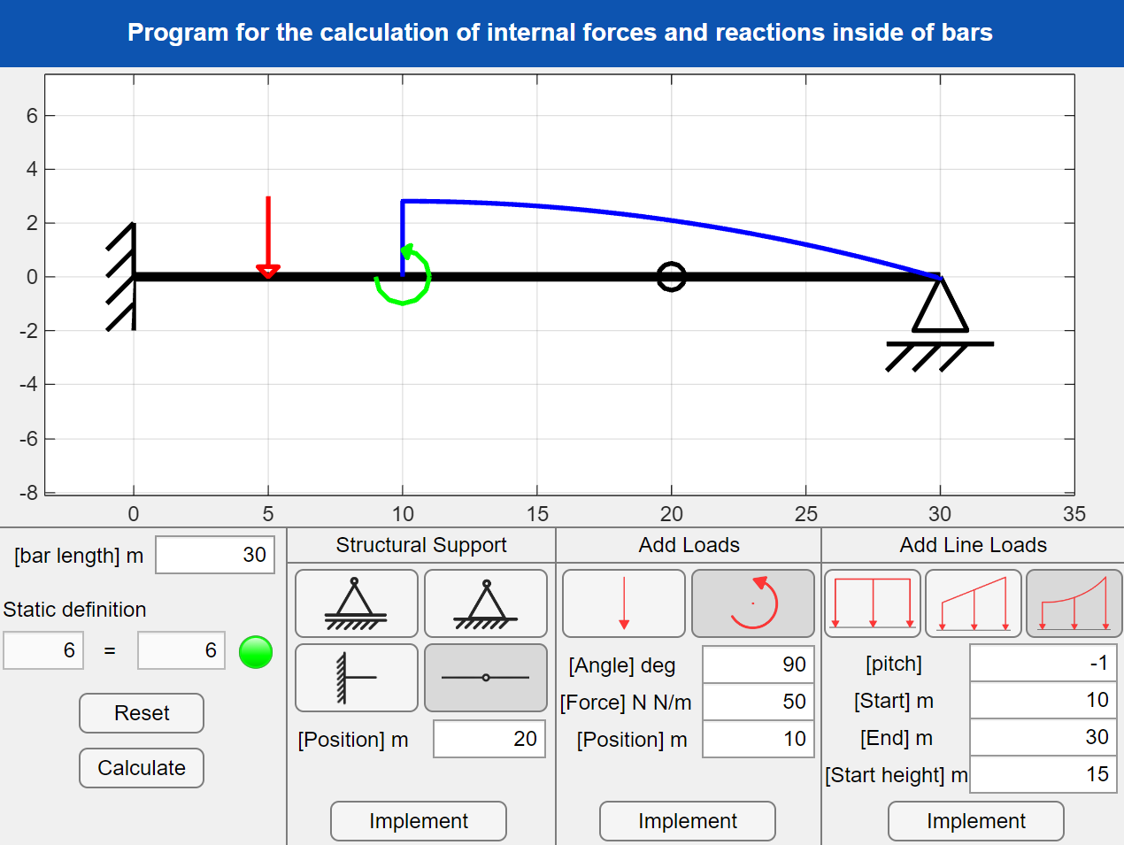
GUI
Figure 4: GUI – Latest Version
Figure 5: GUI – Latest Version
Notes:
Remote and high construction sites: rooftops, mountain peeks,
Special shape: low internal volume, narrow fuselage for good visibility, wide landing gears
Special rotor configurations: intermeshing rotors (set of two main rotors turning, with each rotor mast mounted with a slight angle to the other, which are not touching each other), single main rotor

Slide 10
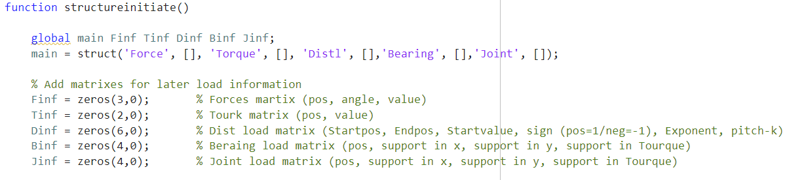
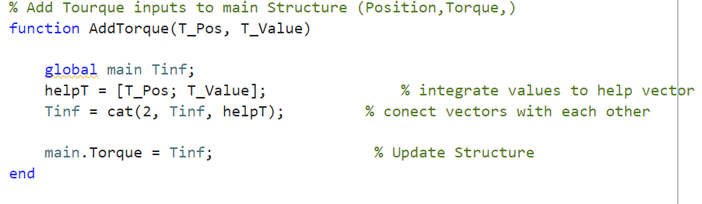
Calculation
Figure 6: MATLAB Code - structureinitiate
Figure 7: MATLAB Code - AddTorque
Notes:
Remote and high construction sites: rooftops, mountain peeks,
Special shape: low internal volume, narrow fuselage for good visibility, wide landing gears
Special rotor configurations: intermeshing rotors (set of two main rotors turning, with each rotor mast mounted with a slight angle to the other, which are not touching each other), single main rotor

Slide 11
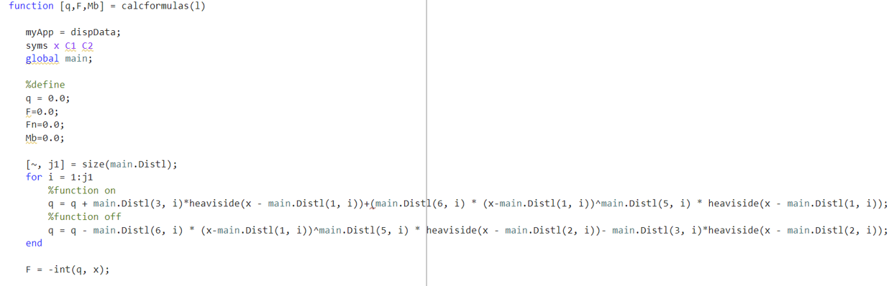
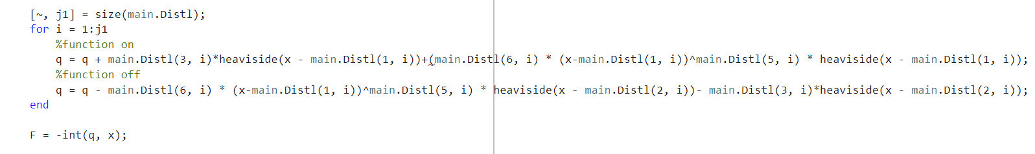
Calculation
Figure 8: MATLAB Code - Föppl
Notes:
Remote and high construction sites: rooftops, mountain peeks,
Special shape: low internal volume, narrow fuselage for good visibility, wide landing gears
Special rotor configurations: intermeshing rotors (set of two main rotors turning, with each rotor mast mounted with a slight angle to the other, which are not touching each other), single main rotor

Slide 12
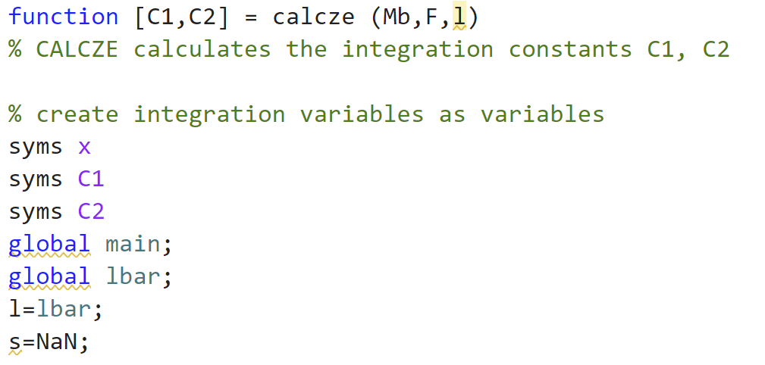
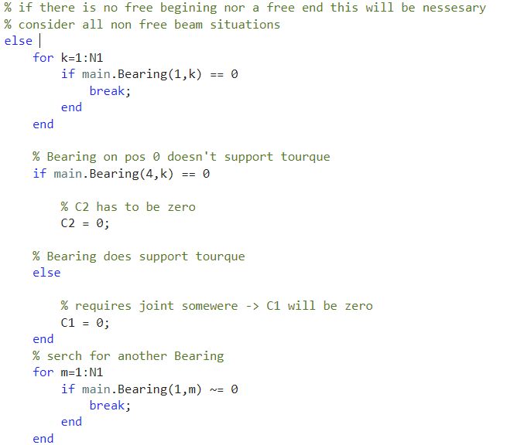
Calculation
Figure 6: MATLAB Code - structureinitiate
Figure 9: MATLAB Code - Calcze
Figure 10: MATLAB Code – Marginal Conditions Detection
Notes:
Remote and high construction sites: rooftops, mountain peeks,
Special shape: low internal volume, narrow fuselage for good visibility, wide landing gears
Special rotor configurations: intermeshing rotors (set of two main rotors turning, with each rotor mast mounted with a slight angle to the other, which are not touching each other), single main rotor

Slide 13
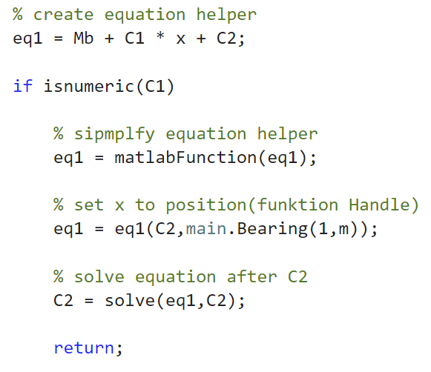
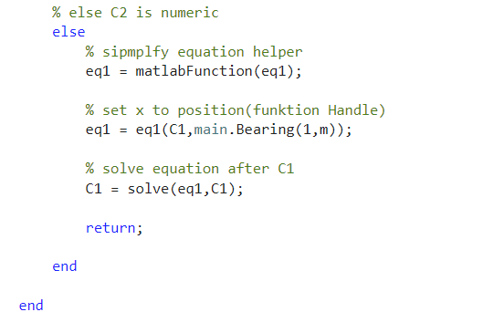
Calculation
Figure 11: MATLAB Code – C2 Calculation
Figure 12: MATLAB Code – C1 Calculation
Notes:
Remote and high construction sites: rooftops, mountain peeks,
Special shape: low internal volume, narrow fuselage for good visibility, wide landing gears
Special rotor configurations: intermeshing rotors (set of two main rotors turning, with each rotor mast mounted with a slight angle to the other, which are not touching each other), single main rotor

Slide 14
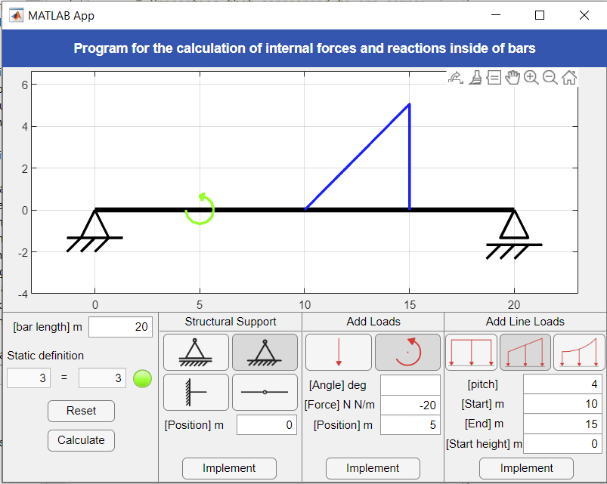
Comparison of Results
Figure 13: GUI – Demonstration
Notes:
Remote and high construction sites: rooftops, mountain peeks,
Special shape: low internal volume, narrow fuselage for good visibility, wide landing gears
Special rotor configurations: intermeshing rotors (set of two main rotors turning, with each rotor mast mounted with a slight angle to the other, which are not touching each other), single main rotor

Slide 15
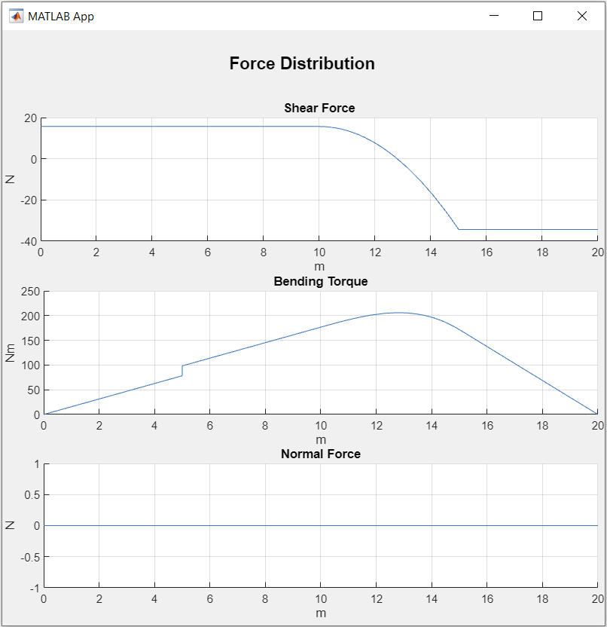
Comparison of Results
Figure 15: Hand Drawing – Graph of Internal Forces
Figure 14: GUI – Demonstration
Figure 15: Hand Drawing – Graph of Internal Forces
Figure 16: GUI – Calculation Results
Notes:
Remote and high construction sites: rooftops, mountain peeks,
Special shape: low internal volume, narrow fuselage for good visibility, wide landing gears
Special rotor configurations: intermeshing rotors (set of two main rotors turning, with each rotor mast mounted with a slight angle to the other, which are not touching each other), single main rotor

Slide 16
To Do’s
Systems - bearings not on the bar edges
Size normation of Forces and Loads in the User Display
Labeling of Forces and Loads
Error Managment
Notes:
Remote and high construction sites: rooftops, mountain peeks,
Special shape: low internal volume, narrow fuselage for good visibility, wide landing gears
Special rotor configurations: intermeshing rotors (set of two main rotors turning, with each rotor mast mounted with a slight angle to the other, which are not touching each other), single main rotor

