Slide 1
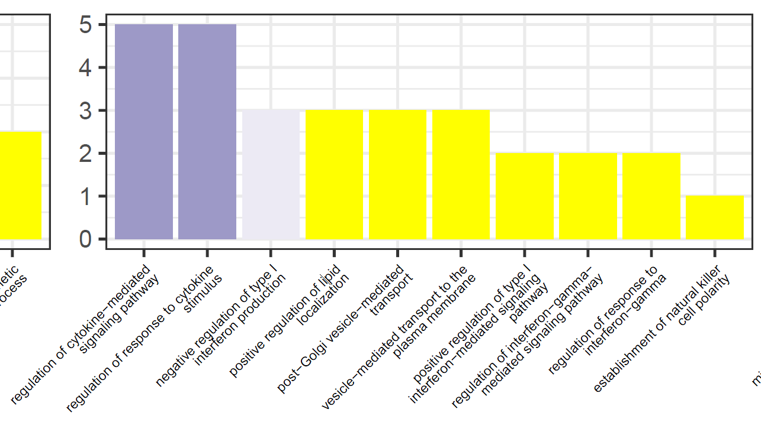
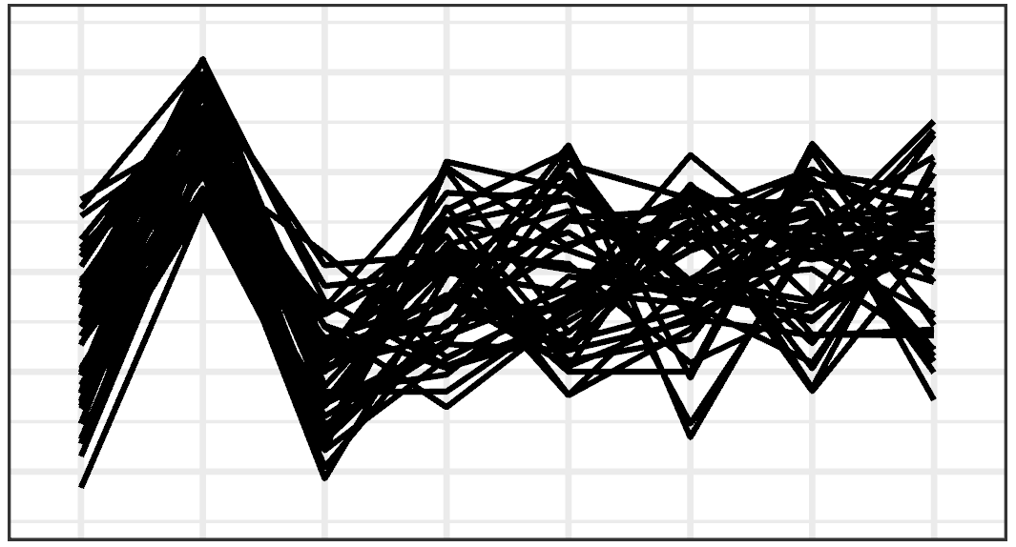
Cluster-wise GO terms of interest - PSI-Sigma
VRK2, NR1H3, NLRC5, IKBKE, CYLD
BP
!!
Cellular stress is important for the adaptation of osteoblasts to the mineralization phenotype.
Whether NF-κB directly upregulates the stress response or co-operates with RUNX2 is unclear.
Lysosomal trafficking via ER/golgi is the mechanism of mineralization.
This evidence possibly reflects concerted regulation by AS.

Slide 2
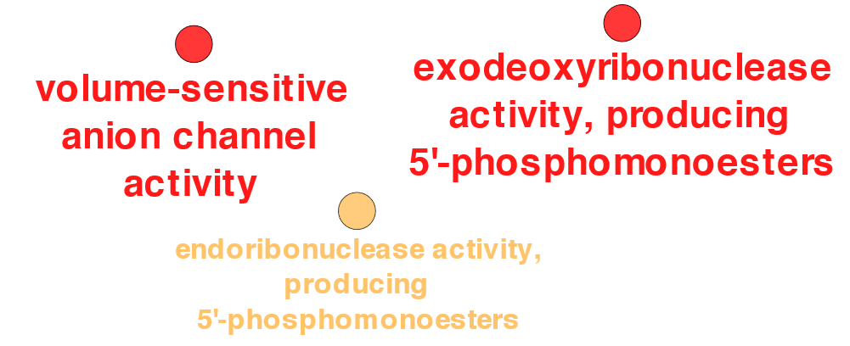
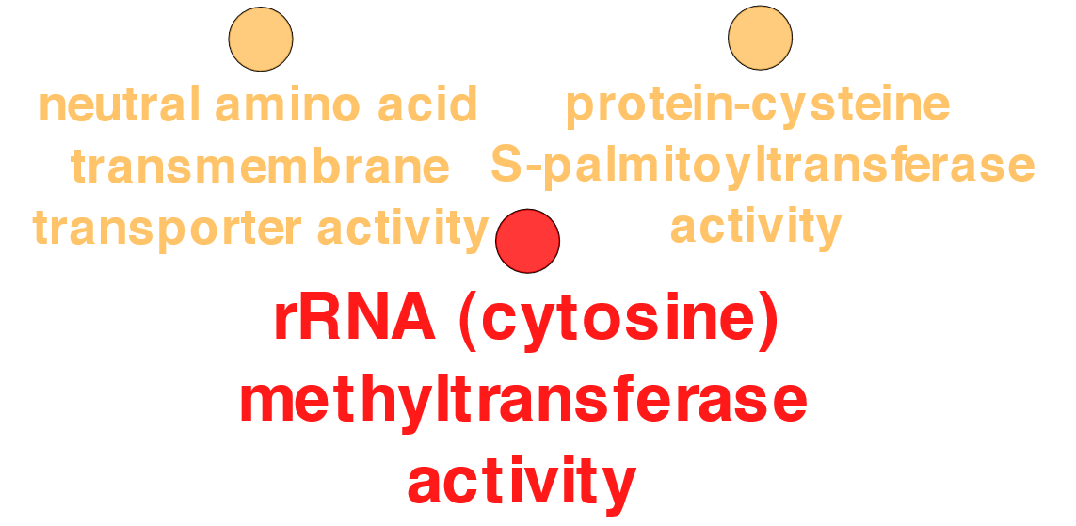
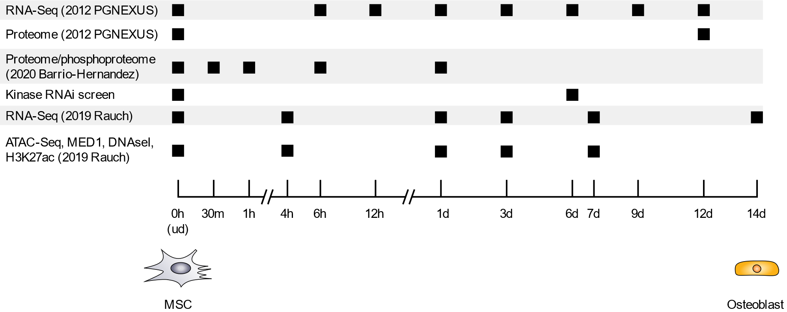
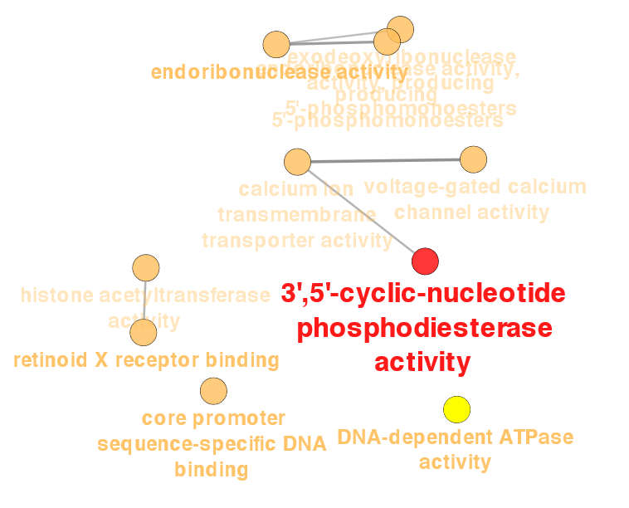
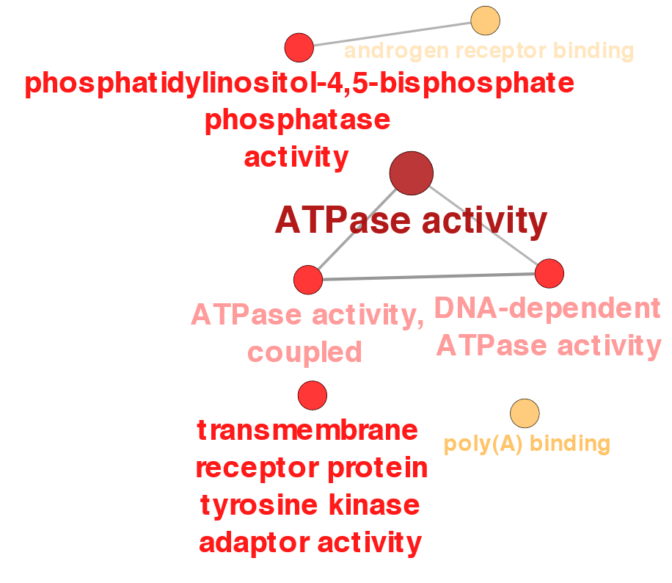
Functional enrichment (MF GO) (highest per time point) PSI-Sigma
MSC
12h
6h
1d
3d
6d
9d
12d

