Slide 1

Spliceome dynamics during osteogenesis
Part 2: Functional consequences enrichment of PSI results (RNA-Seq)
Angel Liang
7/4/2020

Slide 2
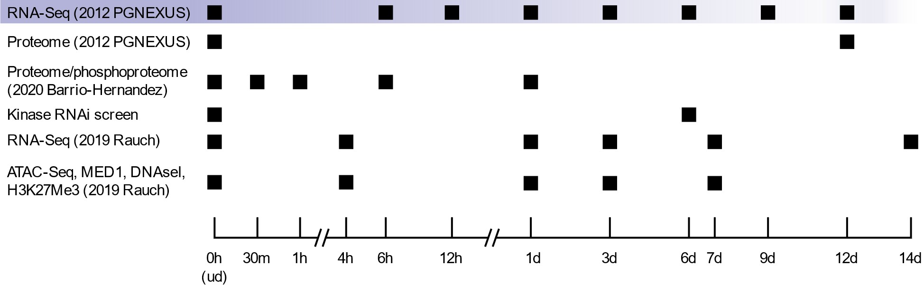
Overview of data
RNA-Seq, hMSC-TERT4 cells induced to differentiate into osteoblasts
PGNEXUS data: 8 timepoints, PAIRED end (2 x 75bp), ~45M reads/sample
2019 Rauch data: 6 timepoints, SINGLE end (1 x 50bp), ~20M reads/sample

Slide 3
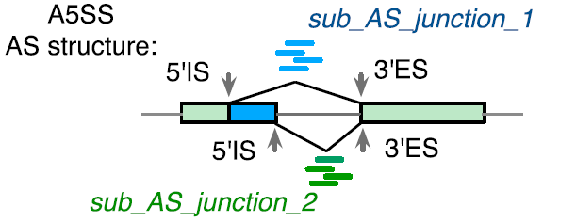
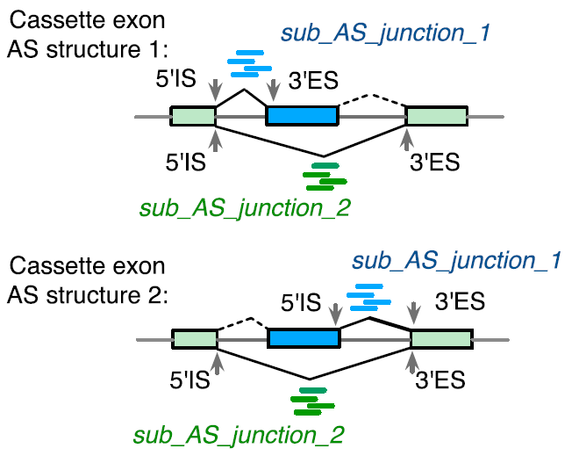
Overview of bioinformatic methods (RNA-Seq)
Reads mapped to reference hg38 genome using STAR (2-pass)
Differential splicing tools:
JUM (Wang et. al., 2018): Junction-centric
Splice graph is constructed
“Junction structures” classified according to differential changes in transcript topology
GLM of junction counts implemented in DEXSeq
PSI values are assigned on a per-junction-structure
PSI-Sigma (Lin et. al., 2019): Exon-centric
For each exon, indexes all possible combinations of upstream + downstream exon based on junction-spanning reads
Each unique combination of flanking constitutive exons (always present) and the exon itself is assigned a PSI value
Student t-test on raw counts
Advantage over JUM: can detect changes in first/last exon usage (alternative promoter, alternative poly-A)

Slide 4
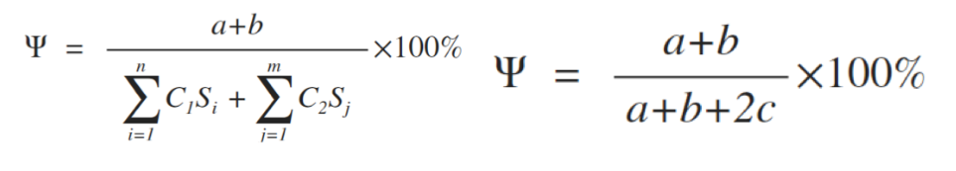
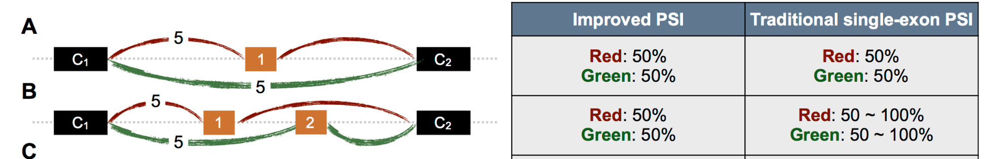
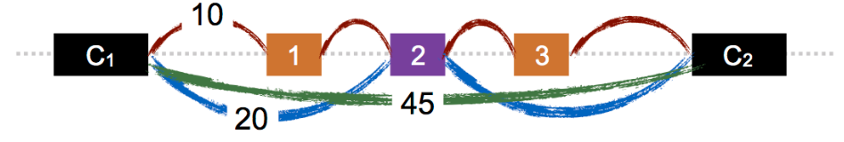
Overview of bioinformatic methods (RNA-Seq)
Reads mapped to reference hg38 genome using STAR (2-pass)
Differential splicing tools:
JUM (Wang et. al., 2018): Junction-centric
Splice graph is constructed
“Junction structures” classified according to differential changes in transcript topology
GLM of junction counts implemented in DEXSeq
PSI values are assigned on a per-junction-structure
PSI-Sigma (Lin et. al., 2019): Exon-centric
For each exon, indexes all possible combinations of upstream + downstream exon based on junction-spanning reads
Each unique combination of flanking constitutive exons (always present) and the exon itself is assigned a PSI value (more correctly, it’s PSI value per LSV*)
Student t-test on raw counts
Advantage over JUM: can detect changes in first/last exon usage (alternative promoter, alternative poly-A)
New PSI index of PSI-Sigma
*LSV = Local Splice Variant

Slide 5
Clustering of time-series data
Kohonen SOM
Map dimensions set to 5x5 at this point
JUM:
Differential junctions (all)
Differential junctions (plausible only)
PSI-Sigma:
Differential LSVs
Differential exons (sum of all LSVs)

Slide 6
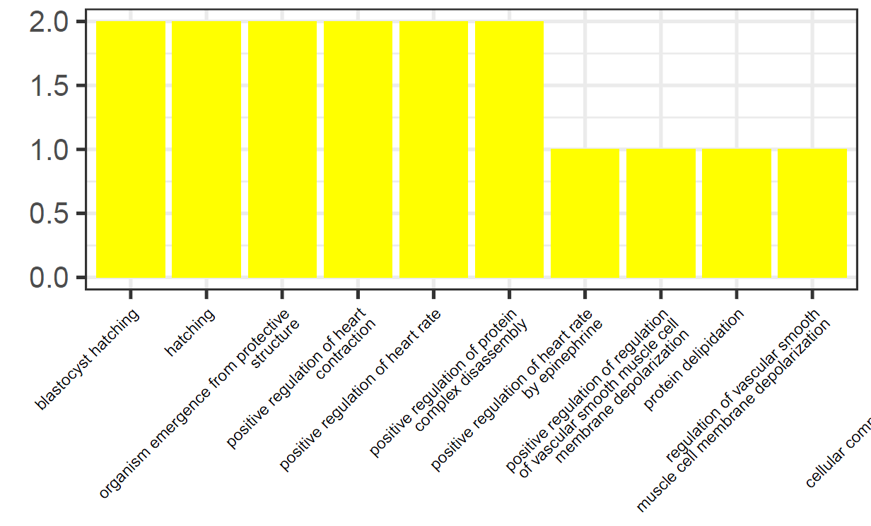
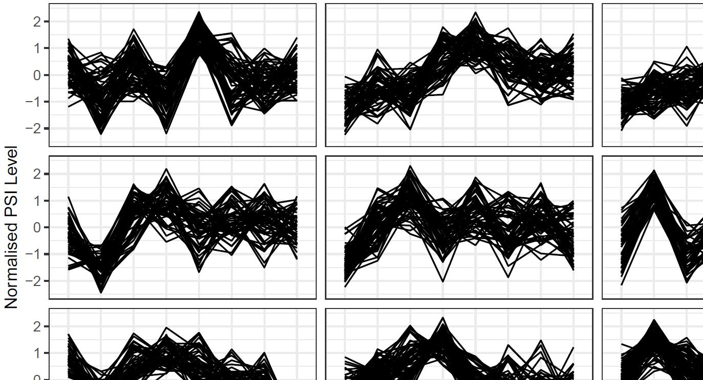
Functional enrichment
GO Terms and PFAM families for ALL genes containing differential junctions/exons
For clustered junctions/exons, functional enrichment done:
GO Terms (each cluster)
PFAM families (each cluster)
Upstream RNA-binding proteins (from CLiP-Seq, FLASH-Seq)
Analyses repeated for the highest/lowest scaled PSI at each time point

Slide 7
Functional enrichment
GO Terms and PFAM families for ALL genes containing differential junctions/exons
For clustered junctions/exons, functional enrichment done:
GO Terms (each cluster)
PFAM families (each cluster)
Upstream RNA-binding proteins (from CLiP-Seq, FLASH-Seq)
Analyses repeated for the highest/lowest scaled PSI at each time point

