Slide 1

Spliceome dynamics during osteogenesis
Part 3a: Multi-omic analyses (RNA-Seq PSI + RNA-Seq expression)
Angel Liang
7/4/2020

Slide 2
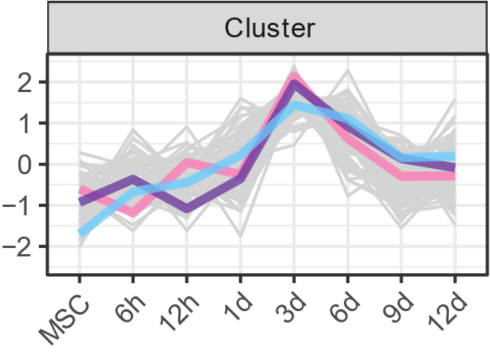
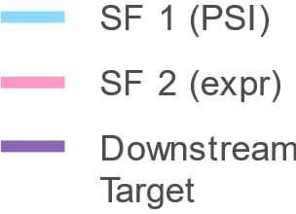
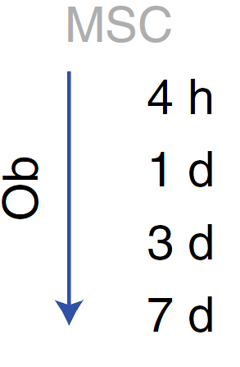
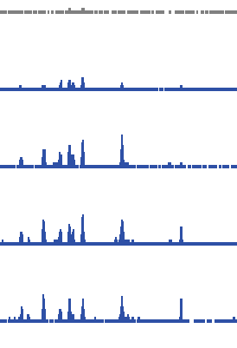
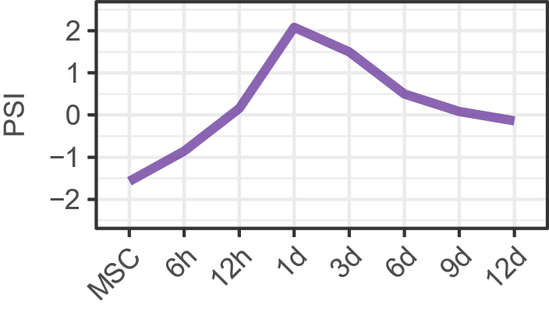
Mechanistic regulation of AS - multilayered
Splicing-regulated splicing (the upstream splicing factors (SFs) are themselves spliced) |  | Prediction: PSI profiles of SFs will co-cluster with the PSI values of downstream target junctions/exons
2. Expression-regulated splicing (expression of the upstream SFs are regulated) |  | Prediction: expression profiles of SFs will co-cluster with the PSI of targets.
3. Phosphorylation-regulated splicing (upstream SFs are regulated by phosphorylation) |  | Prediction: Temporal phosphorylation profiles of SFs will be similar to the PSI of targets
4. Epigenetic regulation at the cis-locus |  | Prediction: Temporal ChIP-Seq peak profiles at junction/exon/gene locus will correspond to PSI profile. (we have DNAse I hypersensitivity, ATAC-Seq and H3K27ac)

Slide 3
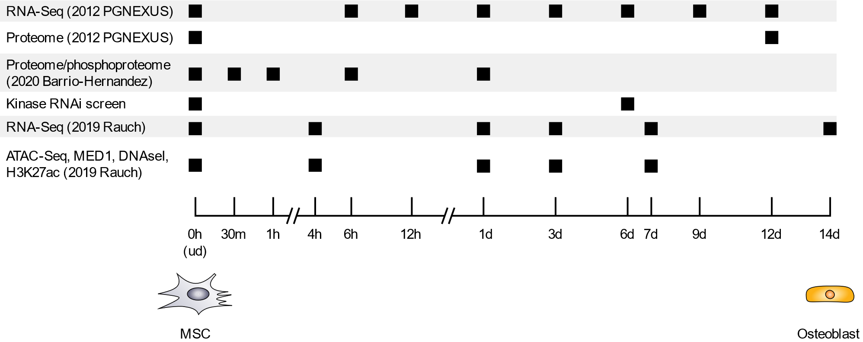
Overview of data
RNA-Seq, hMSC-TERT4 cells induced to differentiate into osteoblasts
We have a few –omics data on hand
Unfortunately, the timepoints for each experiment are sometimes different

Slide 4
Overview of data
RNA-Seq, hMSC-TERT4 cells induced to differentiate into osteoblasts
We have a few –omics data on hand
Unfortunately, the timepoints for each experiment are sometimes different

Slide 5
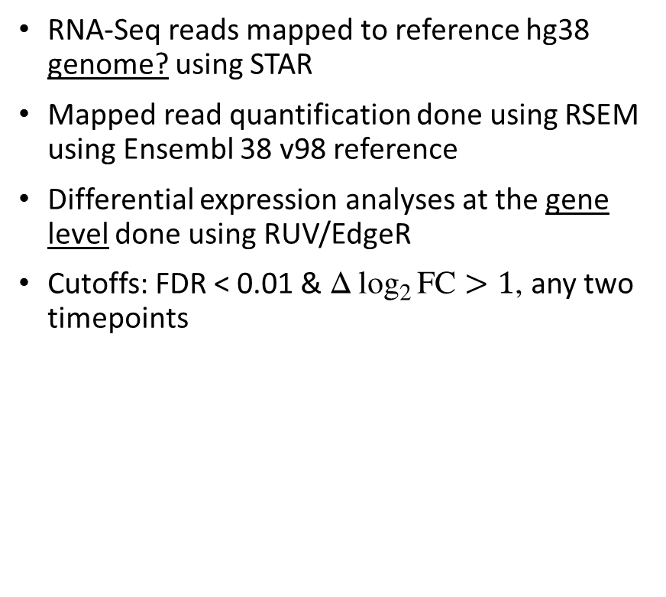
RNA-Seq expression analyses
RNA-Seq reads mapped to reference hg38 genome? using STAR
Mapped read quantification done using RSEM using Ensembl 38 v98 reference
Differential expression analyses at the gene level done using RUV/EdgeR
Cutoffs: FDR < 0.01 & $Δ\log_{2}{FC}>1$, any two timepoints

Slide 6
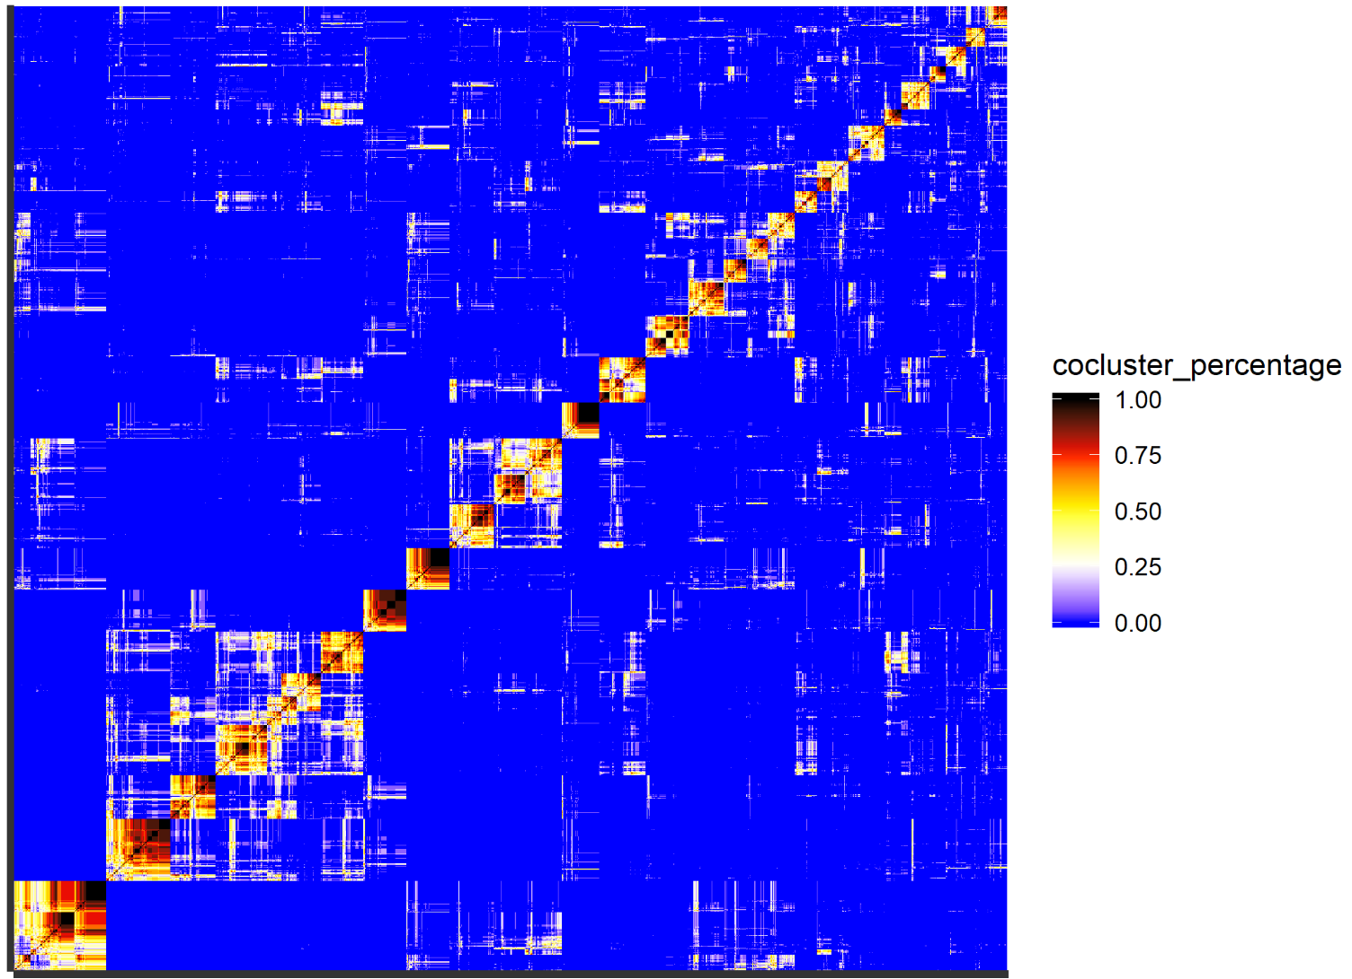
Co-clustering of PSI and expression
Mapped RNA-Seq reads quantified using RSEM
Time-series expression profile/gene obtained
Extracted genes of interest:
310 RNA Binding Proteins (RBPs)
1499 lncRNAs
74 transcription factors/co-factors
Kohonen SOM re-executed across 13 different map dimensions* with grid area ≈ 30
Pair-wise co-occurrence (%) values for each gene/junction or gene/exon
For each item, define neighbours which co-occur more than 50%.
Calculate the number of Pairwise Neighbours in Common (PNC). ↑PNC, ↑likelihood of belonging to the same cluster.
PNC values are edge weights. Re-clustering was done using ClusterONE (Cytoscape).
Co-occurrence matrix
*3 x 8, 3 x 9, 3 x 10, 3 x 11, 4 x 6, 4 x 7, … 6 x 5, 7 x 4

Slide 7
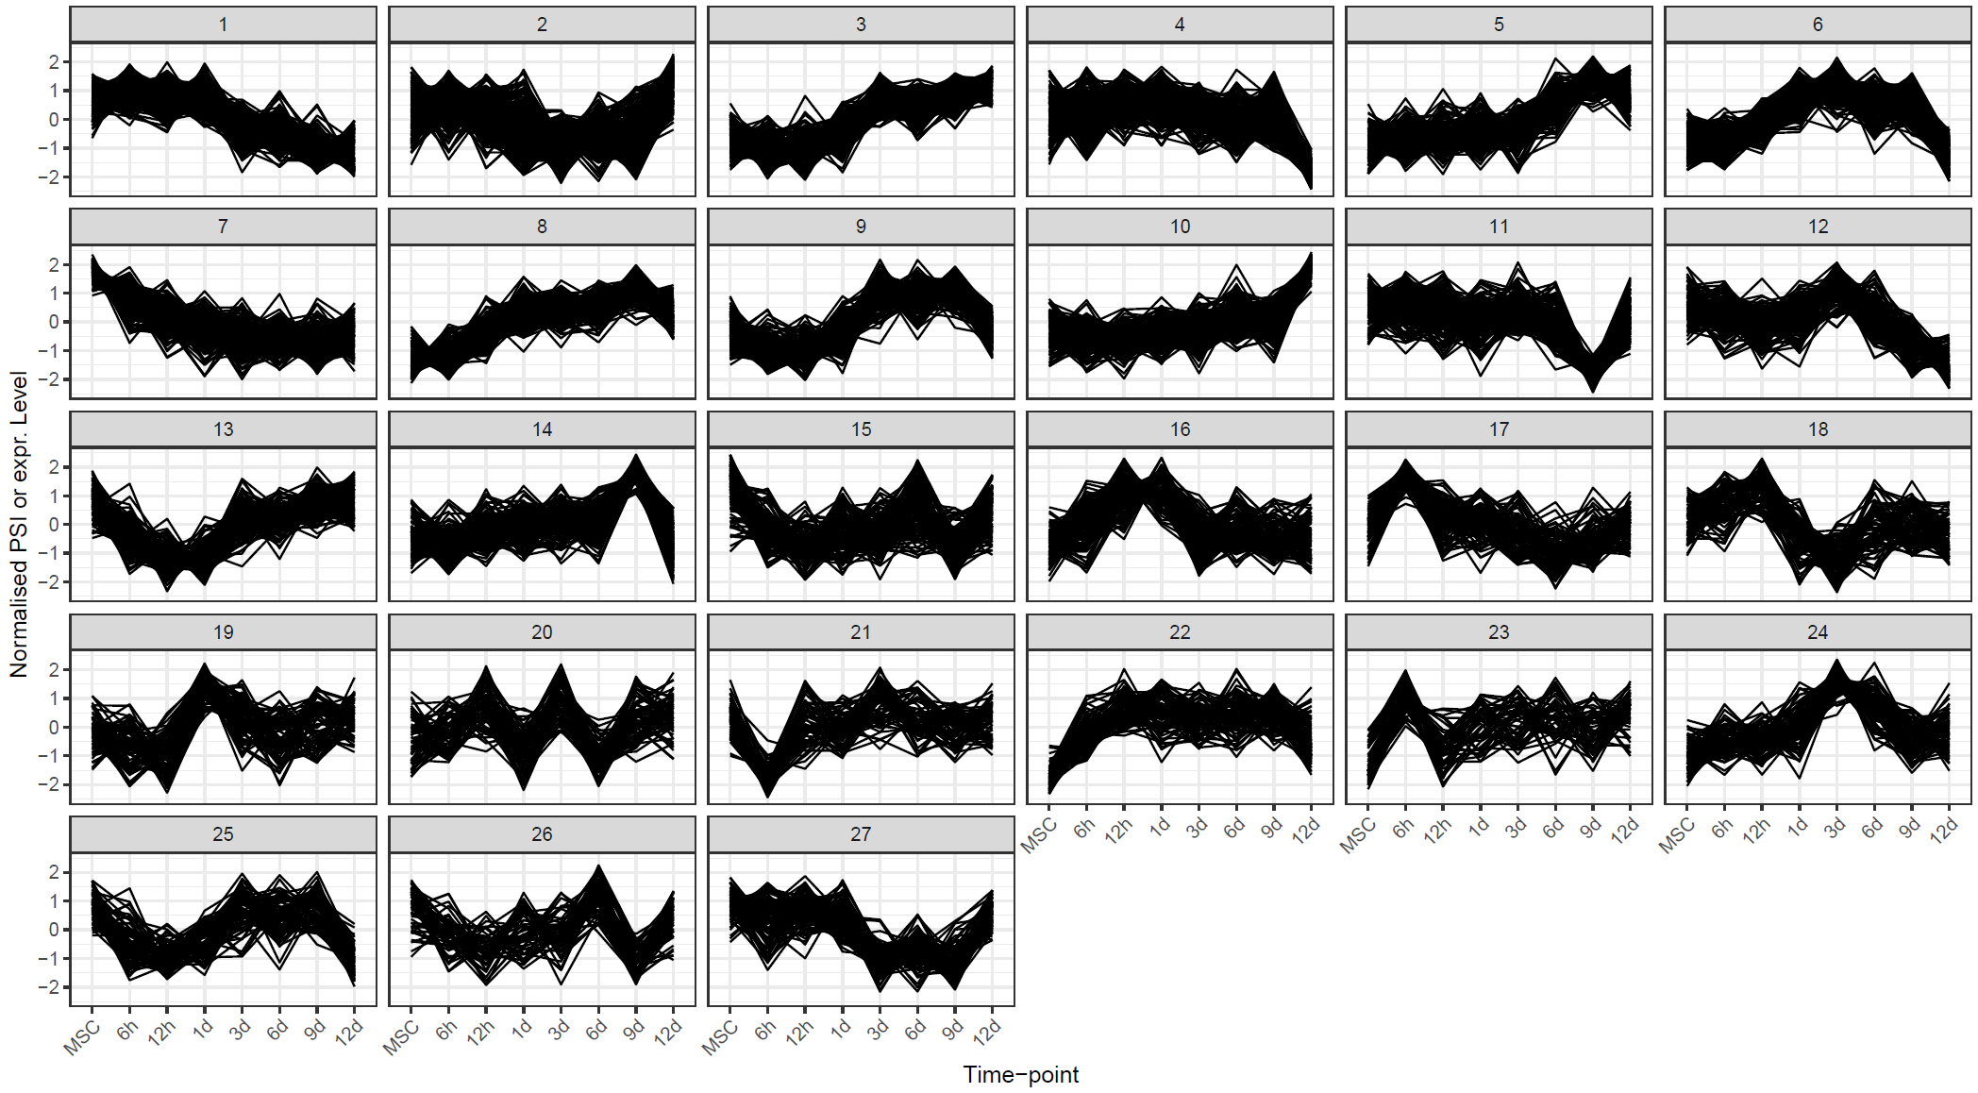
Co-clustering of PSI and expression
This is a form of ensemble clustering
Advantages over traditional SOM, k-means and fuzzy c-means:
Does not necessarily cluster all items - clustering of outlier profiles not enforced
Each item can belong in more than one cluster without needing to manually specify membership cutoff
Automatic detection of unique clusters – affected by sweep range but is not explicitly specified
ClusterONE produces a p-value for each cluster. Used p-value < 0.01
JUM: 24 clusters
PSI-Sigma: 27 clusters

Slide 8
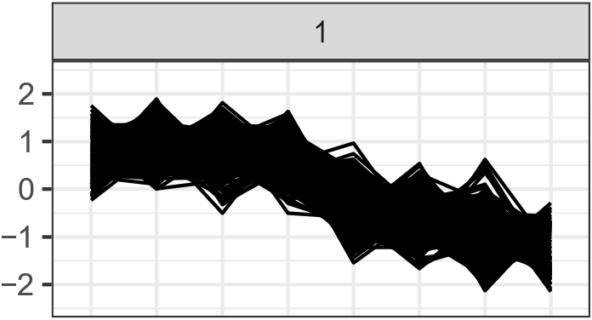
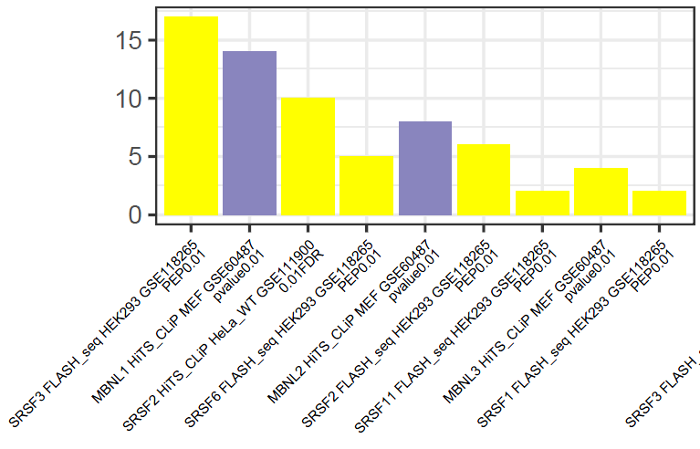
Functional enrichment of PSI and expression – JUM
For the PSI profiles, analyses were repeated:
GO Terms/cluster
PFAM families
Upstream RNA Binding Protein
For cluster 1:
SRSF2 expression co-clustered within SRSF2-regulated cluster 1 - strongly implies expression-regulated splicing
SRRM2 is a target of MBNL1 and SRSF2
MBNL1/2 seem important
Multiple other SFs/spliceosome machinery have similar expression
Additionally:
DNMT1 (5-mC), EZH2 (H3K27me3) expression co-clustering suggests upstream transcriptional regulation
CDK2, E2F2 suggests relation to cell-cycle
However, TLE family is involved in repression of Wnt signalling
CDK2, E2F2, TLE4
HNRNPA2B1, MBNL1, SNRNP(70/A1), SRRM2, ATXN2L, FBXL19, FBXO5, KDM4A, NCOR2, POLD4,
HNRNPA1, SFPQ, SNRP(A1/25), SRSF2, DNMT1, EZH2

Slide 9
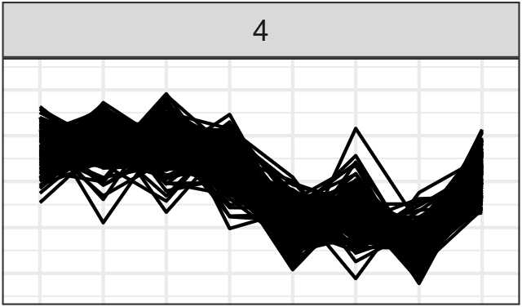
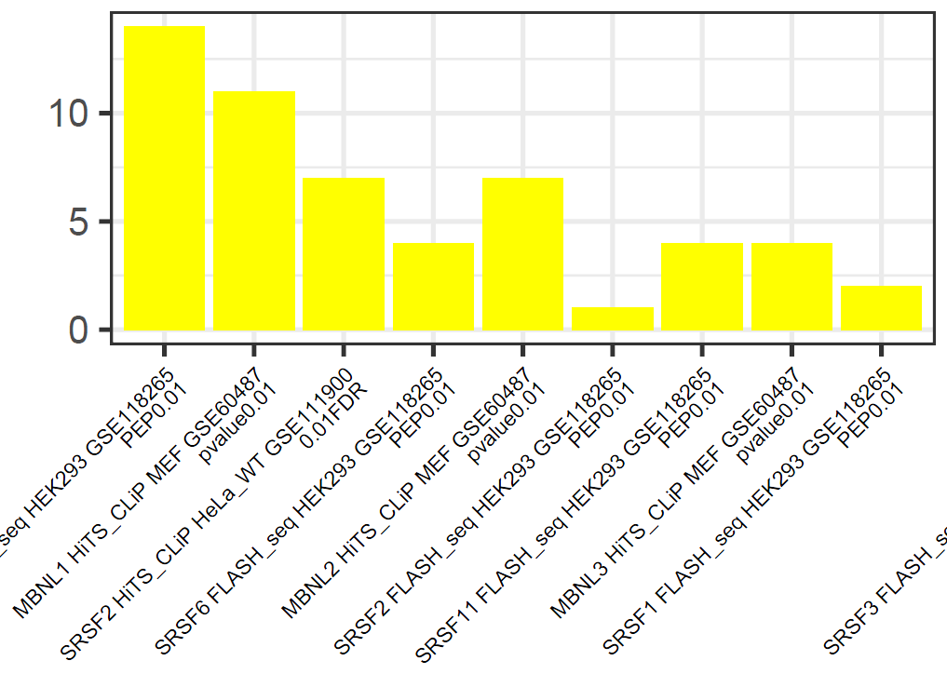
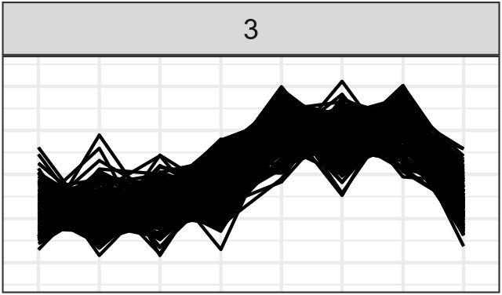
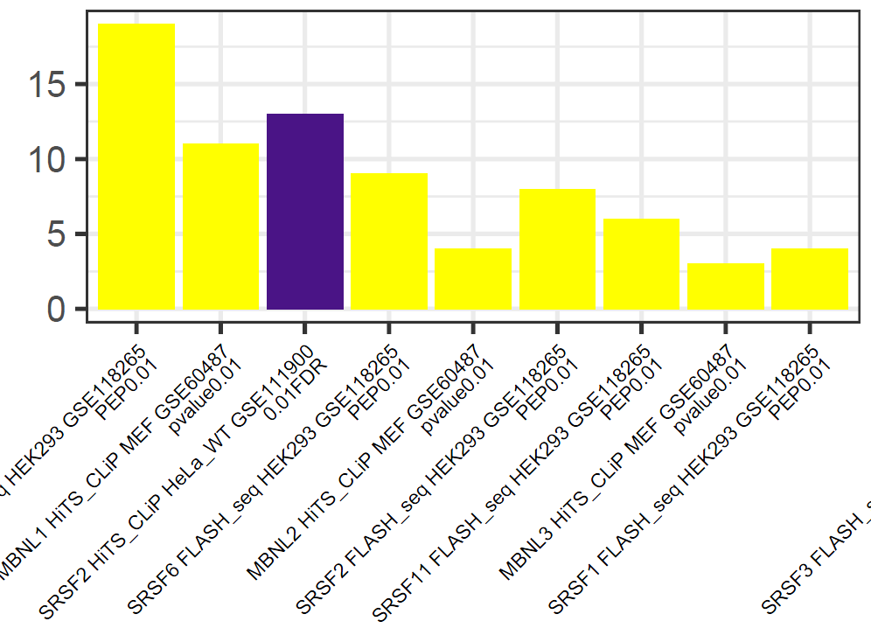
Functional enrichment of PSI and expression – JUM
For the PSI profiles, analyses were repeated:
GO Terms/cluster
PFAM families
Upstream RNA Binding Protein
For JUM, patterns of regulation were found:
SRSF2 expression co-clustered within SRSF2-regulated cluster 1 - strongly implies expression-regulated splicing
SRRM2 is a target of MBNL1 and SRSF2
Cluster 3 (opposite of cluster 4) strongly enriched for SRSF2
MBNL1/2 seem important
Additionally:
The high concentration of major genes in cluster 1 suggests upstream co-regulation
E2F family of TFs are heavily implicated
TCF(7/7L1) TFs are classical effectors of Wnt signaling
CDK2, E2F2, TLE4
HNRNPA2B1, MBNL1, SNRNP(70/A1), SRRM2, ATXN2L, FBXL19, FBXO5, KDM4A, NCOR2, POLD4,
E2F1/7/8, PRKDC, RBM14, RCOR1, TCF7
BRCA1, RBM15
HNRNPA1, SFPQ, SNRP(A1/25), SRSF2, DNMT1, EZH2
AKT1, CHEK1, GOLGA4, KAT2A, NFYB, SMARCD3
TCF7L1, TEAD2, TLE6
ABI1, AKT1, MEG3, RUNX2, MACF1
NEAT1

