Slide 1

Spliceome dynamics during osteogenesis
Part 3: Multi-omic analyses (RNA-Seq PSI + expr)
Angel Liang
7/4/2020

Slide 2
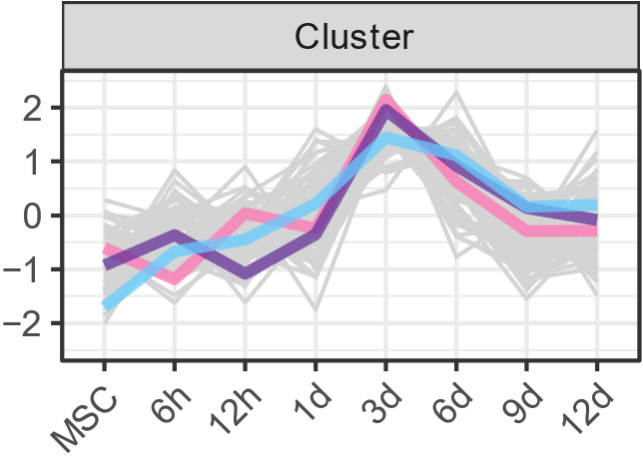
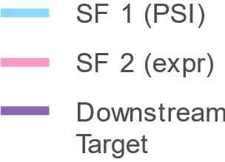
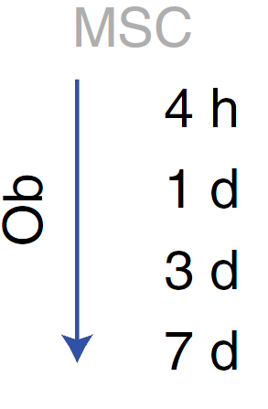
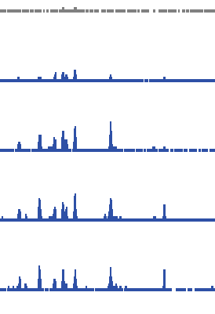
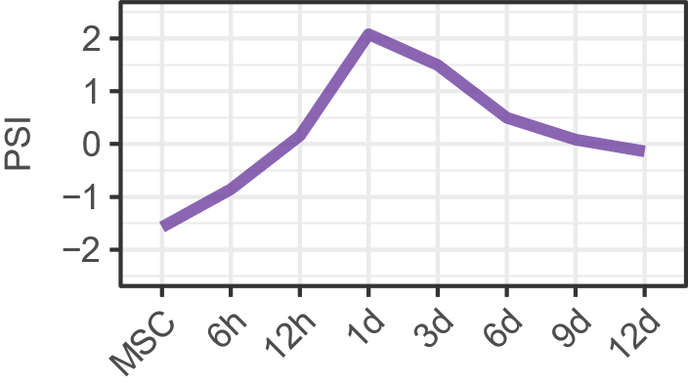
Mechanistic regulation of AS - multilayered
Splicing-regulated splicing (the upstream splicing factors (SFs) are themselves spliced) |  | Prediction: PSI profiles of SFs will co-cluster with the PSI values of downstream target junctions/exons
2. Expression-regulated splicing (expression of the upstream SFs are regulated) |  | Prediction: expression profiles of SFs will co-cluster with the PSI of targets.
3. Phosphorylation-regulated splicing (upstream SFs are regulated by phosphorylation) |  | Prediction: Temporal phosphorylation profiles of SFs will be similar to the PSI of targets
4. Epigenetic regulation at the cis-locus |  | Prediction: Temporal ChIP-Seq peak profiles at junction/exon/gene locus will correspond to PSI profile. (we have DNAse I hypersensitivity, ATAC-Seq and H3K27ac)

Slide 3
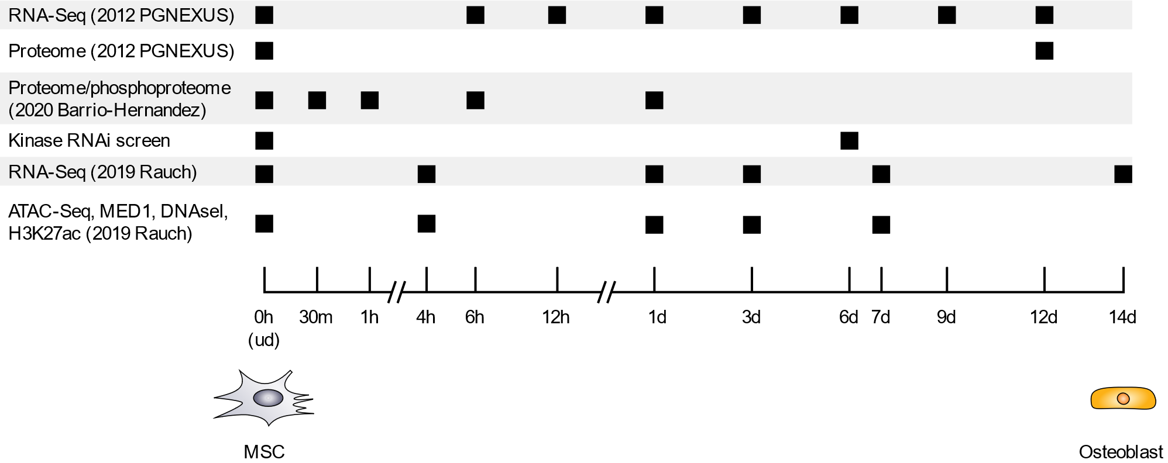
Overview of data
RNA-Seq, hMSC-TERT4 cells induced to differentiate into osteoblasts
We have a few –omics data on hand
Unfortunately, the timepoints for each experiment are sometimes different

Slide 4
Overview of data
RNA-Seq, hMSC-TERT4 cells induced to differentiate into osteoblasts
We have a few –omics data on hand
Unfortunately, the timepoints for each experiment are sometimes different

Slide 5
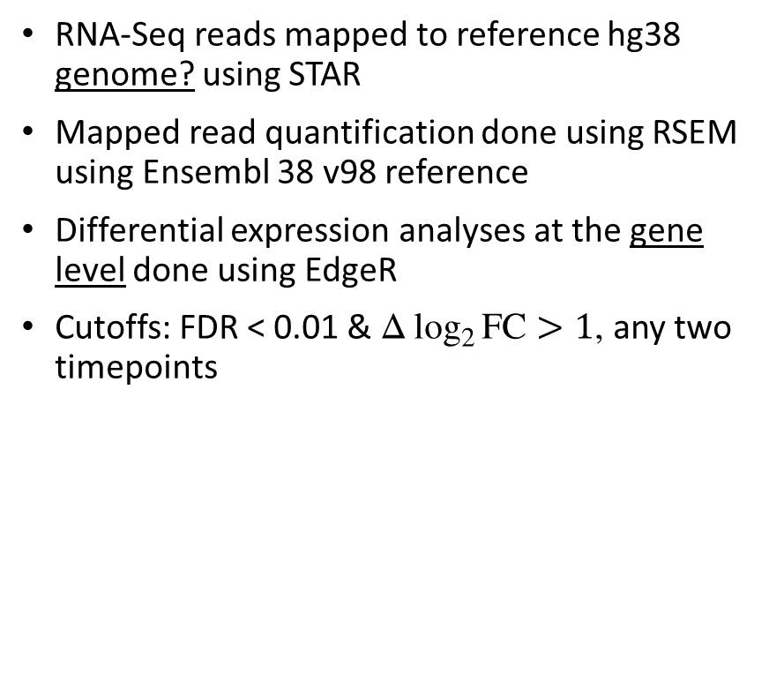
Validation of expression analyses
RNA-Seq reads mapped to reference hg38 genome? using STAR
Mapped read quantification done using RSEM using Ensembl 38 v98 reference
Differential expression analyses at the gene level done using EdgeR
Cutoffs: FDR < 0.01 & $Δ\log_{2}{FC}>1$, any two timepoints

Slide 6
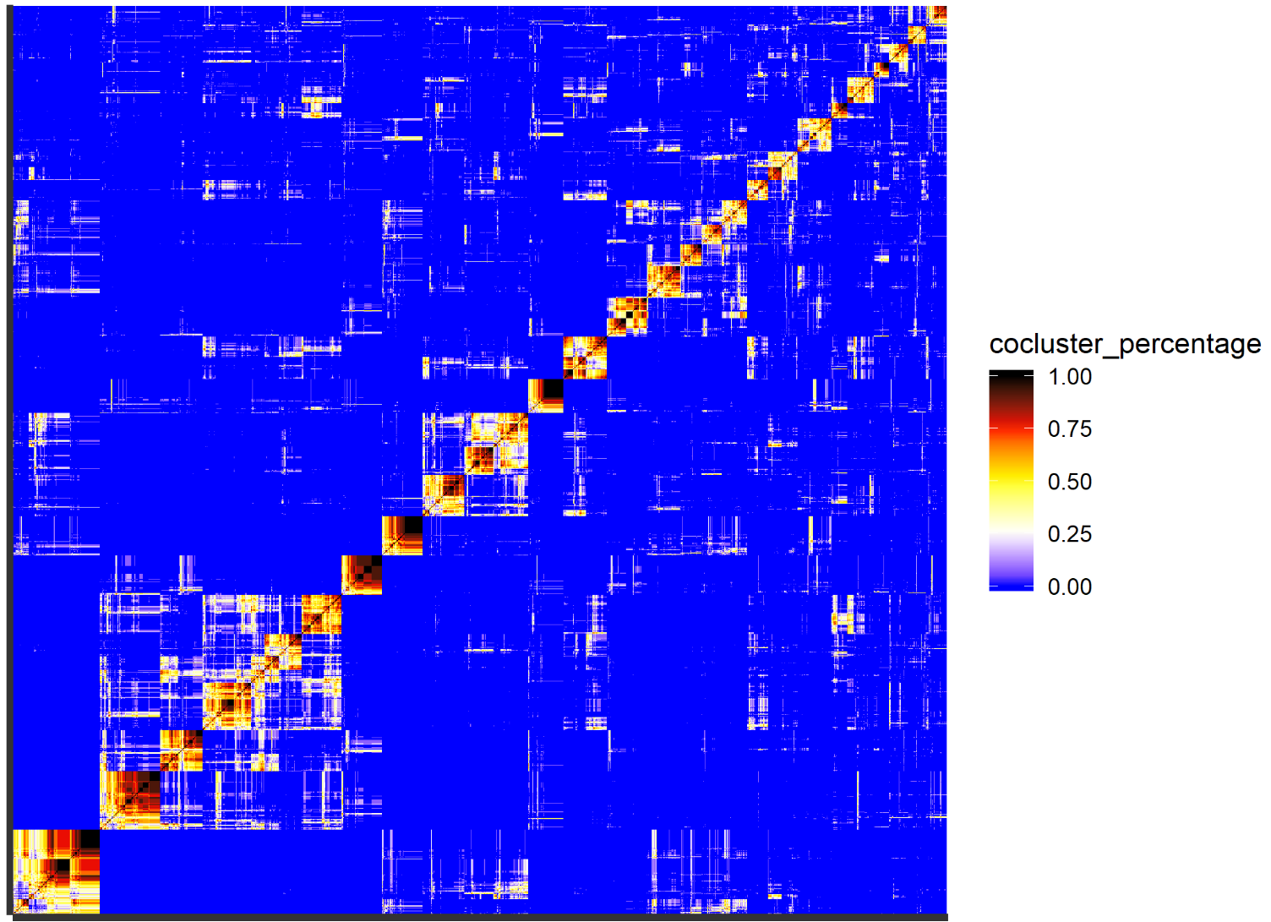
Co-clustering of PSI and expression
Mapped RNA-Seq reads quantified using RSEM
Time-series expression profile/gene obtained
Extracted genes of interest:
310 RNA Binding Proteins (RBPs)
1499 lncRNAs
74 transcription factors/co-factors
Kohonen SOM re-executed across 13 different map dimensions* with grid area ≈ 30
Pair-wise co-occurrence (%) values for each gene/junction or gene/exon
For each item, define neighbours which co-occur more than 50%.
Calculate the number of Pairwise Neighbours in Common (PNC). ↑PNC, ↑likelihood of belonging to the same cluster.
PNC values are edge weights. Re-clustering was done using ClusterONE (Cytoscape).
Co-occurrence matrix
*3 x 8, 3 x 9, 3 x 10, 3 x 11, 4 x 6, 4 x 7, … 6 x 5, 7 x 4

Slide 7
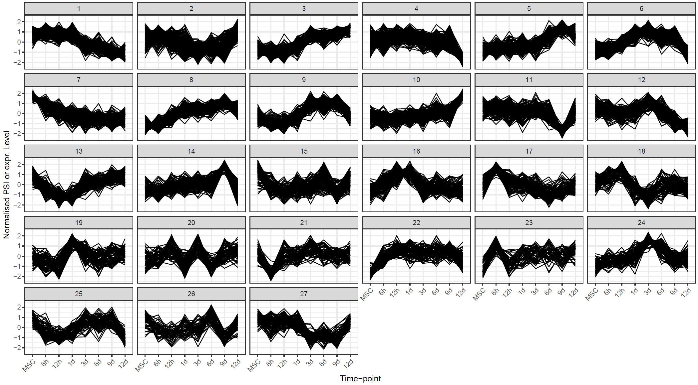
Co-clustering of PSI and expression
This is a form of ensemble clustering
Advantages over traditional SOM, k-means and fuzzy c-means:
Does not necessarily cluster all items - clustering of outlier profiles not enforced
Each item can belong in more than one cluster without needing to manually specify membership cutoff
Automatic detection of unique clusters – affected by sweep range but is not explicitly specified
ClusterONE produces a p-value for each cluster. Used p-value < 0.01
JUM: 24 clusters
PSI-Sigma: 27 clusters

Slide 8
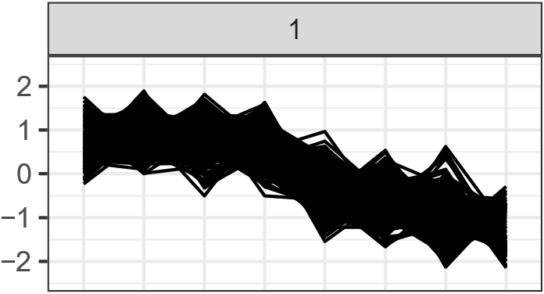
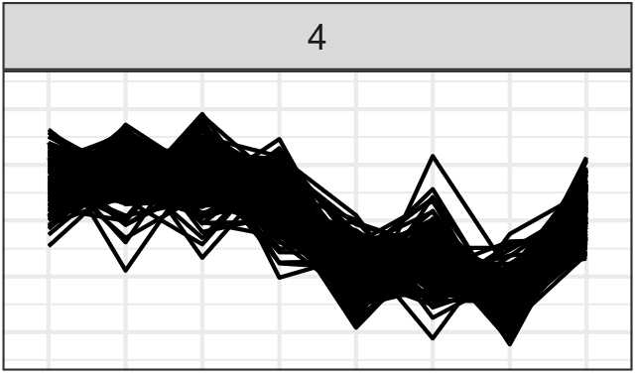
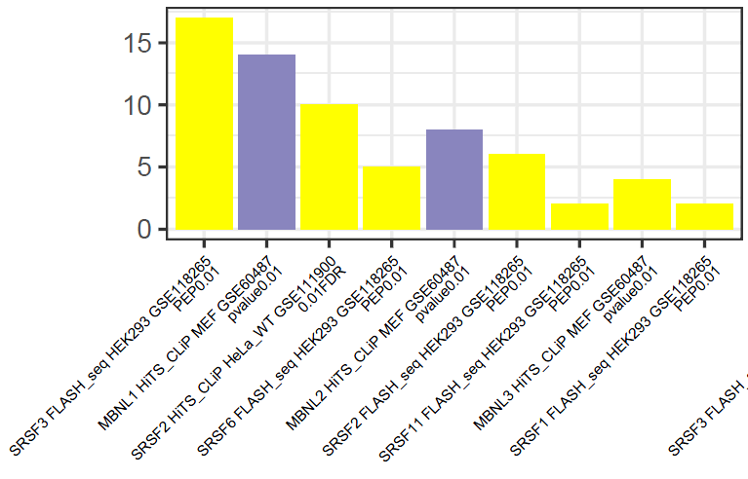
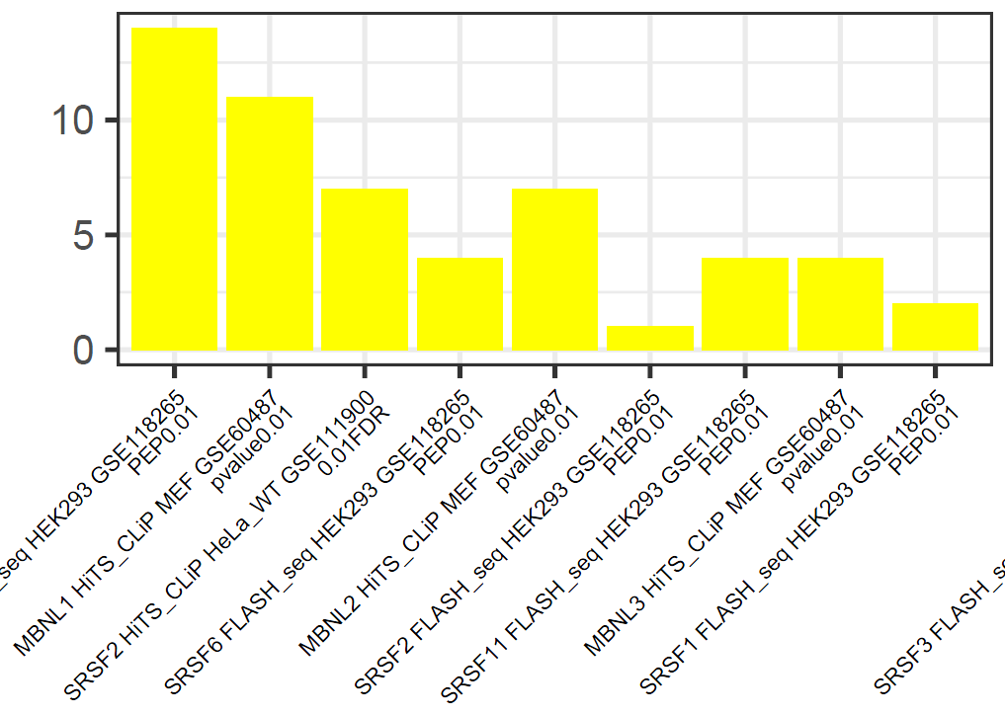
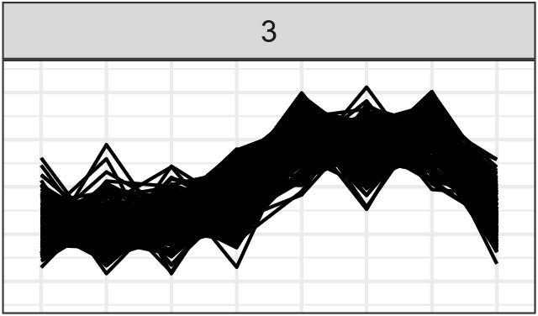
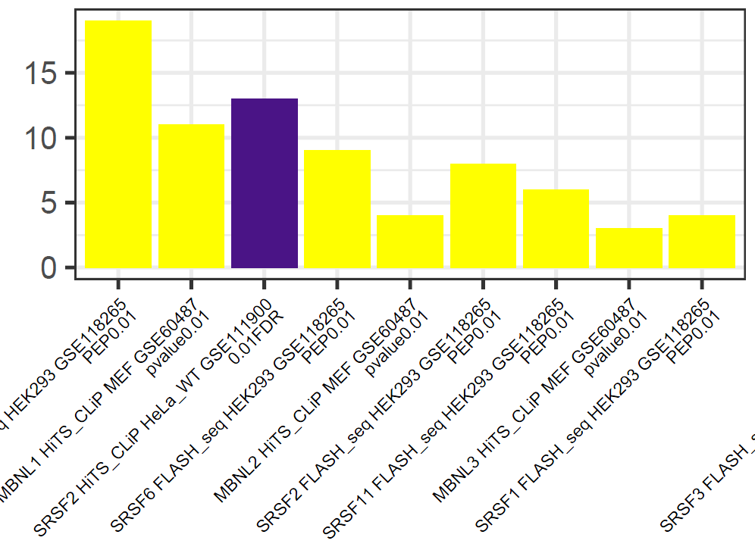
Functional enrichment of PSI and expression – JUM
For the PSI profiles, analyses were repeated:
GO Terms/cluster
PFAM families
Upstream RNA Binding Protein
For JUM, patterns of regulation were found:
SRSF2 expression co-clustered within SRSF2-regulated cluster 1 - strongly implies expression-regulated splicing
SRRM2 is a target of SRSF2.
Cluster 3 (opposite of cluster 4) strongly enriched for SRSF2
MBNL1/2 seem important
Additionally:
The high concentration of major genes in cluster 1 suggests upstream co-regulation
E2F family of TFs are heavily implicated
TCF(7/7L1) TFs are classical effectors of Wnt signaling
CDK2, E2F2, TLE4
HNRNPA2B1, MBNL1, SNRNP(70/A1), SRRM2, ATXN2L, FBXL19, FBXO5, KDM4A, NCOR2, POLD4,
E2F1/7/8, PRKDC, RBM14, RCOR1, TCF7
BRCA1, RBM15
HNRNPA1, SFPQ, SNRP(A1/25), SRSF2, DNMT1, EZH2
AKT1, CHEK1, GOLGA4, KAT2A, NFYB, SMARCD3
TCF7L1, TEAD2, TLE6
ABI1, AKT1, MEG3, RUNX2, MACF1
NEAT1

