Slide 1
SIE’s favourite pet:
Condor
(or how to easily run your programs in dozens of machines at a time)
Adrián Santos Marrero
E.T.S.I. Informática - ULL

Slide 2
Tutorial Outline
The Story of Frieda, the Scientist
  Using Condor to manage jobs
  Using Condor to manage resources
  Condor Architecture and Mechanisms
Stop me if you have any questions!

Slide 3

Meet Frieda.
She is a scientist. But she has a big
problem.

Slide 4
Frieda’s Application …
Run a Parameter Sweep of F(x,y,z) for 20 values of x, 10 values of y and 3 values of z (20*10*3 = 600 combinations)
  F takes on the average 6 hours to compute on a “typical” workstation (total = 3600 hours)
  F requires a “moderate” (128MB) amount of memory
  F performs “moderate” I/O - (x,y,z) is 5 MB and F(x,y,z) is 50 MB

Slide 5

I have 600 simulations to run.
Where can I get help?

Slide 6

As if by magic, a genie appears from a lamp, and says, “Use Condor!”

Slide 7
What is Condor?
Batch system
Takes advantage off free machines at IAC.
Results: It saves time to us and optimizes the available resources.

Slide 8
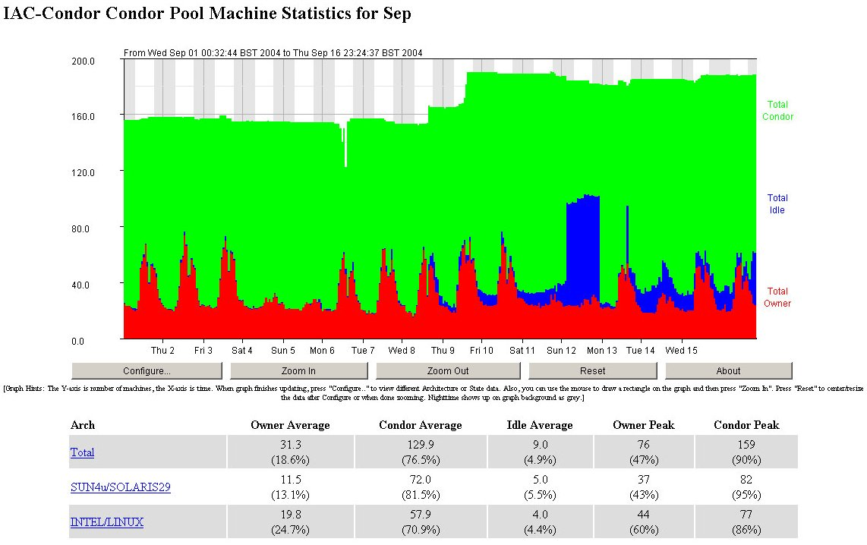

Slide 9
Condor will ...
… keep an eye on your jobs and will keep you posted on their progress
… implement your policy on the execution order of the jobs
… keep a log of your job activities
… add fault tolerance to your jobs
… implement your policy on when the jobs can run on your workstation

Slide 10
What machines will Condor use?
Condor is only going to use machines that:
  Nobody is currently using (neither locally nor remotelly)
  Do not have any applications running with a high CPU load
Condor leaves a machine when this one becomes busy.

Slide 11
Testimonial
Daniel Bramich has been using Condor at IAC for intensive calculations.
Without Condor, he would have spent about 458 days to complete. But his simulations only take a couple of weeks using 30 of the fastest computers at IAC (limited by IDL’s licences).

Slide 12
Getting Started: Submitting Jobs to Condor
Creating a submit description file
Choosing a “Universe” for your job
  Just use VANILLA for now
Make your job “batch-ready”
Run condor_submit on your submit description file

Slide 13
Making your job batch-ready
Must be able to run in the background: no interactive input, windows, GUI, etc.
Can still use STDIN, STDOUT, and STDERR (the keyboard and the screen), but files are used for these instead of the actual devices
Organize data files

Slide 14
Creating a Submit Description File
A plain ASCII text file
Condor does not care about file extensions
Tells Condor about your job:
  Which executable, universe, input, output and error files to use, command-line arguments, environment variables, any special requirements or preferences (more on this later)
Can describe many jobs at once (a “cluster”), each with different input, arguments, output, etc.

Slide 15
Simple Submit Description File
# Simple condor_submit input file
# (Lines beginning with # are comments)
# NOTE: the words on the left side are not
# case sensitive, but filenames are!
Universe = vanilla
Executable = my_job
Queue

Slide 16
Running condor_submit
You give condor_submit the name of the submit file you have created:
  condor_submit my_job.submit
condor_submit parses the submit file, checks for it errors, and creates a “ClassAd” that describes your job(s)
  ClassAds: Condor’s internal data representation
    Similar to classified ads (as the name inplies)
    Represent an object & it’s attributes
    Can also describe what an object matches with

Slide 17
The Job Queue
condor_submit sends your job’s ClassAd(s) to the schedd
  Manages the local job queue
  Stores the job in the job queue
View the queue with condor_q

Slide 18
Running condor_submit
% condor_submit my_job.submit
Submitting job(s).
1 job(s) submitted to cluster 1.
% condor_q
-- Submitter: perdita.cs.wisc.edu : <128.105.165.34:1027> :
ID OWNER SUBMITTED RUN_TIME ST PRI SIZE CMD
1.0 frieda 6/16 06:52 0+00:00:00 I 0 0.0 my_job
1 jobs; 1 idle, 0 running, 0 held
%

Slide 19
More information about jobs
Controlled by submit file settings
Condor sends you email about events
  Turn it off: Notification = Never
  Only on errors: Notification = Error
Condor creates a log file (user log)
  “The Life Story of a Job”
  Shows all events in the life of a job
  Always have a log file
  To turn it on: Log = filename

Slide 20
Sample Condor User Log
000 (0001.000.000) 05/25 19:10:03 Job submitted from host: <128.105.146.14:1816>
...
001 (0001.000.000) 05/25 19:12:17 Job executing on host: <128.105.146.14:1026>
...
005 (0001.000.000) 05/25 19:13:06 Job terminated.
(1) Normal termination (return value 0)
Usr 0 00:00:37, Sys 0 00:00:00 - Run Remote Usage
Usr 0 00:00:00, Sys 0 00:00:05 - Run Local Usage
Usr 0 00:00:37, Sys 0 00:00:00 - Total Remote Usage
Usr 0 00:00:00, Sys 0 00:00:05 - Total Local Usage
9624 - Run Bytes Sent By Job
7146159 - Run Bytes Received By Job
9624 - Total Bytes Sent By Job
7146159 - Total Bytes Received By Job
...

Slide 21
Another Submit Description File
# Example condor_submit input file
# (Lines beginning with # are comments)
# NOTE: the words on the left side are not
# case sensitive, but filenames are!
Universe = vanilla
Executable = /home/frieda/condor/my_job.condor
Log = my_job.log
Input = my_job.stdin
Output = my_job.stdout
Error = my_job.stderr
Arguments = -arg1 -arg2
InitialDir = /home/frieda/condor/run_1
Queue

Slide 22
“Clusters” and “Processes”
If your submit file describes multiple jobs, we call this a “cluster”
Each cluster has a unique “cluster number”
Each job in a cluster is called a “process”
  Process numbers always start at zero
A Condor “Job ID” is the cluster number, a period, and the process number (“20.1”)
  A cluster can have only one process (“21.0”)

Slide 23
Example Submit Description File for a Cluster
# Example submit description file that defines a
# cluster of 2 jobs with separate working directories
Universe = vanilla
Executable = my_job
log = my_job.log
Arguments = -arg1 -arg2
Input = my_job.stdin
Output = my_job.stdout
Error = my_job.stderr
InitialDir = run_0
Queue ·Becomes job 2.0
InitialDir = run_1
Queue ·Becomes job 2.1

Slide 24
Submitting The Job
% condor_submit my_job.submit-file
Submitting job(s).
2 job(s) submitted to cluster 2.
% condor_q
-- Submitter: perdita.cs.wisc.edu : <128.105.165.34:1027> :
ID OWNER SUBMITTED RUN_TIME ST PRI SIZE CMD
1.0 frieda 4/15 06:52 0+00:02:11 R 0 0.0 my_job
2.0 frieda 4/15 06:56 0+00:00:00 I 0 0.0 my_job
2.1 frieda 4/15 06:56 0+00:00:00 I 0 0.0 my_job
3 jobs; 2 idle, 1 running, 0 held
%

Slide 25
Submit Description File for a BIG Cluster of Jobs
The initial directory for each job can be specified as run_$(Process), and instead of submitting a single job, we use “Queue 600” to submit 600 jobs at once
The $(Process) macro will be expanded to the process number for each job in the cluster (0 - 599), so we’ll have “run_0”, “run_1”, … “run_599” directories
All the input/output files will be in different directories!

Slide 26
Submit Description File for a BIG Cluster of Jobs
# Example condor_submit input file that defines
# a cluster of 600 jobs with different directories
Universe = vanilla
Executable = my_job
Log = my_job.log
Arguments = -arg1 –arg2
Input = my_job.stdin
Output = my_job.stdout
Error = my_job.stderr
InitialDir = run_$(Process) ·run_0 … run_599
Queue 600 ·Becomes job 3.0 … 3.599

Slide 27
Using condor_rm
If you want to remove a job from the Condor queue, you use condor_rm
You can only remove jobs that you own (you can’t run condor_rm on someone else’s jobs unless you are root)
You can give specific job ID’s (cluster or cluster.proc), or you can remove all of your jobs with the “-a” option.
  condor_rm 21.1 ·Removes a single job
  condor_rm 21 ·Removes a whole cluster

Slide 28
condor_status
% condor_status
Name OpSys Arch State Activity LoadAv Mem ActvtyTime
haha.cs.wisc. IRIX65 SGI Unclaimed Idle 0.198 192 0+00:00:04
antipholus.cs LINUX INTEL Unclaimed Idle 0.020 511 0+02:28:42
coral.cs.wisc LINUX INTEL Claimed Busy 0.990 511 0+01:27:21
doc.cs.wisc.e LINUX INTEL Unclaimed Idle 0.260 511 0+00:20:04
dsonokwa.cs.w LINUX INTEL Claimed Busy 0.810 511 0+00:01:45
ferdinand.cs. LINUX INTEL Claimed Suspended 1.130 511 0+00:00:55
vm1@pinguino. LINUX INTEL Unclaimed Idle 0.000 255 0+01:03:28
vm2@pinguino. LINUX INTEL Unclaimed Idle 0.190 255 0+01:03:29

Slide 29

How can my jobs access their data files?

Slide 30
Access to Data in Condor
Use Shared Filesystem
Put your files in a location shared between all machines, e.g., your home directory (/home/<user>/) or /net/<machine>/scratch/

Slide 31
Some of the machines in the Pool do not have enough memory or scratch disk space to run my job!

Slide 32
Specify Requirements!
An expression (syntax similar to C or Java)
Must evaluate to True for a match to be made
Universe = vanilla
Executable = my_job
Log = my_job.log
InitialDir = run_$(Process)
Requirements = Memory >= 256 && Disk > 10000
Queue 600

Slide 33
Specify Rank!
All matches which meet the requirements can be sorted by preference with a Rank expression.
Higher the Rank, the better the match
Universe = vanilla
Executable = my_job
Log = my_job.log
Arguments = -arg1 –arg2
InitialDir = run_$(Process)
Requirements = Memory >= 256 && Disk > 10000
Rank = (KFLOPS*10000) + Memory
Queue 600

Slide 34
We’ve seen how Condor can:
… keeps an eye on your jobs and will keep you posted on their progress
… keeps a log of your job activities
… implement your policy on when the jobs can run on your workstation

Slide 35
My jobs run for 20 days…
What happens when they get pre-empted?
How can I add fault tolerance to my jobs?

Slide 36
Condor’s Standard Universe to the rescue!
Condor can support various combinations of features/environments in different “Universes”
Different Universes provide different functionality for your job:
  Vanilla – Run any Serial Job
  Standard – Support for transparent process checkpoint and restart

Slide 37
Process Checkpointing
Condor’s Process Checkpointing mechanism saves the entire state of a process into a checkpoint file
  Memory, CPU, I/O, etc.
The process can then be restarted from right where it left off
Typically no changes to your job’s source code needed – however, your job must be relinked with Condor’s Standard Universe support library

Slide 38
Relinking Your Job for Standard Universe
To do this, just place “condor_compile” in front of the command you normally use to link your job:
% condor_compile gcc -o myjob myjob.c
- OR -
% condor_compile f77 -o myjob filea.f fileb.f

Slide 39
Limitations of the
Standard Universe
Condor’s checkpointing is not at the kernel level. Thus in the Standard Universe the job may not:
  Fork()
  Use kernel threads
  Use some forms of IPC, such as pipes and shared memory
Many typical scientific jobs are OK

Slide 40
When will Condor checkpoint your job?
Periodically, if desired
  For fault tolerance
When your job is preempted by a higher priority job
When your job is vacated because the execution machine becomes busy
When you explicitly run condor_checkpoint command

Slide 41
General User Commands
condor_status View Pool Status
condor_q View Job Queue
condor_submit Submit new Jobs
condor_rm Remove Jobs
condor_prio Intra-User Prios
condor_checkpoint Force a checkpoint
condor_compile Link Condor library
PRACTICAL EXAMPLE

Slide 42
Condor Job Universes
Serial Jobs
  Vanilla Universe
  Standard Universe
Java Universe

Slide 43
Java Universe Job
universe = java
executable = Main.class
jar_files = MyLibrary.jar
input = infile
output = outfile
arguments = Main 1 2 3
queue
condor_submit

Slide 44
Why not use Vanilla Universe for Java jobs?
Java Universe provides more than just inserting “java” at the start of the execute line
  Knows which machines have a JVM installed
  Knows the location, version, and performance of JVM on each machine
  Provides more information about Java job completion than just JVM exit code
    Program runs in a Java wrapper, allowing Condor to report Java exceptions, etc.

Slide 45
Java support, cont.
condor_status -java
Name JavaVendor Ver State Activity LoadAv Mem
aish.cs.wisc. Sun Microsy 1.2.2 Owner Idle 0.000 249
anfrom.cs.wis Sun Microsy 1.2.2 Owner Idle 0.030 249
babe.cs.wisc. Sun Microsy 1.2.2 Claimed Busy 1.120 123
...

Slide 46
Thank you!
Check us out on the Web:
http://goya/inves/SINFIN/Condor/
Email:
condor@iac.es

