Slide 1
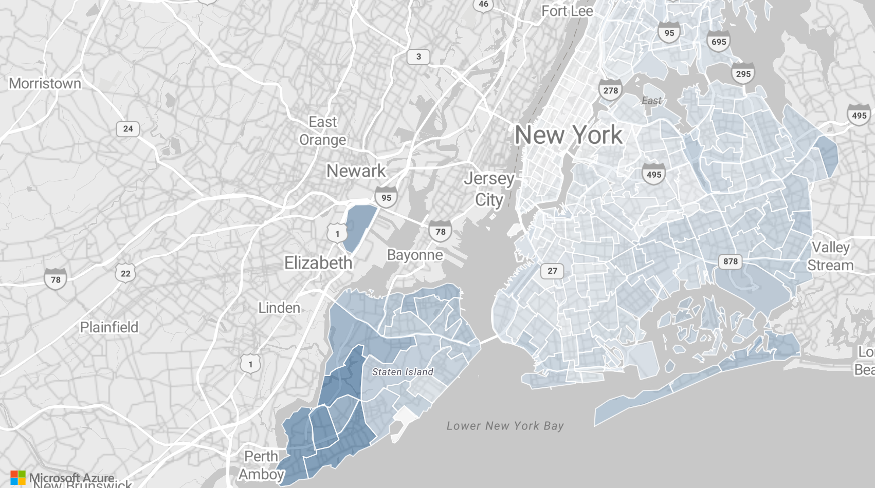
NYC Yellow Taxi: when, where and how drivers earn
Power BI analysis of 898,131 trips
May–June 2020 · Angel Iana
Notes:
This analysis looks at yellow taxi trips in New York in May and June 2020 from two perspectives: the vendor, who needs to know when and where demand happens, and the driver, who wants to know when and where a trip pays the most. All 898,131 records are used, as required by the project brief.

Slide 2
The data: 898,131 trips, checked in SQL and matched to TLC counts
898,131 trips
TLC trip records, 2 monthly files
SQL Server checks
6,608 trips with impossible values flagged, not deleted
Power BI report
898,131 trips · all records
 | Our data | TLC official
Trips, May–June 2020 | 898,131 | 898,127
Trips per day | 14,723.5 | 14,723.4
All records are kept, as required by the project brief. TLC figures: 11,237 trips per day in May and 18,326 in June. Every number in this deck comes from a SQL query and matches the Power BI report.
Notes:
Before building the report I loaded the files into SQL Server and checked them. 6,608 records have impossible values; they are kept and labelled in a Data Quality Flag column, not deleted. The total matches the official TLC monthly figures, so the data is complete.

Slide 3
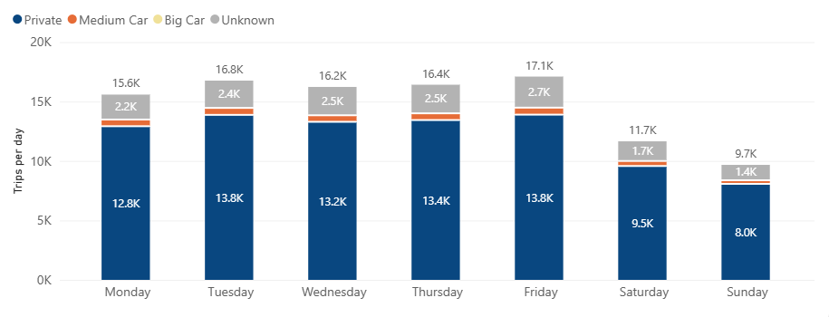
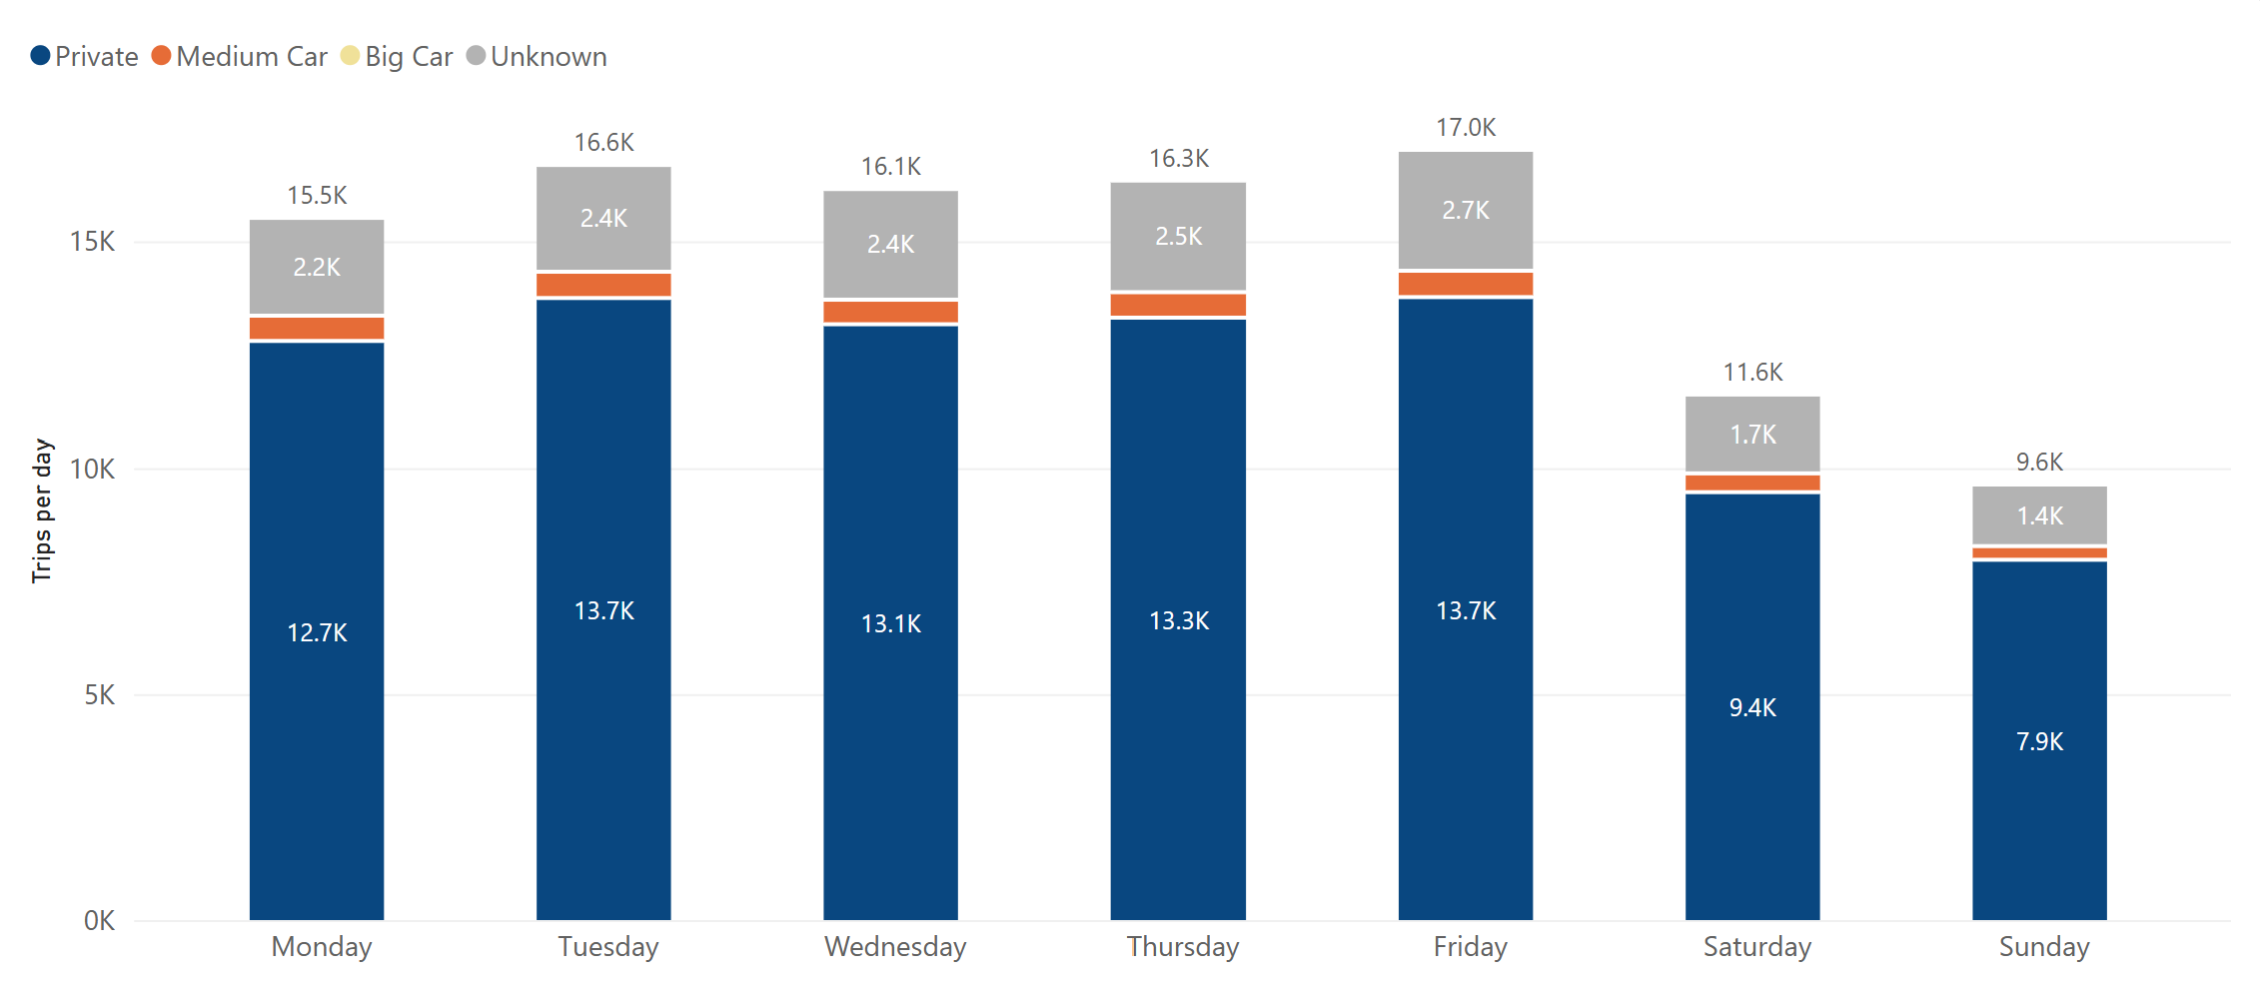
Private cars are about 82% of trips every day; Friday and Tuesday are the busiest
80.8–82.7%
Private, on every weekday
17,100
trips per day on Friday, the busiest
9,672
trips per day on Sunday, the quietest
The vehicle mix does not depend on the day; only the volume does.
Notes:
Wednesday and Thursday have 8 days in the period and the other weekdays 9, so I compare trips per day, not total trips. Big Car appears only 4 times in two months.

Slide 4
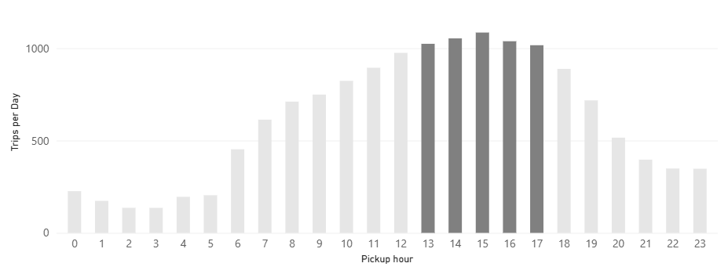
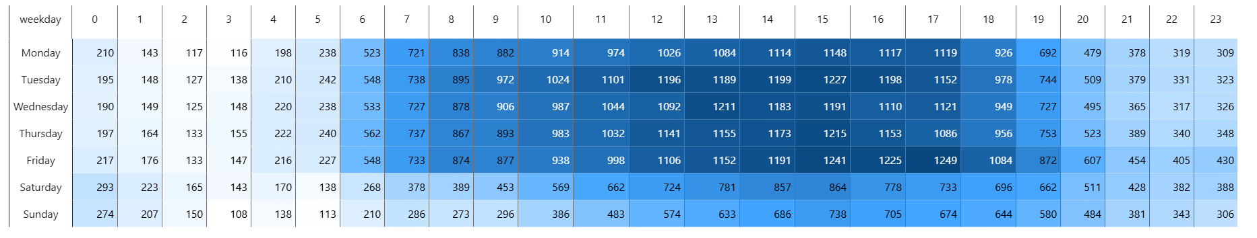
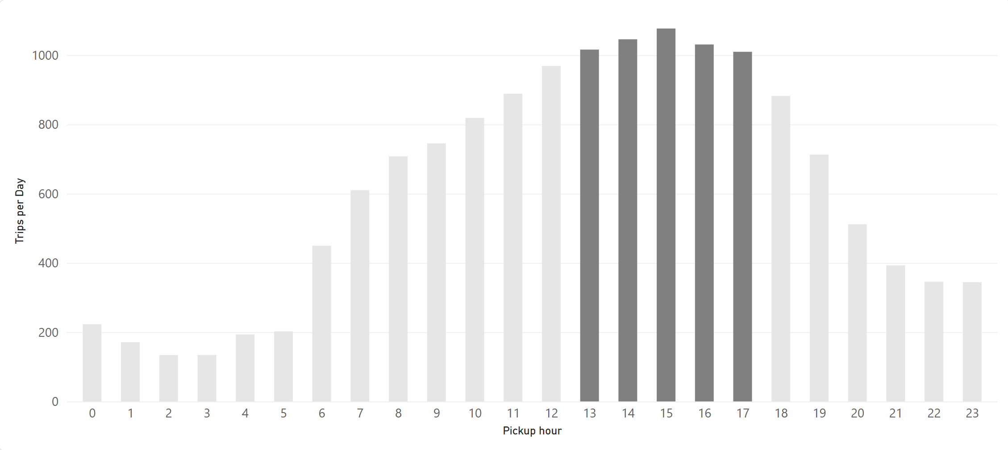
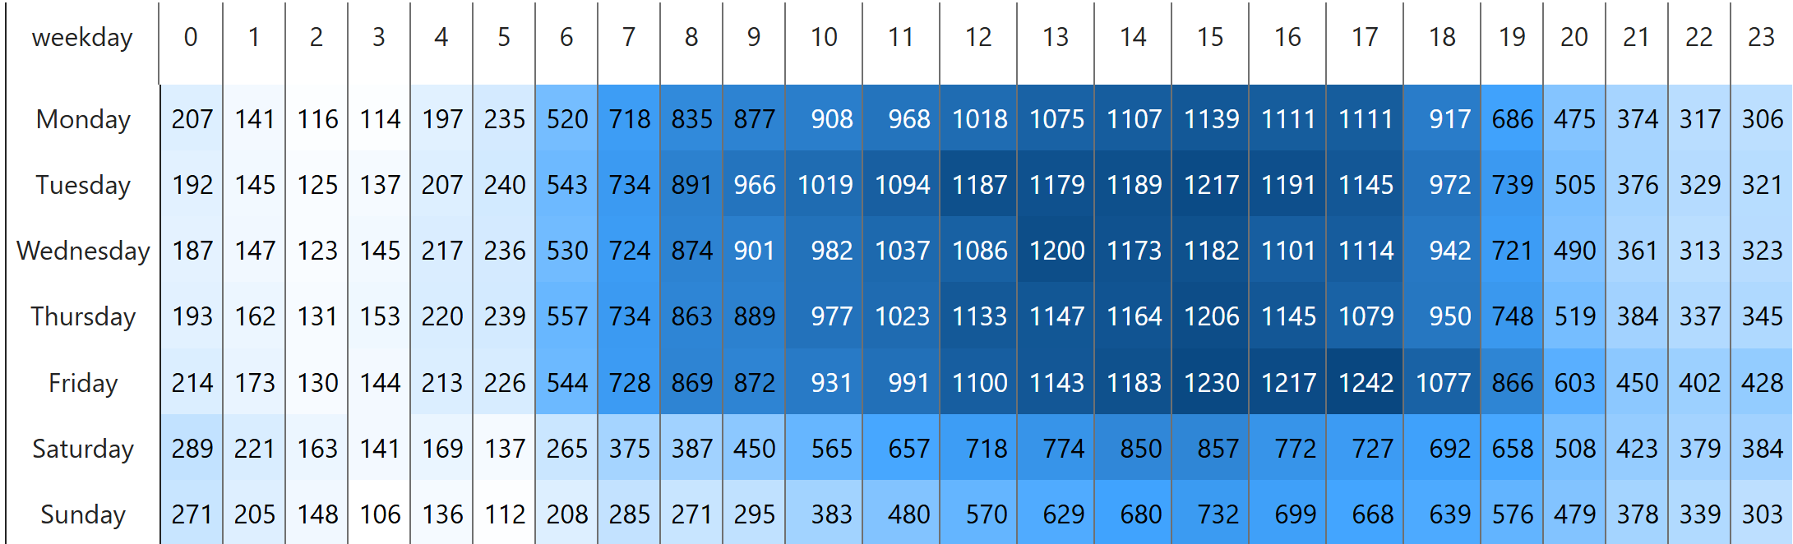
Demand peaks 13:00–17:00 on weekdays, with no morning rush
35.4%
of trips start between 13:00 and 17:00
1,085
trips per day at 15:00, the peak hour
1,249
trips per day on Friday at 17:00, the busiest hour of the week
Most cars are needed on weekday afternoons, not at the usual commute times.
Notes:
May and June 2020 were the start of the recovery after the lockdown. With fewer people commuting to offices, the usual morning peak is missing: 07:00–09:00 has about 720–970 trips per day on weekdays, against 1,100–1,250 in the afternoon.

Slide 5
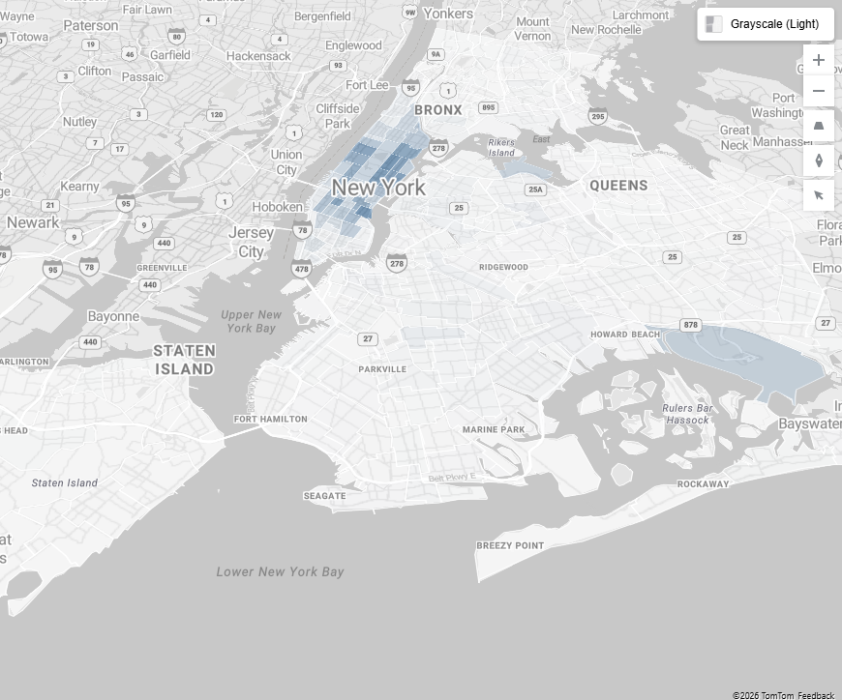
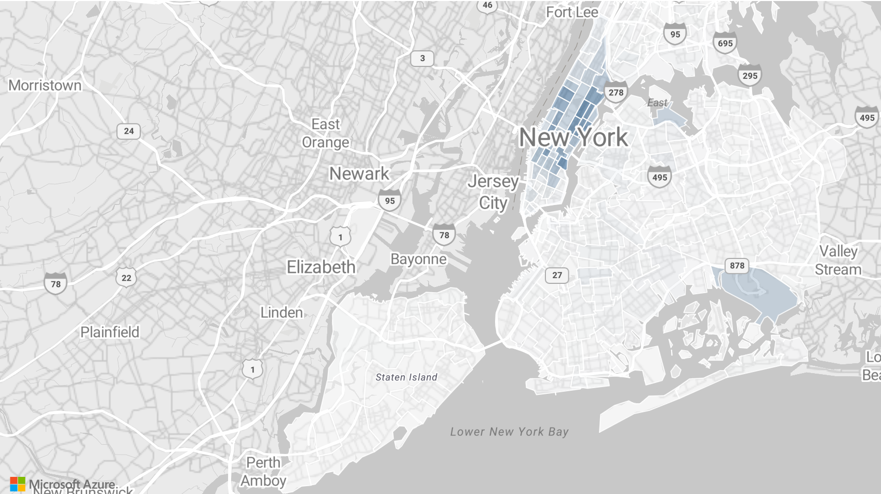
Manhattan has 86% of pickups, but trips that start outside it pay about twice as much
Pickups
Avg driver income per trip, by borough
86.33%
of pickups are in Manhattan
$33.44
per trip from Queens, vs $14.62 from Manhattan
$48.15
per JFK pickup; airports are only 2.71% of pickups
Manhattan brings the volume; airports and outer boroughs bring the value per trip.
Notes:
The average for all trips is $16.76. Brooklyn ($28.43) and the Bronx ($27.35) are close to twice the Manhattan value. Per minute the difference is much smaller, because these trips are longer. Newark has only 38 pickups ($69.25 per trip), so it is left out of the chart and the conclusions.

Slide 6
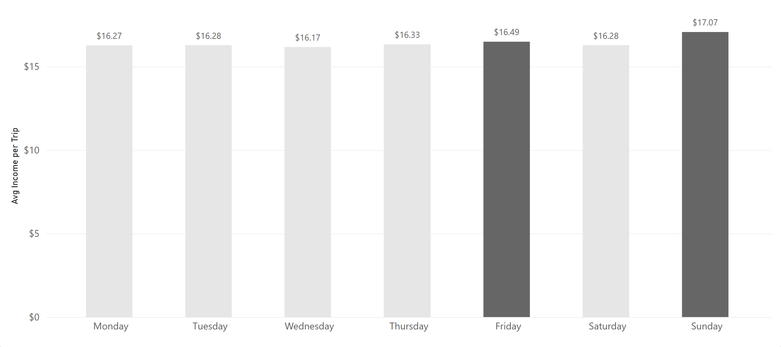
Monday leads income per trip, but only because of one $429,562 trip
$19.21
average driver income per trip on Monday
$16.15
on Monday without that single trip
$16.93
on Sunday, the second day
Without that one record, Sunday and Friday lead, and the gap between days is small.
Notes:
The trip: Monday 4 May 2020, 20:00, Lincoln Square East (Manhattan), $429,562.25 for 0 miles and 0.9 minutes, payment type 3 (no charge). It is a recording error, but it is kept, as required by the project brief. Driver income here is fare plus extra plus tip; taxes, tolls and surcharges are not kept by the driver, so they are not counted.

Slide 7
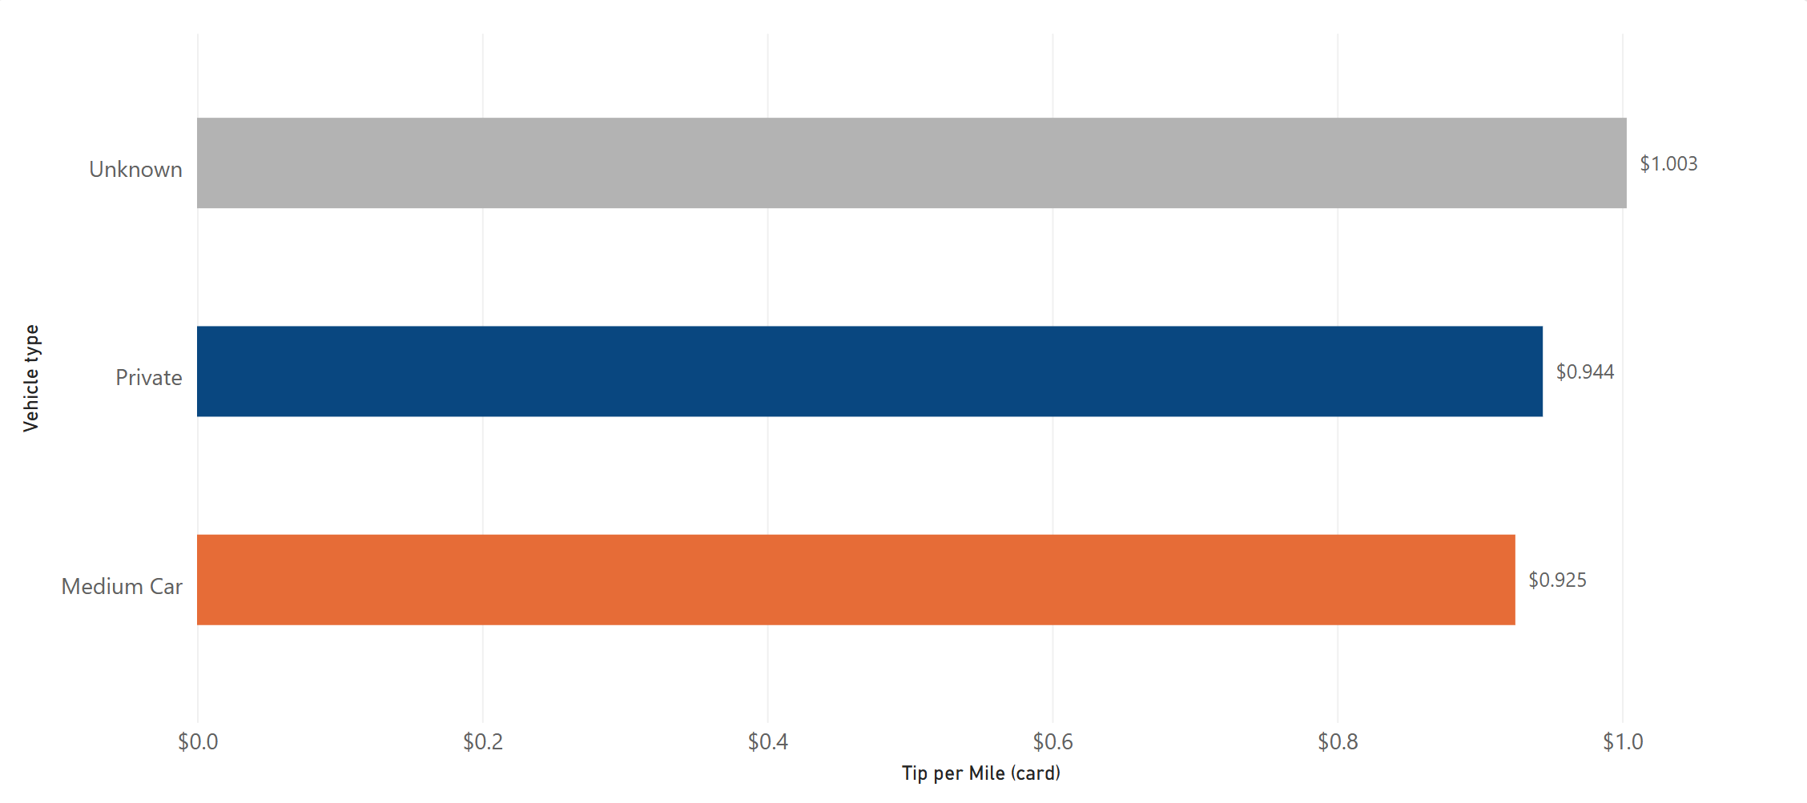
Tips per mile are about the same for every vehicle type once only card tips are counted
Vehicle type | All records | Excl. extremes
Unknown | $1.002 | $1.003
Private | $0.943 | $0.944
Medium Car | $0.924 | $0.925
$0.944
tip per mile, all card payments
Cash tips are not recorded in TLC data, so only card payments are counted. Excluding the extreme values changes the result by less than 0.2%.
Notes:
On all payment types, Unknown looked much worse. The TLC data dictionary says that tip_amount includes only card tips. Unknown has fewer card payments, so its cash tips were missing. With card payments only, the difference disappears. Big Car has 4 trips with 0 miles, so it cannot be calculated.

Slide 8
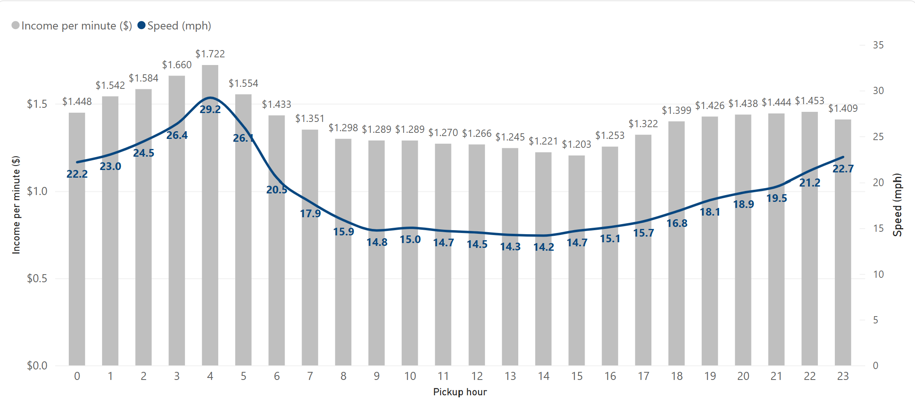
The afternoon pays the least per minute; single records distort 04:00 and 20:00
$1.061
per minute 13:00–17:00, vs $1.358 at other hours
−$1.794
at 04:00: one record with a duration of −531,231 minutes
$2.227
at 20:00: the same $429,562 trip as on Monday
The busy afternoon hours are the slowest, so they pay the least per minute.
Notes:
Minutes are trip time only; waiting time between trips is not in the data. Without the extreme values, 04:00 is the best hour ($1.722 per minute) and 15:00 the worst ($1.203); the grey line shows that view.

Slide 9
What to do with these results
Vendor
• Plan the most cars for weekday afternoons, 13:00–17:00 (35.4% of trips), and for Friday and Tuesday.
• Keep supply in Manhattan (86.33% of pickups); treat airports as few trips with high value ($48.15 per JFK pickup).
• Check trip data at the source: 6,608 records (0.74%) have impossible values, and one of them changes two answers.
Driver
• Afternoon traffic pays the least per minute: $1.061 at 13:00–17:00 vs $1.358 at other hours.
• The JFK flat fare pays $58.85 per trip for 29.88 minutes (6,880 trips).
• Once the single $429,562 trip is set aside, the weekday matters little; the hour and the place matter more.
Notes:
Vendor recommendations come from questions 1, 2 and 5; driver recommendations from questions 3, 5 and 6.

Slide 10
Own initiative: the same analysis without the 6,608 extreme records
Why
• A few impossible values can move averages a lot, so I also looked at the answers without them.
• The records are flagged in a Data Quality Flag column, not deleted, and filtered on separate report pages marked (excl.).
Answers without the extreme values
• Best income days: Sunday ($17.07) and Friday ($16.49).
• Best hour per minute: 04:00 ($1.722); worst: 15:00 ($1.203).
• Busiest days, peak hours, tips and zones: the same as with all records.
• Full deck for this view: presentation/B_extremes-excluded.
Flag | Rule | Records
negative_fare | fare below $0 | 4,062
duration_gt_300 | trip longer than 5 hours | 1,281
duration_le_0 | duration of 0 minutes or less | 1,211
distance_gt_200 | distance above 200 miles | 30
out_of_period | date outside May–June 2020 | 23
fare_gt_1000 | fare above $1,000 | 1
Total | 0.74% of 898,131 records | 6,608
Notes:
This view was not required by the project brief. I added it on my own initiative to see how much the impossible values affect the answers. One label per record: the first rule that applies.

Slide 11
Comparison: 4 of 6 answers stay the same; 2 change because of single records
Question | All records | Extremes excluded | Changed
1 Busiest days | Friday 17,099.7 · Tuesday 16,761.6 | Friday 16,978 · Tuesday 16,643 | No
2 Peak hours | 13:00–17:00 (35.44%) | 13:00–17:00 (35.44%) | No
3 Best income days | Monday $19.21 · Sunday $16.93 | Sunday $17.07 · Friday $16.49 | Yes – one $429,562 trip
4 Tip per mile (card) | Unknown $1.002 · Private $0.943 | Unknown $1.003 · Private $0.944 | No
5 Zones | Manhattan 86.33% · Kips Bay 35,327 | Manhattan 86.37% · Kips Bay 35,081 | No
6 Income per minute | Best 20:00 $2.227 · 04:00 negative | Best 04:00 $1.722 | Yes – one −531,231-min trip
• Totals change little: +0.7% trips per day, +2.9% farebox per day.
• Averages over time and distance move most: minutes per trip +10.1%, average speed +49.4%, income per minute −7.1%.
• Δ% = (all records − extremes excluded) / extremes excluded. All values come from SQL and match the Power BI comparison page.
Notes:
The comparison page in Power BI shows the same table, the key indicators side by side and the income charts for both views. Two answers change, and each change comes from a single record.

Slide 12
Limits of this analysis and next steps
Limits
• The flag rules catch impossible values, not every suspicious one: a $950 trip of 0.3 miles passes every rule.
• Cash tips are not recorded, so tip results use card payments only.
• Minutes are trip time only; waiting time between trips is not in the data.
• There is no vehicle or driver ID, so income per shift or per car is unknown.
• May–June 2020 was the start of the recovery after the lockdown; the results describe that period only.
Next steps
• Repeat the analysis on a full year of TLC data to compare with normal demand.
• Add plausibility rules, such as fare per mile, to catch suspicious trips and not only impossible ones.
Notes:
These limits come from the data itself. A full year of data would show whether the patterns hold outside the recovery period.

