Slide 1
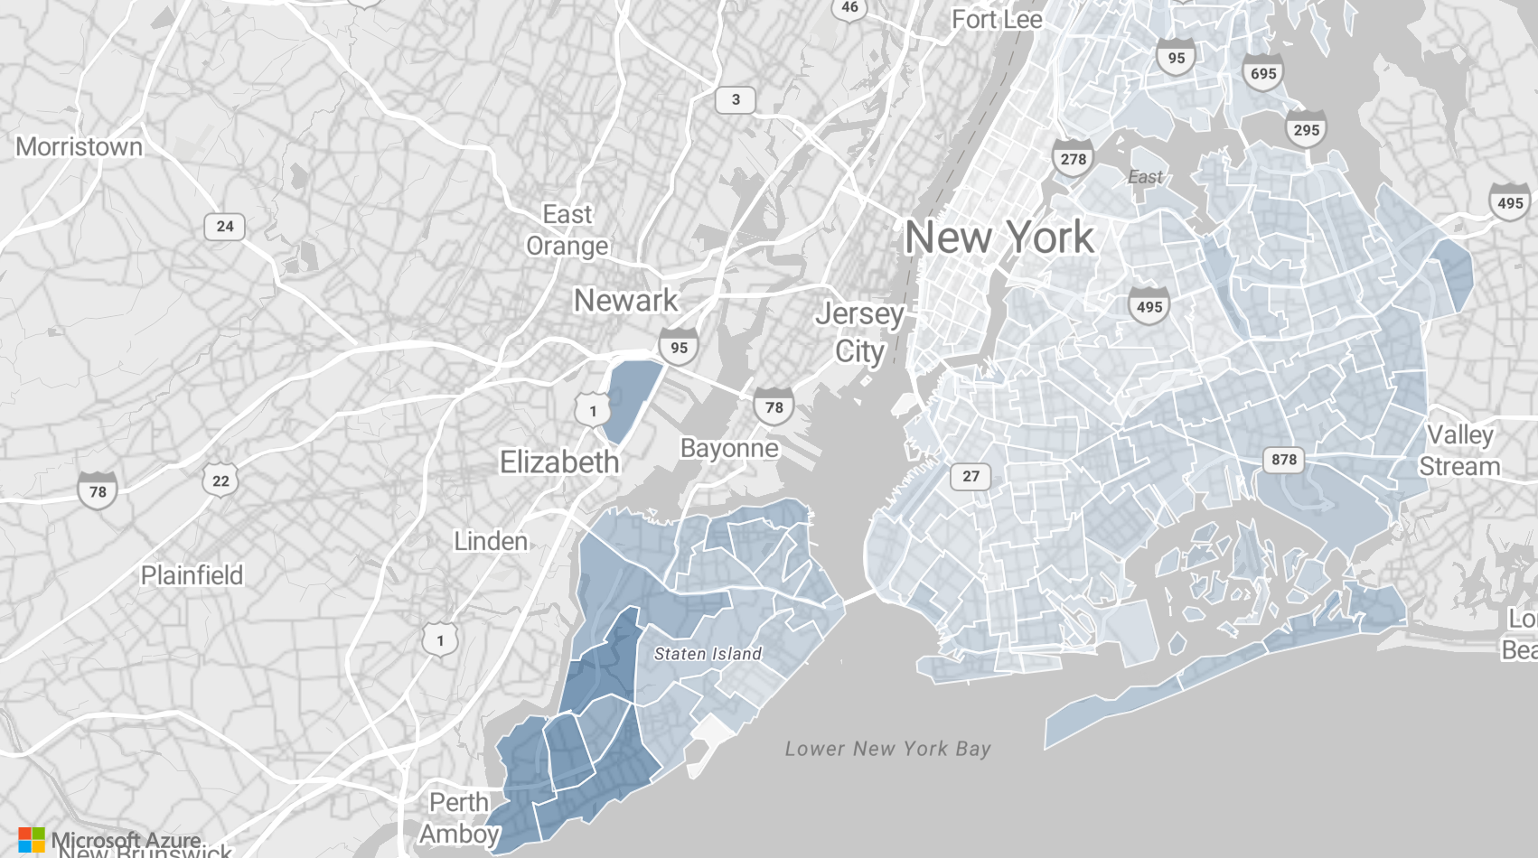
NYC Yellow Taxi: when, where and how drivers earn
Power BI analysis of 891,523 trips
May–June 2020 · Angel Iana
Notes:
This analysis looks at yellow taxi trips in New York in May and June 2020 from two perspectives: the vendor, who needs to know when and where demand happens, and the driver, who wants to know when and where a trip pays the most.

Slide 2
The data: 891,523 trips, checked in SQL and matched to TLC counts
898,131 trips
TLC trip records, 2 monthly files
SQL Server checks
6,608 trips with impossible values excluded
Power BI report
891,523 trips · 4 pages
 | Our data (trips per day) | TLC official
May 2020 | 11,153 | 11,237
June 2020 | 18,192 | 18,326
Our counts are slightly lower because of the 6,608 excluded trips. Every number in this deck comes from a SQL query and matches the Power BI report.
Notes:
Before building the report I loaded the files into SQL Server and checked them. Only trips with impossible values were removed; missing values are kept as Unknown. The totals match the official TLC monthly figures, so the data is complete.

Slide 3
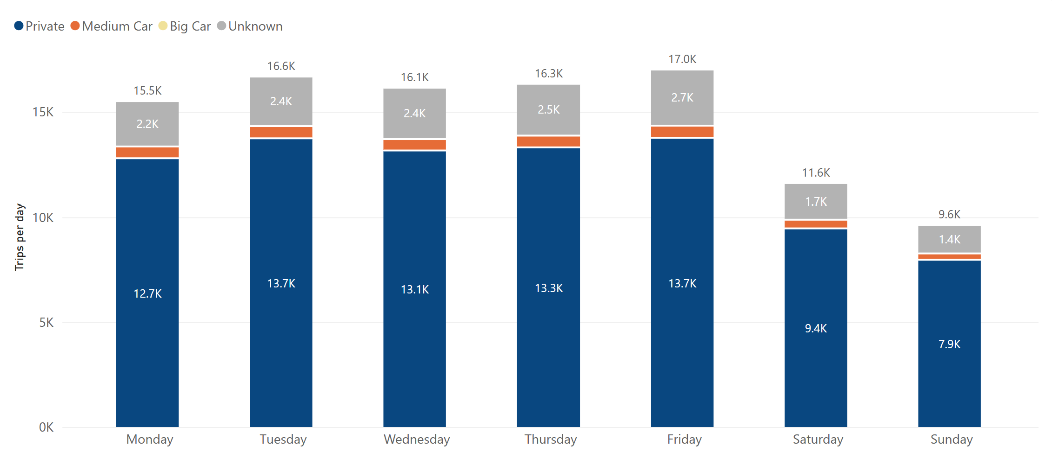
Private cars are about 82% of trips every day; Friday and Tuesday are the busiest
80.8–82.6%
Private, on every weekday
16,978
trips per day on Friday, the busiest
9,594
trips per day on Sunday, the quietest
The vehicle mix does not depend on the day; only the volume does.
Notes:
Wednesday and Thursday have 8 days in the period and the other weekdays 9, so I compare trips per day, not total trips. Big Car appears only 4 times in two months.

Slide 4
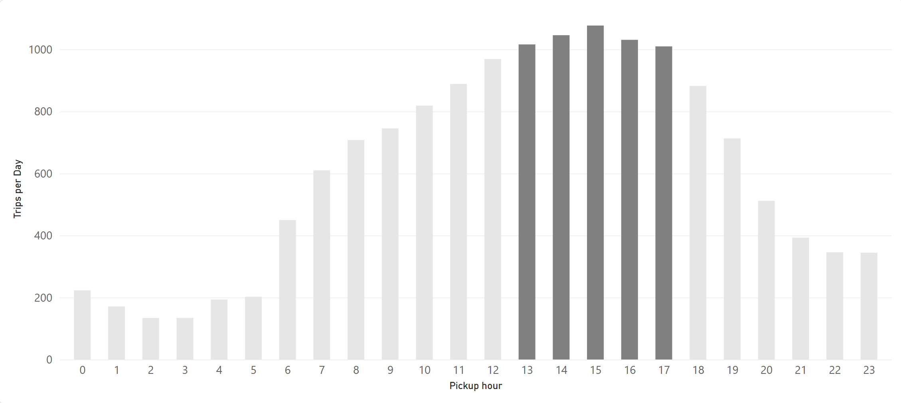
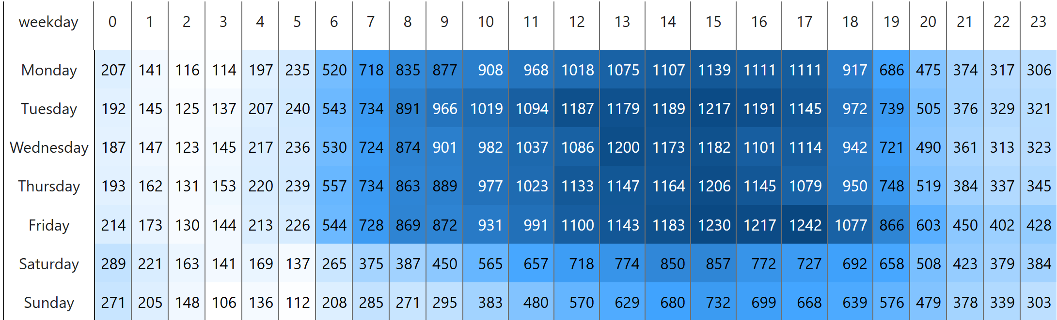
Demand peaks 13:00–17:00 on weekdays, with no morning rush
35.4%
of trips start between 13:00 and 17:00
1,077
trips per day at 15:00, the peak hour
4.2–5.1%
of trips in each hour from 07:00 to 09:00
Most cars are needed on weekday afternoons, not at the usual commute times.
Notes:
May and June 2020 were the start of the recovery after the lockdown. With fewer people commuting to offices, the usual morning peak is missing.

Slide 5
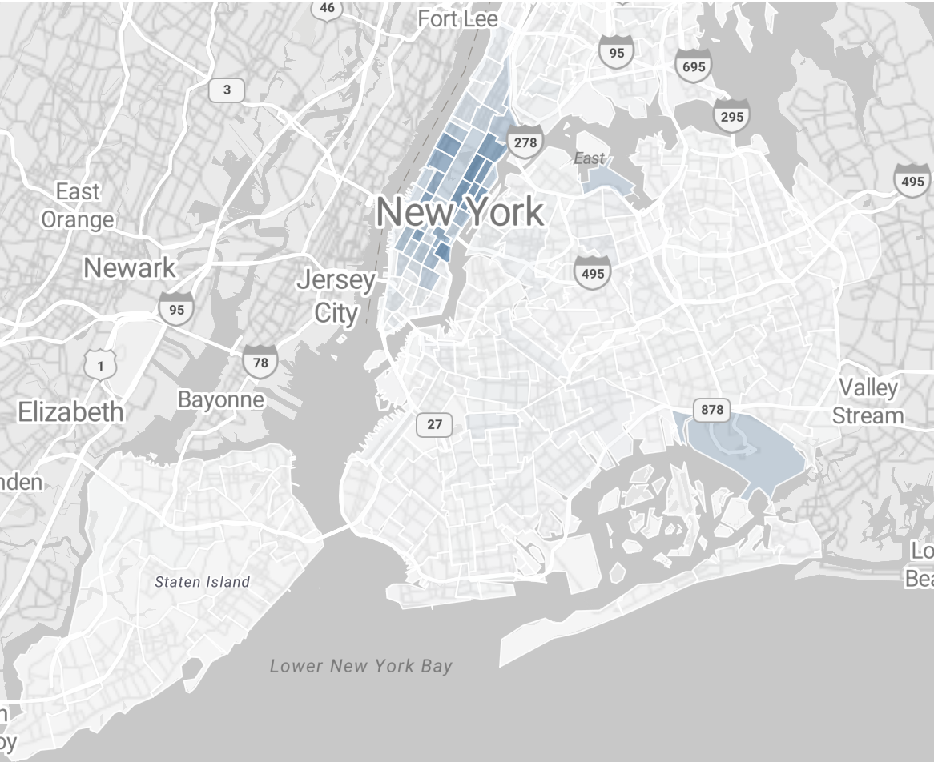
Manhattan has 86% of pickups, but trips that start outside it pay about twice as much
Pickups
Avg driver income per trip
86.37%
of pickups are in Manhattan
$33.68
per trip from Queens, vs $14.17 from Manhattan
$48.20
per JFK pickup; airports are only 2.71% of pickups
Manhattan brings the volume; airports and outer boroughs bring the value per trip.
Notes:
The average for all trips is $16.38. Brooklyn ($28.53) and the Bronx ($27.47) are also close to twice the Manhattan value. Per minute the difference is much smaller, because these trips are longer. Newark has only 36 pickups, so I leave it out of the conclusions.

Slide 6
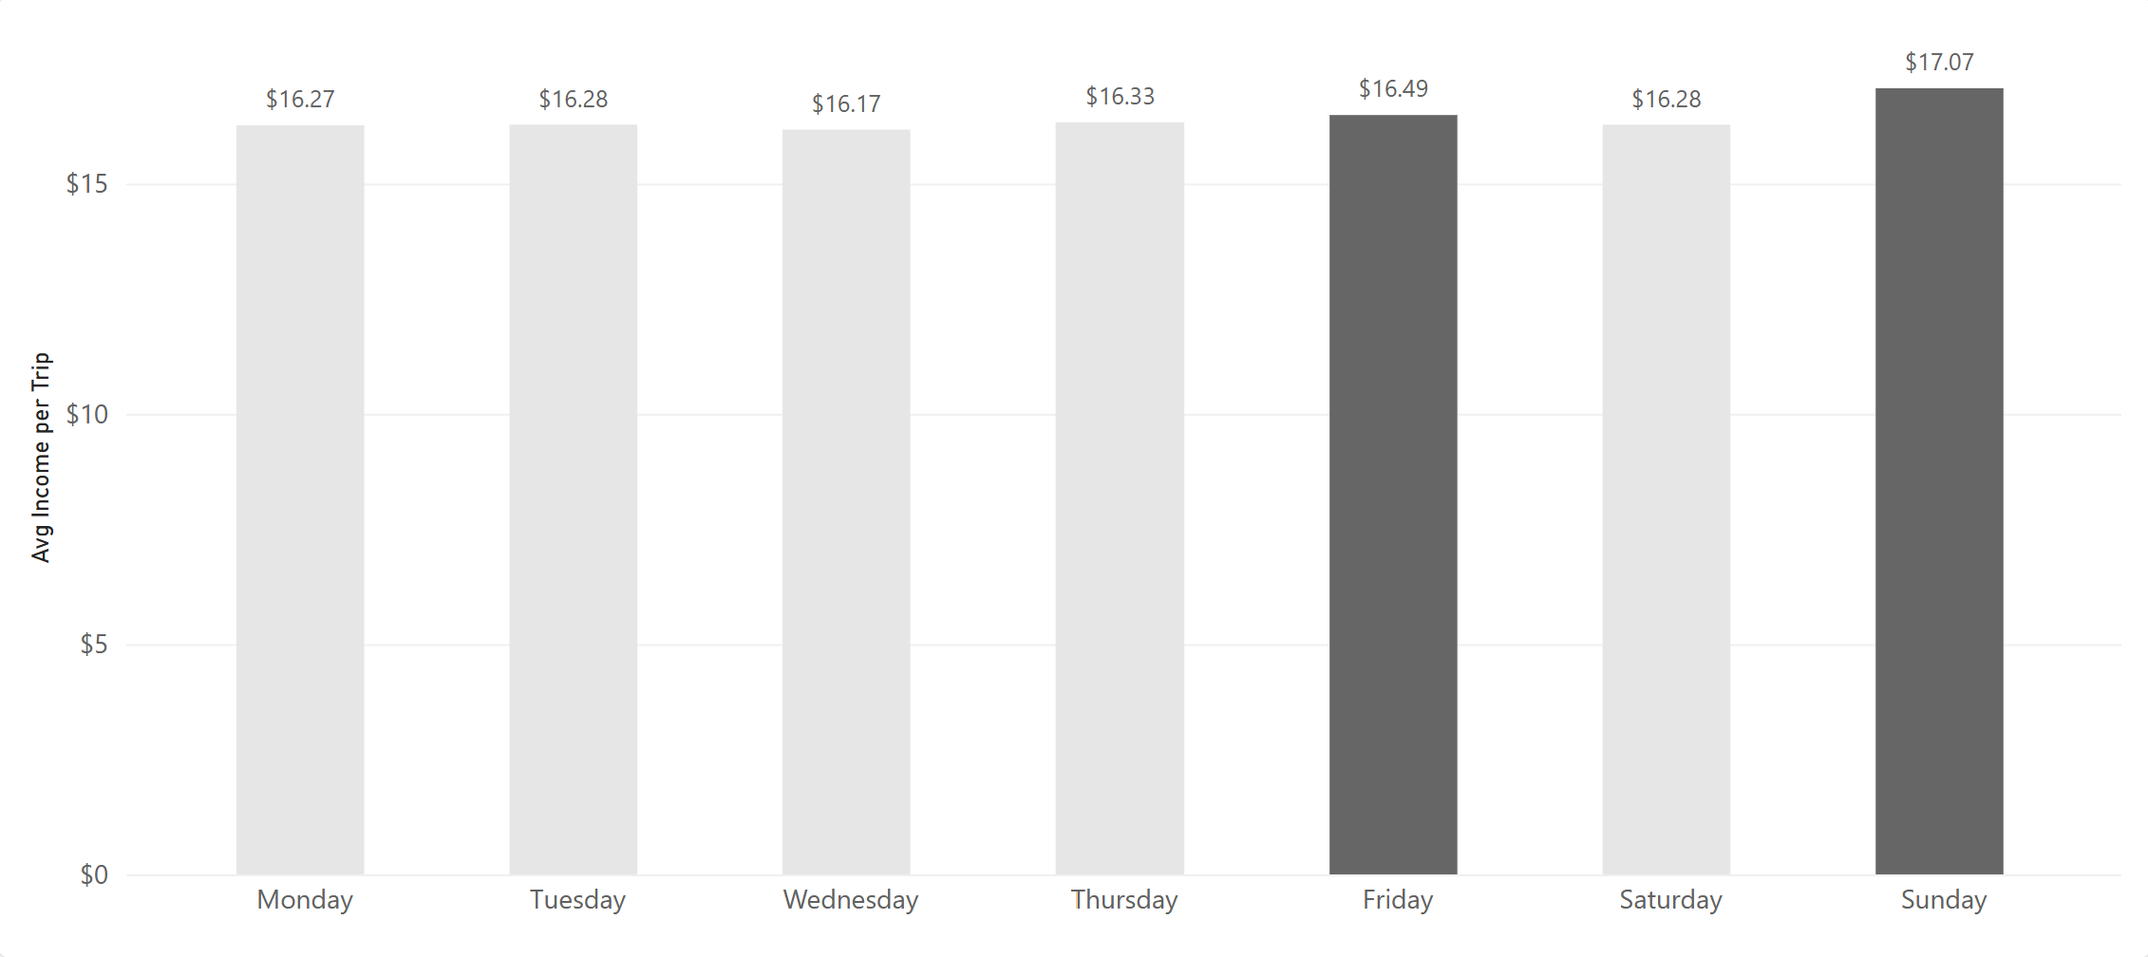
Sunday and Friday pay the most per trip, but the gap between days is only 5.5%
$17.07
average driver income per trip on Sunday
$16.49
on Friday
$0.90
gap between the best and the worst day (Wednesday)
For a driver, the day of the week matters much less than the hour or the place.
Notes:
Driver income here is fare plus extra plus tip. Taxes, tolls and surcharges are passed on, not kept by the driver, so they are not counted.

Slide 7
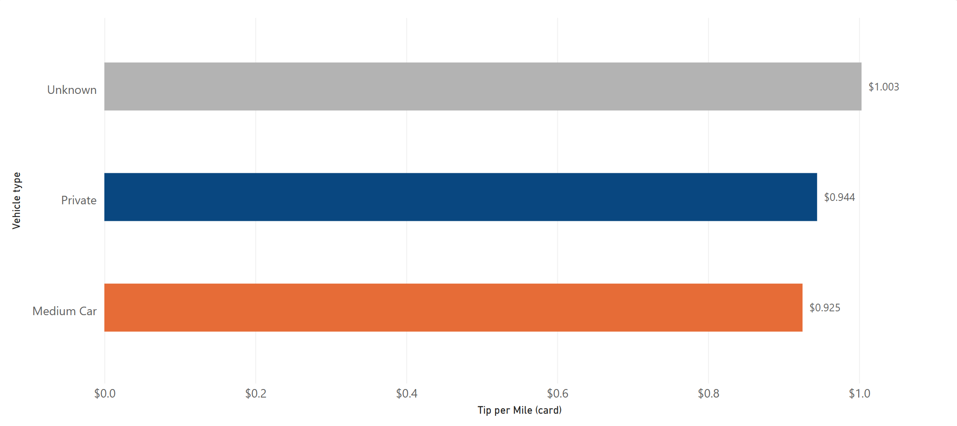
Tips per mile are about the same for every vehicle type once only card tips are counted
Vehicle type | All trips | Card only
Unknown | $0.168 | $1.003
Private | $0.614 | $0.944
Medium Car | $0.616 | $0.925
$0.945
tip per mile, all card payments
The first result came from the payment type, not from the vehicle type: cash tips are not recorded in TLC data.
Notes:
On all trips, Unknown looked much worse. The TLC data dictionary says that tip_amount includes only card tips. Unknown has fewer card payments, so its cash tips were missing. With card payments only, the difference disappears. Big Car has 4 trips with 0 miles, so it cannot be calculated.

Slide 8
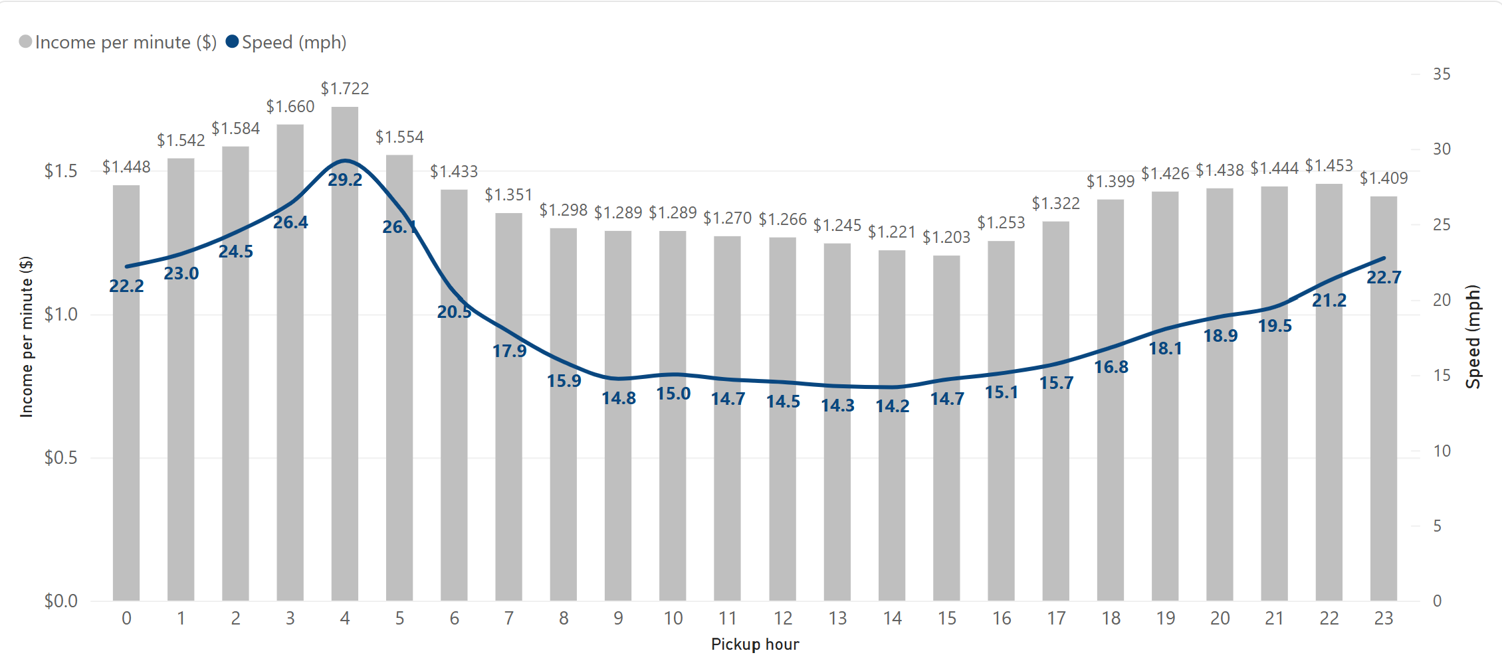
Night hours pay the most per minute; slow afternoon traffic pays the least
$1.722
per minute at 04:00, the best hour
$1.203
per minute at 15:00, the worst hour
29 vs 14 mph
traffic speed at 04:00 vs 14:00
The busiest hours are the slowest, so they pay the least per minute ($1.248 vs $1.390 for other hours).
Notes:
Minutes are trip time only. Waiting time between trips is not in the data, and at night there are fewer passengers, so real hourly earnings at night can be lower.

Slide 9
What to do with these results
Vendor
• Plan the most cars for weekday afternoons, 13:00–17:00 (35.4% of trips), and for Friday and Tuesday.
• Keep supply in Manhattan (86.37% of pickups); treat airports as few trips with high value ($48.20 per JFK pickup).
• Plan for empty returns: Brooklyn, the Bronx and Queens receive more trips than they send.
Driver
• Per minute, night hours pay the most ($1.722 at 04:00), but there are fewer passengers.
• The JFK flat fare pays $61.29 per trip for 27.81 minutes (6,693 trips).
• The weekday matters little (5.5% gap); the hour and the place matter more.
Notes:
Vendor recommendations come from Q1, Q2 and q5; driver recommendations from Q3, q5 and q6.

Slide 10
Limits of this analysis and next steps
Limits
• Cash tips are not recorded, so tip results use card payments only.
• Minutes are trip time only; waiting time between trips is not in the data.
• There is no vehicle or driver ID, so income per shift or per car is unknown.
• May–June 2020 was the start of the recovery after the lockdown; the results describe that period only.
Next steps
• Repeat the analysis on a full year of TLC data to compare with normal demand.
• Add the drop-off zone to the income analysis to measure empty returns.
Notes:
These limits come from the data itself. A full year of data would show whether the patterns hold outside the recovery period.

