Slide 1
Global Supply Chain and Risk Analysis
Data Analytics Project using Power BI
Angel Francis Date : 23-04-2026

Slide 2
Project Introduction & Objective
This project focuses on analyzing global shipment operations to understand performance trends, operational efficiency, and risk factors affecting supply chain activities.
The objective of this project is to monitor shipment performance, identify disruption risks, and support data-driven decision-making through interactive dashboards and data visualization.

Slide 3
Dataset Source & Overview
Data Source: Kaggle The dataset used in this project is a simulated global supply chain dataset designed for analytical and learning purposes.
Total Records: 5,000 shipments
Data Type: Operational and logistics data
Scope: Global transportation and shipment activities
Data Structure: Transactional shipment records
The dataset contains information related to shipment locations, product categories, transportation conditions, and disruption indicators.

Slide 4
Important Columns & Data Types
Shipment_ID -Text
Product_Category - Text
Origin_Port -Text
Destination_Port - Text
Transport_Mode -Text
Lead_Time_Days - Decimal Number
Weight_MT - Decimal Number
Distance_km - Decimal Number
Weather_Condition - Text
Fuel_Price_Index - Decimal Number
Geopolitical_Risk_Score - Decimal Number
Disruption_Occurred - Whole Number (0 = No, 1 = Yes)
These columns were selected because they directly support operational and risk analysis.

Slide 5
Data Cleaning & Transformation
Verified the dataset for duplicate records
Checked for missing or null values
Ensured correct data types for each column
Validated data consistency across fields
Prepared the dataset for analysis and reporting

Slide 6
Data Modeling
Created a Fact table to store shipment transaction data
Developed Dimension tables for Product, Port,Transport,Weather and Date information
Established relationships between tables using key fields
Implemented a star schema data model
This data model improves performance, supports accurate filtering, and enables efficient analysis.

Slide 7
DAX Measures & Calculations
Operational Metrics
Total Shipments
Total Distance
Total Weight
Average Lead Time
Total Product Categories
Total Ports
Performance Metrics
Average Reliability Score
Most Reliable Product Category
Most Reliable Port

Slide 8
Risk Metrics
Disruption Rate
Average Disruption Rate
Total Disrupted Shipments
Average Geopolitical Risk Score
Highest Risk Product Category
Weather Condition with Highest Disruption
Product Category with Highest Disruption
Logistics & Flow Metrics
Most Shipped Product Category
Top Exporting Port
Top Importing Port

Slide 9
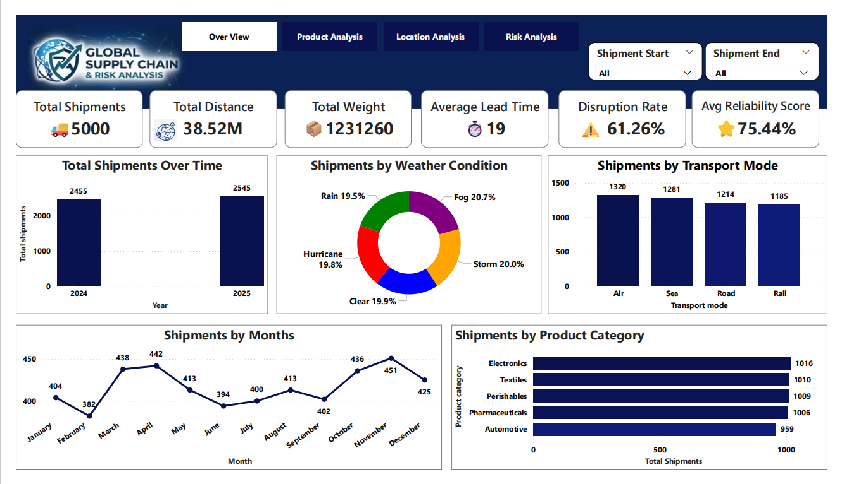
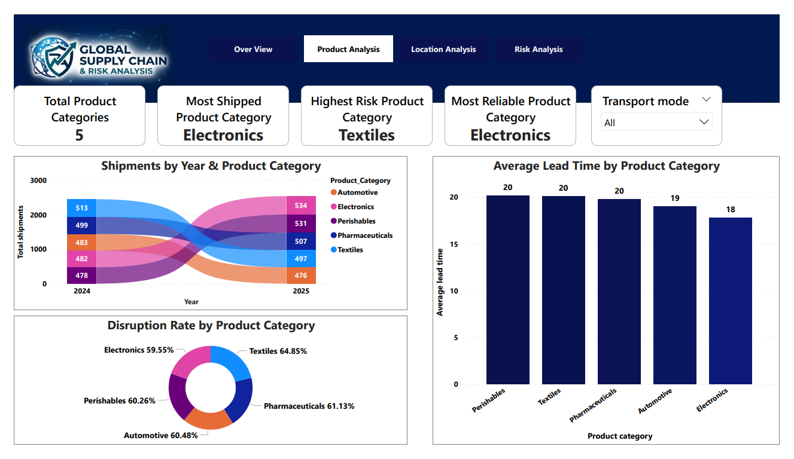
Report Design & Visual Appearance

Slide 10
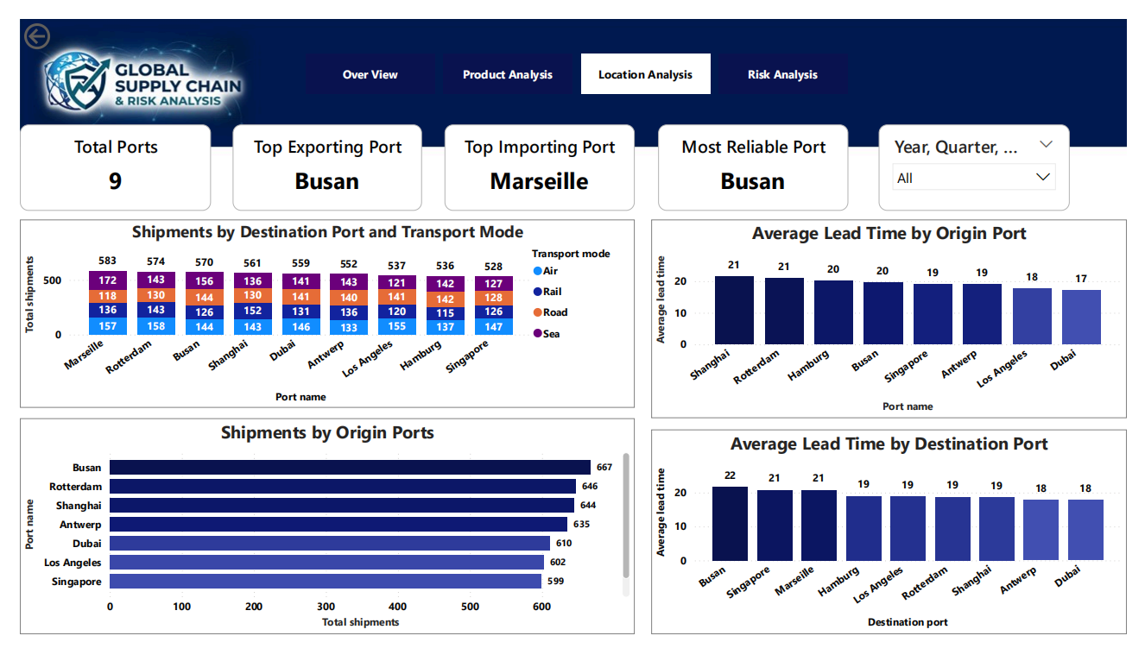
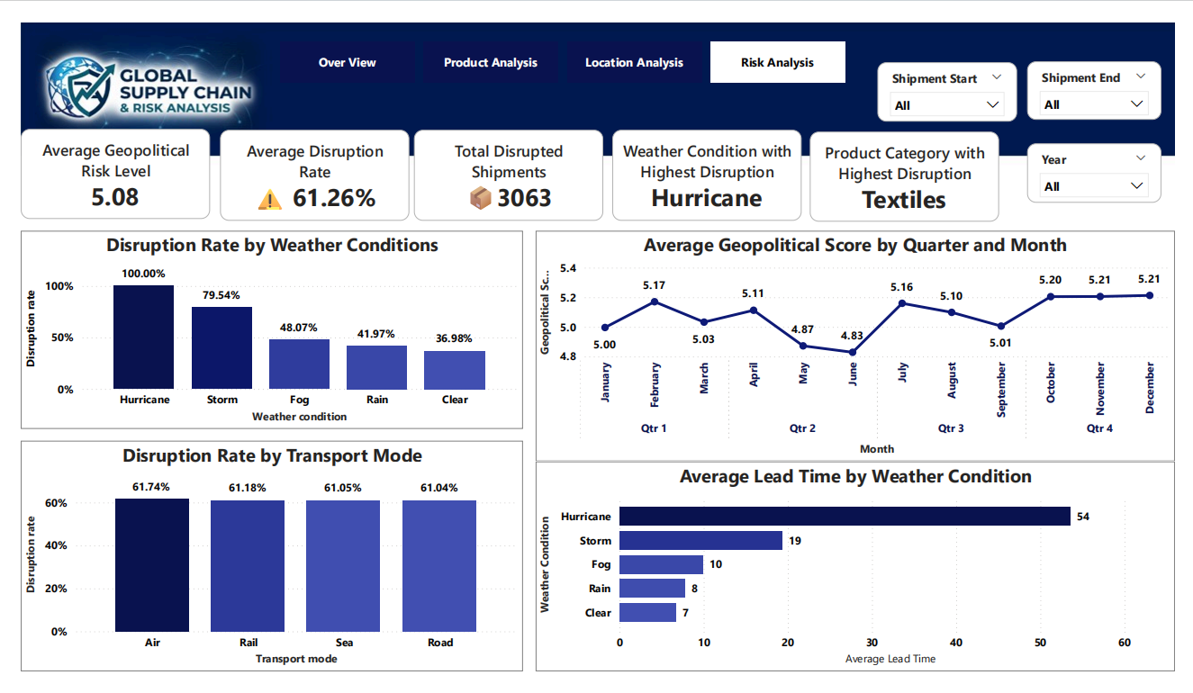

Slide 11
Designed a clean and professional dashboard layout
Used consistent color themes and formatting across all pages
Selected appropriate chart types for each type of analysis
Included KPI cards for quick performance monitoring
Applied clear titles and labels to improve readability

Slide 12
Power BI Features Used
Slicers implemented across report pages, including Shipment Start (Origin Port), Shipment End (Destination Port), Transport Mode, Date Hierarchy (Year, Quarter, Month, Day), and Year.
Interactive filters for dynamic data exploration.
Drill-down functionality for detailed analysis.
Tooltips to display additional information.
Cross-filtering between visuals.
Page Navigator for easy navigation between dashboard pages.

Slide 13
Key Analysis and Insights
Shipment Patterns
The highest number of shipments occurred during fog weather conditions (20.7%), followed by storms.
Air transport mode handled the highest shipment volume (1,320 shipments), followed by sea transport.
Electronics was the most shipped product category, followed by textiles.
Product Performance
Textiles recorded the highest disruption rate (64.85%), followed by automotive products.
Perishables, textiles, and pharmaceuticals showed the highest average lead times.

Slide 14
Location Performance
Busan was the busiest origin port (667 shipments), followed closely by Rotterdam.
Shanghai and Rotterdam recorded the highest average lead time among origin ports (21 days).
Busan, Singapore, and Marseille showed the highest average lead time among destination ports (21 days).
Risk and Disruption Analysis
Hurricane conditions resulted in the highest disruption rate.
Air transport mode showed the highest disruption rate.
A total of 3,063 shipments were disrupted.
Geopolitical risk scores were analyzed on a quarter-wise basis, with peak values observed in February, April, July, November and December.

Slide 15
Storytelling, Business Impact, and Conclusion
Storytelling
This project analyzed global shipment operations to identify patterns, operational efficiency, and risk factors affecting supply chain performance.
The dashboard enables monitoring of shipment trends, disruptions, and delivery performance across products, locations, and transportation modes.
Business Impact
Identify high-risk weather conditions and reduce disruptions
Improve transportation planning and delivery schedules
Monitor shipment performance using real-time metrics
Support data-driven decision-making

Slide 16
Conclusion
The Global Supply Chain & Risk Analysis dashboard demonstrates how data visualization and analytics can improve operational visibility, risk management, and supply chain efficiency.

Slide 17
Thank You All

