Slide 1
Chapter14 Capital Structure in a Perfect Marcket
第6組
108AB8012 陳睿理
108AB8004 尹宜蓁
108AB8011 尹貽正
108AB8020 黃怡瑄
Notes:
完美市場中的資本結構

Slide 2
Chapter Outline
14.1 Equity Versus Debt Financing
14.2 Modigliani-Miller I: Leverage, Arbitrage, and Firm Value
14.3 Modigliani-Miller II: Leverage, Risk, and the Cost of Capital
14.4 Capital Structure Fallacies
14.5 MM: Beyond the Propositions
Notes:
14.1 股權融資與債務融資
14.2 MM第一定理：財務槓桿、套利與公司價值
14.3 MM第二定理：財務槓桿、風險和資本成本
14.4 資本結構謬論
14.5 MM:超越定理之外

Slide 3
14.1 Equity Versus Debt Financing
The relative proportions of debt, equity, and other securities that a firm has outstanding constitute its capital structure.
Notes:
14.1股權與債務融資
資本結構(capital structure)—公司發行在外的債務、股權和其他證券的相對比例。
當公司從外部投資者那裡籌集資金時，他們必須選擇發行哪種類型的證券?最常見的選擇是融資 這一節我們開始用通過股權融資，通過債務和股權的組合融資，這兩種選擇。進行討論。

Slide 4
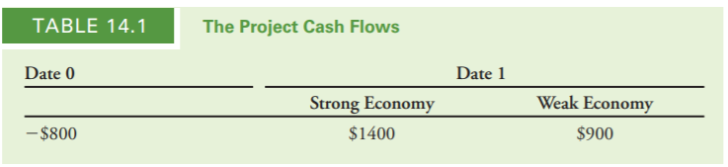
Financing a Firm with Equity
For an initial investment of $800 this year, a project will generate cash flows of either $1400 or $900 next year.
Notes:
以股權為公司融資：
考慮如下投資機會，今年初始投資800美元，預期明年產生的現金流為1400美元或900美元。現金流分別取決於經濟形勢的强或弱。出現兩者 情形的概率相等，如表14.1所示(項目的現金流)。
如果經濟很好的話， 你就可以拿到1400塊 ，如果經濟不好的話，你可以拿到900塊， 就是不管怎樣你都會賺到錢， 然後他就折現，折現就是經濟好跟經濟不好各有 50percent的機會發生，所以我們就做一個折現，所以就發現說.
我們預期會流入的金流，是1150塊，

Slide 5
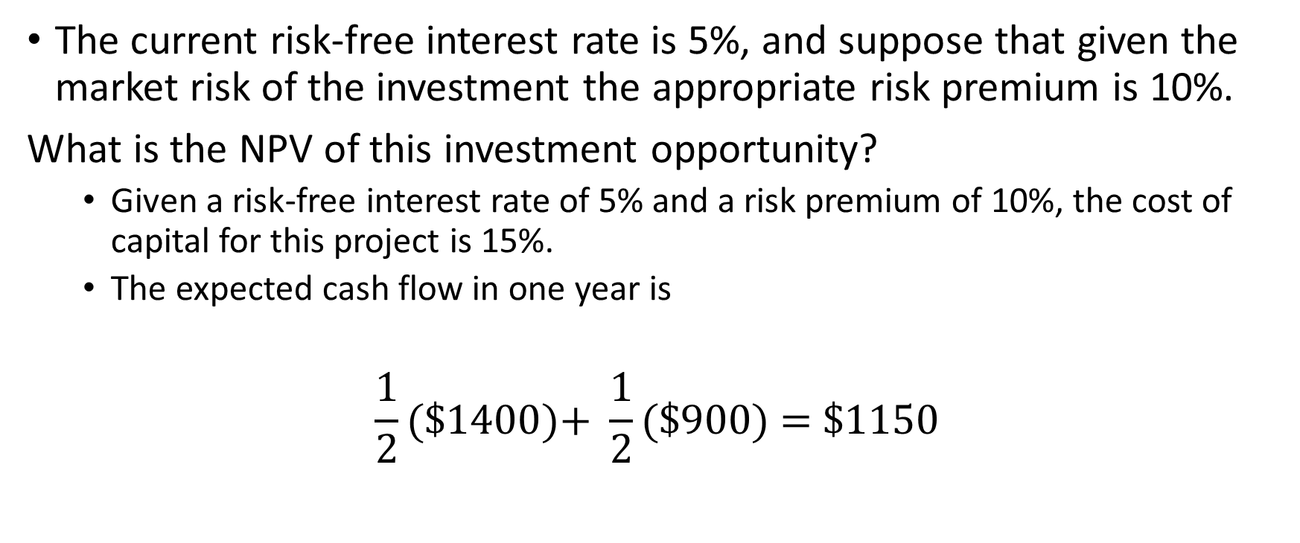
Financing a Firm with Equity
The current risk-free interest rate is 5%, and suppose that given the market risk of the investment the appropriate risk premium is 10%.
What is the NPV of this investment opportunity?
Given a risk-free interest rate of 5% and a risk premium of 10%, the cost of capital for this project is 15%.
The expected cash flow in one year is
$$\frac{1}{2}(\text{\$1400)+} \frac{1}{2}(\text{\$900) = \$1150}$$
Notes:
以股權為公司融資：
假設目前的無風險利率為5%，投資者要求的風險溢價為10%。 此投資機會的淨現值是多少？
給予5%的無風險利率，風險溢價為10%，項目的資金成本為15%。(出現兩者情形的概率相等)
一年後的期望現金流為：
如果經濟很好的話， 你就可以拿到1400塊 ，如果經濟不好的話，你可以拿到900塊， 就是不管怎樣你都會賺到錢，然後他就折現，折現就是經濟好跟經濟不好各有 50percent的機會發生，所以我們就做一個折現，所以就發現說.
我們預期會流入的金流，是1150塊
NPV(淨現值)
所以他就說這間公司呢就會把這兩百塊錢吞掉，然後把它拿一千塊錢去販售，因為一千塊錢是這個投資案的現值但是我可以用八百塊實現他，所以說我不用用八百塊去賣給大家，我要用一千塊的價格賣給大家，大家就會買

Slide 6

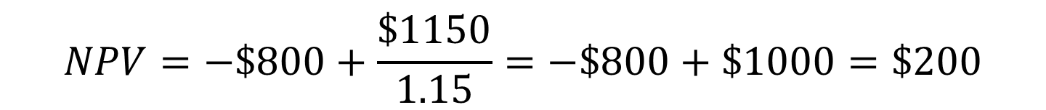
Financing a Firm with Equity
If this project is financed using equity alone, how much would investors be willing to pay for the firm’s shares?
PV (equity cash flows) = $\frac{\$1150}{1.15}$= $1000
$$NPV=−\$800+\frac{\$1150}{1.15}=−\$800+\$1000=\$200$$
Notes:
以股權為公司融資：
如果這個項目僅用股權融資，投資者將願意為項目支付多少？
PV (現值、股權現金流) = $\frac{\$1150}{1.15}$= $1000
如果通過出售公司股權可以募集1000美元，在支付
800美元的投資成本後，可以保留剩餘的200美元(項目的NPV)作為利潤。
NPV(淨現值)
所以他就說這間公司呢就會把這兩百塊錢吞掉，然後把它拿一千塊錢去販售，因為一千塊錢是這個投資案的現值但是我可以用八百塊實現他，所以說我不用用八百塊去賣給大家，我要用一千塊的價格賣給大家，大家就會買

Slide 7
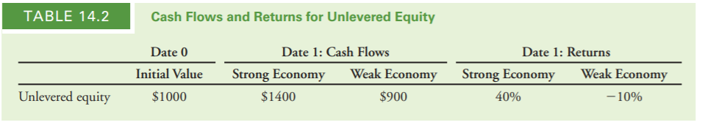
Financing a Firm with Equity
Equity in a firm with no debt is called unlevered equity.
Given equity’s initial value of $1000, shareholders’ returns are either 40% or -10%.
the expected return on the unlevered equity is
$\frac{1}{2}$（40%）+ $\frac{1}{2}$（-10%）=15%
Notes:
無槓桿權益(Unlevered Equity)—無債務公司的股權
因為沒有債務，無槓桿股權的現金流就等於項目的現金流。
表14.2無槓桿股權的現金流和回報率。
股本的初始價值為1000美元，股東的回報率為40%或-10%
無槓桿權益的期望回報率為：
1/2（40%）+1/2（-10%）=15%
因為項目的資本成本為15%，股東對於他們所承擔的風險而言獲得了合理的回報。

Slide 8
Financing a Firm with Debt and Equity
Suppose she decides to borrow $500 initially, in addition to selling equity.
It will owe the debt holders $ 500 * 1.05 = $525 in one year.
Equity in a firm that also has debt outstanding is called levered equity.
Notes:
以債務和股權為公司融資:
為公司提供股權融資並非企業家的唯一選擇。
假設除了出售股權以外，還決定在最初借入500美元的債務。
一年後將償還債權人：$500*1.05=$525(無風險利率為5%)
有槓桿權益(Levered Equity)—有未償付債務的公司的股權
因為我現在我的金流，就是我拿出來的這一千塊裡面有五百塊是債，所以說債的話呢， 就變成我不管怎麼樣我都會付給你的利息525塊 ，

Slide 9
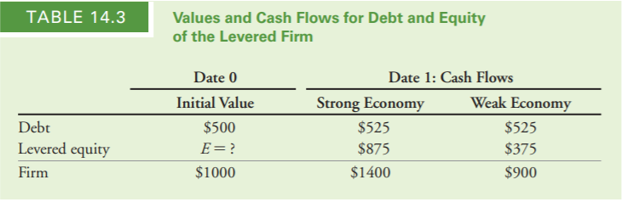
Financing a Firm with Debt and Equity
Given the firm’s $525 debt obligation, the shareholders will receive only $1400 - $525 = $875 if the economy is strong and $900 - $525 = $375 if the economy is weak.
Notes:
給定公司525美元的債務支付義務，股東在經濟強勁時只能收到875 美元(1400 美元 - 525 美元) ;在經濟衰弱時只能收到375 美元($900 - $525 )。
因為我現在我的金流，就是我拿出來的這一千塊裡面有五百塊是債，所以說債的話呢， 就變成我不管怎麼樣我都會付給你的利息525塊 ，
有槓桿股權的出售價格E應該為多少?
對企業家而言哪種是最優的資本結構選擇?
但是如果說我剩下的50percent是權益 ，權益的話就他這裡就槓桿權益，剛剛前面這個是無槓桿權益，這個變成槓桿權益，就變成你現在承擔的就是個更多ㄉ，你要賺到更多的錢是500塊你的return變成了875塊， 是代表你賠也賠得更多，他從500塊如果經濟不好的話他就變成這個375塊，他就是說你可以用兩種既發債也發股票的方式去籌錢只是投資的人他們拿到的東西就很不一樣， 但是他們最後這個投資方案本身創造出來的現金流量是不變的，然後債的那個現金流出的不變， 就是我們要付給他們5%，這個不變的所以改變的就是權益的部分

Slide 10
Financing a Firm with Debt and Equity
In an important paper, researchers Franco Modigliani and Merton Miller proposed an answer to this question that surprised researchers and practitioners at the time. They argued that with perfect capital markets, the total value of a firm should not depend on its capital structure.
Their reasoning: The firm’s total cash flows still equal the cash flows of the project, and therefore have the same present value of $1000 calculated earlier.
Because the cash flows of the debt and equity sum to the cash flows of the project, by the Law of One Price the combined values of debt and equity must be $1000.
Therefore, if the value of the debt is $500, the value of the levered equity must be
E = $1000 - $500 = $500.
Notes:
在一篇重要論文中，研究人員莫迪格利安尼和米勒認為，在完美的資本市場中，公司的總價值不應依賴于公司的資本結構。
他們的推論：公司的總現金流 (槓桿權益) 仍然等於項目的現金流，因此兩者具有相同的現值。
因為債務和股權的現金流之和等於項目的現金流， 根據一價定律，債務和股權的價值必為500美元。
E=$1000-$500=$500。

Slide 11
Financing a Firm with Debt and Equity
Because the cash flows of levered equity are smaller than those of unlevered equity, levered equity will sell for a lower price ($500 versus $1000).
The equity is less valuable with leverage does not mean that the entrepreneur is worse off. She will still raise a total of $1000 by issuing both debt and levered equity, just as she did with unlevered equity alone. As a consequence, she will be indifferent between these two choices for the firm’s capital structure.
Notes:
因為杠杆權益的現金流小於無杠杆權益的現金流， 有杠杆股權將以較低的價格出售（500美元與1000美元）。
然而，事實上 股票在杠杆作用下價值降低並不意味著企業家的境况更糟。她 仍將通過發行債務和杠杆股權籌集1000美元，因此，她不在乎在這兩種公司資本結構之間的選擇。

Slide 12

The Effect of Leverage on Risk and Return
Modigliani and Miller’s conclusion went against the common view, which stated that even with perfect capital markets, leverage would affect a firm’s value. In particular, it was thought that the value of the levered equity would exceed $500, because the present value of its expected cash flow at 15% is
Notes:
莫迪利亞尼和米勒的結論與普遍的觀點背道而馳，其中指出，
即使在完美的資本市場，杠杆也會影響公司的價值。尤其是 認為杠杆權益的價值將超過500美元，因為 預計15%的現金流是$543
之所以這種邏輯是不正確的是，

Slide 13
The Effect of Leverage on Risk and Return
leverage increases the risk of the equity of a firm.
Therefore, it is inappropriate to discount the cash flows of levered equity at the same discount rate of 15% that we used for unlevered equity. Investors in levered equity require a higher expected return to compensate for its increased risk.
Notes:
財務槓桿對風險和回報的影響:
財務槓桿增加了公司權益的風險。
因此，以適用於無杠杆權益的折現率15%折現有槓桿股權的現金流是不恰當的。
有杠杆股權的投資者將要求一個更高的預期回報率以補償增加的風險。
之所以這種邏輯是不正確的是，槓桿增加了權益的風險 公司。因此，同時對杠杆權益的現金流量進行折現是不合適的 我們用於無杠杆權益的15%的折現率。杠杆股權投資者要求 更高的預期回報以補償其新增的風險

Slide 14
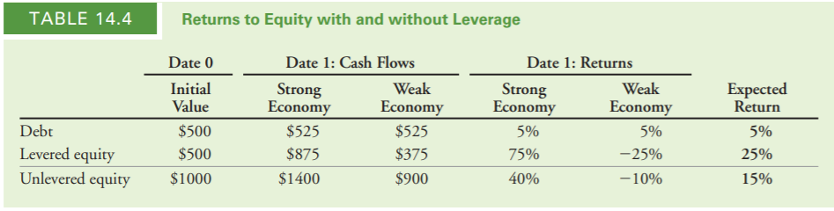
The Effect of Leverage on Risk and Return
Note that the returns to equity holders are very different with and without leverage.
Unlevered equity has a return of either 40% or -10%, for an expected return of 15%.
levered equity has higher risk, with a return of either 75% or -25%.
To compensate for this risk, levered equity holders receive a higher expected return of 25%.
Notes:
有槓桿時和無槓桿時股權持有者的回報率非常不同。
無杠杆權益的回報率為 40% 或 -10%，預期回報率為15%。
有杠杆股權的風險較高，回報率為75%或-25%。
為了彌補這種風險，有槓桿股權的持有者獲得更高的期望回報率25%。

Slide 15
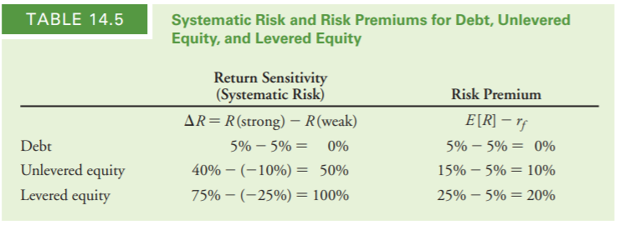
The Effect of Leverage on Risk and Return
We can evaluate the relationship between risk and return more formally by computing the sensitivity of each security’s return to the systematic risk of the economy.
Notes:
通過計算每種證券的回報率對經濟中的系統性風險的敏感度，可以更正式地評估風險與回報之間的關係。
14.5顯示了每種證券的回報敏感性&風險溢價
因為債務的回報沒有系統性風險，所以它的風險溢價是零。
然而，在這種特殊情况下，有杠杆權益的系統性風險是無杠杆權益的兩倍。因此，有杠杆股東獲得的風險溢價是無槓桿的兩倍。
總之:
在完美資本市場的情況下，如果公司是100％股權融資，股權持有人將要求15％的期望回報率。
如果公司融資50％的債務和股權50％，債權人將獲得5％的回報率，而有槓桿股權的持有者將要求25%的期望回報率(因為他們的風險增加了)

Slide 16
EXAMPLE 14.1 Leverage and the Equity Cost of Capital
Problem:
Suppose the entrepreneur borrows only $200 when financing the project. According to Modigliani and Miller, what should the value of the equity be? What is the expected return?
Notes:
問題 假設企業家在為項目融資時只借款200美元。根據莫迪格利安尼和米勒的研究，股權的價值應該是多少？
預期回報率是多少?

Slide 17
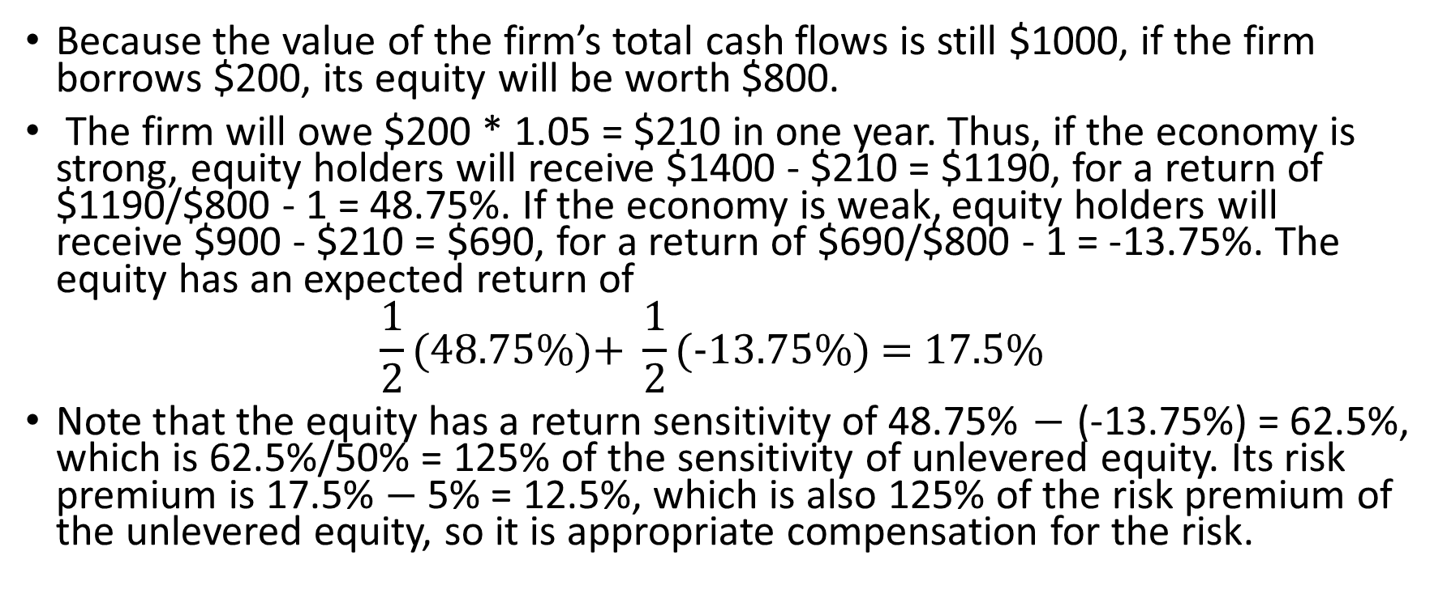
Solution
Because the value of the firm’s total cash flows is still $1000, if the firm borrows $200, its equity will be worth $800.
The firm will owe $200 * 1.05 = $210 in one year. Thus, if the economy is strong, equity holders will receive $1400 - $210 = $1190, for a return of $1190/$800 - 1 = 48.75%. If the economy is weak, equity holders will receive $900 - $210 = $690, for a return of $690/$800 - 1 = -13.75%. The equity has an expected return of
$$\frac{1}{2}(\text{48.75\%}\text{)+} \frac{1}{2}(\text{−13.75\%}\text{) = }\text{17.5\%}$$
Note that the equity has a return sensitivity of 48.75% $−$ (-13.75%) = 62.5%, which is 62.5%/50% = 125% of the sensitivity of unlevered equity. Its risk premium is 17.5% $−$ 5% = 12.5%, which is also 125% of the risk premium of the unlevered equity, so it is appropriate compensation for the risk.
Notes:
解答：
因為公司總現金流的價值仍然是1000美元，如果公司借200美元，它股權的價值將為800美元。
公司將在一年後將需要償還債權人200*1.05=210美元。因此，如果經濟 強勁，股東將獲得1400美元-210美元=1190美元，回報率為1190/800(權益)-1 =48.75%。如果經濟衰弱，股東將獲得900-210美元=690，回報率為690美元/800美元-1=-13.75%。股權的預期回報率為1/2（48.75%）+1/2（-13.75%）=17.5%。
注意，有槓桿股權的回報率的敏感度為48.75%-（-13.75%）=62.5%，即無杠杆股權回報率敏感度的62.5%/50%=125%。
有槓桿股權的風險溢價為17.5%-5%=12.5%，也是無槓桿股權風險溢價的125%，所以他是對於風險的恰當補償。

Slide 18
14.2 Modigliani-Miller I: Leverage, Arbitrage, and Firm Value
Leverage would not affect the total value of the firm.
It merely changes the allocation of cash flows between debt and equity, without altering the total cash flows of the firm.
MM showed that this result holds more generally under a set of conditions referred to as perfect capital markets:

Slide 19
14.2 Modigliani-Miller I: Leverage, Arbitrage, and Firm Value
Investors and firms can trade the same set of securities at competitive market prices equal to the present value of their future cash flows.
There are no taxes, transaction costs, or issuance costs associated with security trading.
A firm’s financing decisions do not change the cash flows generated by its investments, nor do they reveal new information about them.

Slide 20
14.2 Modigliani-Miller I: Leverage, Arbitrage, and Firm Value
Under these conditions, MM demonstrated the following result regarding the role of capital structure in determining firm value:
MM Proposition I: In a perfect capital market, the total value of a firm is equal to the market value of the total cash flows generated by its assets and is not affected by its choice of capital structure.

Slide 21
14.2 Modigliani-Miller I: Leverage, Arbitrage, and Firm Value - MM and the Law of One Price
In the absence of taxes or other transaction costs, the total cash flow paid out to all of a firm’s security holders is equal to the total cash flow generated by the firm’s assets.
by the Law of One Price, the firm’s securities and its assets must have the same total market value.
this decision will not change the total value of the firm or the amount of capital it can raise.

Slide 22
14.2 Modigliani-Miller I: Leverage, Arbitrage, and Firm Value - Homemade Leverage
investors would prefer an alternative capital structure to the one the firm has chosen.
MM demonstrated that in this case, investors can borrow or lend on their own and achieve the same result.
investor who would like more leverage than the firm has chosen can borrow and add leverage to his or her own portfolio
When investors use leverage in their own portfolios to adjust the leverage choice made by the firm, we say that they are using homemade leverage.

Slide 23
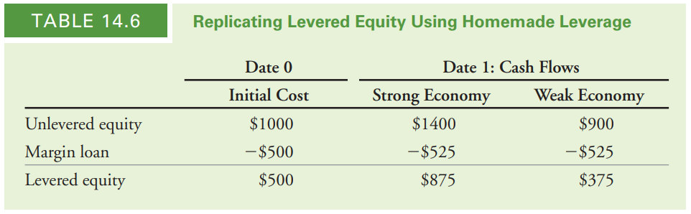
14.2 Modigliani-Miller I: Leverage, Arbitrage, and Firm Value - Homemade Leverage
by using homemade leverage, the investor has replicated the payoffs to the levered equity illustrated in Table 14.3, for a cost of $500. Again, by the Law of One Price, the value of levered equity must also be $500.

Slide 24
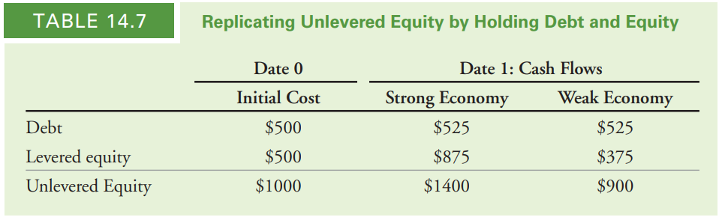
14.2 Modigliani-Miller I: Leverage, Arbitrage, and Firm Value - Homemade Leverage
suppose the entrepreneur uses debt, but the investor would prefer to hold unlevered equity. The investor can replicate the payoffs of unlevered equity by buying both the debt and the equity of the firm

Slide 25
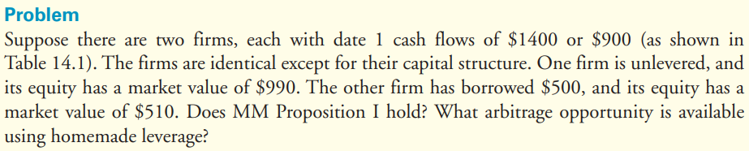
EXAMPLE 14.2 Homemade Leverage and Arbitrage

Slide 26
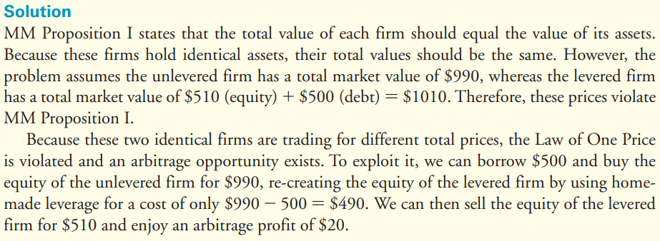
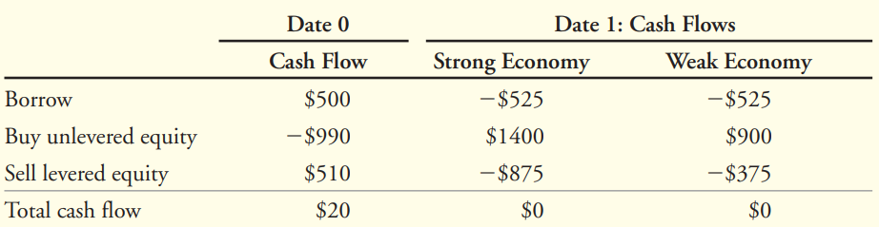

Slide 27
14.2 Modigliani-Miller I: Leverage, Arbitrage, and Firm Value - The Market Value Balance Sheet
A market value balance sheet is similar to an accounting balance sheet
Two distinctions:
First, all assets and liabilities of the firm are included(intangible assets : reputation, brand name, or human capital).
Second, all values are current market values rather than historical costs.

Slide 28
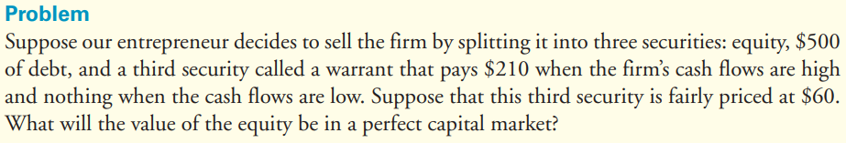
EXAMPLE 14.3 Valuing Equity When There Are Multiple Securities

Slide 29
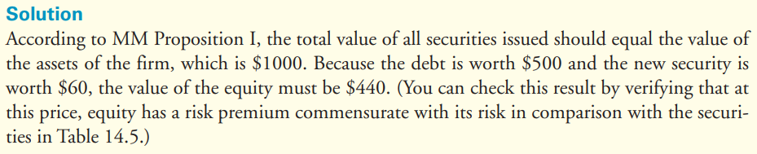
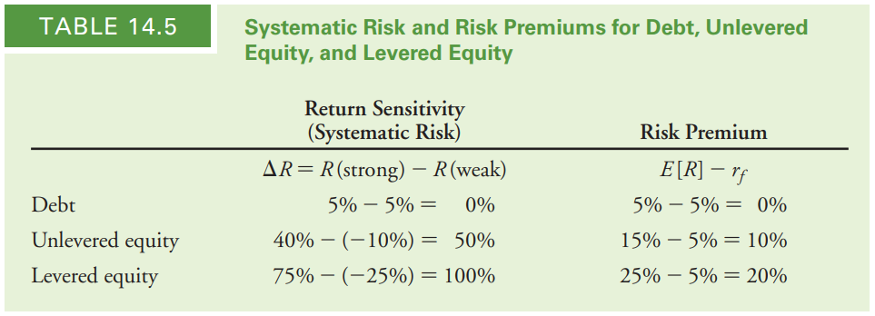

Slide 30
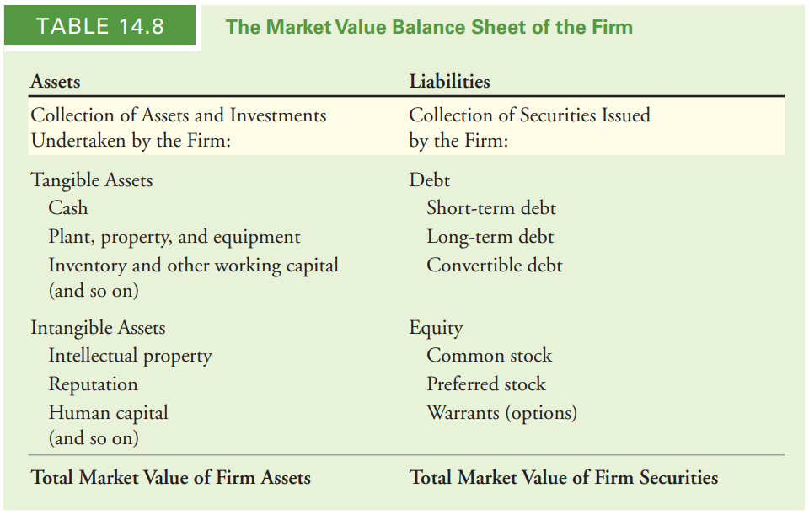
14.2 Modigliani-Miller I: Leverage, Arbitrage, and Firm Value - Application: A Leveraged Recapitalization

Slide 31
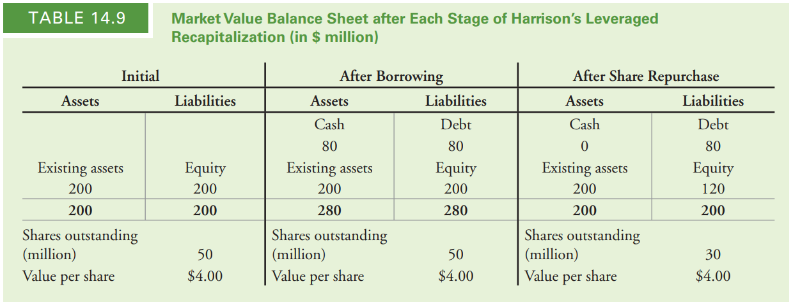
14.2 Modigliani-Miller I: Leverage, Arbitrage, and Firm Value - Application: A Leveraged Recapitalization

Slide 32



14.3 Modigliani-Miller II: Leverage, Risk, and the Cost of Capital
Modigliani and Miller: The firm’s finance choice does not affect its value
The cost of capital differs for different securities
Isn’t debt a cheaper and better source of capital than equity?
While debt itself may be cheap, it increases the risk of the firm’s equity (the cost of capital of the firm’s equity)
Notes:
MM說：公司的資產決策不會影響其價值
(?) 不同的有價證券的資本成本都不同
一項投資全部以發股籌資，資本成本為15%，若以5%的無風險利率舉債，不是更好嗎？
* 債雖然成本低，但會增加風險

Slide 33

14.3 Modigliani-Miller II: Leverage, Risk, and the Cost of Capital
Objectives of this section
Calculate the impact of leverage on the expected return of a firm’s stock (the equity cost of capital)
Consider how to estimate the cost of capital of the firm’s assets and show that it is unaffected by leverage
Notes:
本節目標：
計算 ”舉債” 對 ”公司股票預期報酬” 的影響
如何估計公司資產的資本成本，並證明它不會受槓桿影響
最後會發現，”低資本成本的負債” 所省下來的部分，會剛好被 ”較高的權益資本成本” 抵銷
The savings from the low expected return on debt are exactly offset by a higher equity cost of capital

Slide 34
14.3 Modigliani-Miller II: Leverage, Risk, and the Cost of Capital
Leverage and the Equity Cost of Capital
The relationship between leverage and the equity cost of capital
MM Proposition I states that
E + D = U = A (Eq.14.2)
The total market value of the firm’s securities is equal to the market value of its assets, whether the firm is unlevered or levered.
E: The market value of equity if the firm is levered.
D: The market value of debt if the firm is levered.
U: The market value of equity if the firm is unlevered.
A: The market value of the firm’s assets.
Notes:
===槓桿和權益的資本成本===
以MM第一定理表示 ”槓桿” 和 ”權益資本成本” 之間的關係
E：公司有槓桿之 ”權益市值”
D：公司有槓桿之 ”負債市值”
U：公司無槓桿之 ”權益市值”
A：公司之資產市值
公司舉債之權益市值 + 公司舉債之負債市值 = 公司無槓桿之權益市值 = 公司資產市值
→不管是否有槓桿，”公司有價證券市值” 與 “公司資產市值” 相等

Slide 35
14.3 Modigliani-Miller II: Leverage, Risk, and the Cost of Capital
replicate the cash flows from holding unlevered equity by holding a portfolio of the firm’s equity and debt
Leverage and the Equity Cost of Capital
Interpret Eq. 14.2 in terms of homemade leverage
$\frac{E}{E+D}R_{E}+$ $\frac{D}{E+D}R_{D}=$ $R_{U}$ (Eq.14.3)
The return of a portfolio is equal to the weighted average of the returns of the securities in it
$R_{E}$: the returns of levered equity
$R_{D}$: the returns of levered debt
$R_{U}$: unlevered equity
Notes:
藉由homemade leverage來表示Eq. 14.2
Homemade leverage：利用持有該公司的權益和負債，複製出持有該公司 ”無槓桿下的權益” 的現金流
Portfolio的報酬 = 該portfolio內的有價證券加權平均之報酬

Slide 36
14.3 Modigliani-Miller II: Leverage, Risk, and the Cost of Capital
Leverage and the Equity Cost of Capital
Solve Eq. 14.3 for $R_{E}$:
$R_{E}=R_{U}$+ $\frac{D}{E}{(R_{U}−R}_{D})$ (Eq.14.4)
“Extra kick”:
Having extra effect on the firm’s equity return based on the firm’s performance
The amount of additional risk depends on the amount of leverage
“extra kick”
Notes:
用Eq. 14.3移項推導出$R_{E}$
可發現公司有無槓桿之間的 “權益報酬”，差在$\frac{D}{E}{(R_{U}−R}_{D})$ (extra kick)
報酬率和風險有正向關係
所以$R_{U}$也可以說是無槓桿下的風險(系統風險)，$\frac{D}{E}{(R_{U}−R}_{D})$就是因為舉債而多產生的風險(非系統風險)，兩者相加就會是總風險
”公司的權益報酬“ = “無槓桿下的權益報酬” + “風險所帶來的溢酬 (extra kick)”
Extra kick之特性：
對公司權益報酬有加成效果
公司表現好(賺比較多=>利潤分給股東)，$R_{U}$>$R_{D}$(+)→$R_{E}$更高
公司表現壞(賺比較少=>沒有利潤分給股東)，$R_{U}$<$R_{D}$(-)→$R_{E}$更低
加成效果由 ”負債權益比” 決定

Slide 37
14.3 Modigliani-Miller II: Leverage, Risk, and the Cost of Capital
Leverage and the Equity Cost of Capital
Replace $R$ in Eq.14.4 with $r$for expected returns
$r_{E}=r_{U}+\frac{D}{E}{(r_{U}−r}_{D})$ (Eq.14.5)
MM Proposition II: The cost of capital of levered equity increases with the firm’s market value debt-equity ratio
Notes:
Eq.14.4中的R 代表 “實際產生的報酬”
換成r 代表 ”預期報酬” (接下來我們要討論的)
Eq14.5 的$r_{E}$ 是 ”公司的權益預期報酬率“ (投資人的角度)，也是 ”公司的權益資本成本”(公司的角度)
用Eq.14.5可說明MM第二定理
MM第二定理：有槓桿下的 ”公司資本成本”，會隨著 ”負債權益比” 增加而增加

Slide 38
14.3 Modigliani-Miller II: Leverage, Risk, and the Cost of Capital
Leverage and the Equity Cost of Capital
Illustrate MM Proposition II for the entrepreneur’s project in Section 14.1
all-equity financed, $r_{U}$ = 15%
If the firm is financed with $500 of debt, $r_{D}$ = 5% (risk-free interest rate)
According to MM Proposition II, the expected return on equity for the levered firm ($r_{E}$) is
$r_{E}=r_{U}+$ $\frac{D}{E}{(r_{U}−r}_{D})$
$=15\%$+ $\frac{500}{500}\left(15\%−5\%\right)=25\%$
Notes:
用14.1節的case來說明MM第二定理
原本該公司的資本結構100%都是權益，$r_{U}$=15%
如果該公司要用500美元的債務融資，$r_{D}$=5%
根據MM第二定理，權益的預期報酬($r_{E}$)是$15\%$+ $\frac{500}{500}\left(15\%−5\%\right)=25\%$

Slide 39
14.3 Modigliani-Miller II: Leverage, Risk, and the Cost of Capital
Leverage and the Equity Cost of Capital
Example 14.4 – Computing the Equity Cost of Capital
[Problem]
Suppose the entrepreneur of Section 14.1 borrows only $200 when financing the project. According to MM Proposition II, what will be the firm’s equity cost of capital ($r_{E}$) ?
[Solution]
$$r_{E}=r_{U}+\frac{D}{E}{(r_{U}−r}_{D})$$
$=15\%$+ $\frac{200}{800}\left(15\%−5\%\right)=17.5\%$
Notes:
若14.1節中的case只借了200美元來進行這項計劃
根據MM第二定理，該公司 “權益的資本成本”($r_{E}$) 會是多少？
因為公司資產市值為1,000，如果只借200的負債來融資，權益市值就會是800
$r_{E}=r_{U}+$ $\frac{D}{E}{(r_{U}−r}_{D})$
公司權益的資本成本為17.5%
此結果符合14.1節中的結果

Slide 40
14.3 Modigliani-Miller II: Leverage, Risk, and the Cost of Capital
Capital Budgeting and the Weighted Average Cost of Capital
If a firm is financed with both equity and debt, then the risk of its underlying assets will match the risk of a portfolio of its equity and debt
The appropriate cost of capital for the firm’s assets is the cost of capital of this portfolio
Unlevered Cost of Capital (Pretax WACC)
$r_{U}≡\left({\text{Fraction} \text{of} \text{Firm} \text{Value} \atop \text{Financed} \text{by} \text{Equity}}\right)$ $\left({\text{Equity} \atop \text{Cost} \text{of} \text{Capital}}\right)$+ $\left({\text{Fraction} \text{of} \text{Firm} \text{Value} \atop \text{Financed} \text{by} \text{Debt}}\right)$ $\left({\text{Debt} \atop \text{Cost} \text{of} \text{Capital}}\right)$
= $\frac{E}{E+D}r_{E}+$ $\frac{D}{E+D}r_{D}$
$$=r_{wacc}=r_{A}$$
Notes:
===資本預算和加權平均資本成本===
如果一間公司的透過 “負債” 和 ”權益” 融資，”標的物資產的風險” 會符合 “以該公司權益和負債組成的投資組合的風險”
所以，該公司”資產的成本” 就是 “以該公司權益和負債組成的投資組合的資本成本”
寫成數學式
發現就是 ”權益” 和 “負債” 個別資本成本的加權平均 (WACC)
WACC就是資產的資本成本，因此也可以$r_{A}表示$
在12章中，我們用公司 ”稅後的負債成本” 計算WACC
在完美資本市場中沒有稅，所以我們在本章利用 “未減稅的負債成本” 計算出的WACC，就是12章裡的pretax WACC

Slide 41
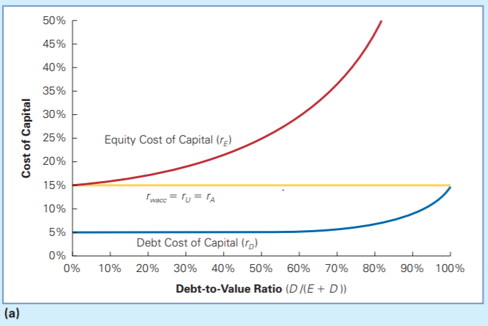
14.3 Modigliani-Miller II: Leverage, Risk, and the Cost of Capital
Capital Budgeting and the Weighted Average Cost of Capital
Figure 14.1 WACC and Leverage with Perfect Capital Markets
The fraction of the firm financed with debt increases
=> Both the equity and the debt become riskier
=> Their cost of capital rises
More weight is put on the lower-cost debt
=> The WACC remains constant
Equity, debt, and WACC for different amounts of leverage
Notes:
不同槓桿比例下，權益和負債分別的資本成本和WACC
槓桿程度以debt-to-value ratio(D/(E+D))衡量
隨著公司負債的比例變大
=>負債和權益的 “風險” 都會提高
=>兩者的 “資本成本” 都會增加
兩者的資本成本都會提高，但因為增加的是負債比例(D/(D+E))，負債的資本成本又比權益成本低，因此WACC不變 (trade-off)
$r_{D}$ 和 $r_{E}$上升的幅度取決於公司現金流量特性

Slide 42
14.3 Modigliani-Miller II: Leverage, Risk, and the Cost of Capital
Capital Budgeting and the Weighted Average Cost of Capital
With no debt,
$$r_{wacc}=r_{U}=r_{E}$$
As the amount of debt increases,
both $r_{D}$ and $r_{E}$ rise
Net effect: $r_{wacc}$ is unchanged
100% debt,
The debt is as risky as the assets
Equity, debt, and WACC for different amounts of leverage
Notes:
沒有負債：=>沒有槓桿
$WACC=r_{U}=r_{E}$
隨著負債增加：
$r_{D}\text{上升}$ (因可能違約而增加)
$r_{E}$隨之上升 =>淨影響: WACC不變
100%負債：
負債風險和資產本身一樣 (因為資產=負債)

Slide 43
14.3 Modigliani-Miller II: Leverage, Risk, and the Cost of Capital
Capital Budgeting and the Weighted Average Cost of Capital
The enterprise value of the firm is its future free cash flow discounted by WACC – CH9
Although debt has a lower cost of capital than equity, leverage does not lower a firm’s WACC – MM I
→The value of the firm’s free cash flow evaluated using the WACC does not change, so the enterprise value does not depend on its financing choices

Slide 44
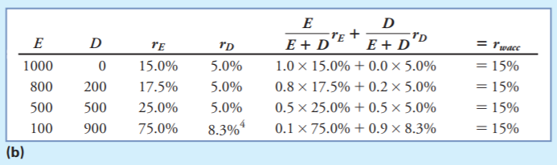
14.3 Modigliani-Miller II: Leverage, Risk, and the Cost of Capital
Capital Budgeting and the Weighted Average Cost of Capital
Figure 14.1 WACC and Leverage with Perfect Capital Markets
Calculating the WACC for alternative capital structures
Data in this table correspond to the example in Section 14.1.
Notes:
同樣是1,000的資本額，在不同的資本結構下，WACC都是15%
此結果與14.1節的範例相符

Slide 45
14.3 Modigliani-Miller II: Leverage, Risk, and the Cost of Capital
Capital Budgeting and the Weighted Average Cost of Capital
Example 14.5 – Reducing Leverage and the Cost of Capital
[Problem]
NRG Energy, Inc. (NRG)
Before
$\frac{D}{E}$ = 3
$r_{D}$ = 6%
$r_{E}$ = 14%
After
$\frac{D}{E}$ = 2
$r_{D}$ = 5.5%
issues equity and uses the proceeds to repay its debt
Notes:
NRG是一間能源公司
原本 負債權益比=3，負債的資本成本=6%，權益的資本成本=14%
後來NRG利用 “發行股票” 償債，使負債權益比降至2，負債的資本成本=5.5%

Slide 46
14.3 Modigliani-Miller II: Leverage, Risk, and the Cost of Capital
Capital Budgeting and the Weighted Average Cost of Capital
Example 14.5 – Reducing Leverage and the Cost of Capital
[Problem 1]
With perfect capital markets, what effect will this transaction have on NRG’s equity cost of capital ($r_{E}$) and WACC?
Notes:
[問題1] 在完美資本市場中，這樣的變化對 ”NRG的權益資本成本($r_{E}$)” 和 “WACC” 有什麼影響？

Slide 47
14.3 Modigliani-Miller II: Leverage, Risk, and the Cost of Capital
Capital Budgeting and the Weighted Average Cost of Capital
Example 14.5 – Reducing Leverage and the Cost of Capital
[Solution]
initial $r_{wacc}$= $r_{U}=$ $\frac{E}{E+D}r_{E}+$ $\frac{D}{E+D}r_{D}$
$$=\frac{1}{1+3}\left(14\%\right)+\frac{3}{1+3}\left(6\%\right)=8\%$$
$r_{E}$= $r_{U}+$ $\frac{D}{E}{(r}_{U}−r_{D})$
$$r_{WACC}=\frac{1}{3}\left(13\%\right)+\frac{2}{3}\left(5.5\%\right)=8\%$$
$=8\%+$ $\frac{2}{1}\left(8\%−5.5\%\right)=13\%$
No net gain
Notes:
[問題1] 在完美資本市場中，這樣的變化對NRG的權益資本成本($r_{E}$)和WACC有什麼影響？
計算原本的WACC
計算發股後的權益資本成本($r_{E}$) →從原本的15%下降到13%
計算發股後的WACC
即便權益資本成本($r_{E}$)下降至13%， WACC在完美資本市場中仍維持在8%，因此沒有賺到

Slide 48
14.3 Modigliani-Miller II: Leverage, Risk, and the Cost of Capital
Capital Budgeting and the Weighted Average Cost of Capital
Example 14.5 – Reducing Leverage and the Cost of Capital
[Problem 2]
What would happen if NRG issues even more equity and pays off its debt completely?
[Solution]
$${r_{U}=r}_{wacc}=8\%$$
Notes:
[問題2] 假設NRG發行股票把所有債務清償掉會發生什麼事？
假設公司把所有債務清償掉，就會變成無槓桿的狀態
因此，它的權益資本成本將會等於它的WACC=8%

Slide 49
14.3 Modigliani-Miller II: Leverage, Risk, and the Cost of Capital
Capital Budgeting and the Weighted Average Cost of Capital
Example 14.5 – Reducing Leverage and the Cost of Capital
[Problem 3]
How would these alternative capital structures affect NRG’s enterprise value?
[Solution]
With perfect capital markets, its enterprise value will not be affected by these different capital structure choices.
Notes:
[問題3] 這些資本結構的改變，會對NRG的企業價值有什麼影響？
在完美資本市場下，公司企業價值不會受到資本結構改變影響

Slide 50


14.3 Modigliani-Miller II: Leverage, Risk, and the Cost of Capital
Capital Budgeting and the Weighted Average Cost of Capital
Is Debt Better Than Equity?
Common Mistake
A firm can reduce its overall WACC by increasing the amount of debt financing
The Fact
Adding leverage increases the risk of the equity
Notes:
常見錯誤：舉債成本< 發股成本，因此可以利用 “增加舉債融資的比例” 降低WACC
那大家都舉債就好了啊!
事實：即便負債沒有風險，公司也不會違約，增加負債比例會增加權益的風險

Slide 51
14.3 Modigliani-Miller II: Leverage, Risk, and the Cost of Capital
Capital Budgeting and the Weighted Average Cost of Capital
Is Debt Better Than Equity?
risk ↑
risk premium ↑
expected return ↑
The increase in $r_{E}$ offsets the benefit of a greater reliance on the cheaper debt capital
=> The firm’s overall cost of capital remains unchanged
Notes:
權益風險增加=>需支付較高的風險溢酬=>權益成本提高
“權益的成本增加量” 抵銷了 ”利用負債所降低的成本” =>整體資本成本不變

Slide 52
14.3 Modigliani-Miller II: Leverage, Risk, and the Cost of Capital
Computing the WACC with Multiple Securities
If the firm’s capital structure is more complex,
$$r_{U}=r_{wacc}$$
= the weighted average cost of capital of all of the firm’s securities
Notes:
===計算公司有多種有價證券時的WACC===
前面我們都假設 ”公司只發行兩種有價證券 (股票和債券)”，因此 ”加權資本成本” 只需考慮 ”股票” 和 ”債券” 兩種
如果公司資本結構更複雜，WACC就要 “用公司全部的有價證券的資本成本” 加權計算

Slide 53
14.3 Modigliani-Miller II: Leverage, Risk, and the Cost of Capital
Computing the WACC with Multiple Securities
Example 14.6 – WACC with Multiple Securities
[Problem]
The entrepreneur
Equity = 440
Debt = 500
Warrant = 60, when the firm’s cash flows are high, pay $210
when the firm’s cash flows are low, pay $0
Notes:
[問題] 利用範例14.3的資本結構計算該公司的WACC
權益=440
負債=500
權證=60

Slide 54
14.3 Modigliani-Miller II: Leverage, Risk, and the Cost of Capital
Computing the WACC with Multiple Securities
Example 14.6 – WACC with Multiple Securities
[Problem]
Compute the WACC for the entrepreneur’s project with the capital structure described in Example 14.3.
[Solution]
The expected returns for each security – Debt ($r_{D}$)
Given the risk-free interest rate = 5% and the debt is risk free
so it has an expected return of 5%.
Notes:
[問題] 利用範例14.3的資本結構計算該公司的WACC
算出各有價證券的預期報酬
負債(D)：給定公司的現金流，負債無風險，因此預期報酬=5%

Slide 55
14.3 Modigliani-Miller II: Leverage, Risk, and the Cost of Capital
Computing the WACC with Multiple Securities
Example 14.6 – WACC with Multiple Securities
[Solution]
The expected returns for each security – Warrant ($r_{W}$)
The warrant has an expected payoff of $\frac{1}{2}\left(\$210\right)+\frac{1}{2}\left(\$0\right)=\$105$
so its expected return is $\frac{\$105}{\$60}−1=75\%$
Notes:
[問題] 利用範例14.3的資本結構計算該公司的WACC
算出各有價證券的預期報酬
負債(D)：給定公司的現金流，負債無風險，因此預期報酬率=5%
權證(W)：if 現金流高, 得到 210 / if 現金流低, 得到0，因此預期報酬=$\frac{1}{2}\left(\$210\right)+\frac{1}{2}\left(\$0\right)=\$105$，預期報酬率=$\frac{\$105}{\$60}−1=75\%$

Slide 56
14.3 Modigliani-Miller II: Leverage, Risk, and the Cost of Capital
Computing the WACC with Multiple Securities
Example 14.6 – WACC with Multiple Securities
[Solution]
The expected returns for each security – Equity ($r_{E}$)
Equity has a payoff of ($1400 $−$ $525 $−$ $210) = $665 when cash flows are high
thus, its expected payoff is $\frac{1}{2}\left(\$665\right)+\frac{1}{2}\left(\$375\right)=\$520$
The expected return for equity is then $r_{E}$ = $\frac{\$520}{\$440}−1=18.18\%$
($900 $−$ $525) = $375 when cash flows are low
Notes:
[問題] 利用範例14.3的資本結構計算該公司的WACC
算出各有價證券的預期報酬
負債(D)：給定公司的現金流，負債無風險，因此預期報酬率=5%
權證(W)：if 現金流高, 得到 210 / if 現金流低, 得到0，因此預期報酬 = $\frac{1}{2}\left(\$210\right)+\frac{1}{2}\left(\$0\right)=\$105$，預期報酬率 = $\frac{\$105}{\$60}−1=75\%$
權益(E)：if 現金流高, 賺到 665 / if 現金流低, 得到375，因此預期報酬 = $\frac{1}{2}\left(\$665\right)+\frac{1}{2}\left(\$375\right)=\$520$，預期報酬率 = $\frac{\$520}{\$440}−1=18.18\%$
//equity賺到的-債息(d*1.05)-權證收益

Slide 57
14.3 Modigliani-Miller II: Leverage, Risk, and the Cost of Capital
Computing the WACC with Multiple Securities
Example 14.6 – WACC with Multiple Securities
[Solution]
compute the WACC
Once again, the firm’s WACC and unlevered cost of capital is 15%, the same as if it were all-equity financed.
$r_{wacc}$= $r_{U}=$ $\frac{E}{E+D+W}r_{E}+$ $\frac{D}{E+D+W}r_{D}+ \frac{W}{E+D+W}r_{W}$
= $\frac{\$440}{\$1000}\left(18.18\%\right)+$ $\frac{\$500}{\$1000}\left(5\%\right)+ \frac{\$60}{\$1000}\left(75\%\right)=15\%$
Notes:
[問題] 利用範例14.3的資本結構計算該公司的WACC
算出各有價證券的預期報酬
負債(D)：給定公司的現金流，負債無風險，因此預期報酬率=5%
權證(W)：if 現金流高, 得到 210 / if 現金流低, 得到0，因此預期報酬=$\frac{1}{2}\left(\$210\right)+\frac{1}{2}\left(\$0\right)=\$105$，預期報酬率=$\frac{\$105}{\$60}−1=75\%$
權益(E)：if 現金流高, 賺到 665 / if 現金流低, 得到375，因此預期報酬 = $\frac{1}{2}\left(\$665\right)+\frac{1}{2}\left(\$375\right)=\$520$，預期報酬率 = $\frac{\$520}{\$440}−1=18.18\%$
計算WACC
公司的 “WACC” 和 ”無槓桿下的資本成本” =15%，和全部以權益融資時相同

Slide 58
14.3 Modigliani-Miller II: Leverage, Risk, and the Cost of Capital
Levered and Unlevered Betas
A firm’s unlevered beta (asset beta) is the weighted average of its equity and debt beta:
$β_{U}=$ $\frac{E}{E+D}β_{E}+$ $\frac{D}{E+D}β_{D}$(Eq.14.8)
Unlevered beta:
Measures the market risk of the firm’s underlying assets, and thus can be used to assess the cost of capital for comparable investments
Remained unaltered when a firm changes its capital structure without changing its investments
Notes:
===Levered Beta 和 Unlevered Beta===
Unlevered beta是equity beta 和 debt beta的加權平均
Unlevered beta 之特性：
可衡量公司 “標的資產” 的市場風險，因此可用於估計 ”不同投資組合” 的資本成本
當公司在 ”不改變總投資額” 的情況下調整資本結構，unlevered beta不會改變

Slide 59
14.3 Modigliani-Miller II: Leverage, Risk, and the Cost of Capital
Levered and Unlevered Betas
Rearrange Eq.14.8 to solve for $β_{E}$
$β_{E}=$ $β_{U}+$ $\frac{D}{E}\left(β_{U}−β_{D}\right)$(Eq.14.9)
Equity beta:
Changes to reflect the capital structure change on its risk
Increases with leverage
Notes:
用Eq.14.8移項推出equity beta
Equity beta之特性：
反映因 “資本結構改變” 未權益帶來的風險
會隨著 “槓桿比例” 增加而增加

Slide 60
14.3 Modigliani-Miller II: Leverage, Risk, and the Cost of Capital
Levered and Unlevered Betas
Example 14.7 – Betas and Leverage
[Problem]
Drug retailer CVS
Before
$β_{E}$ = 0.8
$\frac{D}{E}$ = 0.1
After
$\frac{D}{E}$ = 0.5
$β_{D}$ = 0
increase its leverage
Notes:
CVS是一間一間藥品零售商
原本equity beta($β_{E}$) = 0.8, 負債權益比 = 0.1
後來增加負債，使負債權益比 = 0.5
並假設$β_{D}$ = 0

Slide 61
14.3 Modigliani-Miller II: Leverage, Risk, and the Cost of Capital
Levered and Unlevered Betas
Example 14.7 – Betas and Leverage
[Problem 1]
Estimate its asset beta ($β_{U}$) assuming its debt beta ($β_{D}$) is zero.
[Solution]
$β_{U}=$ $\frac{E}{E+D}β_{E}+\frac{D}{E+D}β_{D}$
$$=\frac{10}{10+1}(0.8)+\frac{1}{10+1}(0)=0.73$$
Notes:
[問題1] 假設debt beta($β_{D}$) = 0，求 asset beta
asset beta 就是 unlevered beta
$β_{U}=$ $\frac{E}{E+D}β_{E}+\frac{D}{E+D}β_{D}$

Slide 62
14.3 Modigliani-Miller II: Leverage, Risk, and the Cost of Capital
Levered and Unlevered Betas
Example 14.7 – Betas and Leverage
[Problem 2]
Assuming its debt beta ($β_{D}$) is zero, what would you expect its equity beta ($β_{E}$) to be after the increase in leverage?
[Solution]
$$β_{E}=β_{U}+\frac{D}{E}\left(β_{U}−β_{D}\right)$$
$$=0.73+0.5\left(0.73−0\right)=1.09$$
$β_{E}$ will increase with leverage
Notes:
[問題2] 假設debt beta($β_{D}$) = 0，求 “增加槓桿比例” 後的equity beta
Equity beta ($β_{E}$)從原本0.8增加為1.09，證實剛剛所提到 “equity beta會隨著leverage增加而增加”
若debt beta ($β_{D}$)增加，equity beta ($β_{E}$)就會小一些，因為股東可以幫忙分擔一些市場風險，這樣債權人就不用承擔那麼多了

Slide 63
14.3 Modigliani-Miller II: Leverage, Risk, and the Cost of Capital
Levered and Unlevered Betas
Cash or risk-free securities
Reduce the risk of the firm’s asset
Holding excess cash has the opposite effect of leverage on risk and return → negative debt
Assess a firm’s enterprise value with leverage in terms of net debt
debt – holdings of excess cash or short-term investments
Notes:
“現金及無風險有價證券” 之特性：
由於沒有風險，他們降低了公司資產的風險，進而降低了投資人所要求的風險溢酬
“持有自由現金流” 會對 “風險” 和 “報酬” 造成 “和槓桿相反” 的效果，因此我們視 “現金” 為 “負債減項”
槓桿- 風險高 報酬高
現金- 風險低 報酬低
以 ”淨負債” 作為leverage 估計 “公司價值”，淨負債 = 負債 – 自由現金流或短期投資

Slide 64
14.3 Modigliani-Miller II: Leverage, Risk, and the Cost of Capital
Levered and Unlevered Betas
Example 14.8 – Cash and the Cost of Capital
[Problem]
Cisco Systems
August, 2015
Market capitalization $140 billion
Debt $25.4 billion
Cash and short-term investments $60.4 billion
$β_{E}$ = 1.09
$β_{D}$ ≈ 0
Notes:
Cisco Systems在2015年8月時，
市值 = 140 billion
負債 = 25.4 billion
現金和短期投資 = 60.4 billion

Slide 65
14.3 Modigliani-Miller II: Leverage, Risk, and the Cost of Capital
Levered and Unlevered Betas
Example 14.8 – Cash and the Cost of Capital
[Problem 1]
What was Cisco’s enterprise value at the time?
[Solution]
net debt = debt – holdings of excess cash or short-term investments
enterprise value = firm’s market value – net debt
= $25.4 billion $−$$60.4 billion = $−$$35.0 billion
= $140 billion $−$ $35 billion = $105 billion
Notes:
[問題1] 求Cisco公司現在的價值
淨負債= debt – cash
公司價值 = 公司市值 + net debt

Slide 66
14.3 Modigliani-Miller II: Leverage, Risk, and the Cost of Capital
Levered and Unlevered Betas
Example 14.8 – Cash and the Cost of Capital
[Problem 2]
Given a risk-free rate of 2% and a market risk premium of 5%, estimate the unlevered cost of capital ($r_{U}$) of Cisco’s business.
Notes:
[問題2] 給定無風險利率 = 2%, 市場風險溢酬 = 5%, 求該公司在無槓桿下的權益資本成本

Slide 67
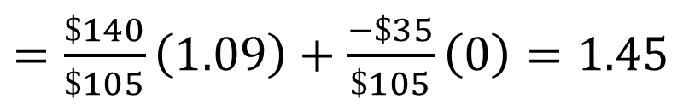

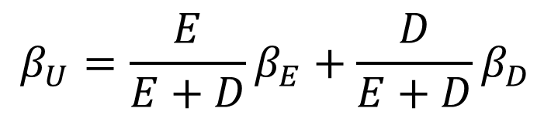
14.3 Modigliani-Miller II: Leverage, Risk, and the Cost of Capital
Levered and Unlevered Betas
Example 14.8 – Cash and the Cost of Capital
[Solution]
Given a zero beta for its net debt, Cisco’s unlevered beta was
$$β_{U}=\frac{E}{E+D}β_{E}+\frac{D}{E+D}β_{D}$$
Note that because of its cash holdings, Cisco’s equity is less risky than its underlying business.
$=\frac{\$140}{\$105}\left(1.09\right)+$ $\frac{−\$35}{\$105}\left(0\right)=1.45$
$$r_{U}=2\%+1.45∗5\%=9.25\%$$
Notes:
[問題2] 給定無風險利率 = 2%, 市場風險溢酬 = 5%, 求該公司在無槓桿下的權益資本成本
$$β_{U}=\frac{E}{enterprise value}β_{E}+\frac{D}{enterprise value}β_{D}$$
$r_{U}=r_{D}+β_{U}∗market risk premium$
無槓桿權益的資本成本 = 負債資本成本 + unlevered beta*市場風險溢酬

Slide 68
14.4 Capital Structure Fallacies
MM Propositions I and II state that with perfect capital markets, leverage has no effect on firm value or the firm’s overall cost of capital. Here we take a critical look at two incorrect arguments that are sometimes cited in favor of leverage.
Notes:
14.4資本結構謬誤
MM提議I和II指出，在完善的資本市場下，槓桿不會影響公司價值或公司的整體資本成本。 在這裡，我們對兩個不正確的論點進行批判性考察，有時會引用兩個不正確的論點來支持槓桿作用。

Slide 69
14.4 Capital Structure Fallacies - Leverage and Earnings per Share
Leverage can increase a firm’s expected earnings per share(EPS). An argument sometimes made is that by doing so, leverage should also increase the firm’s stock price.
Notes:
槓桿作用可以提高公司的預期每股收益（EPS）。 有時會提出這樣的論點，即這樣做還可以提高公司的股價。

Slide 70
EPS
每股盈餘（英文：Earnings Per Share，EPS)，又稱每股收益或每股盈利，是指公開市場上，由於股價波動，每股給投資者/股東帶來的收益。它是公司的獲利指標，對於有公開市場股票交易的公司而言，每股盈餘和公司的股價都有一定的聯動性，因此這也是公司現有股東與潛在投資人衡量公司獲利的關鍵要素之一。這詞彙經常出現於財經刊物或報章的財經版。
'每股盈餘'＝稅後淨利-當年特別股股利／加權平均流通在外普通股股數

Slide 71
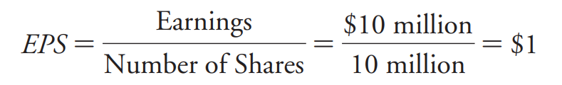
14.4 Capital Structure Fallacies - Leverage and Earnings per Share
LVI is currently an all-equity firm. It expects to generate earnings before interest and taxes (EBIT) of $10 million over the next year. Currently, LVI has 10 million shares outstanding, and its stock is trading for a price of $7.50 per share.
LVI borrow $15 million at an interest rate of 8% and using the proceeds to repurchase 2 million shares at $7.50 per share.
The consequences of this transaction in perfect capital market(no taxes)
LVI’s earnings equal to its EBIT(earing before interest and taxes)
Notes:
LVI目前是一家全資公司。 預計明年將產生1000萬美元的息稅前利潤（EBIT）。 目前，LVI已發行1000萬股股票，其股票交易價格為每股7.50美元。
LVI以8％的利率借入1500萬美元，並用所得款項以每股7.50美元的價格回購200萬股。
完美資本市場中此交易的後果（不含稅）
LVI的收益等於其EBIT（未計利息和稅項的收益）

Slide 72
14.4 Capital Structure Fallacies - Leverage and Earnings per Share
The new debt will obligate LVI to make interest payment each year of
$\$15million×8\%interest$/$year=\$1.2million$/$year$
As a result, LVI will have expected earnings after interest of
$$earnings=EBIT−Interest=\$10million−\$1.2million=\$8.8million$$
The interest payments on the debt will cause LVI’s total earnings to fall. But outstanding shares will also have fallen to 10 million - 2 million = 8 million shares after the share repurchase, LVI’s expected earnings per share is
$$EPS=\frac{\$8.8million}{8million}=\$1.10$$
As we can see, LVI’s expected earnings per share increases with leverage.

Slide 73
14.4 Capital Structure Fallacies - Leverage and Earnings per Share
This increase might appear to make shareholders better off and could potentially lead to an increase in the stock price.
Yet we know from MM Proposition I that as long as the securities are fairly priced, these financial transactions have an NPV of zero and offer no benefit to shareholders. How can we reconcile these seemingly contradictory results?
Suppose LVI’s earnings are only $4 million.
Without the increase in leverage $EPS=\frac{\$4million}{\$10million shares}=\$0.40$
With the new debt $EPS=\frac{earnings after interest payment=\$4million−\$1.2million}{\$8million shares}=\$0.35$
Notes:
答案是盈利風險(risk of earnings)已經改變。 到目前為止，我們僅考慮了每股預期收益。 我們尚未考慮此交易對risk of the earnings的影響。 為此，我們必須確定在各種情況下槓桿增加對每股收益的影響。
假設未付利息的收入只有400萬美元。 如果不增加槓桿作用，每股收益將為400萬美元，1000萬股= 0.40美元。 但是，有了新債務，付息後的收益將為400萬美元-120萬美元= 280萬美元，從而導致淨收益280萬美元，即800萬股= 0.35美元。

Slide 74
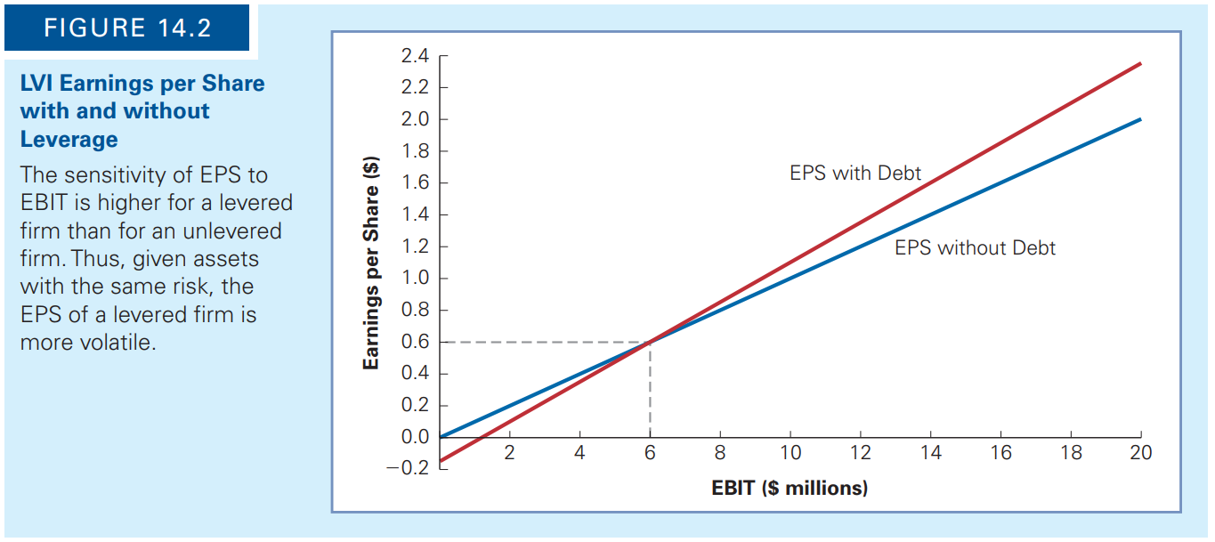
14.4 Capital Structure Fallacies - Leverage and Earnings per Share
Leverage can increase a firm’s expected earnings per share. An argument sometimes made is that by doing so, leverage should also increase the firm’s stock price.
Notes:
因此，當收益較低時，槓桿將導致EPS下降得比原本預期還要嚴重。
圖14.2提出了此例子的範圍。
如果未計利息前的收益超過600萬美元，則槓桿產生的EPS會更高。 但是，當收益降至600萬美元以下時，使用槓桿後的EPS會比不使用槓桿時的EPS低。 實際上，如果利息前收益低於120萬美元（利息支出水平），則利息後LVI的每股收益將為負。 因此，儘管LVI的預期每股收益會隨著槓桿作用而增加，但其每股收益的風險也會增加。 可以看到增加的風險，因為圖14.2中顯示有槓桿作用的EPS線比沒有槓桿作用的線陡峭，這意味著一旦引入槓桿作用，相同的EBIT波動將導致EPS出現較大波動。 綜上所述，這些觀察結果與MM主張I一致。雖然EPS平均增加，但這種增加對於補償股東承擔的額外風險是必要的，因此LVI的股價不會因交易而增加。 讓我們以示例的形式檢查此結果。

Slide 75
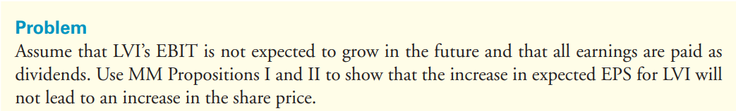
EXAMPLE 14.9 The MM Propositions and Earnings per Share
Notes:
假設LVI的EBIT預期不會在未來增長，並且所有收益都將作為股息支付。 使用MM提議I和MM II來表明，LVI的預期每股收益的增加不會導致股價上漲。

Slide 76
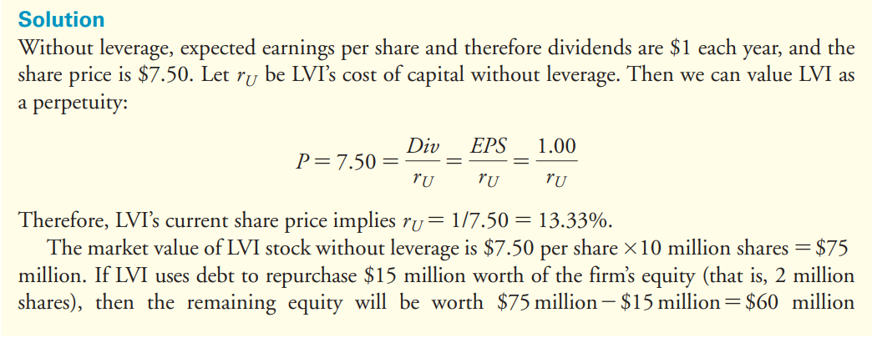
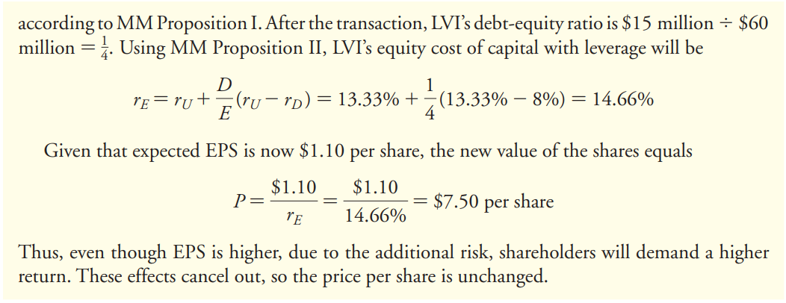
Notes:
如果沒有槓桿，則預期每股收益和股息每年為1美元。P是股票價格，Div是股利，$r_{U}$=無槓桿預期報酬。
將LVI市值視為不變的，預期報酬率是1/7.5=13.33%
如果LVI用債將價值1500萬(200萬股份)買回，則剩下的權益將價值7500萬-1500萬=6000萬，交易後，LVI的債權比(debt-equity ratio)=1500萬/6000萬=1/4
LVI的權益資金成本(equity cost of capital)
鑑於現在的預期每股收益為1.10美元，股票的新價值等於$7.50，因此，即使每股收益較高，由於額外的風險，股東將要求更高的回報。 這些影響被抵消，因此每股價格(P)不變。
由於公司的每股收益和本益比受槓桿影響，因此我們無法可靠地比較具有不同資本結構的公司的這些指標。 對於基於會計的績效指標，例如股本回報率（ROE），也是如此。
因此，大多數分析師傾向於使用基於公司扣除利息之前的收益的績效指標和估值倍數。 例如，在分析資本結構非常不同的公司時，企業價值與EBIT（或EBITDA）之比 比 比較其本益比更為有用。

Slide 77
ROE
股本報酬率（又稱股權收益率、股本收益率或股東權益報酬率，英語：Return On Equity，縮寫：ROE），是衡量相對於股東權益的投資報酬之指標，反映公司利用資產淨值產生純利的能力。計算方法是將稅後淨利扣除優先股股息和特殊收益後的淨收益除以股東權益。此比例計算出公司普通股股東的投資報酬率，是上市公司盈利能力的重要指標。
ROE = 淨收益 / 股東權益
※ 淨收益 = 稅後淨利 - （優先股的股息 + 特殊收益）

Slide 78
本益比
股票的市盈率 (Price-to-Earning Ratio，P/E 或 PER)，又稱為本益比，指每股市價除以每股盈餘 (Earnings Per Share，EPS)，通常作為股票是便宜抑或昂貴的指標 (通貨膨脹會使每股收益虛增，從而扭曲本益比的比較價值)。本益比把企業的股價與其製造財富的能力聯繫起來。
本益比＝每股市價／每股盈餘

Slide 79
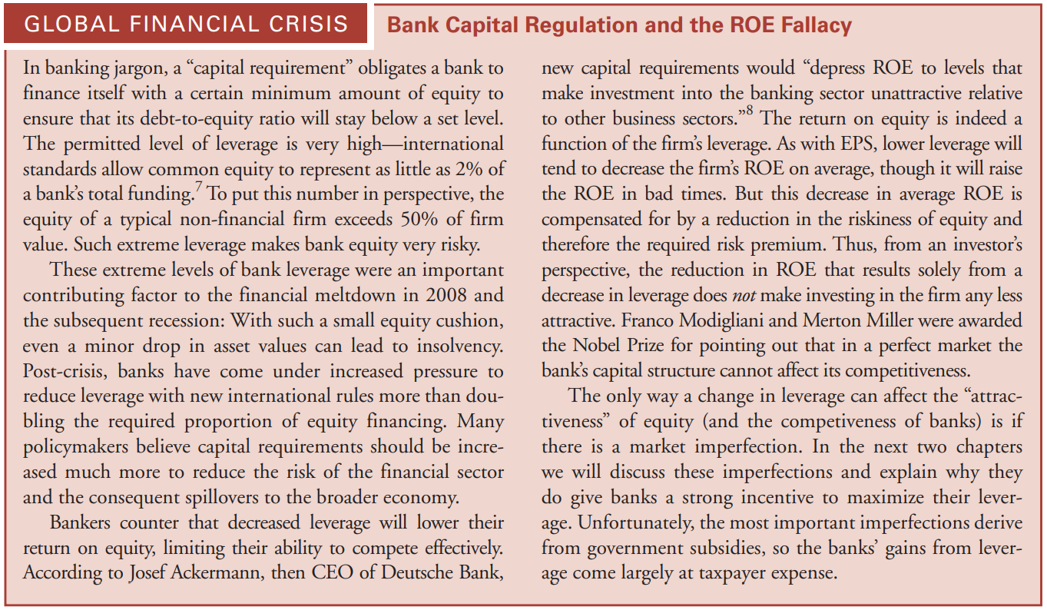
Global Financial Crisis Bank Capital Regulation and the ROE Fallacy
Notes:
用銀行術語來說，“資本要求”規定銀行有義務以一定數量的最低股本為自身融資，以確保其債務權益比率保持在設定水平以下。允許的槓桿水平非常高-國際標准允許普通股本僅佔銀行總融資的2％。從這個角度來看，典型的非金融公司的股本超過了公司價值的50％ 。如此高的槓桿率使銀行股權具有很高的風險。
這些極高的銀行槓桿水平是導致2008年金融危機和隨後的經濟衰退的重要因素：憑藉如此小的股權緩衝，即使資產價值小幅下降也可能導致破產。危機後，隨著新的國際規則，銀行在降低杠桿作用方面承受的壓力越來越大，超過了股權融資所需比例的兩倍。許多決策者認為，應增加更多的資本要求，以減少金融部門的風險以及隨之而來的對整個經濟的溢出。
銀行家們反駁說，槓桿率下降將降低其股本回報率，從而限制其有效競爭的能力。
德意志銀行當時的首席執行官約瑟夫·阿克曼（Josef Ackermann）表示，新的資本要求將“將股本回報率降低至相對於其他業務領域而言，對銀行業的投資沒有吸引力的水平。”
股本回報率的確是公司槓桿作用的函數。與每股收益一樣，較低的槓桿率通常會降低公司的淨資產收益率，儘管這會在不利時期提高淨資產收益率。但是，平均股本回報率的下降可以通過降低股本風險以及因此所需的風險溢價來彌補。因此，從投資者的角度來看，僅由於槓桿率下降而導致的淨資產收益率下降並不會減少對公司投資的吸引力。
弗朗哥·莫迪利亞尼（Franco Modigliani）和默頓·米勒（Merton Miller）指出，在一個完美的市場中，銀行的資本結構不會影響其競爭力，因此獲得了諾貝爾獎。
槓桿率變化會影響股本的“吸引力”（以及銀行的競爭力）的唯一途徑是市場存在缺陷。在接下來的兩章中，我們將討論這些缺陷，並解釋為什麼它們確實會給銀行提供強大的動力來最大程度地發揮槓桿作用。不幸的是，最重要的缺陷來自政府補貼，因此銀行從槓桿中獲得的收益主要來自納稅人的費用。

Slide 80
14.4 Capital Structure Fallacies - Equity Issuances and Dilution
Another often-heard fallacy is that issuing equity will dilute existing shareholders’ ownership, so debt financing should be used instead. By dilution, the proponents of this fallacy mean that if the firm issues new shares, the cash flows generated by the firm must be divided among a larger number of shares, thereby reducing the value of each individual share.
Notes:
另一個經常聽到的謬論是，發行股票會稀釋現有股東的所有權，因此應改用債務融資。 通過稀釋，這種謬論的支持者意味著，如果公司發行新股，則必須將公司產生的現金流量分配給更多股，從而降低每隻股票的價值。 這種推理的問題在於，它忽略了通過發行新股籌集的現金將增加公司資產的事實。 讓我們考慮一個例子。

Slide 81
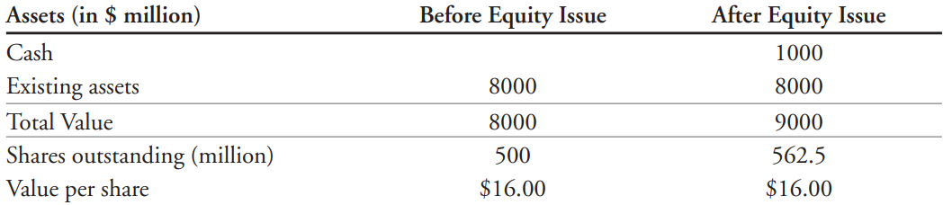
14.4 Capital Structure Fallacies - Equity Issuances and Dilution
Jet Sky Airlines (JSA) is a highly successful discount airline serving the southeastern United States. It currently has no debt and 500 million shares of stock outstanding.
JSA announce an operation to northeast, the expansion will require the purchase of $1 billion of new planes, which will be financed by issuing new equity. How will the share price change when the new equity is issued today?
Any gain or loss associated with the transaction will result from the NPV of the investments the firm makes with the funds raised.
Notes:
JSA是一家成功的廉航
根據公司的當前股價（發行前），公司的股權以及資產的市值為5億股*每股16美元= 80億美元。
由於已經做出並宣布了擴張決定，因此在完善的資本市場中，該價值包含了與擴張相關的淨現值。
假設JSA以當前每股16美元的價格出售6250萬股新股，以籌集購買飛機所需的額外10億美元。
JSA發行股本時會發生兩件事。 首先，由於公司籌集了額外的10億美元現金，其資產的市值得以增長。 第二，股份數量增加。 儘管股票數量已增至5.625億股，但每股價值沒有變化：90億美元，5.625億股=每股16美元。
一般而言，只要公司以公平價格出售新股，與股本發行相關的股東就不會有損益。 公司因發行股票而獲得的資金恰好抵消了股票的攤薄。 與交易相關的任何損益將由公司利用募集資金進行的投資的淨現值產生。

Slide 82
14.5 MM: Beyond the Propositions
Proposition I was one of the first arguments to show that the Law of One Price could have strong implications for security prices and firm values in a competitive market; it marks the beginning of the modern theory of corporate finance.
Clearly, if a single individual or a single institutional investor owned all of the bonds, stocks and warrants issued by the corporation, it would not matter to this investor what the company’s capitalization was (except for details concerning the income tax). Any earnings collected as interest could not be collected as dividends.
Thus, the results in this chapter can be interpreted more broadly as the conservation of value principle for financial markets: With perfect capital markets, financial transactions neither add nor destroy value, but instead represent a repackaging of risk (and therefore return).
Notes:
自從他們的原始論文發表以來，莫迪利亞尼和米勒的想法極大地影響了金融研究和實踐。 MM所採用的方法也許比特定命題本身更重要。命題I是表明“一個價格定律”可能對競爭市場中的證券價格和公司價值產生重大影響的第一個論點。它標誌著現代公司財務理論的開始。
Modigliani和Miller的工作正式確立了一種新的金融市場思維方式，該方式由約翰·伯勒·威廉姆斯（John Burr Williams）在1938年出版的《投資價值理論》中首次提出。威廉姆斯認為：
如果從定義上說，整個企業的投資價值是其所有未來分配給證券持有人的現值，無論是利息還是股利帳戶，那麼該價值絕對不取決於公司的資本金。顯然，如果一個人或一個機構投資者擁有公司發行的所有債券，股票和認股權證，那麼對於該投資者而言，公司的資本金是多少都沒有關係（關於所得稅的詳細信息除外）。作為利息收取的任何收益都不能作為股息收取。對於這樣的人來說，很明顯，總的支付利息和股息的能力絕不取決於發行給公司所有者的證券的種類。此外，企業總資本價值的變化不會導致整個企業投資價值的變化。可以通過發行股票來退回債券，或者可以將兩種初級證券合併為一種，而不會改變整個公司的投資價值。投資價值的這種恆定性類似於物質或能量的不可破壞性：它使我們談論投資價值守恆定律，就像物理學家談論物質守恆定律一樣。
因此，本章中的結果可以更廣義地解釋為金融市場的價值守恆原則：在完善的資本市場中，金融交易既不會增加也不會破壞價值，而是代表了風險的重新包裝（並因此產生了回報）。
價值守恆原則遠遠超出了債務與股權甚至資本結構的問題。這意味著，就增值而言，看起來很不錯的任何金融交易要么太好以至於無法實現，要么正在利用某種類型的市場缺陷。為了確保價值不是虛幻的，確定作為價值來源的市場缺陷是很重要的。在接下來的幾章中，我們將研究不同類型的市場缺陷以及它們為公司的資本結構選擇和其他金融交易引入的潛在價值來源。

