Slide 1
Brain Stroke CT Classification
Using Deep Learning and Traditional Machine Learning
Automated classification of brain CT images into hemorrhagic stroke, ischemic stroke, and normal
Models: ResNet-50 | Logistic Regression | SVM | Random Forest
Dataset: 6,650 Brain CT Images | 3 Classes | PyTorch + Scikit-learn

Slide 2
Problem & Motivation
The Problem
Our Goal
Stroke is the 2nd leading cause of death globally, affecting 15 million people per year
Hemorrhagic vs. ischemic stroke require completely different treatments
CT scans are the first-line imaging tool in emergency rooms
Interpreting CT scans requires expert radiologists who aren't always available 24/7
Early ischemic changes are subtle and frequently missed, even by trained specialists
Build an automated classification system that can distinguish between Bleeding, Ischemia, and Normal CT scans
Compare deep learning (ResNet-50) against traditional ML (Logistic Regression, SVM, Random Forest)
Achieve clinically meaningful accuracy that could assist radiologists in emergency triage
Handle real-world challenges like class imbalance (Normal is 4x more common)

Slide 3
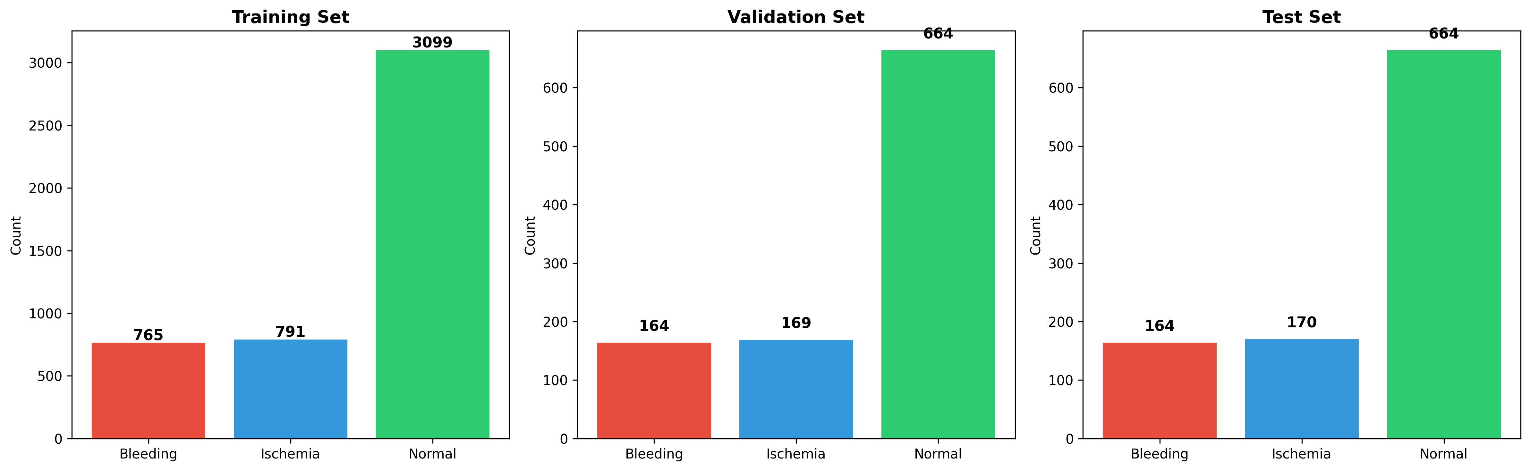
Dataset Overview
Key Facts
Total: 6,650 brain CT images
Bleeding: 1,093 (16.4%)
Ischemia: 1,130 (17.0%)
Normal: 4,427 (66.6%)
Split: 70% train / 15% val / 15% test
Stratified sampling preserves class ratios
Challenge: Normal class is ~4x larger than stroke classes

Slide 4
Our Approach — The Journey
1. Data Preparation
2. Preprocessing
3. Class Imbalance
4. Model Training
5. Evaluation
6,650 CT images 70/15/15 stratified split PNG format, 224x224
Augmentation: flip, rotation, translation, color jitter ImageNet normalization
Weighted random sampling Class-weighted loss function Balanced representation
ResNet-50 fine-tuning Logistic Regression SVM (RBF) + Random Forest
Accuracy, F1, Kappa, AUC Confusion matrices ROC & PR curves
Key Design Decisions
ResNet-50 chosen for proven medical imaging performance + residual connections prevent vanishing gradients
Traditional ML classifiers use ResNet-50 as feature extractor (2048-d) for fair comparison on same representations
AdamW optimizer + cosine annealing LR + early stopping (patience=7) to prevent overfitting

Slide 5
Predicted Challenges & Solutions
Class Imbalance
Issue: Normal (66.6%) vastly outnumbers stroke classes — models will default to predicting Normal
Solution: Weighted random sampling + class-weighted cross-entropy loss
Result: Balanced per-class F1 scores; no majority-class bias
Ischemia Detection
Issue: Early ischemic changes are subtle on CT — even radiologists miss them
Solution: Transfer learning from ImageNet provides strong feature representations
Result: 91.45% F1 on Ischemia (ResNet-50) — clinically meaningful
Overfitting Risk
Issue: Only 6,650 images — deep networks can memorize small datasets
Solution: Data augmentation, dropout (0.5), early stopping, weight decay
Result: Val accuracy (97.6%) closely tracks train accuracy — mild overfitting controlled
High-Dimensional Features
Issue: 2048-d ResNet features may overwhelm traditional ML classifiers
Solution: StandardScaler normalization; SVM with RBF kernel handles high-d well
Result: SVM reached 87.4%; Random Forest struggled (72.2%) — confirmed prediction

Slide 6
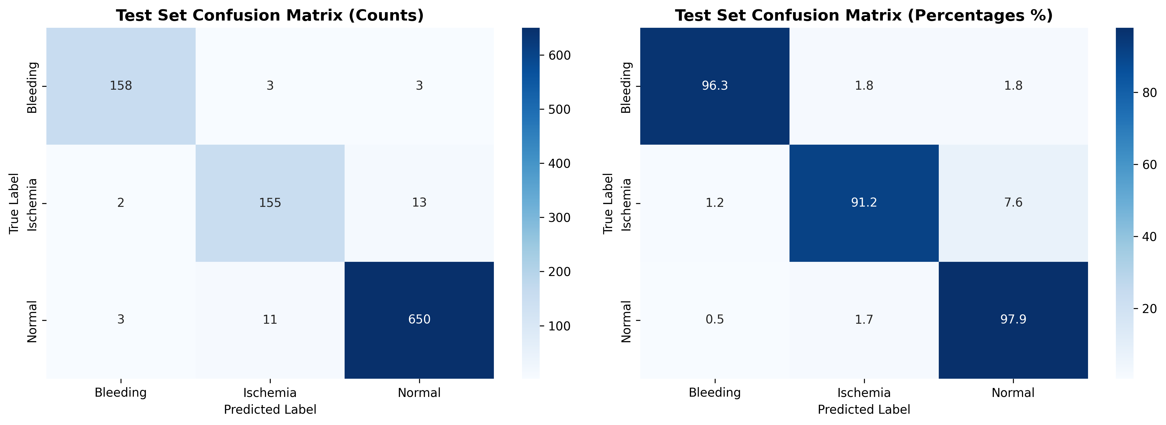
ResNet-50 Results (Fine-Tuned)
96.49%
95.28%
0.9299
0.9959
Accuracy
Macro F1
Cohen's Kappa
Micro AUC
Per-Class Performance
Class Precision Recall F1-Score AUC
─────────────────────────────────────────────────────
Bleeding 96.93% 96.34% 96.64% 0.9971
Ischemia 91.72% 91.18% 91.45% 0.9918
Normal 97.60% 97.89% 97.74% 0.9951
Only 35 misclassifications out of 998 test images. Ischemia is hardest — subtle early changes on CT.

Slide 7
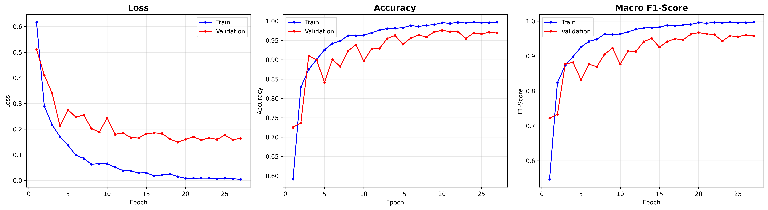
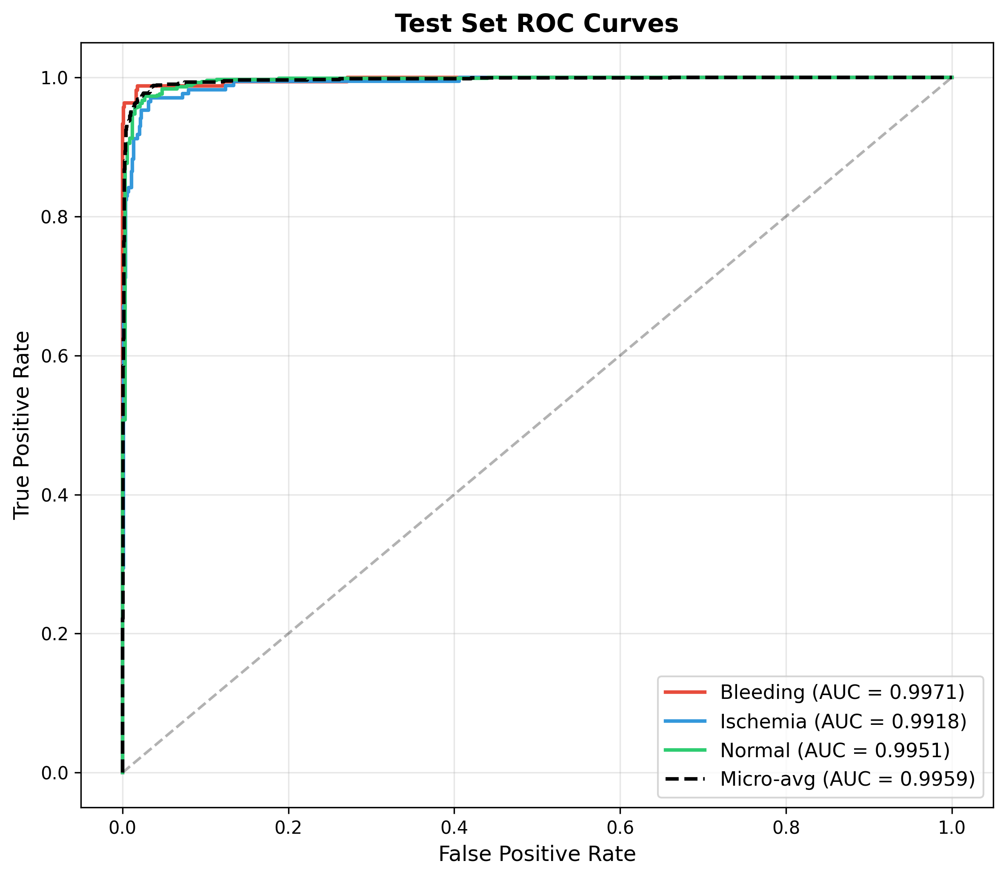
ResNet-50 — Training Curves & ROC
Trained 27 epochs, best model at epoch 20 (early stopped with patience=7)
Training time: ~72 minutes on Apple MPS GPU
All classes achieve AUC > 0.99 — near-perfect discrimination
Mild overfitting in later epochs, effectively controlled by dropout + early stopping

Slide 8
Traditional ML Classifier Results
Features: 2048-d vectors extracted from pretrained ResNet-50 (ImageNet) + StandardScaler
SVM (RBF Kernel)
Logistic Regression
Random Forest
Accuracy
87.37%
Accuracy
81.66%
Accuracy
72.24%
Macro F1
81.74%
Macro F1
75.29%
Macro F1
47.59%
Kappa
0.7324
Kappa
0.6414
Kappa
0.2551
C=10, balanced weights Best traditional model Strong on Normal (96.2%) Weaker on stroke classes (~70% recall)
LBFGS solver, balanced weights Middle performance Spreads errors more evenly Higher false positive rate
500 trees, balanced weights Struggles with 2048-d features Classifies ~78% of strokes as Normal Needs dimensionality reduction

Slide 9
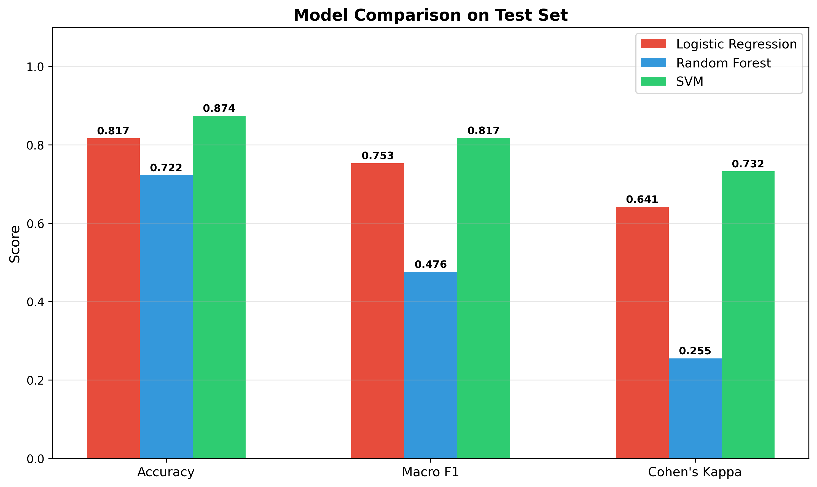
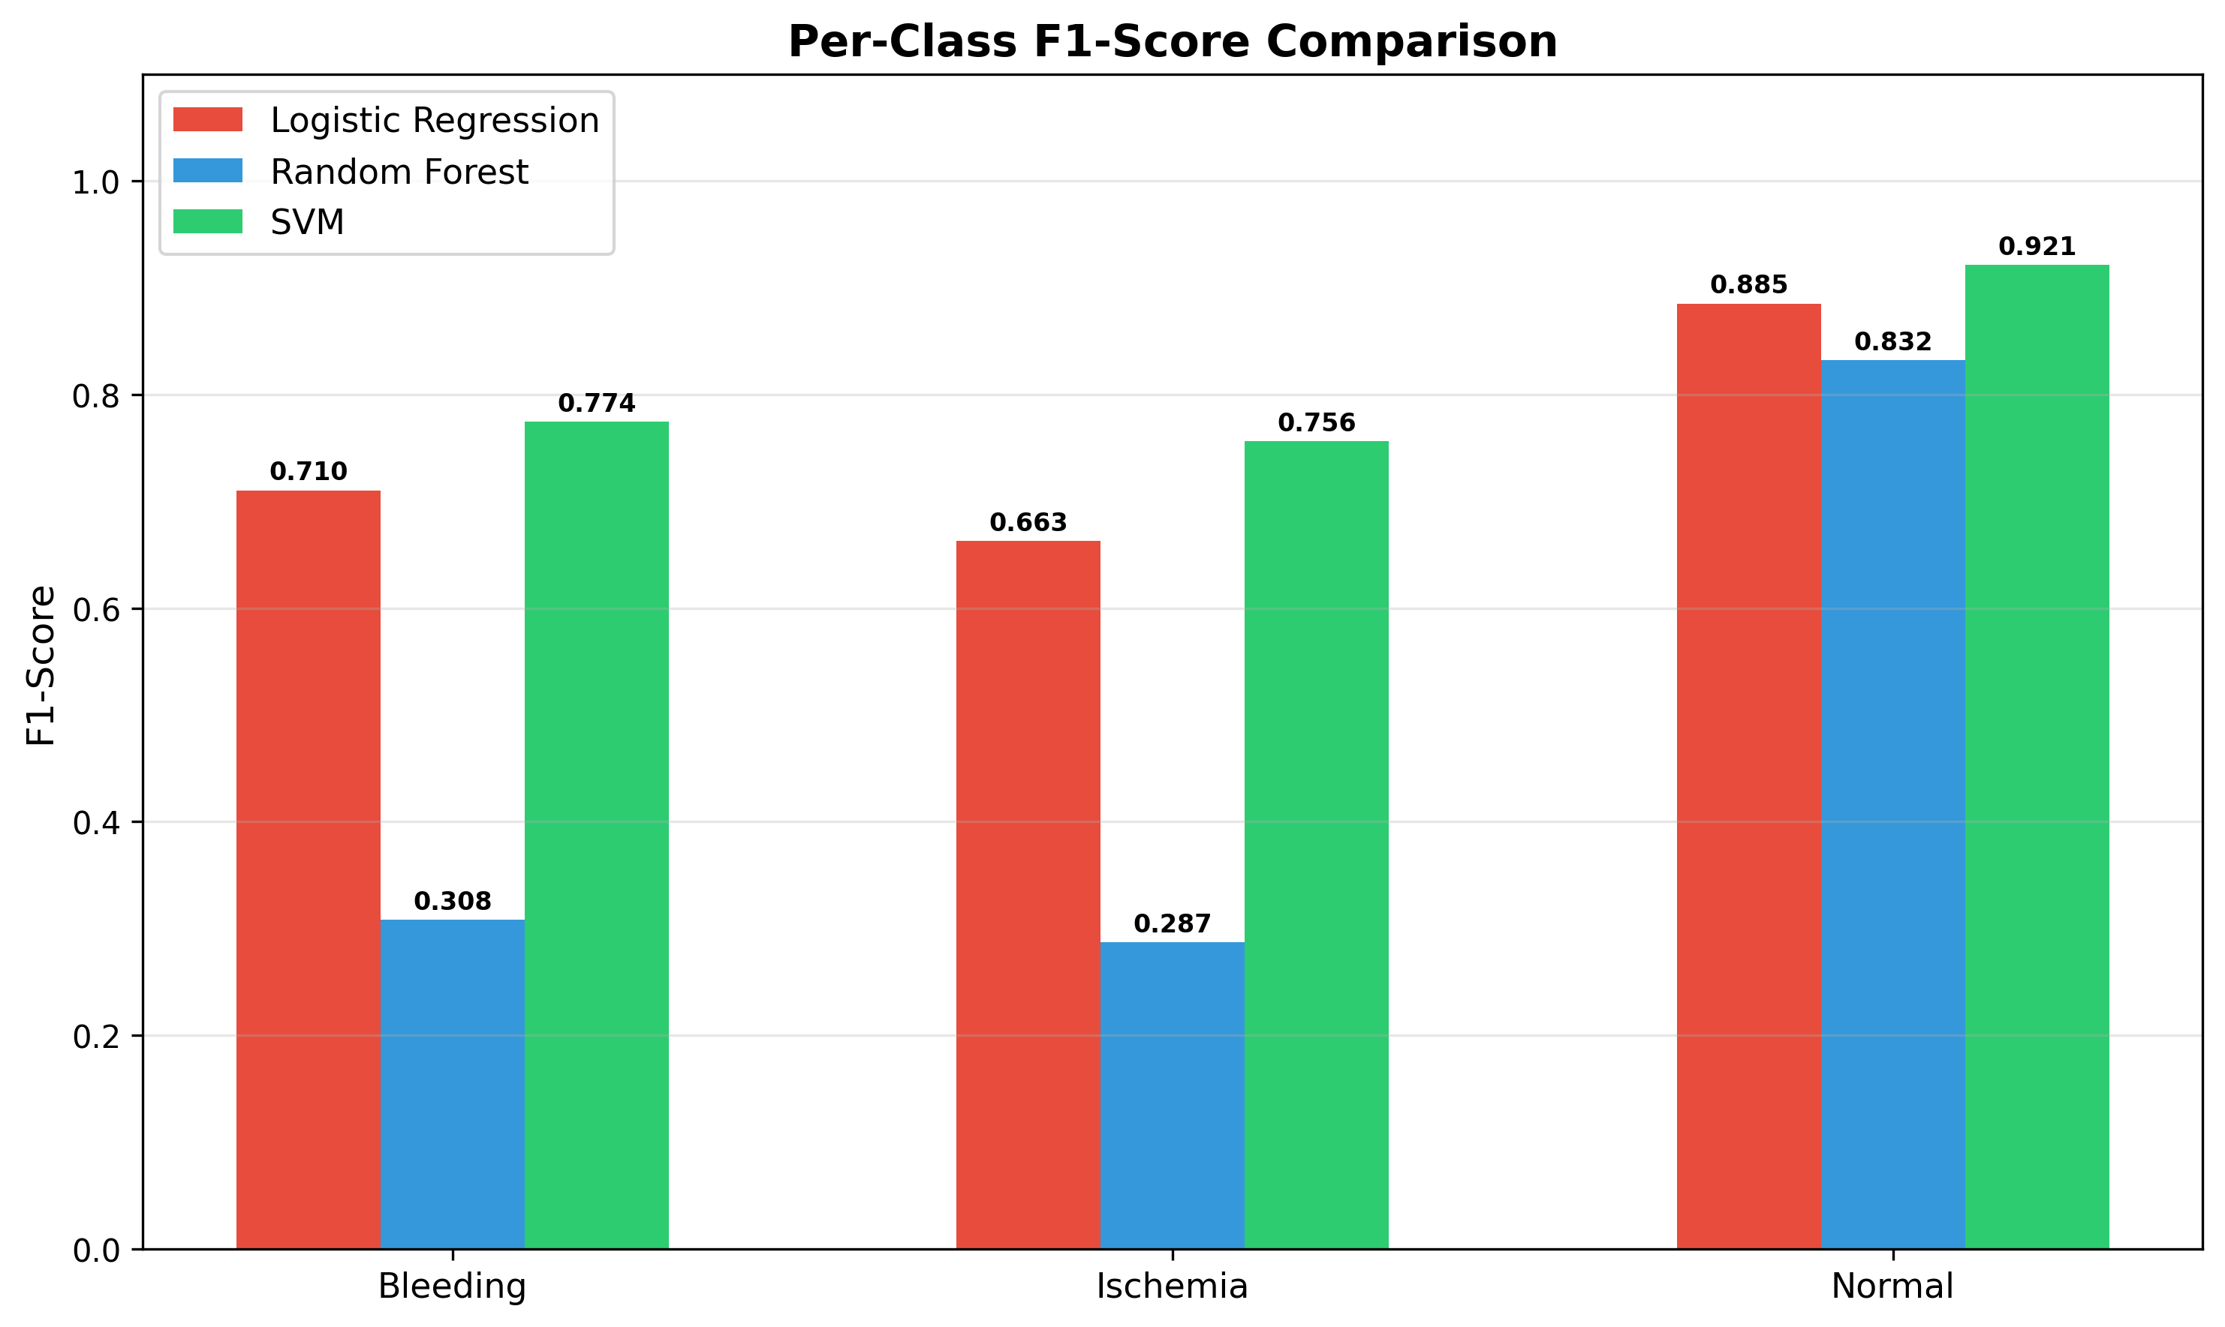
Model Comparison
Full Comparison (Test Set)
Model Accuracy Macro F1 Kappa Micro AUC
────────────────────────────────────────────────────────────────────────
ResNet-50 (fine-tuned) 96.49% 95.28% 0.9299 0.9959
SVM (RBF) 87.37% 81.74% 0.7324 0.9674
Logistic Regression 81.66% 75.29% 0.6414 0.9375
Random Forest 72.24% 47.59% 0.2551 0.9080

Slide 10
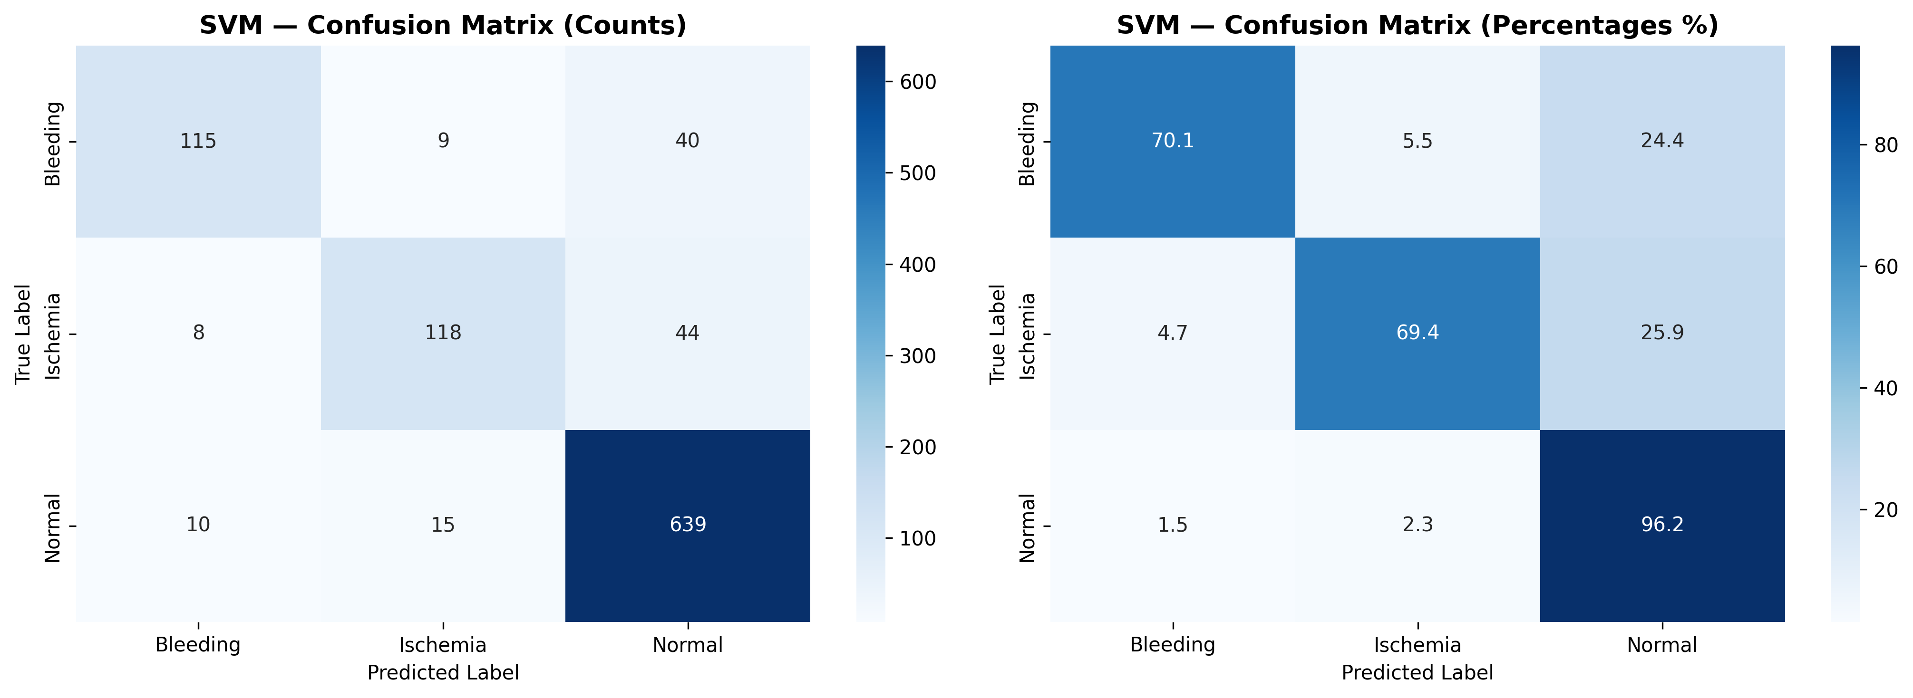
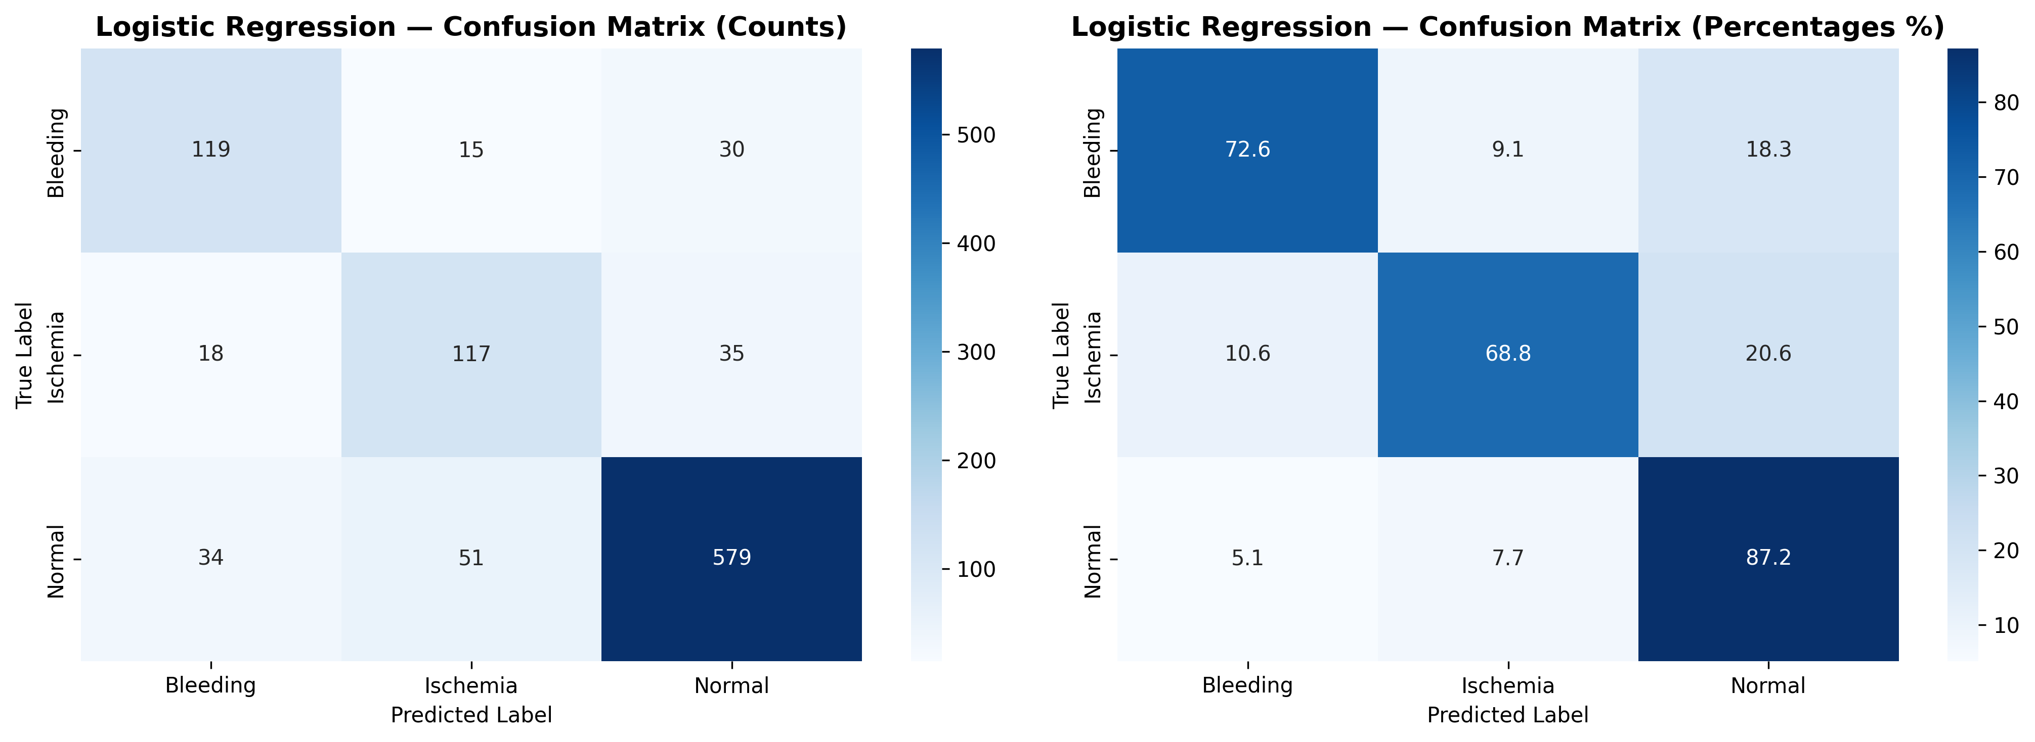
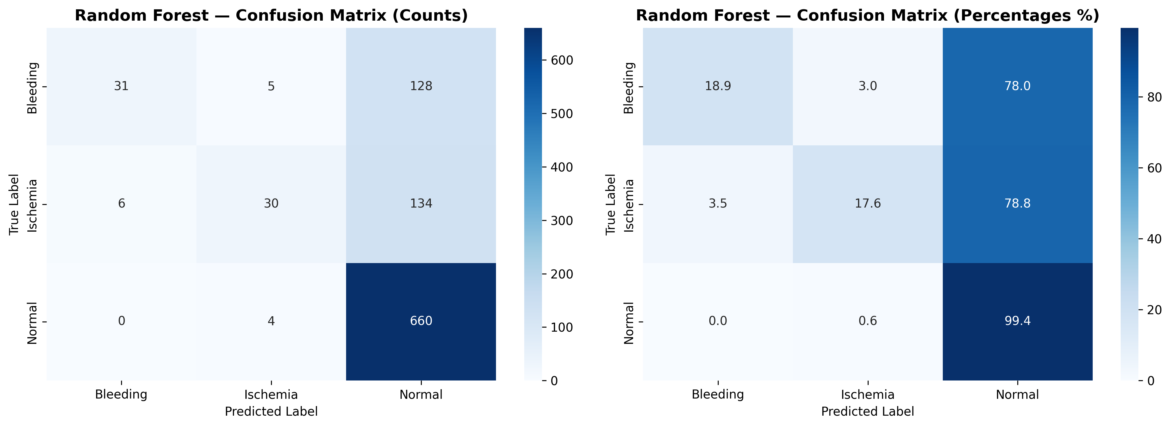
Confusion Matrices — Traditional Classifiers
SVM
Logistic Regression
Random Forest

Slide 11
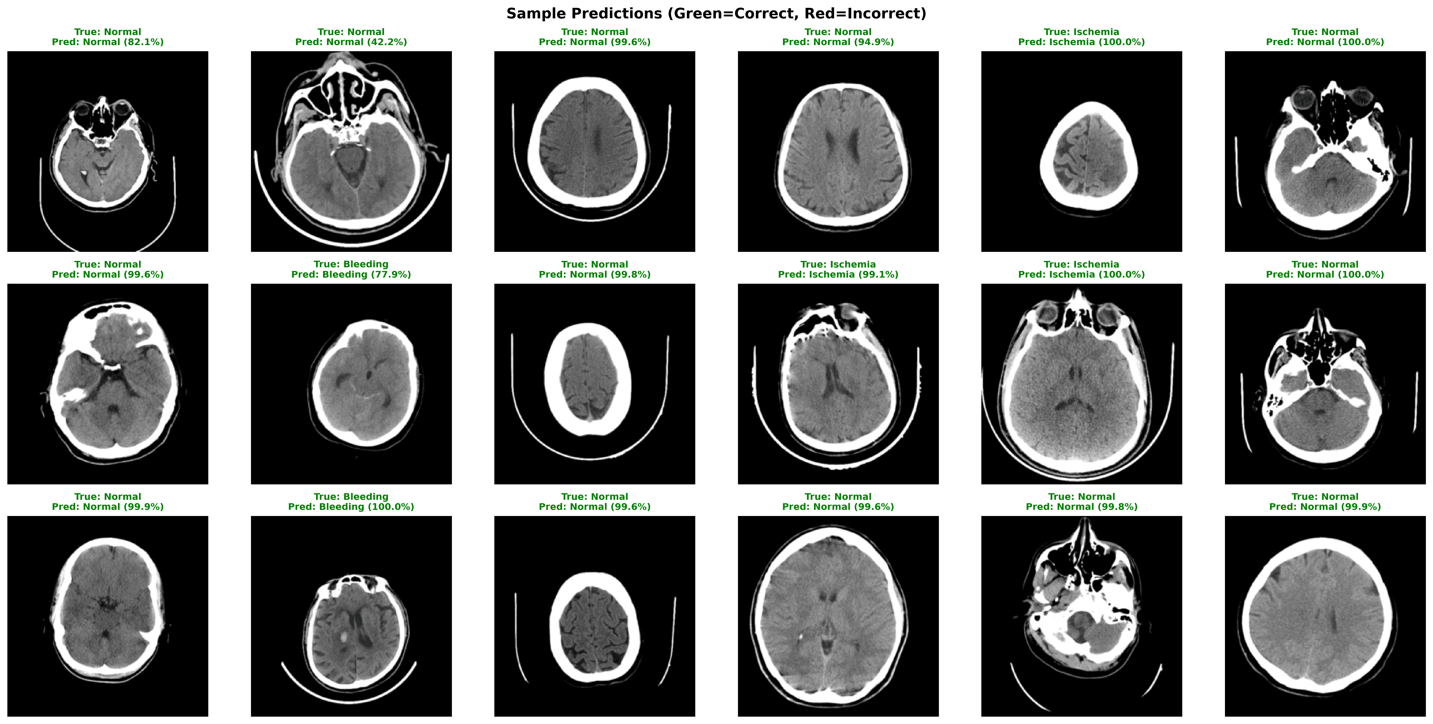
Sample Predictions — ResNet-50
Green = correct prediction | Red = incorrect prediction | Confidence shown in parentheses

Slide 12
Key Takeaways & Future Work
Key Takeaways
Future Work
Fine-tuned ResNet-50 (96.5%) vastly outperforms traditional ML (best: SVM at 87.4%)
End-to-end learning captures features that frozen extraction cannot
Ischemia is the hardest class across all models — consistent with clinical reality
Class imbalance was effectively handled with dual strategy (weighted sampling + weighted loss)
Random Forest fails on high-dimensional features without dimensionality reduction
All per-class AUCs exceed 0.99 for ResNet-50 — near-perfect discrimination
Multi-center external validation for generalizability
Grad-CAM explainability to visualize what the model sees
Hemorrhage subtype classification (epidural, subdural, etc.)
Volume-level prediction across full CT exam slices
Compare with Vision Transformers (ViT) and EfficientNet
Clinical integration study with radiologist comparison

Slide 13
Thank You
Questions?
github.com/angel3848/brain-stroke-ct-classification

