Slide 1

Music and Mental Health
Presented by:
Gabor Horvath, Brittany Laurent, Don Smith

Slide 2
Introduction
Our dataset was drawn from a survey of ~730 people.
Each row contains information regarding the respondent’s age, number of hours per day listening to music, favorite musical genre and streaming service, and the extent to which they experience mental health-related problems with Anxiety, Depression, OCD, and Insomnia.
Respondents also indicated how often they listen to each of 16 listed musical genres.
Our analytical interest was in attempting to predict respondents’ levels of self-reported mental health issues using information about their music-listening habits.

Slide 3
Data Cleaning
The survey data originated as a .csv file which we loaded into a Pandas dataframe.
Initial data cleaning steps included dropping unneeded columns and renaming others to adhere better to Python conventions.
Some columns required data type conversion.

Slide 4
Feature Engineering
Some distinct values in the single-answer ‘favorite genre’ column were merged based on an application of the “reasonable sufficient similarity” rule:
‘Rap’ and ‘Hip-Hop’ became ‘Rap or Hip-Hop’
‘Rock’ and ‘Metal’ became ‘Rock or Metal’
‘Pop’ and ‘K-Pop’ became ‘Pop or K-Pop’
The four mental health-related columns, each scored out of 10, were summed to create an ‘overall_mh’ column which could be used as a target variable.
Internal correlations were run between the original and derived columns to ensure the conversion to a summed metric was defensible statistically.

Slide 5
Feature Engineering (Continued)
Some respondents’ values for ‘hours per day spent listening to music’ were assessed to be unrealistic and unlikely.
Rather than lose data from an already-small dataset by removing those values, we substituted a “reasonable maximum” of 18 hours per day (24 total hrs - 8 sleeping hrs) for any original respondent-provided value over 18 hours.
The Likert-type columns for each of the 16 genres (originally formed as “how often do you listen to this genre of music?”) were remapped as binary classifiers. Any response other than ‘Never’ was coded as 1, and all responses of ‘Never’ were coded as 0.

Slide 6
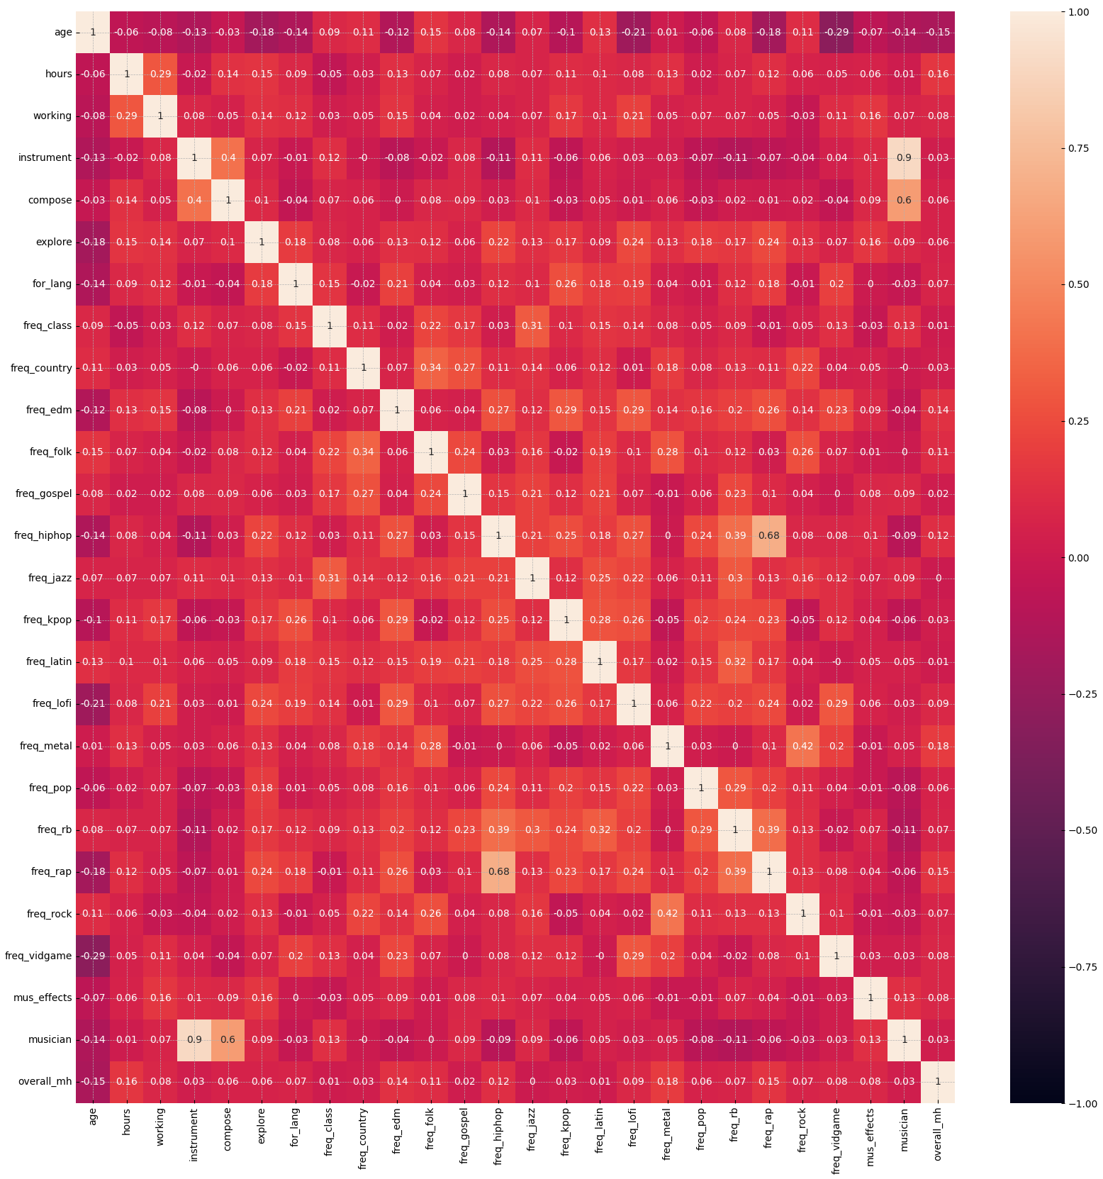
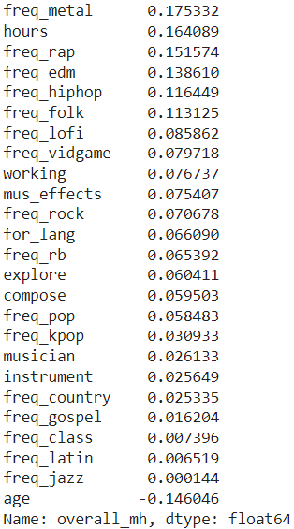
Target & Intra-Feature Correlations
We computed Pearson correlation values against our engineered target variable and built a correlation heatmap in Seaborn to test intra-feature correlations.
The results were not encouraging.
Don’t be misled by the correlations among ‘instrument,’ ‘compose,’ and ‘musician.’
The ‘musician’ feature was something we derived by combining the ‘instrument’ and ‘compose’ features.
The correlations are therefore implicit.

Slide 7
First Analytical Steps
Because our initial correlation values (both against our target value and among the features) produced no obvious guidance for how to proceed, we began with an unsupervised machine-learning method: K-Means cluster analysis.
Our hope was that clustering the data would show us where the meaningful variance/differentiation among respondents could be found and that we could use those results to better guide our regressor-based predictions of overall mental health.
The data were prepared appropriately with scaling and one-hot encoding. The next task was to identify the correct number of clusters using inertia values and silhouette scores.

Slide 8
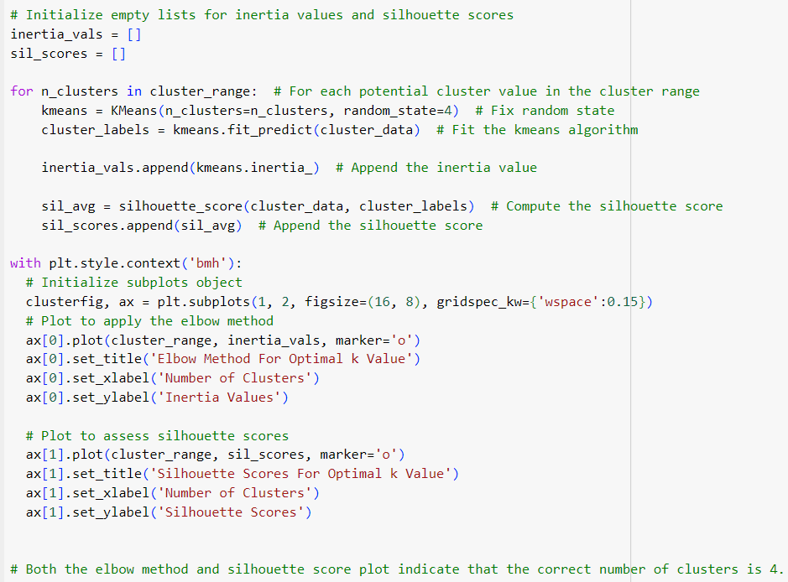
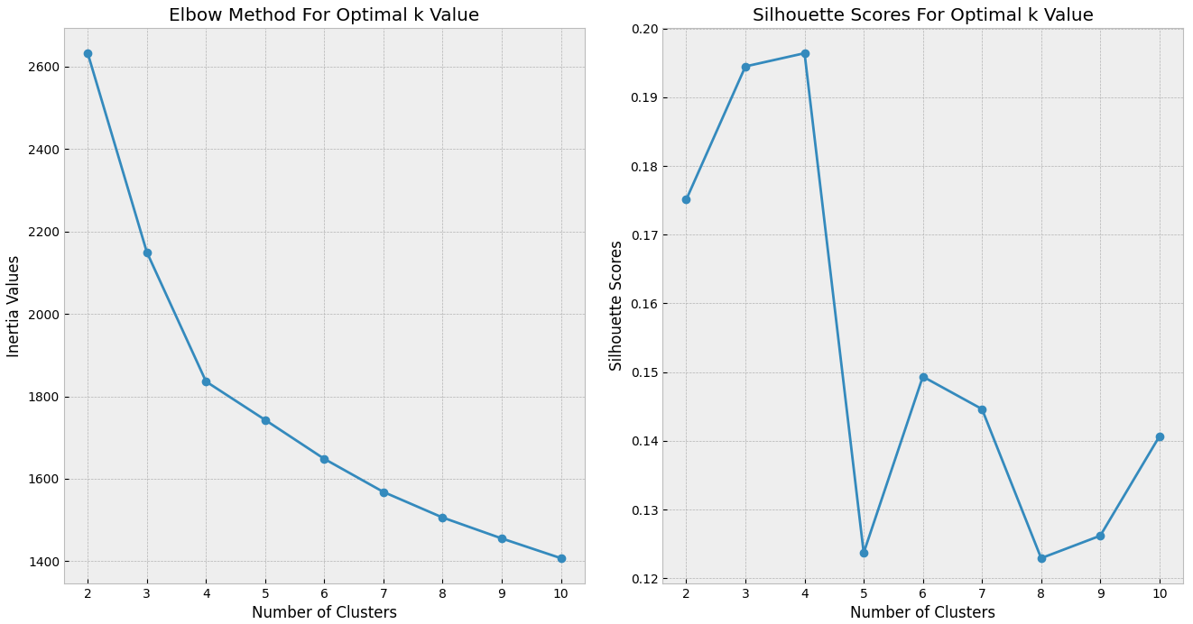
Selecting a Number of Clusters
Selecting the correct number of clusters using the elbow method and silhouette scores, evaluating a potential range from 2 to 10 clusters.
Both plots indicated that the correct number of clusters to use was 4.

Slide 9
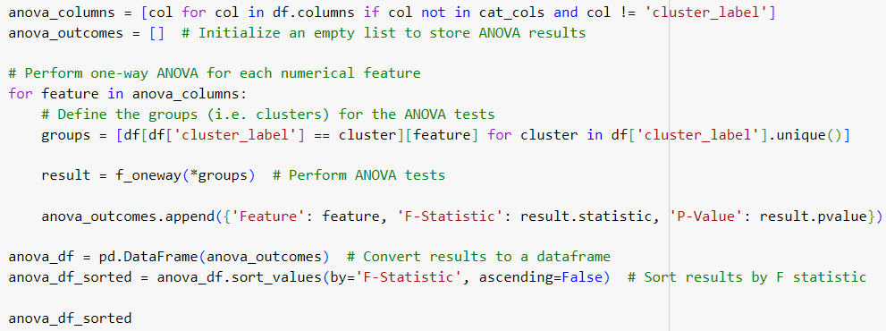
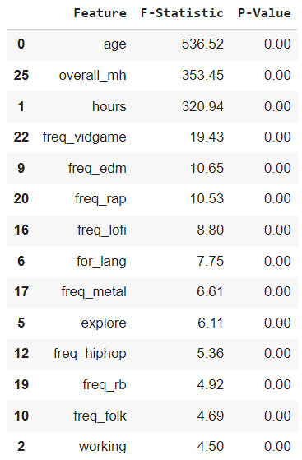
Analyzing Feature Importance in Clustering: One-Way ANOVA
After the clustering was performed and cluster labels were applied to each row, we ran per-feature One-Way ANOVA tests to identify which features were most important in cluster differentiation.
A higher F-Statistic suggests a larger difference between the group means, implying that the feature is more significant in differentiating between the clusters.
These results indicated that three features (‘age,’ ‘hours,’ and ‘overall_mh’) were far more important than any others in terms of cluster differentiation.

Slide 10
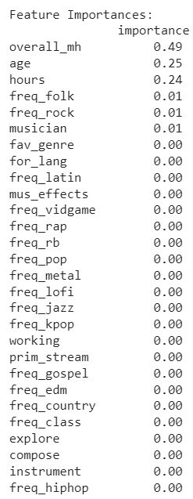
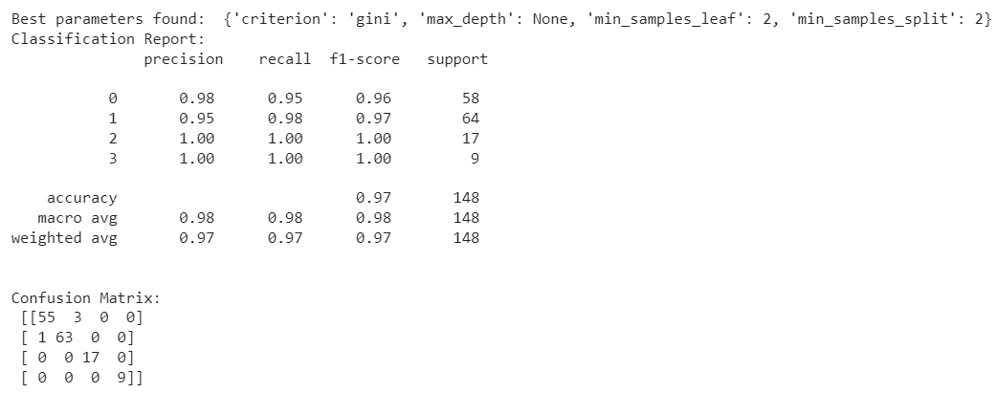
Seeking Confirmation: Building a Decision Tree
To confirm the primacy of these three features, we created and tuned a decision tree which attempted to predict the created cluster label value of each row.
By looking at feature importances in the model, we would be able to assess whether this method also identified ‘overall_mh,’ ‘age,’ and ‘hours’ as the most meaningful features in terms of cluster differentiation.
The results speak for themselves.
These results exactly reinforced the conclusions we drew from our ANOVA tests.

Slide 11
So, What Have We Learned?
Initial correlation tests were not encouraging either in terms of intra-feature correlation or in terms of feature correlation with the target variable.
The results of the cluster analysis showed convincingly that only three meaningful differentiating features existed in our dataset: ‘age,’ ‘hours,’ and our derived target variable ‘overall_mh.’
Considered together, this is general evidence that the vast majority of our features, because they can’t even usefully differentiate among the respondents in an unsupervised model, are unlikely to be powerful predictors of overall mental health.

Slide 12
What’s Next?
If it is true that ‘age,’ ‘hours,’ ‘overall_mh’ are the meaningful differentiating features among the clusters, we should see evident and meaningful difference in the descriptive statistics for those features when they are calculated at the cluster level.
Hopefully, descriptive statistics will allow us to assign a ‘meaning’ or ‘identity’ to each cluster – i.e. we will be able to say that cluster ‘x’ is defined by its particular values of feature ‘y’.

Slide 13
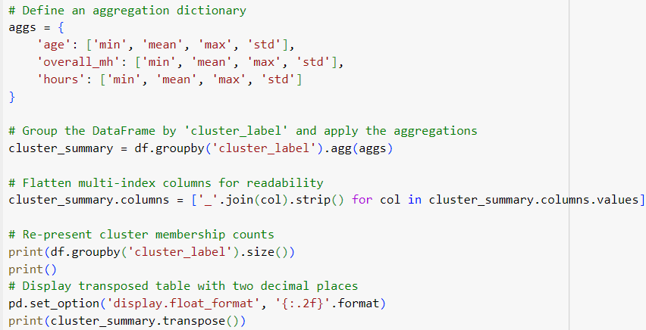
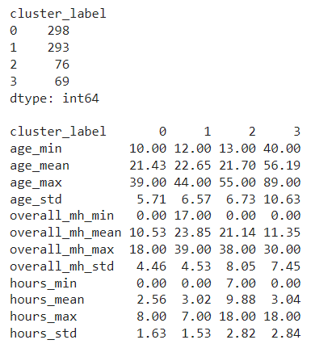
Descriptive Analysis of Meaningful Features
In terms of membership, we have 2 big clusters (0 & 1) and 2 small clusters (2 & 3).
The defining feature for cluster 3 is ‘age’ (An ‘old people’ cluster.)
The defining feature for cluster 2 is ‘hours’ (A ‘high hours’ cluster.)
We also found a bifurcated/’barbell’ distribution in terms of mean values for overall mental health by cluster.

Slide 14
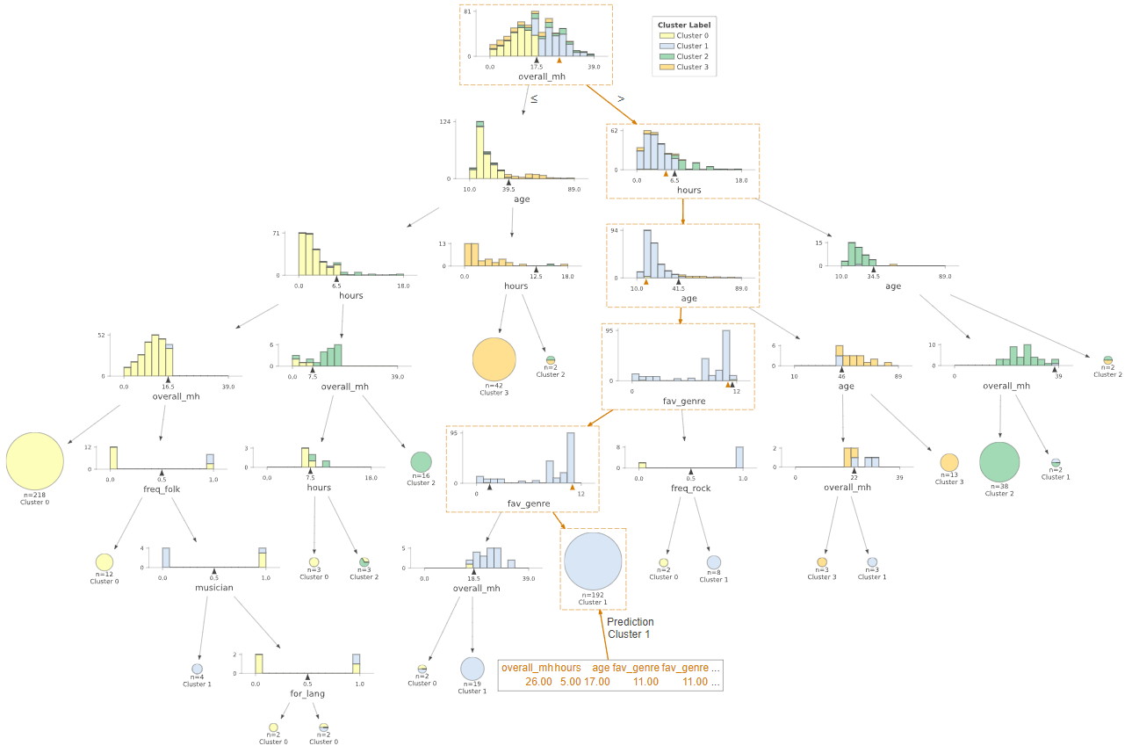
GridSearch Cross-Validated
Best Model applied to
Training Data
← Start here
Left/Right split indicated by black arrow
Sample data-point marked by orange arrow and dotted boxing
A visual walkthrough of the clustering process performed by our decision tree, enabled by ‘dtreeviz’ library
Notably, ‘overall_mh’, ‘age’, and ‘hours’ are the primary decision factors at almost all branches up to a depth of 3

Slide 15
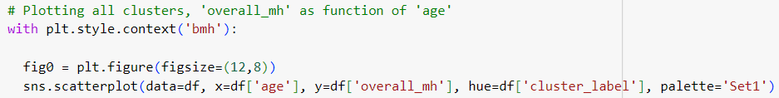
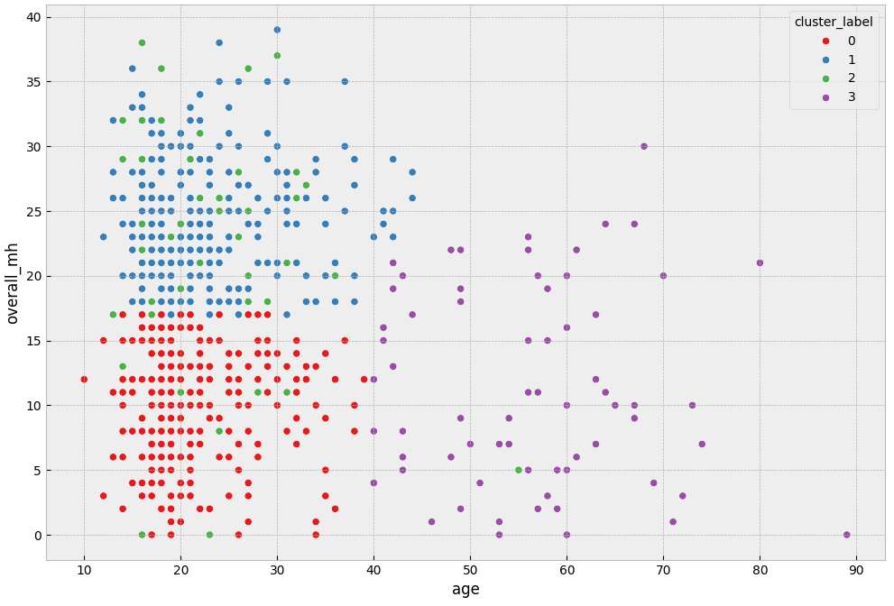
Cluster-Based Scatterplots: ‘overall_mh’ v. ‘age’ (1)

Slide 16
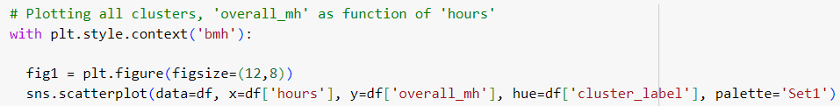
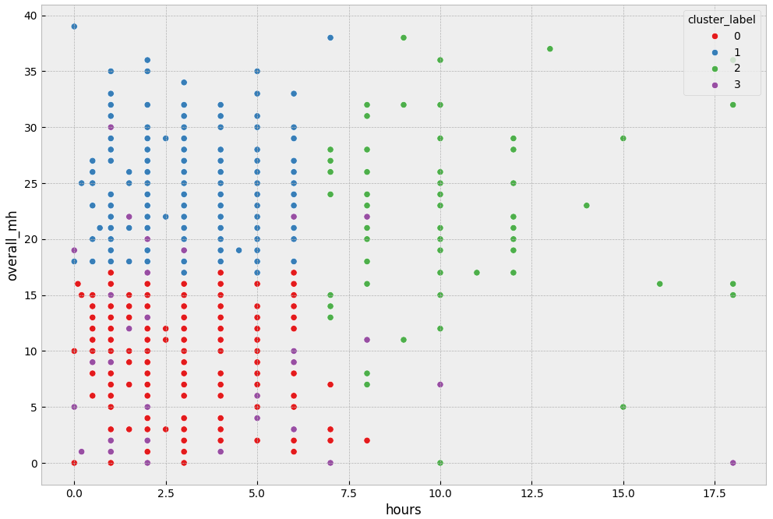
Cluster-Based Scatterplots: ‘overall_mh’ v. ‘hours’ (2)

Slide 17
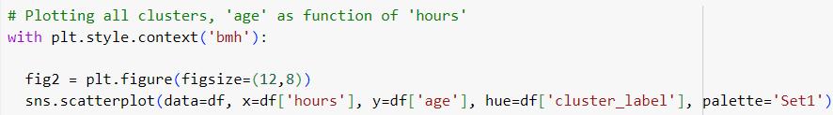
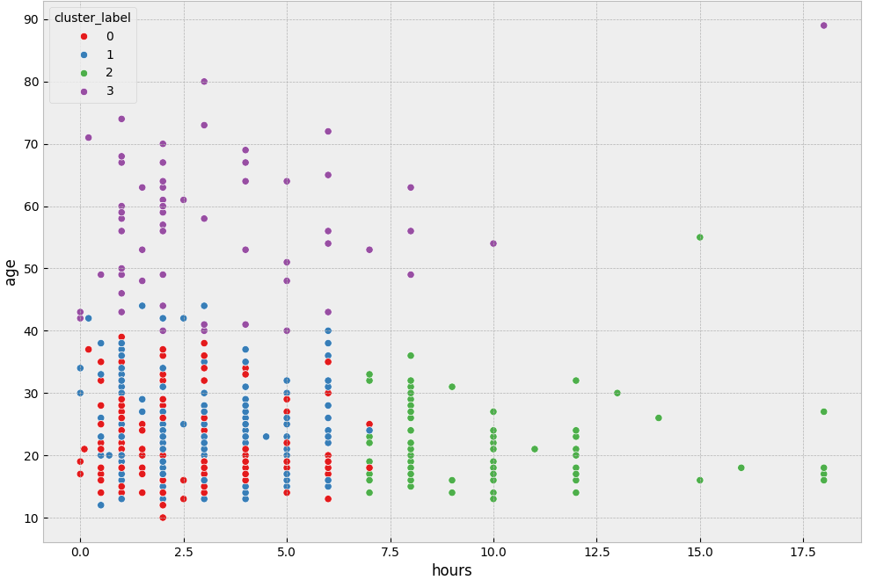
Cluster-Based Scatterplots: ‘age’ v. ‘hours’ (3)
These three scatterplots might lead one to believe there is meaning to be found in the varying locations of these clusters as they relate to comparisons between our 3 “best” predictors of ‘overall_mh’
Upcoming boxplots do a better job of demonstrating that this is not necessarily the case

Slide 18
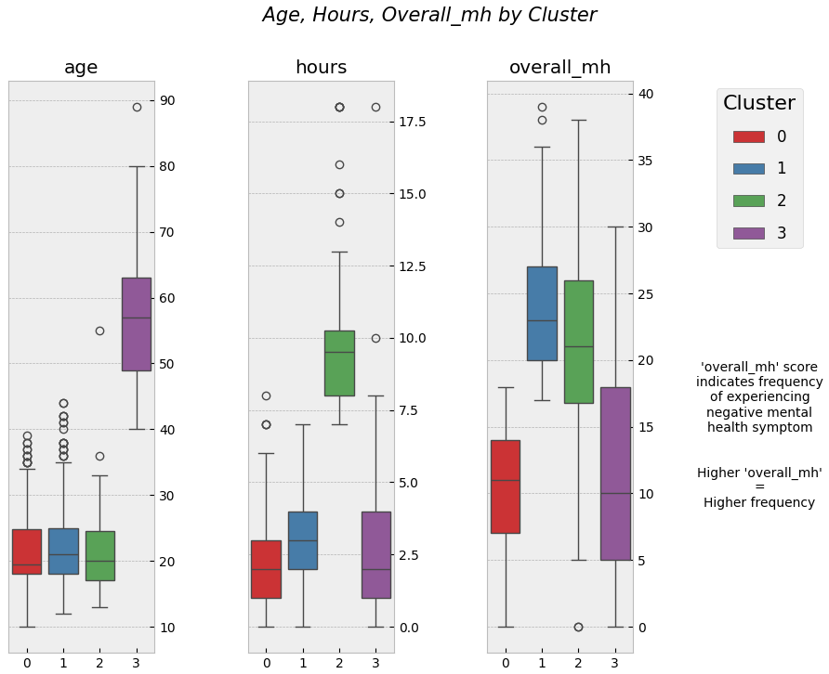
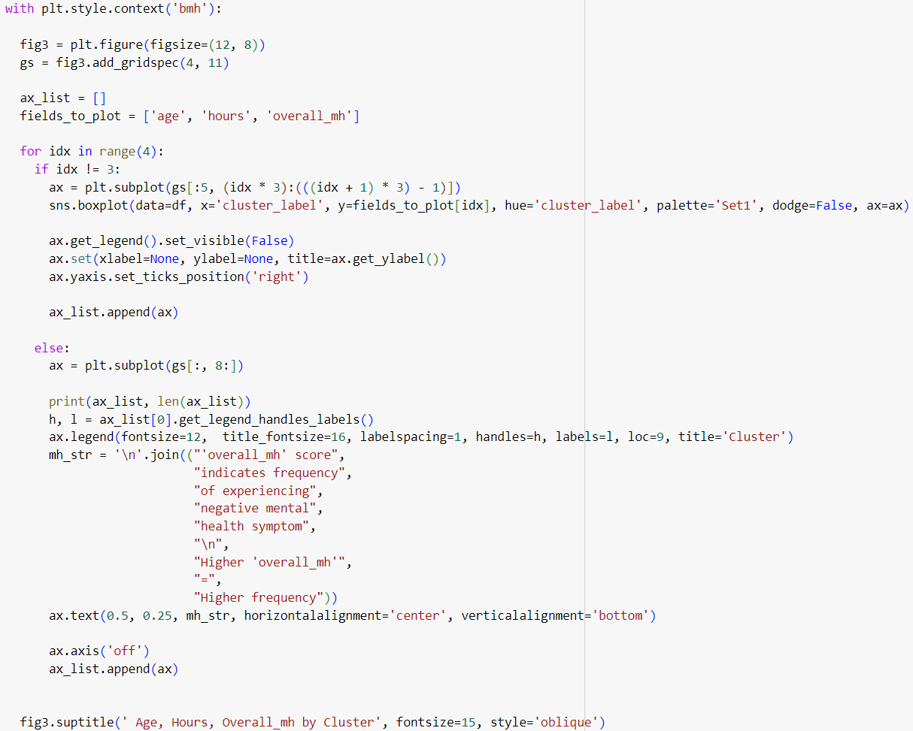
Boxplots
We have many combinations ‘age’ v. ‘hours’ v. ‘overall_mh’ results here
This breadth of results should trigger intuitions that we need to dig deeper somehow
(0) ↓ ‘age’ : ↓ ’hrs’ : ↓ ‘mh’
(1) ↓ ‘age’ : ↓ ’hrs’ : ↑ ‘mh’
(2) ↓ ‘age’ : ↑ ‘hrs’ : ↑ ‘mh’
(3) ↑ ‘age’ : ↓ ‘hrs’ : ↓ ‘mh’
This iterative approach employing .add_gridspec allows us greater control over location and spacing of ‘axis’ elements, hiding of redundant legends and labels, as well as the ability to store the ‘axis’ elements and get their various labels as needed

Slide 19
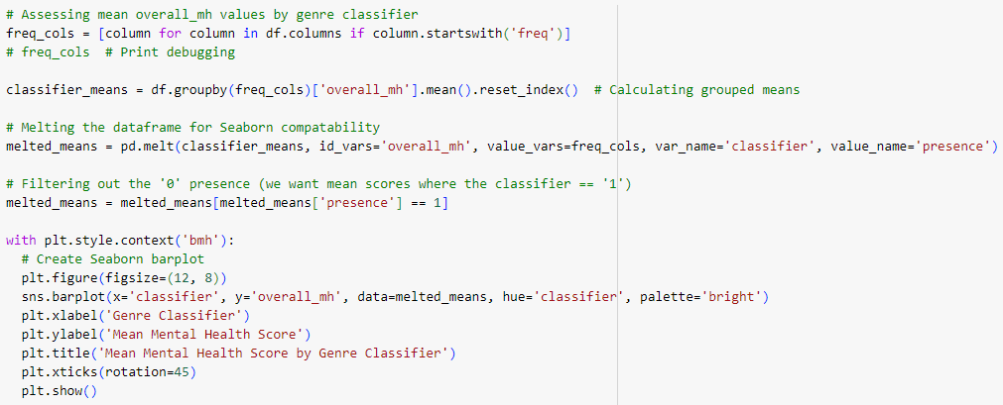
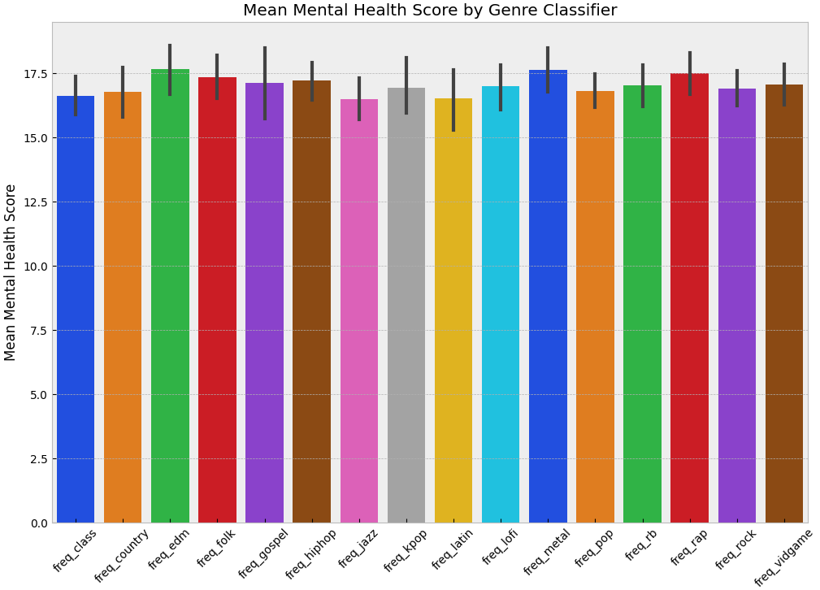
Binary Genre Classifiers - Barplot
What about mean ‘overall_mh’ scores in terms of our binary genre classifiers?
Here, the error bars tell the story, which is that “there’s nothing here.”
Given the magnitude of the error bars in the context of the comparative column heights, it’s clear that these features are not going to be useful as predictors of overall mental health.
Genre Classifier

Slide 20
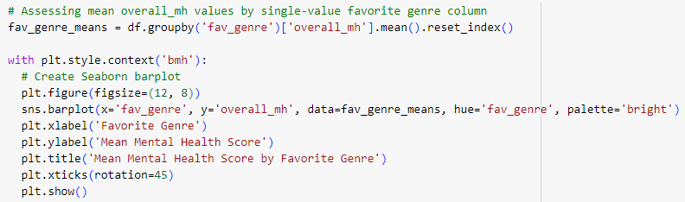
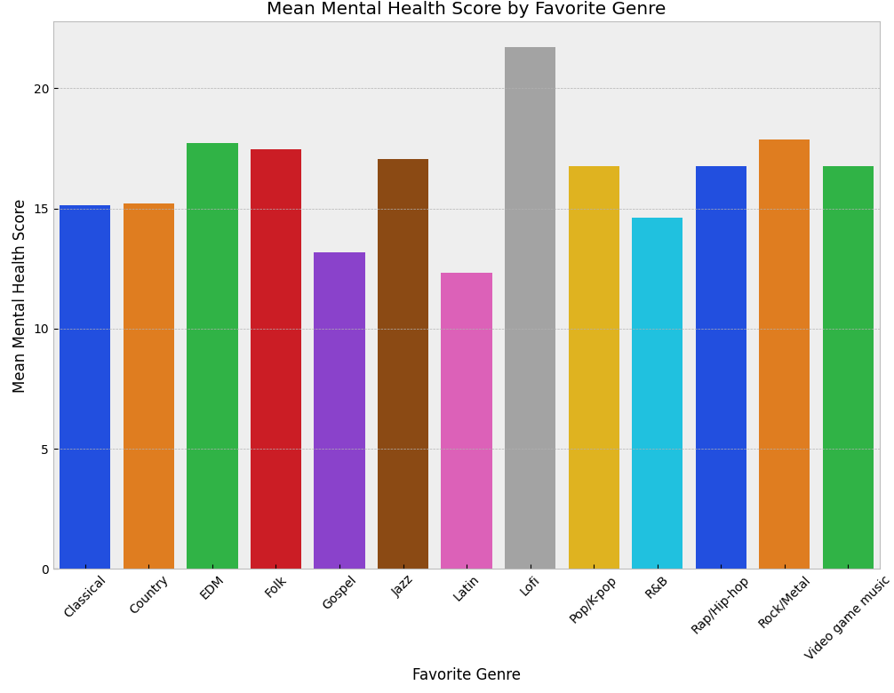
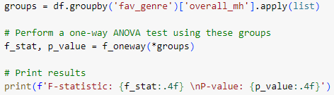

Favorite Genre Feature - Barplot
We assessed mean overall mental health values in the context of the single-answer ‘favorite genre’ feature.
Initially, this plot appears more promising.
However, because our eyes can fool us, it’s always best to seek rigorous quantitative confirmation of what a plot seems to indicate.
And sadly…
No, there’s nothing here, either. ANOVA doesn’t lie.
This feature, in terms of predicting overall mental health, is also very unlikely to be useful.

Slide 21
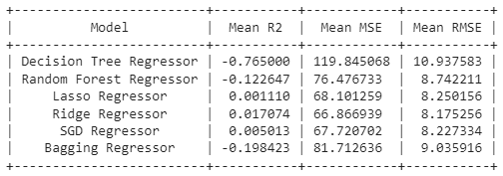

“Giving It a Shot:” Evaluating Regressor Models & Attempting to Predict Overall Mental Health
We tested several different regressor estimators (not using our cluster label column) to see if any meaningful predictions of overall mental health could be made.
Even our best predictive model was essentially useless. The R^2 score is statistically indistinguishable from zero.
This indicates that the model’s predictive power is no better than a ‘trivial model’ which always predicts the average of the target
The highly-regularized Ridge regressor “won,” likely because our dataset is small, and complex models tend to overfit more.
The GridSearch likely chose a highly-regularized model because it assessed that the majority of our data, in this predictive context, is functionally just “noise.”
We therefore concluded that without further differentiating among the clusters, no useful predictions could be made using our data.

Slide 22
Okay, what now?
At this point, we were aware that the only reasonable next step was to create subsetted datasets using our cluster labels, and to assess whether we could build better models using the subsets which the k-means method had shown to be more similar to each other.
To that end, we created three new data frames: one containing only the members of the ‘old people’ cluster (df_old), one containing only the members of the ‘high hours’ cluster (df_hours), and one containing the rest of the respondents (df_rest).
We then repeated the evaluate-and-tune process for a set of regressor estimators on the data frames representing the smaller ‘old people’ and ‘high hours’ clusters.
Our hope was that because these subsets were smaller and contained respondents who were similar to each other, that we’d be able to build a more powerful estimator, even though we were cognizant of the dangers of overfitting, given a smaller dataset.
If you’ve been following along and understand how things have gone so far, you might be able to guess where this is going.

Slide 23
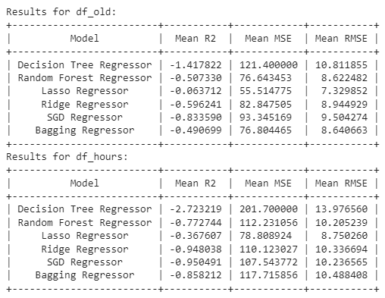
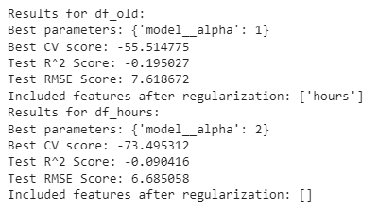
Well, there goes that idea…
Initial performance:
And, after tuning:
The GridSearch once again selected a highly-regularized Lasso regressor. This was expected given the small sizes of the subsets/clusters.
Tuning made only a small positive difference in terms of RMSE for df_hours and actually harmed the RMSE score for df_old.
Both models failed to meaningfully capture the variance in the target variable.
In sum, for the goal of predicting overall_mh, even our best models for these smaller clusters were statistically useless.
As we can see from the R^2 values, both models fail to capture the variance in the target variable, and both are outperformed by a trivial model that always predicts the average of the target.
In fact, the lasso model for df_hours ended up including no features whatsoever. (Note the empty list in its ‘included features’ parameter.)

Slide 24
Re-Clustering Using df_rest
After seeing that even the smaller subsets of data representing the initial ‘old people’ and ‘high hours’ clusters could not be useful in predicting overall mental health, we decided to re-cluster the remaining data, stored in df_rest, to see if different features (i.e. features other than ‘age,’ ‘hours,’ and ‘overall_mh’) would be useful in differentiating between the clusters.
This seemed at least possible, given that the observations so clearly demarcated by their values for the ‘age’ and ‘hours’ in the original smaller clusters had been removed from the dataset.
So, we selected an appropriate cluster value, re-clustered using k-means on the df_rest subset, and were hoping to see that the clusters would be defined by other features.
This would indicate that we had removed the influence of the outlying respondents’ extreme values for ‘age’ and ‘hours.’
It’s very likely that in the real world we would have given up by now, but we kept going!
And, once again, if you’ve been paying attention, you might be able to guess where this is going.

Slide 25
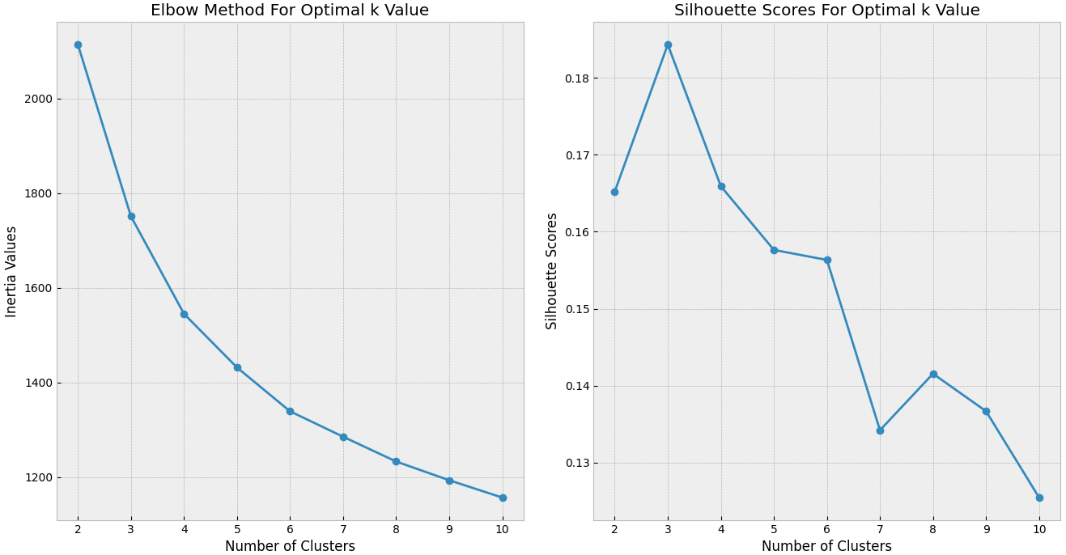
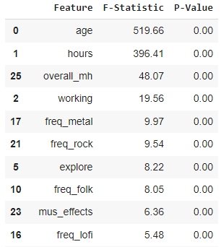
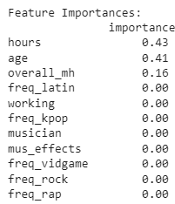
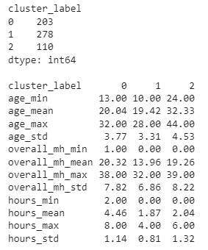
K-Means Cluster Analysis on df_rest
Repeating ANOVA Tests:
Repeating Feature Importance Tests:
Nothing has meaningfully changed.
We still have the same three features differentiating among the clusters.
Despite the removal of the rows in the ‘old people’ and ‘high hours’ clusters, these three features still have overwhelming primacy.
In fact, when we consider the descriptive statistics, it turns out that we still have one ‘old people’ cluster and one ‘high hours’ cluster.
Mean scores for overall_mh are closer, but that feature is now a less useful differentiator in the clustering.

Slide 26
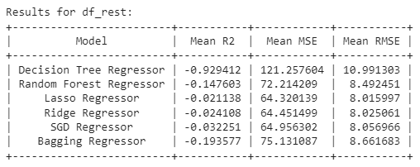
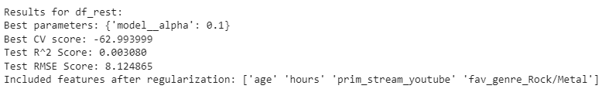
Evaluating Regressor Models on df_rest
Once again, GridSearch selected a Lasso regressor.
The smaller alpha value indicates that more features were used in the model after regularization.
However, the R^2 value indicates that there is still no meaningful predictive power in the model.
The model built using the subsetted df_rest dataframe is better, but remains neither predictive nor probative.

Slide 27

Conclusions
Unsupervised clustering methods showed that there are different groups of respondents in our data.
Cluster analysis demonstrated meaningful variance in respondents’ age, hours spent listening, and overall mental health.
However, none of the features showed any ability to participate in the construction of a regressor model which could usefully predict a respondent’s overall self-reported mental health.
Therefore, we must report a negative result in terms of the scope of our original investigation.
Subsetting our data and re-clustering got us some progress, but to further re-cluster and drill down would start diminishing sample size to such an extent that regularized models would be empty of predictors and non-regularized models would overfit to the training data, making the results fraudulent.
Nonetheless, we should recall that “a negative result is a result in itself.”
Negative results reveal flaws in experiment design, data collection, or underlying analysis assumptions. This allows us to refine methodologies and adjust theoretical frameworks.
By documenting what does not work, we may guide future research and development efforts more effectively, avoiding repetition of ineffective strategies and focusing resources more appropriately.
Pictured above for no particular reason: Three people “beating a dead horse.”

