Slide 1

Creating Your Own Extension Points
(It's Easier Than You Think!)
*All images are royalty-free courtesy of http://SXC.hu
Notes:
This presentation is about creating your own extension points. It was originally intended to be a tutorial, but there were not enough spots available so it has morphed into a long talk. I am going to walk through a sample application – kind of a before and after scenario – in an effort to explain exactly how an application can benefit from extension points. This talk is geared mostly towards people who have never written an extension point before, and is intended to be introductory material. If you are an experienced extension point author, while you may learn something, you will most likely find this presentation to be largely a review. If that’s the case, now is a good time to leave, or fire up your laptop and check your email.

Slide 2
Presentation Overview
Introductory material
The Eclipse extension registry
A simple application
Refactoring for extensibility
Creating your own extension points
Putting it all together
Beyond the basics
Things to remember
Questions?
Notes:
This is basically what will be covered in this presentation.
Feel free to stop me at any point during the presentation and ask questions. If it cannot be answered quickly, I’ll defer it until the end. I will also make an effort to repeat the question but if I forget, feel free to yell at me.
Since I only have 50 minutes, and there is a lot to cover, let’s get started.

Slide 3
Introduction
Who am I?
  I am not an expert (but I know some stuff)
  Been developing Eclipse plug-ins for over 5 years
  Not a committer, but have fairly broad knowledge of internals
  Written many extension points and learned from the process
Notes:
So exactly who am I and why am I qualified to talk to you?
I am not an expert, but I have been using Eclipse for over 5 years (since Eclipse 2.0). I am not an Eclipse committer but I have a fairly broad knowledge of the internals of Eclipse having developed plug-ins for it as part of our IDE for embedded DSP development. I have also done a fair amount of my own extension point writing as part of our own CDT-like build engine.
I am a member of several 12-step programs but I am not a licensed therapist. I am good enough, smart enough, and doggone it, people like me.
A good deal of my extension point development was done on earlier versions of Eclipse, and as a result I have learned quite a bit about the latest and greatest way to do things myself while developing this presentation. Consequently, if you think I said something wrong or stupid – call me on it!

Slide 4
What Are Extension Points?
Extension Point
  A unit of functionality declared by a plug-in in its plugin.xml file using the <extension-point> element.
Has an id, name, and optional schema attribute
What you are here to learn more about
Notes:
Let’s start with some terminology. This is fairly elementary, but people tend to mix up the two concepts of extension points and extensions, and using the right language matters.
An extension point is a unit of functionality declared by a plug-in in its plugin.xml file using the <extension-point> element. An extension point has an id, and a schema attribute, as well as a human-readable name and that is it.
Note that the schema attribute is optional. I’ll talk more about that later.

Slide 5
What Are Extensions?
Extension
  A particular contribution to an extension point declared in the plugin.xml file of your plug-in using the <extension> element.
Can contain many sub-elements and attributes as defined by the extension point to which you are contributing
What you’ve been writing as plug-in developers
Notes:
An extension, is a particular contribution to an extension point, and is what you have been writing all these years as a plug-in developer. It is declared in the plugin.xml file of your plug-in using the <extension> element, and can contain many sub-elements and attributes specific to the extension point you are extending (as defined by the extension point's schema).

Slide 6
Why Do I Need Extension Points?
Extension points can promote modularity and re-use
Extension points can reduce coupling and increase cohesion
Well-designed extension points are like well-designed APIs, but with additional benefits
Notes:
Extension points can promote modularity and re-use. By breaking up your code into more manageable and re-usable chunks, you make it more modular and easier to understand and maintain. Hopefully you break up your code into re-usable chunks, not just chunks.
Extension points can reduce coupling and increase cohesion. If you have a modular design connected by a simple interface (extension points and extensions), plug-ins are more loosely coupled and are free to change without affecting each other. Also, by breaking up code into functional units, you naturally increase cohesion, with each unit of code performing a well-defined and focused task.
Extension points and their contributions (extensions) are basically API contracts, but they have many advantages over simple Java interfaces. They do everything simple APIs do, but also allow you to leverage a lot of additional functionality that already exists in the the Eclipse platform.
I say can in all of the above points because extension points still need to be well thought out and well written. It is just as easy to write bad extension points as it is to write bad code.

Slide 7
Advantages of Extension Points
Extension points can be dynamic
  Code required but Eclipse platform does the heavy-lifting
Eclipse classloading advantages
You get tooling and documentation for free
Notes:
Extension points can also be dynamic. Because Eclipse is dynamic, you have the ability to make your extension points dynamic. This isn’t nearly as hard as it sounds thanks to the machinery that is already built into Eclipse.
Also, one of the main benefits of extensions and extension points – in fact the whole Eclipse plug-in architecture in general – is classloading. You don’t need to manage classpaths to ensure class.forName works. The Eclipse extension point machinery uses your plug-in’s declared dependencies and for most scenarios, it “just works”.
You get tooling and documentation for free. When you think of the tools the PDE provides in terms of schema editing (for extension point definition), extension validation (plugin.xml editor), and the extension point documentation you get for free (provided you fill in the documentation fields of your extension points) this is major.

Slide 8
The Bottom Line
You don’t need extension points
…but you should use them!
Can you imagine an Eclipse without them?
Notes:
Enough buzzwords and hand-waving; I’m sure you’ve heard it all before. Why do you need extension points? You don’t! But you should use them!
Can you imagine an Eclipse without extension points? Well, I’m sure the OSGi services people can, but we’ll talk more about that later…

Slide 9

The Eclipse Extension Registry
*All images are royalty-free courtesy of http://SXC.hu
Notes:
I think it is best to do a quick run through the basics of the Eclipse extension registry and how it works before examining a simple application and adding extension points.
Before we start in, are there any questions so far?

Slide 10
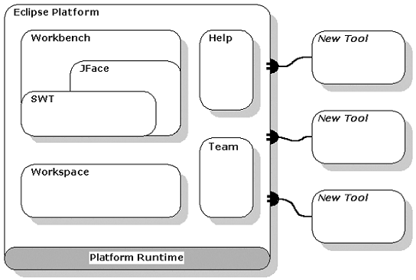
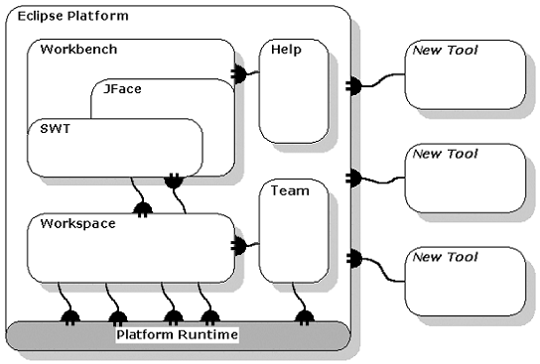
The Extension Registry
We’ve all seen this diagram before, right?
Notes:
This diagram dates back quite a long time (it was in the first Eclipse paper that I ever read), and gives a good general picture of Eclipse from a marketing standpoint, but it is in fact a little too simplistic.
Eclipse is not just a big box you plug into. Eclipse is “made up of” hundreds of little boxes that can all plug into each other, and can in turn be plugged into by you.
Plug-ins (or bundles) provide extension points. Think of these as power strips that always have one more socket available no matter how many cords you plug in. As long as you have the right connector (an extension), you can plug into an extension point.
Eclipse uses its own extension points.
Plug-ins that declare extension points can plug into themselves.
The point is, Eclipse is not just a box you can plug tools into like the traditional graphic suggests. Lots of other programs support plug-ins in this naïve sense of the term, but Eclipse’s plug-in architecture goes way beyond that. This is made possible by the extension registry.

Slide 11
The Extension Registry: Lazy Loading
In general, Eclipse is lazy (get a job, ya bum!)
First execution of Eclipse scans metadata (plugin.xml) for all bundles
Subsequent runs use cached information unless:
  Cache appears invalid or corrupt
  You specify –clean on the command line
When new bundles are installed, their metadata is also parsed and cached
More info:
  org.eclipse.core.runtime.adaptor.EclipseStarter
  org.eclipse.core.internal.registry.ExtensionRegistry
Notes:
I realize most of you already know all of this, but for the benefit of those that don’t I’ll quickly go over it. In general, Eclipse is designed to be lazy. It scans the metadata for all of the installed bundles when it is run for the first time, and caches that information. Subsequent runs use this cached information unless something appears to be wrong with the cache, or you tell it to re-scan everything with the “-clean” argument. I believe there are other command line parameters that affect how Eclipse caches metadata as well. Check out the online help regarding Eclipse command line arguments for more information.
If you are really interested in how all this works you can turn on tracing for the org.eclipse.update.* family of plugins (configurator and core) and org.eclipse.equinox.registry bundles. I also suggest you have a look at the following classes:
org.eclipse.core.runtime.adaptor.EclipseStarter
org.eclipse.core.internal.registry.ExtensionRegistry

Slide 12
The Extension Registry: Lazy Loading (cont’d)
Cached metadata or not, Eclipse still does not start your bundle activator until it has to
Metadata-only can be used to create GUI contributions
Poorly-designed extension points can lead to unnecessary bundle starts
Notes:
Cached metadata or not, a fundamental feature of Eclipse is that your bundle activator is not started until it is absolutely needed.
Ideally, the metadata-only can be used to create GUI contributions such as toolbar buttons and menu items, and your activator is only started when the code behind these GUI items needs to be executed for the first time (which can be much later, or even never).
That being said, poorly designed extension points can break down this entire process. For instance, it would be silly to have contributed extensions calculate the name of a menu item dynamically by returning a simple, static String from a “NameProvider” class contribution, when it could be provided as a simple XML attribute. Also, you may have Java code being contributed as part of an extension to an extension point, but if that code is not needed, you do not need to create any Java classes until they are required. This may mean caching IConfigurationElements, and dealing with simple proxy objects until the last possible moment.

Slide 13
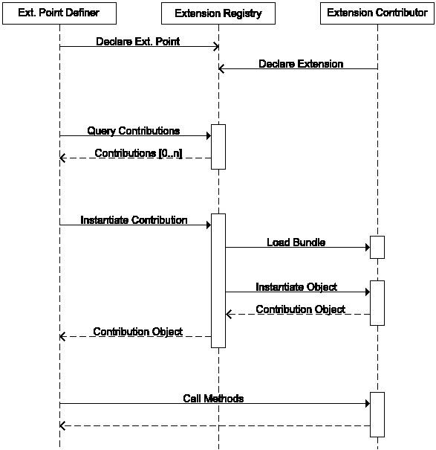
Extension Sequence Diagram
What happens when an extension is loaded?
*Image courtesy of Neil Bartlett from
A Comparison of Eclipse Extensions and OSGi Services
Notes:
So what happens when the platform actually needs to execute some code contributed by an extension? This slide shows a UML sequence diagram (courtesy of Neil Bartlett) that illustrates the extension loading process.
We have an extension point definer, and an extension contributor. The interesting bits are:
At some point, the extension point definer is going to query the extension registry for its contributions.
At some later point, a Java class that is provided by one of these contributions is needed.
The extension point definer is going to ask the extension registry to instantiate one of these objects using its cached metadata.
The extension registry is going to automatically load the required bundle, and instantiate the object and give it back to the extension point definer.
The extension point definer is now able to use that object.

Slide 14

A Simple Application
EclipseEyes
Notes:
Enough background. Let’s look at a simple application (EclipseEyes) that contains no extension points. We’ll also have a brief look at the code and I’ll talk a bit about what it is doing.
<<demo>>

Slide 15
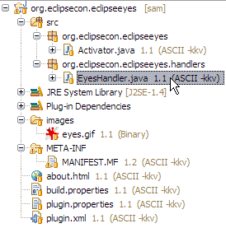

EclipseEyes: An Overview
A simple plug-in based on built-in PDE action handler sample
Transparent shell based on SWT snippet #219 with a simple eye-tracking algorithm
Notes:
This code is very simplistic and is contained entirely in a single class. It is based on the PDE action handler sample application, combined with one of the non-rectangular, transparent shell SWT samples (Snippet #219). There is a little more code inserted to draw and track the pupils of the eyes.
<<do a quick overview of the code>>

Slide 16

EclipseEyes: Summary
Wow! That’s incredibly useless!
How can we make this more extensible and modular and more annoying at the same time?
I’m glad you asked! This looks like the perfect starting point for…
An Eclipse Assistant!
Notes:
Now you may be tempted to say – “Wow! That’s incredibly useless!”
And I would have to agree with you.
But taking this useless concept one step further, I know you are all thinking – “Gee, how can we make this more extensible and modular and more annoying at the same time?”
I’m glad you asked. This looks like the perfect starting point for a framework for…
An Eclipse Assistant!
Aside: I figured re-implementing one of the most hated characters in software history would pretty much ensure nobody tried to take this sample code and use it as the basis for extension point implementations in a nuclear reactor or the space shuttle or something like that (I have made every attempt to write good code, but in the interests of time there has been some shortcuts taken in the area of error checking).

Slide 17
Adding Extension Points
Goal:
  Re-factor this plug-in to provide a common Eclipse Assistant framework to which other people can contribute additional Eclipse Assistant characters and custom behaviors.
Requirements:
  Framework should provide all character-independent code
  Must be able to contribute new images, as well as custom animation and character behaviors
  Functionality must be provided through extension points
  Resulting framework must survive extension registry changes without restarting
Notes:
In order to turn this into an Eclipse Assistant framework, we want users to be able to contribute their own characters and behavior. And because this is a talk about extension points, we want to facilitate this using extension points.

Slide 18
Adding Extension Points (continued)
Procedure:
  Identify the common and re-usable bits in the existing plug-in and re-factor
  Figure out what you want to be extensible (contributable) and come up with a reasonable extension point schema
  Consume this new framework ourselves by contributing the existing EclipseEyes character (eating our own dog food)
Notes:
This really gets into standard software architecture and design, and is beyond the scope of this presentation. I’ll even issue the disclaimer that the code included with this presentation is not intended to be well-designed, or even optimal. After all, we are re-creating one of the most hated software features in history.
Identifying the stuff that is totally generic and will never change is a good first step, and you can start there. If you can identify things that you may want to optionally override, this can guide you to design some useful abstract classes that provide a default implementation that users can optionally override. However, depending on the situation it may end up being more convenient and lightweight to provide this information in the extension information, but create the schema such that it provides default values.
Something to keep in mind (if it isn’t obvious) is that it is perfectly legal (in fact encouraged) to contribute to your own extension points, even within the plug-in that declares them. This is an excellent way of exercising your design, and will help work out any potential pain points early in the process.

Slide 19

Refactoring for Extensibility
*All images are royalty-free courtesy of http://SXC.hu

Slide 20
Refactoring EclipseEyes
What should be part of the framework?
  Command to toggle visibility
  Background image loading
  Preferences (if any)
  Event handling framework (mouse, keyboard, timer)
  Extension lifecycle management
What should be extensible?
  Character name
  Background image
  Animation providers
Gray areas
  Frequently-used animations (eye tracking)
  Annoying message generation
Notes:
Ask the audience time! So, what do you think in the previous EclipseEyes example could be considered common to a generic Eclipse Assistant framework?
What do you think we would want to be extensible by others to make our generic Eclipse Assistant framework useful?
Can you think of anything else? OK, let’s get down to it!

Slide 21
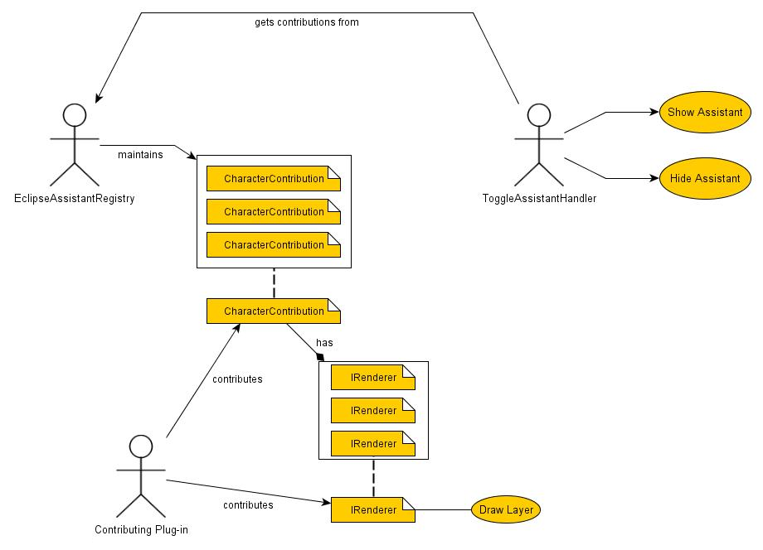
The EclipseAssistant Plug-In
Notes:
There are many different ways we can refactor the existing application, but keeping in mind that this is a simple demo app for a conference presentation (i.e. we don’t need to over-analyze this), here is a concept for a simple framework. This is obviously not a UML diagram, more of a picture of a concept. Did I mention I am not a graphic designer?
Our framework plug-in will contain an EclipseAssistantRegistry that will manage the CharacterContributions contributed from other plug-ins. It will also have a ToggleAssistantHandler that will be responsible for showing and hiding the assistant. The ToggleAssistantHandler will get the CharacterContributions from the EclipseAssistantRegistry, and will use their IRenderers to draw the character. A character can have multiple renderers, each of which draws a layer in a specific order.

Slide 22
The EclipseAssistant Plug-In (continued)
CharacterContribution
  Has an id, name, and background image
  Has optional IRenderers for animation layers
IRenderer
  Has a z-order, and draws artifacts onto a GC
  Has optional event-based triggers (mouse, keyboard)
Notes:
Let’s take a quick look at the key classes and interfaces we alluded to on the last slide.
The CharacterContribution class is the main class that provides an Eclipse Assistant character. It has a unique id, a name, and a background image. It can also consist of optional renderers to draw on top of the background (one way of providing animations).
The IRenderer interface provides a way to draw multiple layers by stacking instances of them in a particular order. There is also a means to connect them to events through filters (or triggers).
Let’s get into the implementation of the extension point itself.

Slide 23

Creating Your Own Extension Points
*All images are royalty-free courtesy of http://SXC.hu

Slide 24
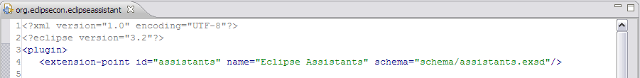

Declaring an Extension Point
You declare an extension point in plugin.xml
Schema is optional, strictly speaking (but you should always provide one!)
Don’t forget to update MANIFEST.MF
(Don’t worry – the PDE has got your back!)
Notes:
All you have to do to declare an extension point is to add the following to your plugin.xml:
<extension-point id=“some.id” name-”some name”/>
You don’t even need a schema! But not providing a schema would never be considered good practice, so you should always specify one. Not only is your plug-in much more user-friendly (because you have a well-defined structure for your extension point), you also get lots of development assistance and tooling provided by the PDE for free! This includes free extension point definition documentation and user assistance in the plugin.xml editor when users are trying to extend your plug-in. Not only that, you also get a full-featured schema editor to help you write the schema in the first place!
You also need to remember to keep your manifest.mf file up to date, in particular you need to add the “singleton:=true” clause to your bundle. However, if you are using any recent version of Eclipse, most if not all of this is flagged automatically by the PDE and is practically foolproof.

Slide 25
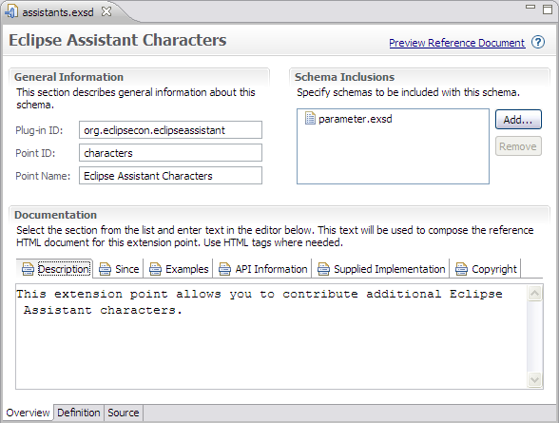
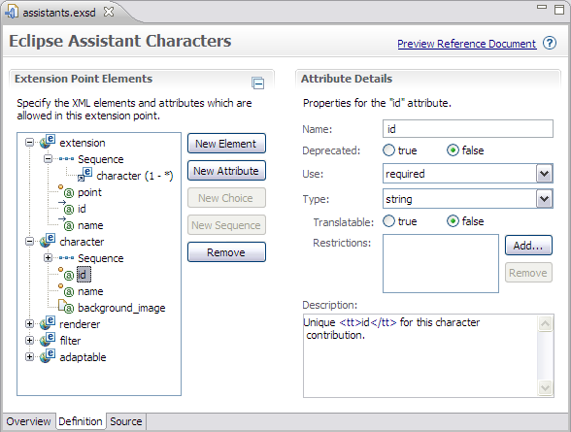
The Extension Schema Editor
The PDE provides powerful tools for editing extension point schemas
Notes:
The extension point schema editor provided by the Plug-in Development Environment (PDE), is a rich, multi-page editor that allows easy editing of extension point structure and documentation. There are three pages: Overview, Definition, and Source. Let's have a look at these in a little more detail.

Slide 26
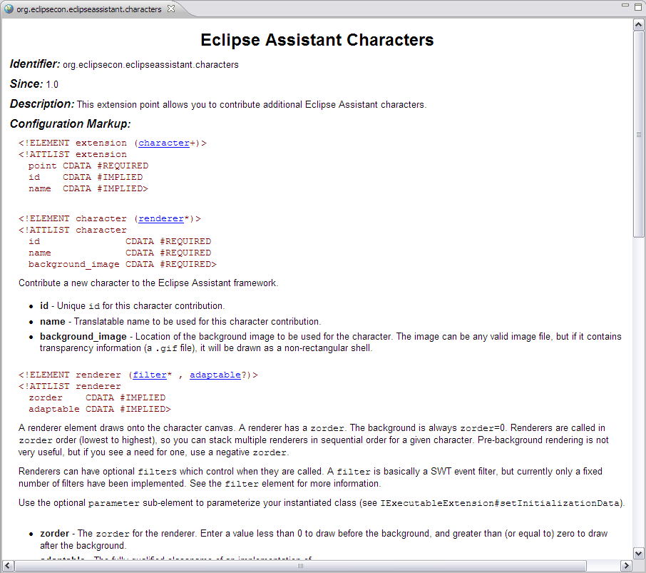
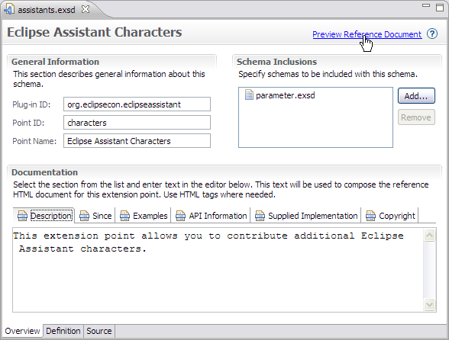
The Extension Schema Editor - Overview
Notes:
Overview Page
This page is where you to specify the plug-in id (the default extension point namespace), the extension point id (the short name), as well as the human-readable extension point name. There are multiple sub-panes in which you can define all of the documentation, examples, API and copyright information. You are free to mark up the text in these text areas with tags like <b></b> and <i></i>, and you can wrap sample code and keywords with <samp></samp>, <code></code>, or <tt></tt>. All of this information is optional but highly recommended as it is used by the PDE to generate those incredibly helpful extension point definition documents that you as plug-in developers are used to reading. Have you ever opened a poorly-crafted version of one of these reference documents and been frustrated at the lack of information? Don't be guilty of this yourself; a few minutes of effort here is time well spent. You can use the hyperlink in the upper right corner of the page to check out a preview of the generated documentation that will be available to consumers of your extension point.
The last thing on this page of the schema editor is the Schema Inclusions section. This allows you to include other schema files in order to reuse common content. Simply browse to the schema file you would like to include and its elements will be available to you on the definition page. I have used this feature quite a bit in the past, and it can be quite handy, but it does not seem to be a feature that is widely used in the core Eclipse plug-ins (at least not the last time I checked).
Interesting notes:
By default, the extension point namespace is your plug-in identifier.
You can alternatively provide your own in front of the extension point’s short name (but I am not sure why would you want to). Even if you do this, the schema still includes a "targetNamespace" which is the plug-in identifier.

Slide 27
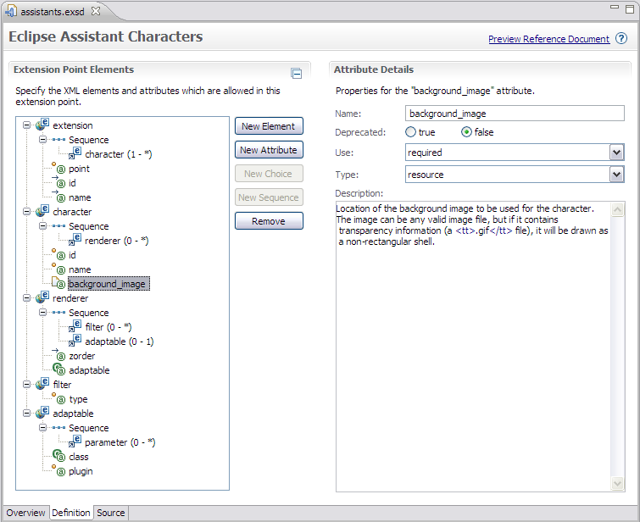
The Extension Schema Editor - Definition
Define your schema’s structure and related documentation
Start by creating base elements
Next add element attributes
  boolean
  string
  java
  resource
  identifier (proposed for 3.4)
Connect together with choice or sequence compositors
Notes:
Definition
This page is where you create the extension point structure itself; its elements and attributes, and most likely where you will spend most of your time when constructing your extension point schema.
By default you are already given an extension element that contains point (required), id, and name attributes. You start by creating new, base elements then add attributes to these elements. You can create four types of elements (perhaps five in Eclipse 3.4 final as there is talk of adding an ‘identifier’ attribute; I have used my own ‘refid’ attribute in the past--support in the PDE that proposes valid identifiers, and potentially cross-checks your references for you would be most welcome).
An element with no attributes allows character data between its XML tags (for instance, a description element).
Once your elements and attributes are created, wire them together with choice or sequence compositors. I find the documentation of compositors (in the Eclipse docs) quite confusing. The plugin.xml editor is much better than it used to be at enforcing these relationships as well as responding to changes in the schema. Make a change to your schema, save it, then flip over to the plugin.xml editor of the plug-in that is actually contributing to this extension and see what the PDE offers you as choices. Things also can get a little mind-warping because you can specify min/max occurrences on the compositor as well as on the elements that are children of the compositor. My recommendation is to experiment.
In general, use a sequence when you want to specify a list of items and a choice when you want to specify…err…a choice…amongst a bunch of items. It is possible to use either one and get the same result in a lot of cases, but generally a sequence is the most commonly used compositor.
For much more detailed information refer to the Plugin Development Environment Guide.
Finally, don’t forget to fill in the description fields as this automatically gets sucked into the generated documentation and is invaluable to people consuming your extension point down the road!

Slide 28
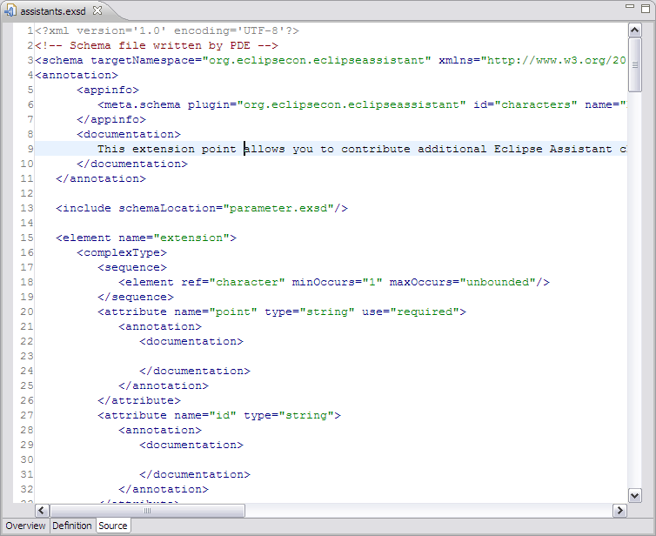
The Extension Schema Editor - Source
You can always edit raw XML if you prefer, on the Source page
PDE will magically keep everything synchronized
Notes:
Source
This editor page is simply a raw XML view of the schema itself, and is kept in sync with the changes you make on the other pages. It is often useful to drop into the source pane and tweak the XML by hand. As usual, the PDE does an admirable job of keeping all of the pages in sync with each other for a seamless editor experience.

Slide 29
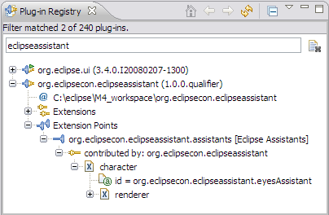
Contributing EclipseEyes
The same as contributing to any other Eclipse extension point
Edit plugin.xml and add an extension to the extension point we just created
This is enough to create entries in the extension registry, but we’re not quite there yet
  We still need to read the extension registry and instantiate objects!
Notes:
Now that you have defined a schema, that is all we need to define an extension point that we can contribute to. You can now use the plugin.xml editor to help you construct a contribution to that extension point. Contributing to your extension point is exactly the same as contributing to any platform-provided extension point, and the PDE will hand-hold you through the entire process. You get free extension creation facilities, as well as free documentation because you provided a schema with documentation information!
Now if you went through this entire process and created the schema and then contributed to that schema via an extension – you would have a perfectly valid connection there, and in fact your metadata would all be cached in the the Eclipse extension registry. You can verify this by using the Plug-in Registry View. But it is not incredibly useful. We still need to read that information from the extension registry, and turn it into Java objects.

Slide 30

Putting It All Together
*All images are royalty-free courtesy of http://SXC.hu

Slide 31
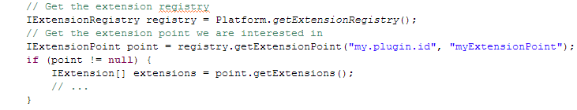
Reading the Extension Registry
Not particularly hard, but think ahead
The basic principle is this:
Instances of IExtension hold information about the declaring plug-in, and a Java representation of the XML (from plugin.xml) as a tree of IConfigurationElements.
Use this information to construct and cache proxy objects
Notes:
Right, so how do we read the extension registry? It is, in fact, dead simple – but you need to think ahead a bit in terms of when you would want to read the registry, how you are going to store the information you get from the registry, and what to do when that information changes or is out of date.
In general, you just get an instance of IExtensionRegistry from the org.eclipse.core.runtime.Platform class, grab your extension point from it, and call IExtensionPoint#getExtensions. You then need to translate this information, accessed through the tree of IConfigurationElements you get from the IExtension items. Normally you store this information in proxy objects which you keep in a cache. You can then invalidate this cache and force it to be rebuilt when the extension registry changes.

Slide 32
Reading the Extension Registry (continued)
A lot of generic machinery but no public, reusable RegistryReader class*
See org.eclipse.ui.internal.registry.RegistryReader for a reasonable starting point
IConfigurationElements are (potentially) short-lived and should be checked for validity if cached
If your registry reader is dynamic-aware, this is not a concern
*https://bugs.eclipse.org/bugs/show_bug.cgi?id=221603
Notes:
A lot of this machinery is generic but there is no public, reusable RegistryReader class that you can take advantage of. I did find four internal classes by this name that are *very* similar, and I filed an enhancement request to make this functionality generic, and public. It is recommended that you look at org.eclipse.ui.internal.registry.RegistryReader for a reusable, abstract implementation. It looks like the general trend is to clone this class, or roll your own. Hopefully something like this will be made public and re-usable (see https://bugs.eclipse.org/bugs/show_bug.cgi?id=221603) in the future.
Important interfaces/classes
- Platform, IExtensionRegistry, IExtension, IConfigurationElement, IExtension, IExecutableExtension
- IExtensionTracker, ExtensionTracker, IRegistryEventListener

Slide 33
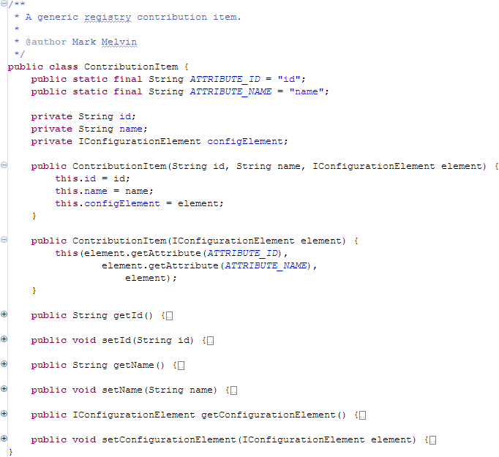
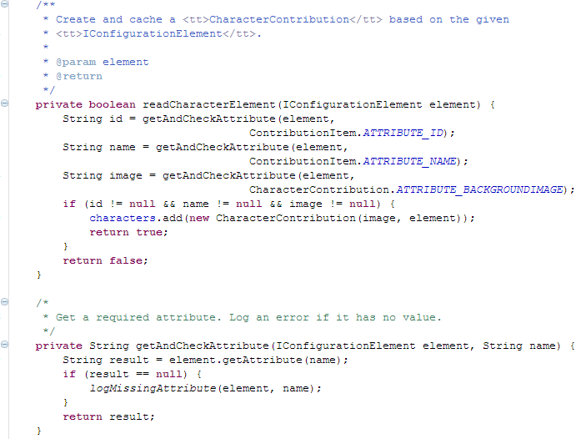
Reading the Extension Registry (continued)
An example proxy object implementation
Notes:
Note in this code that the class CharacterContribution actually extends ContributionItem. It also assumes that the registry creating these objects will be dynamic-aware as it is caching IConfigurationElement objects.

Slide 34
Reading the Extension Registry (continued)
You have translated XML markup from plugin.xml into Java objects that contain data
Useful classes and interfaces:
Platform, IExtension, IConfigurationElement, IExecutableExtension, ExtensionTracker, IExtensionChangeHandler
Still more effort required to make this more useful
More advanced topics:
  Creating Java objects from class names specified in extension point contributions (not so advanced…)
  Respond to changes in extension registry
Notes:
So, this is all we need to contribute simple character images without any fancy animations or other behavior that requires contributed Java code.
So what is missing? Well, we haven’t actually contributed any Java-based extensions yet, which is what most of you will use extension points for. So far, I have intentionally left this out of the mix not because it is any more difficult, but rather to drive home the point that extensions do not have to involve Java code at all. And there are Eclipse extension points that do not involve any user code whatsoever (the Eclipse Help system).
Also, the current code as it sits right now is not dynamic. If a plug-in that contributes something to our extension point is installed (or uninstalled) after Eclipse is running, our plug-in will know nothing about it. That means we will miss new information, or perhaps be dealing with stale or missing information – which could be simply annoying, or very bad (if we are referencing invalid IConfigurationElements).

Slide 35

Beyond the Basics
*All images are royalty-free courtesy of http://SXC.hu

Slide 36
When to Read the Extension Registry
When should you read the registry?
  NOT on startup
  Be as lazy as possible
Create and initialize the registry reader on first access
  Start listening for changes to the extension registry
Defer reading extension point contributions until you need them
Cache extension point contributions, reloading if required on registry change
Clean up on plug-in shutdown
Notes:
Before we go any further, a lot of you may be wondering “when should I read contributions to my extension points from the registry?” You *could* read all of the extensions when your plug-in is started, and for some applications this may be required. But most of the time you do not need the list of contributions to your extension point(s) until much later.
Since you will also want to make your plug-in more dynamic and be able to deal with changes to the extension registry, it makes sense to have one registry reader that does all of this. Therefore, you may as well make it a singleton. You can create this on plug-in startup, or be even lazier than that and only create it the first time you need it. You don’t need to listen to changes to the registry if you have not loaded any extensions yet. Once created, wait until the first extension point contribution is requested, before you read and cache contributions.
And to close the loop, disconnect from listening to the extension registry and do any other cleanup when your plug-in is shut down. This may occur if a user uninstalls your plug-in, and does not necessarily mean that Eclipse itself is shutting down.

Slide 37
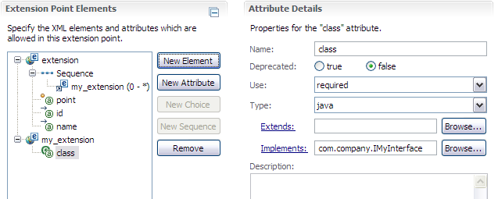
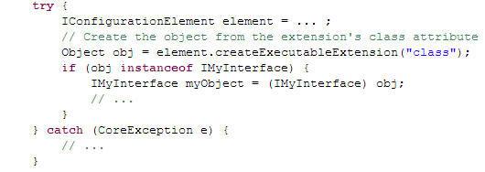
Contributing Java Objects
In your schema, use the “java” attribute type
Optionally force consumers to extend a super class or implement an interface
  Super class or interface provided by plug-in providing extension point (must be publicly exposed)
Use IConfigurationElement#createExecutableExtension to create instance and cast
Notes:
To allow Java object contributions as part of your extension point, use the “java” attribute type when you are creating your schema. You can choose any attribute name you wish (in this case, “class” is an obvious choice, but as we will see later this may not be the greatest choice for an attribute name). Along with the straightforward “Deprecated” and “required/optional” settings, you can also specify whether or not the consumer must implement an interface, or extend a specific class. Naturally, if you are going to force consumers to implement an interface or extend a class, you should provide these interfaces and classes in your plug-in and ensure they are publicly exposed. Also, if you are going to force your extension point consumers to implement a large interface, why not provide an abstract class or a default implementation they can use to make their lives easier? The easier it is to contribute the more contributions you will get.
To create a Java object while reading the extension registry, you use the IConfigurationElement node itself to instantiate the object using createExecutableExtension, passing the name of the XML attribute that specifies the class name. If you are expecting a specific superclass or interface, ensure the returned object is an instance of what you are expecting, and cast it.

Slide 38
Contributing Java Objects (continued)
Default behavior calls 0-argument constructor
To pass additional initialization data
  Ensure your class implements IExecutableExtension
  After 0-argument constructor is called IExecutableExtension#setInitializationData will be called
  Method signature:
public void setInitializationData(IConfigurationElement config,
String propertyName,
Object data) throws CoreException;
Notes:
The default behavior when instantiating an object with createExecutableExtension is for Eclipse to call the class’s zero-argument constructor (if there isn’t a zero-argument constructor present, you will get a “java.lang.NoSuchMethodError: com.company.YourClass: method <init>()V not found” exception!).
But what if you want to have your class instantiated with a non-zero argument constructor, or somehow pass initialization data to your class? Well, you can’t do the former, but Eclipse provides a facility to do the latter. You accomplish this by having your class implement IExecutableExtension. This interface has one method with the following signature:
public void setInitializationData(IConfigurationElement config, String propertyName, Object data) throws CoreException;
The first argument is the parent IConfigurationElement that triggered the creation of the class, and the second argument is the attribute name that was used to specify the classname in the XML (“class” for the extension on the previous slide). But what is the last argument? Well, it turns out that it depends on how the class was specified in the XML for the extension.

Slide 39
IExecutableExtension#setInitializationData
Two methods of supplying initialization data:
  Supply parameters after classname
<action run="com.example.ExternalAdapter:./cmds/util.exe -opt 3"/>
  Supply parameters as nested <parameter> elements
<action>
<run class="com.example.ExternalAdapter"
plugin="com.example">
<parameter name="exec" value="./cmds/util.exe"/>
<parameter name="opt" value="3"/>
</run>
</action>
class, plugin and parameter attributes are “magic” (required)
Read Javadoc for more details
Notes:
There are two different methods with which you can specify initialization data to your class when implementing IExecutableExtension. The first method is to place a colon (‘:’) after your class name, after which you can specify a string containing data of any format you like. This will be passed directly as the “data” argument of setInitializationData(IConfigurationElement config, String propertyName, Object data) as a String object. As an example, for this snippet of XML:
<action run="com.example.ExternalAdapter:./cmds/util.exe -opt 3"/>
setInitializationData will be called like so:
setInitializationData(<IConfigurationElement instance>, “run”, “:./cmds/util.exe -opt 3”)
The second method is to supply the initialization data as nested <parameter> elements, with name and value attributes. Your original attribute specifying the classname now becomes a nested element of the same name, with class and plugin attributes, and nested inside that are the parameters. So this:
<action run="com.example.ExternalAdapter:./cmds/util.exe -opt 3"/>
Turns into this:
<action>
<run class="com.example.ExternalAdapter"
plugin="com.example">
<parameter name="exec" value="./cmds/util.exe"/>
<parameter name="opt" value="3"/>
</run>
</action>
In this case, the “data” argument of setInitializationData(IConfigurationElement config, String propertyName, Object data) will be passed a Hashtable object containing key/value entries constructed from your nested parameters. As an example, for the above XML snippet, setInitializationData will be called like so:
setInitializationData(<IConfigurationElement instance>, “run”, <Hashtable {“exec” : “./cmds/util.exe”, “opt” : “3”}>)

Slide 40
IExecutableExtension#setInitializationData
Clever extension point schema construction allows both initialization forms with automatic fall-through
  Specify an optional “java” attribute, and an optional nested construct
  Attribute will be tried first, followed by nested construct
See IExecutableExtension#setInitializationData Javadoc for more details
Notes:
Now, if you are clever with your extension point schema, you can accommodate both forms of initialization. You can do this by specifying an optional Java attribute (“run” in the previous slides), and also specify an optional nested construct (0-1 occurrences) consisting of a <run> element with class and plugin attributes, with (0-*) nested <parameter> elements containing name and value attributes.
For more details on how this all works, look at the Javadoc for IExecutableExtension.

Slide 41
Responding to Extension Registry Changes
When extensions are added or removed you should handle it gracefully
ExtensionTracker makes it easy to detect fine-grained extension registry changes
After initial registry read, start listening for changes
Use:
org.eclipse.core.runtime.dynamichelpers.ExtensionTracker
Implement:
org.eclipse.core.runtime.dynamichelpers.IExtensionChangeHandler
public void addExtension(IExtensionTracker tracker, IExtension extension)
public void removeExtension(IExtension extension, Object[] objects)
See:
IExtensionTracker#registerHandler, IExtensionTracker#registerObject
Notes:
The last thing you should do to make your extension point provider a good Eclipse citizen is to listen for changes to the Eclipse extension registry so you can react and cope with these changes. If you take a little time to do this properly, your plug-in will survive installation and uninstallation of other plug-ins that contribute to your extension point without issue, allowing users to take full advantage of the Eclipse update mechanism with no unnecessary restarts.
While there is more than one way to accomplish this, the easiest and most current seems to be to use the org.eclipse.core.runtime.dynamichelpers.ExtensionTracker class. Have your extension registry read implement IExtensionChangeHandler, and register it with the workbench using IExtensionTracker#registerHandler to track changes to a specific extension point in the extension registry.
Similarly, when you create your proxy objects, you can associate them with specific extension elements using IExtensionTracker#registerObject. This will allow your implementation of IExtensionChangeHandler to be notified of changes to those specific elements, allowing a fine-grained approach to detect changes at the object level.

Slide 42
Responding to Extension Registry Changes
Register your handler
IExtensionTracker tracker = PlatformUI.getWorkbench().getExtensionTracker();
IExtensionRegistry xregistry = Platform.getExtensionRegistry();
tracker.registerHandler(this,
ExtensionTracker.createExtensionPointFilter(
xregistry.getExtensionPoint(“my.extension.point.id”)));
Register your objects
CharacterContribution character = ...;
IExtensionTracker tracker = PlatformUI.getWorkbench().getExtensionTracker();
tracker.registerObject(
character.getConfigurationElement().getDeclaringExtension(),
character, IExtensionTracker.REF_STRONG);
Respond to change
public void addExtension(IExtensionTracker tracker, IExtension extension) { ... }
public void removeExtension(IExtension extension, Object[] objects) { ... }
Notes:
This is a typical way to use ExtensionTracker.
Step 1, register your handler. This will get you notifications as new extensions are added to the registry.
Step 2, register your objects. This will ensure you are notified when extensions associated with those objects are removed.
Step 3, respond to change.

Slide 43
Responding to Extension Registry Changes
At a minimum:
  Delete cached items when registry changes
  Rebuild cache from Extension Registry on next access
It is relatively simple to be dynamic, so do it!
  Search for implementors of IExtensionChangeHandler for examples
Be careful of SWT threading issues
  Use PlatformUI.getWorkbench().getExtensionTracker() for UI contribution changes
Notes:
When responding to changes in the extension registry, you should at a minimum delete any cached objects whenever the extension registry changes. Often this is good enough, but ExtensionTracker allows you to be quite a bit smarter than that, and only throw out state when you really need to. When a new extension is added, chances are you don’t need to throw out existing cached items. And you only need to delete cached items whose parent plug-in has been removed.
One final note on threading. If you are dealing with extensions that contribute to the Eclipse UI, you should use that ExtensionTracker provided by PlatformUI.getWorkbench().getExtensionTracker() . This performs all notifications on the GUI thread, ensuring you do not run into any SWT threading issues.

Slide 44

Things to Remember
*All images are royalty-free courtesy of http://SXC.hu

Slide 45
Things to Remember
Extension points are for everyone
Be as lazy as possible
Contribute (and expose!) abstract classes and interfaces you intend consumers to implement / extend
Don’t be too lazy!
  Always fill in schema documentation
  Always be dynamic (ExtensionTracker)
The PDE is your friend
  Don’t forget about the Plug-in Registry View!
Notes:
So, the take-home items for today about extension points are:
Extension points are easy to use and they are there for everyone to use
Be as lazy as possible. Do not query the extension registry until you absolutely need to, and do not instantiate Java objects until they are required.
Contribute (and remember to expose) abstract classes and interfaces you intend consumers to implement
While we are on the topic - If you are going to force your extension point consumers to implement a large interface, why not provide an abstract class or a default implementation they can use to make their lives easier? The easier it is to contribute the more contributions you will get.
Don’t be too lazy!
Always fill in schema documentation
Always be dynamic (ExtensionTracker)
The PDE is your friend
Don’t forget about the Plug-in Registry View!

Slide 46

Demo
Code is available:
  http://eclipsesvn.cloudsmith.com/eclipsecon2008/
  http://public.xdrive.com/opc/XDPC-3675niWSqDiuOChpGLlIcv80ROHqooXe/
*All images are royalty-free courtesy of http://SXC.hu
Notes:
A quick demonstration – if there is time – showing the finished, and dynamic behavior of the plug-in.

Slide 47

Questions?
*All images are royalty-free courtesy of http://SXC.hu

Slide 48

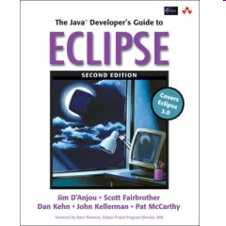
Useful Resources
Eclipse: Building Commercial-Quality Plug-ins (2nd Edition), Eric Clayberg and Dan Rubel
Java(TM) Developer's Guide to Eclipse, The (2nd Edition), Jim D'Anjou, Scott Fairbrother, Dan Kehn, John Kellerman, Pat McCarthy
Getting started with Eclipse plug-ins: creating extension points, Alex Blewitt
http://www.eclipsezone.com/eclipse/forums/t97608.rhtml
OSGi-Related Information
Eclipse Extensions vs OSGi Services, Neil Bartlett
http://neilbartlett.name/blog/2008/01/22/eclipse-extensions-vs-osgi-services/
Getting Started with OSGi (webinar), Neil Bartlett
http://live.eclipse.org/node/407

