Slide 1
Grating Diffraction
Diagram Generator
GUI User Guide
Yen-Chi (Angel) Chung
Grating Diffraction Diagram Generator
Notes:
Instruction deck based on the supplied Python GUI. Background and typography follow the supplied Image Analysis GUI template.

Slide 2
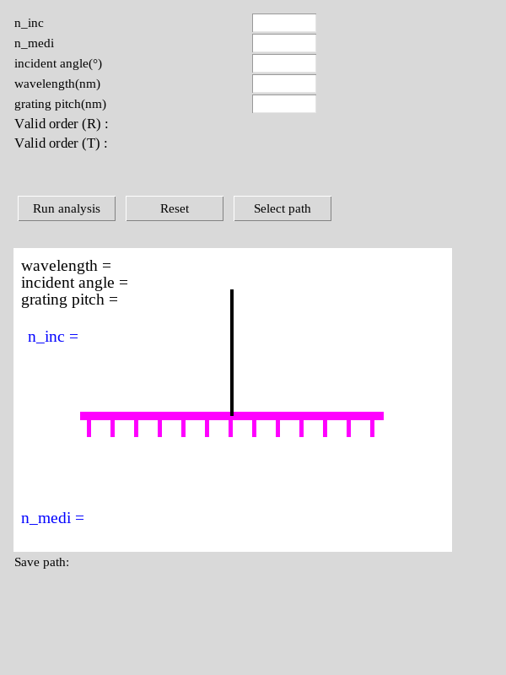
Grating Diffraction Diagram – GUI
Purpose and initial screen
Calculate reflected and transmitted diffraction angles for one wavelength.
Automatically find orders with real propagation angles.
Launch Grating Diffraction Diagram Generator.exe. All five input fields start blank.
Window title: Diffraction angle & order calculator
2
Notes:
Source: application module packaged in the supplied Grating Diffraction Diagram Generator.exe. Screenshots run from its extracted Python module on Linux; native widget appearance may differ on Windows. Example inputs are illustrative, not defaults.

Slide 3
Grating Diffraction Diagram – GUI
1. Input parameters
GUI field | Meaning | Unit
n_inc | Refractive index of the incident-side medium | Dimensionless
n_medi | Refractive index of the transmission-side medium | Dimensionless
incident angle(°) | Signed input angle measured from the surface normal | Degrees
wavelength(nm) | Vacuum wavelength for this calculation | nm
grating pitch(nm) | Grating period | nm
Use positive indices, wavelength and pitch. Enter the incident angle between −90° and +90°.
3
Notes:
Source: application module packaged in the supplied Grating Diffraction Diagram Generator.exe. Screenshots run from its extracted Python module on Linux; native widget appearance may differ on Windows. Example inputs are illustrative, not defaults.

Slide 4
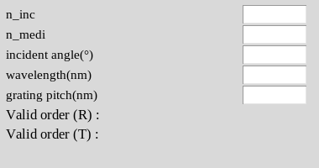
Grating Diffraction Diagram – GUI
2. Example inputs
Parameter | Example
n_inc / n_medi | 1.0 / 1.8
Incident angle | +15°
Wavelength | 532 nm
Grating pitch | 700 nm
One wavelength per run. Repeat with another wavelength to compare colors.
Example values are entered manually. The tool does not preselect diffraction orders.
4
Notes:
Source: application module packaged in the supplied Grating Diffraction Diagram Generator.exe. Screenshots run from its extracted Python module on Linux; native widget appearance may differ on Windows. Example inputs are illustrative, not defaults.

Slide 5
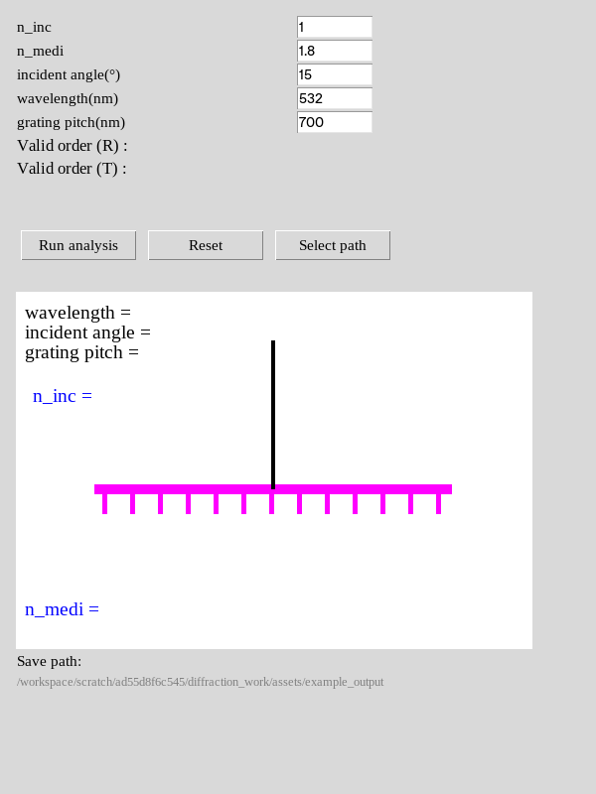
Grating Diffraction Diagram – GUI
3. Select path and run
1. Fill all five numeric fields.
2. Click Select path and choose an output folder.
3. Click Run analysis.
4. Review the order lists and diagram. A successful run shows “Successfully done!”.
Choose a folder before running. With no selected path, this version attempts to save under D:\.
5
Notes:
Source: application module packaged in the supplied Grating Diffraction Diagram Generator.exe. Screenshots run from its extracted Python module on Linux; native widget appearance may differ on Windows. Example inputs are illustrative, not defaults.

Slide 6
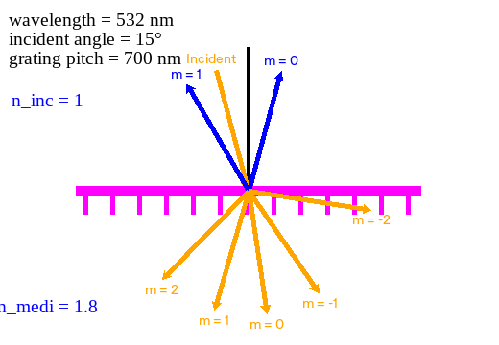
Grating Diffraction Diagram – GUI
4. Diagram legend
Magenta: grating interface.
Black vertical line: surface normal.
Orange incoming arrow: incident beam.
Blue outgoing arrows: reflected orders (R).
Orange lower arrows: transmitted orders (T).
Labels m = … identify diffraction order. Ray length and line width do not represent optical power.
6
Notes:
Source: application module packaged in the supplied Grating Diffraction Diagram Generator.exe. Screenshots run from its extracted Python module on Linux; native widget appearance may differ on Windows. Example inputs are illustrative, not defaults.

Slide 7
Grating Diffraction Diagram – GUI
5. Diffraction equations and angle signs
q = n_inc sin(θ_inc) − mλ / Λ
θ_T = arcsin(θ / n_medi)
θ_R = arcsin(−θ / n_inc)
Λ is grating pitch. λ and Λ must use the same unit.
The GUI reports signed angles in degrees.
In this diagram, positive θ_T points right below the interface; positive θ_R points left above it.
This application uses −mλ/Λ. Match its order convention when comparing with the other GUI tools.
7
Notes:
Source: application module packaged in the supplied Grating Diffraction Diagram Generator.exe. Screenshots run from its extracted Python module on Linux; native widget appearance may differ on Windows. Example inputs are illustrative, not defaults.

Slide 8
Grating Diffraction Diagram – GUI
6. Meaning of “Valid orders”
Test | Interpretation
Reflection: |q / n_inc| ≤ 1 | A real reflected angle exists in the incident medium
Transmission: |q / n_medi| ≤ 1 | A real transmitted angle exists in the second medium
Magnitude greater than 1 | No real far-field propagation angle for that order
Magnitude equal to 1 | A grazing direction at ±90°, included by this version
Each listed item gives the order number and angle, for example 1 : 30.08°.
An allowed direction does not imply nonzero or high diffraction efficiency.
8
Notes:
Source: application module packaged in the supplied Grating Diffraction Diagram Generator.exe. Screenshots run from its extracted Python module on Linux; native widget appearance may differ on Windows. Example inputs are illustrative, not defaults.

Slide 9
Grating Diffraction Diagram – GUI
7. Example results
Order m | Reflection θ_R | Transmission θ_T
−2 | No real angle | +81.20°
−1 | No real angle | +34.47°
0 | −15.00° | +8.27°
+1 | +30.08° | −16.17°
+2 | No real angle | −44.48°
Example: n_inc = 1, n_medi = 1.8, θ_inc = +15°, λ = 532 nm, Λ = 700 nm.
9
Notes:
Source: application module packaged in the supplied Grating Diffraction Diagram Generator.exe. Screenshots run from its extracted Python module on Linux; native widget appearance may differ on Windows. Example inputs are illustrative, not defaults.

Slide 10
Grating Diffraction Diagram – GUI
8. Saved JPG
Run analysis automatically saves one image.
Item | Output
Parent folder | Your selected path
Application subfolder | Grating Diffraction Diagram
Run subfolder | YYYY-MM-DD_HH-MM-SS
Image filename | Diffraction_Diagram.jpg
Image dimensions | 2080 × 1440 pixels
This version saves a JPG only. It does not export Excel or TXT reports.
10
Notes:
Source: application module packaged in the supplied Grating Diffraction Diagram Generator.exe. Screenshots run from its extracted Python module on Linux; native widget appearance may differ on Windows. Example inputs are illustrative, not defaults.

Slide 11
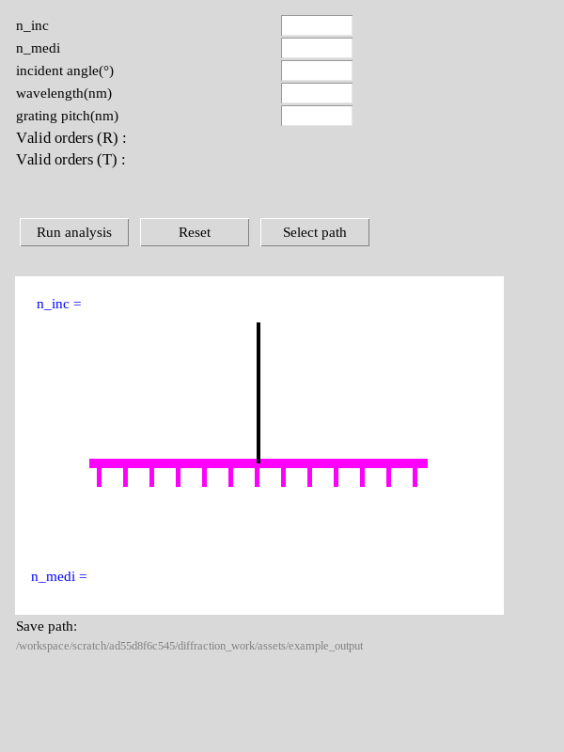
Grating Diffraction Diagram – GUI
9. Reset and troubleshooting
Reset clears the five parameter fields, order lists and current rays.
The selected save path remains. Use Select path to change it.
If “Something wrong...” appears, check numeric entries, positive indices / wavelength / pitch, and folder access.
Resize the window if result text or the save-path label is cut off.
Reset does not remove previously saved images.
11
Notes:
Source: application module packaged in the supplied Grating Diffraction Diagram Generator.exe. Screenshots run from its extracted Python module on Linux; native widget appearance may differ on Windows. Example inputs are illustrative, not defaults.

Slide 12
Grating Diffraction Diagram – GUI
Scope and quick reference
Task | Action or scope
Generate a diagram | Enter five parameters, select a path, then run
Compare wavelengths or angles | Change the input and run each case separately
Read allowed directions | Review both R and T order lists
Assess diffraction efficiency | Requires a separate electromagnetic calculation
Check full FOV or waveguide TIR | Use the corresponding k-space / tolerance analysis tool
This tool models diffraction directions at a single grating interface.
12
Notes:
Source: application module packaged in the supplied Grating Diffraction Diagram Generator.exe. Screenshots run from its extracted Python module on Linux; native widget appearance may differ on Windows. Example inputs are illustrative, not defaults.

