Slide 1
Final Project Maze Runner
Luis berber
Csci 166 fall 2020
Link to repo of project
https://github.com/angel9293/CSCI166

Slide 2



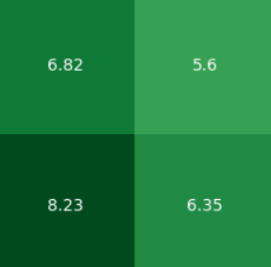
Part 1-Domain
Maze made of multiple cells
Multiple goals(blue)
Multiple traps(orange)
Multiple random event cells(purple)
Normal cells(green)
Blockades (missing)

Slide 3
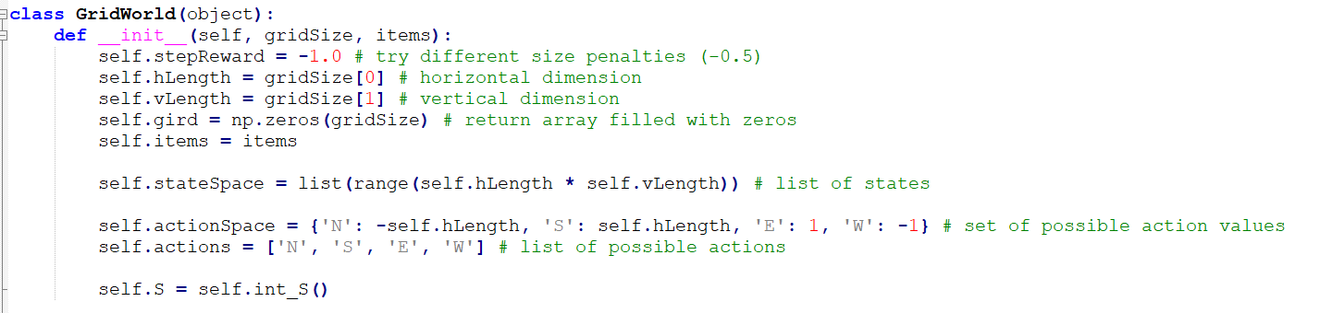
Part 2-Problem Representation
MDP for my domain would consist of:
States = individual cells of maze
Actions = directional movement
Rewards = reaching an exit
Transition Model = transition cells with
its reward depending on what type of cell
it reached

Slide 4
Part 3-Implementation
Implement value iteration
Find best route
Try to avoid traps
How will it determine what exit to go for?

Slide 5
Part 3-Implementation
Implement Policy Iteration

Slide 6
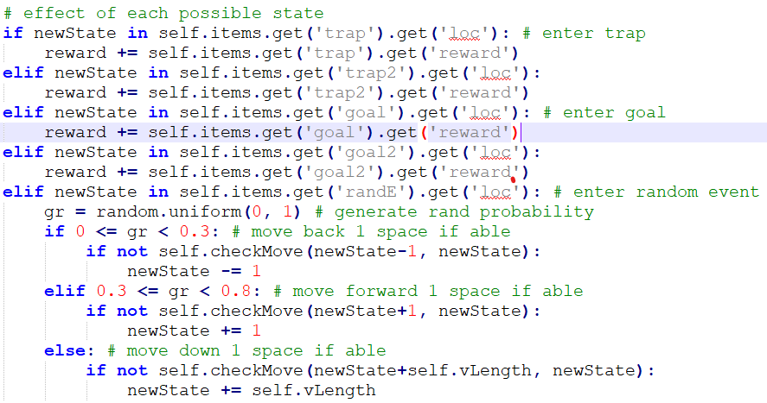
Part 4-Experimental Results
30 and 56 cell sizes
Different maze layouts
Multiple goals
Multiple traps
Multiple random moves(unique selection)

Slide 7
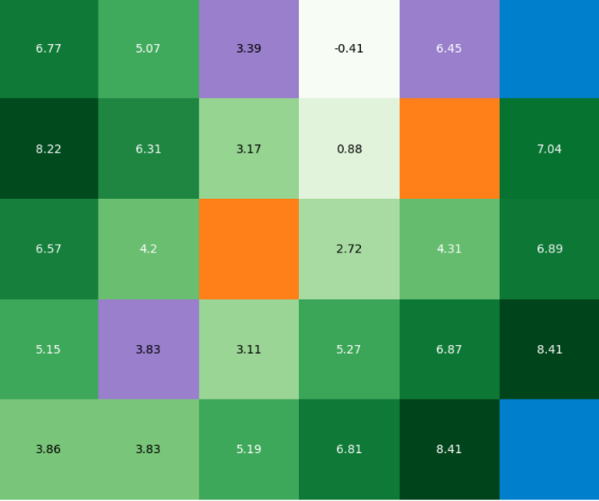
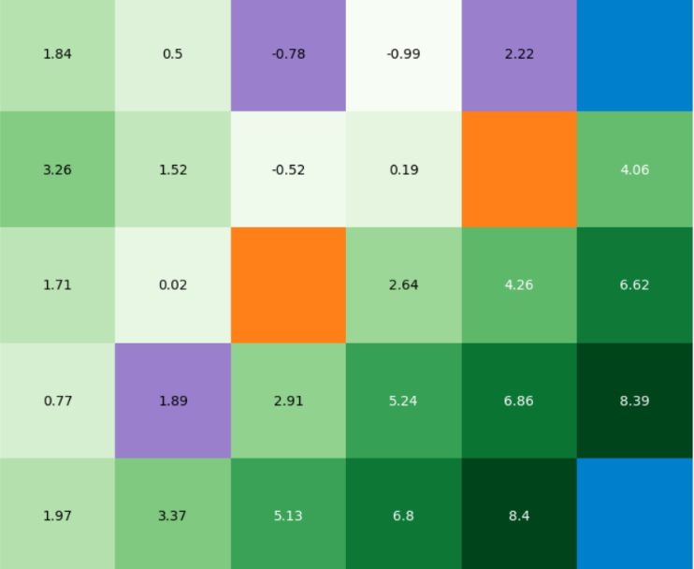
Part 4-Experimental Results
Goal states -> equal reward values
Goal states -> different reward values

Slide 8
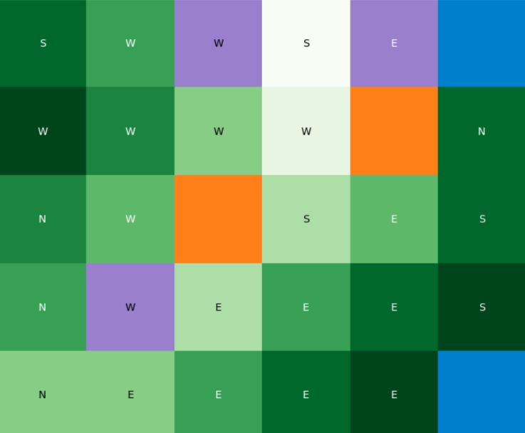
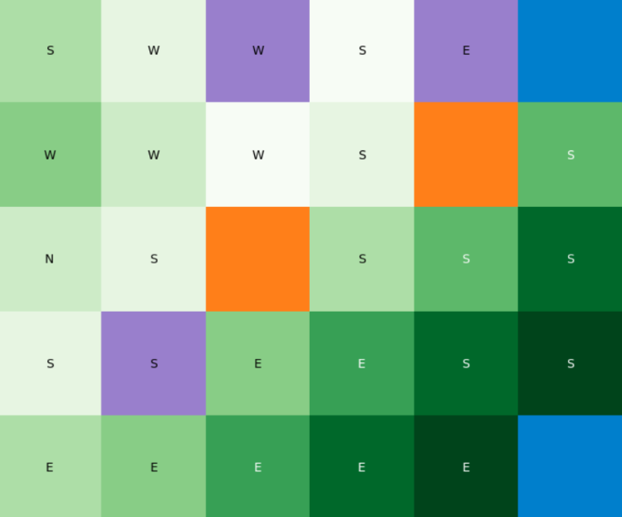
Part 4-Experimental Results
Goal states -> equal reward values
Goal states -> different reward values

