Slide 1
Operator Pattern
Balearic Kubernetes Day 2021

Slide 2
Introduction
What is Hotelbeds?
Operator Pattern
Existent Operators
Creating an Operator
Let’s go
Questions

Slide 3
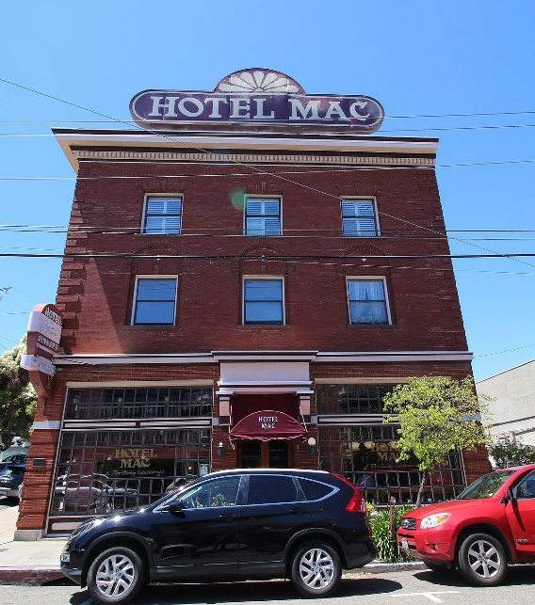
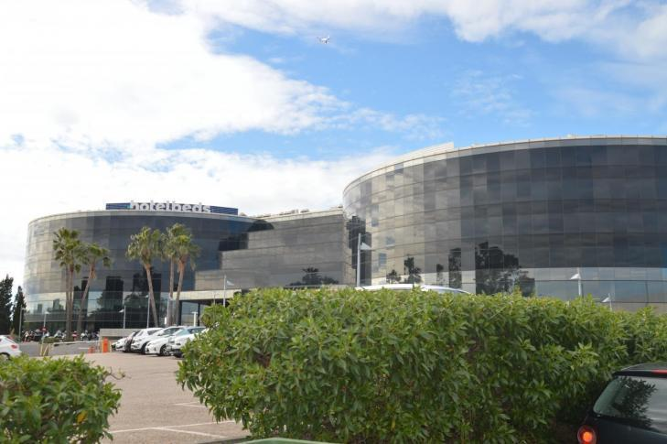
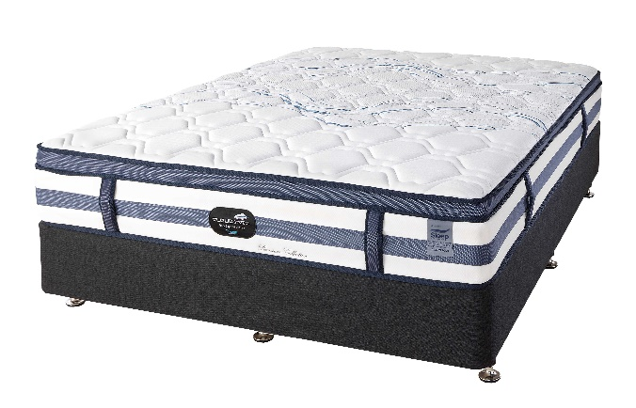
What is Hotelbeds?
A Hotel?
A Mattress Shop?
A Nuclear power plant?
This Photo by Unknown Author is licensed under CC BY-SA
This Photo by Unknown Author is licensed under CC BY-NC-ND
Got from Google Maps

Slide 4
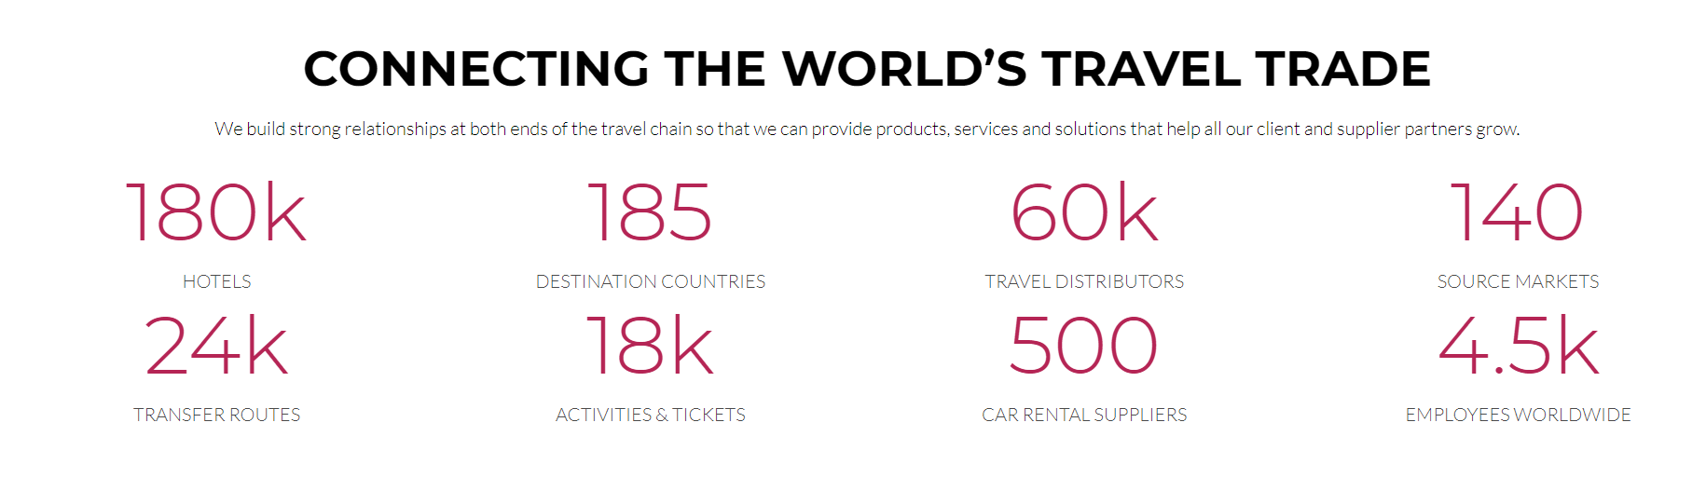
What is Hotelbeds?

Slide 5
What is Hotelbeds?
~ 60.000 searches per second
Distributed in 5 Datacenters (MADRID, IRELAND, BELGIUM, TAIWAN, CHINA)
Present on 3 public clouds (GCP, AWS, ALIBABA) and On Premise (BT)
1684 deployed building blocks
More than 10 Production deployments every day
Lots of Scrum teams organized as Product teams

Slide 6
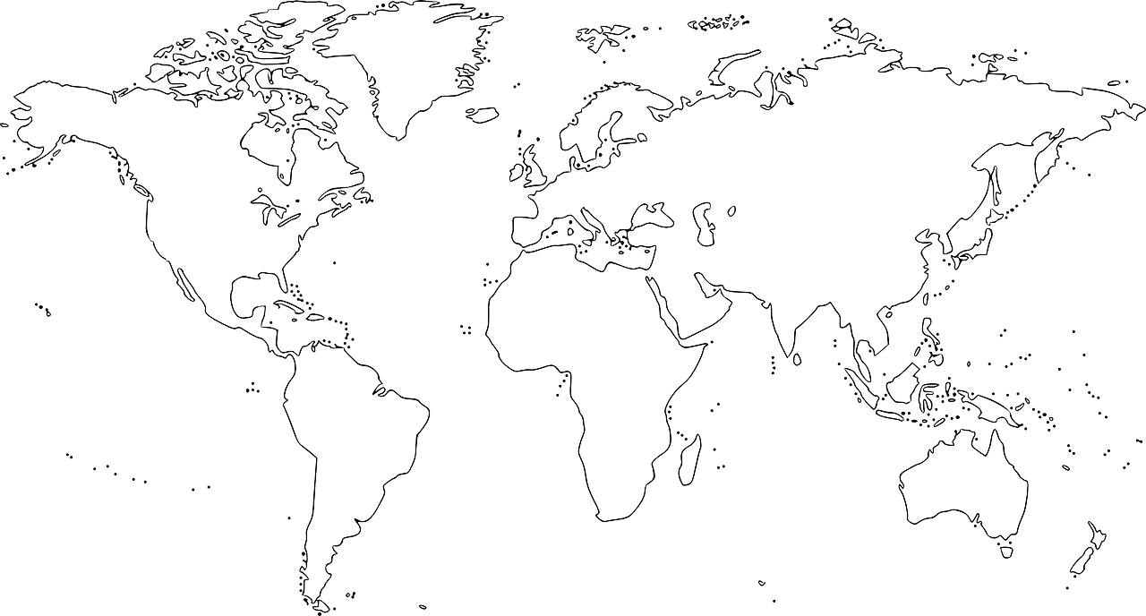











What is Hotelbeds?
Notes:
Estamos desplegados por todo el mundo para estar cerca de los clientes. Tenemos que ser rápidos desplegando y ser lo más agnósticos posible.
Hotelbeds es una empresa de turismo con muchísimo uso en la tecnología, replicando toda su información a lo largo del mundo.

Slide 7
What is Hotelbeds?
A Hotel?
A Mattress Shop?
A Nuclear power plant?
This Photo by Unknown Author is licensed under CC BY-SA
This Photo by Unknown Author is licensed under CC BY-NC-ND
Got from Google Maps

Slide 8
Operator Pattern
Scenario 1: very few services and low maturity on automation
kubectl apply -f service_manifests.yaml
Wrong way: The automation consists in bash scripts that does this commands for you
Coupled script
High probability to lose availability
Misclick
Notes:
Soy desarrollador

Slide 9
Operator Pattern
Perfumerias loli is just opening their minds to the IT world, with a unique technician they want a first version of a website based on wordpress. A very geek friend of the technician told him to use Kubernetes because it’s cool.
Ingredients:
A Dockerfile with wordpress
Hopefully using a docker image of a database compatible with wordpress
A Manifest of a Pod or (hopefully) a Deployment to manage the container of the wordpress
Hopefully a Manifest of a Statefulset to manage the database
A LoadBalancer Service for wordpress
For sure we will see:
A bash script to re-execute all (“Upgrades”), with probably a first line with “delete all”
Another LoadBalancer for database with public access
All kinds of imagination while reading Stackoverflow © and the “latest” usage

Slide 10
Operator Pattern
apiVersion: apps/v1
kind: Deployment
metadata:
name: building-block-name
labels:
app: buildingblock
spec:
replicas: 1
selector:
matchLabels:
app: buildingblock
minReadySeconds: 5
revisionHistoryLimit: 3
strategy:
type: RollingUpdate
template:
metadata:
labels:
app: buildingblock
spec:
containers:
- name: building-block-name
image: "buildingblock"
imagePullPolicy: IfNotPresent
ports:
- containerPort: 8080
name: http
protocol: TCP
#Local build: docker build -t perfumerias-loli:local .
#Local run: docker run -p 8080:8080 perfumerias-loli:local
FROM openjdk:11.0.4-jre-slim
ARG COMMIT_ID="0"
WORKDIR /home/project
COPY target/perfumeriasloli-1.0-SNAPSHOT.jar app.jar
ENV JAVA_TOOL_OPTIONS "\
-XX:+UseG1GC \
-XX:+PrintGC \
-Xss256k \
-Xms1500M \
-Xmx1500M \
-Dfile.encoding=UTF-8 \
-Djava.security.egd=file:/dev/urandom \
-Dspring.application.name=perfumerias-loli \
-Dspring.profiles.active=fat"
EXPOSE 8080
ENTRYPOINT java -jar app.jar

Slide 11
Operator Pattern
Scenario 2: Services growing and/or relying on some CI/CD automation platform
Use Kustomize (https://kustomize.io/)
Use Helm (https://helm.sh/)
Bad idea: Use Ksonnet (https://github.com/ksonnet/ksonnet)
…
A diabolical Combination of two or more
A Folder in your service repository, or in a repository dedicated for your service infrastructure.
You know (and is your responsibility to evolve) your service infrastructure
Templating & Automation
Lots of manifests (with lots of similarities across them -ahem-)
Maintenance hell
Kubernetes upgrades and the lovely big O

Slide 12
Operator Pattern
Perfumerias loli is growing. They installed Jenkins and ArgoCD because they read in medium.com and they want to start selling across Internet. They will use microservices and detected that having lots of manifests is a problem. They want a testing environment.
Ingredients:
Two repositories for each microservice (the service code and the infrastructure code)
A dockerfile in the service code repository
A Helm folder in the infrastructure code
Every service is mounted by different teams and evolves in different ways
For sure we will see:
Services using Deployment
Services using StatefulSets
Services with a Pod containing lots of containers with lots of responsibilities.

Slide 13
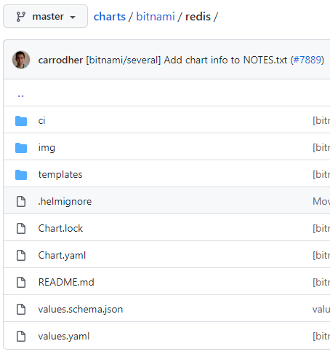
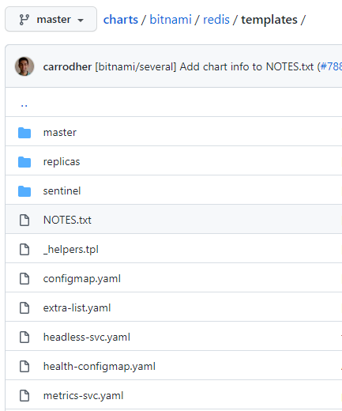
Operator Pattern

Slide 14
Operator Pattern
Scenario 3: Services growing with mature CI/CD and with standardized architecture
Use some kind of abstraction to avoid “boilerplate” in your services (chart)
Utopia: No need of infrastructure repository code
Reality: You guide your service using configuration (helm chart)
Community maintain and evolve the abstraction that hides all base manifests
Only one place to keep in sync with Kubernetes version
Manual Operation of the service (refresh of properties)
Some hard resource configuration still manual and is responsibility of the developer

Slide 15
Operator Pattern
Perfumerias loli is growing too fast!. The number of microservices increases faster than the employee number. They need to unify their architecture and they understand that a unified architecture also has a unified infrastructure. They want to be global (multiples regions)
Ingredients (getting from the previous step):
A Common repository of initialization code (maven archetype in case of java)
A Common repository of libraries
A Common repository of infrastructure manifests (Library chart)
Ingress, Service, and Deployment are equal except for the name
For sure we will see:
Repositories with specific needs as CronJobs or ConfigMaps

Slide 16
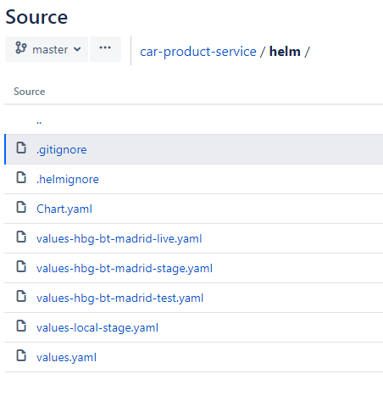
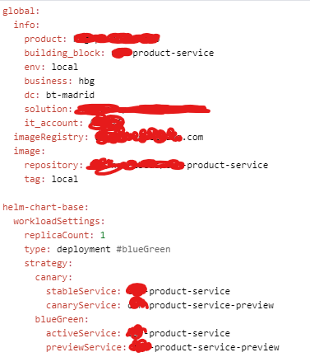
Operator Pattern

Slide 17
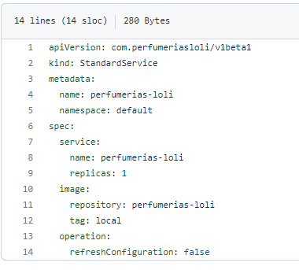
Operator Pattern
Perfumerias loli now a high level tech company, with global transactions but they are exhausted. They need their services to work in a total automated environment.
Also, they don’t want to see any kind of duplication between microservices
The Manifest target: https://github.com/angel9484/bk8s-demo-decompose-legacy/blob/main/

Slide 18
Operator Pattern
Operator pattern
https://kubernetes.io/docs/concepts/extend-kubernetes/operator/
Extend the API of Kubernetes with controllers made by us.
“All controllers in Kubernetes are operators”
Validation “DTO” using CRDs (Custom Resource Definition)
https://kubernetes.io/docs/concepts/extend-kubernetes/api-extension/custom-resources/
https://kubernetes.io/docs/tasks/extend-kubernetes/custom-resources/custom-resource-definitions/

Slide 19
Operator Pattern
Ingredients for creating an Operator:
SDK
Communicating with Kubernetes master (https://kubernetes.io/docs/reference/using-api/client-libraries/)
Most supported in Go
https://sdk.operatorframework.io/docs/building-operators/golang/quickstart/
https://sdk.operatorframework.io/docs/building-operators/golang/crds-scope/
https://sdk.operatorframework.io/docs/building-operators/golang/operator-scope/
We will use JAVA :D (https://github.com/kubernetes-client/java/ or the fabric8 one): https://github.com/java-operator-sdk/java-operator-sdk
A Very Large Community:
https://book.kubebuilder.io/quick-start.html#create-an-api
https://kudo.dev/

Slide 20
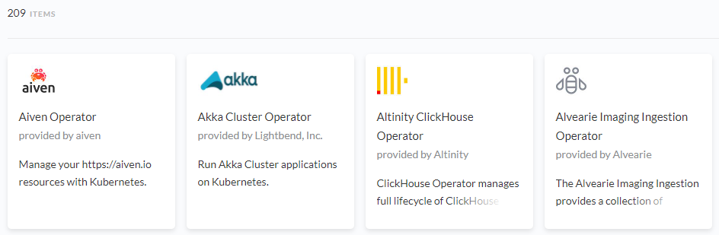
Operator Pattern
But wait… this is very complex to develop…
Really?
Don’t worry: https://operatorhub.io/ lots of geek people made lot’s of operators for you.
Hey! I’m using some of them!
Yes, ArgoCD, ArgoRollouts, ArgoWorkflows are operators

Slide 21
Operator Pattern
Let’s create an Operator: https://github.com/angel9484/bk8s-kubernetes-operator
Some useful pages:
https://blog.payara.fish/creating-a-kubernetes-operator-in-java
https://www.instana.com/blog/writing-a-kubernetes-operator-in-java-part-3/
https://developers.redhat.com/blog/2019/10/07/write-a-simple-kubernetes-operator-in-java-using-the-fabric8-kubernetes-client#
Future stuff:
Print the body of an error in the httpProbe: https://github.com/kubernetes/kubernetes/blob/master/pkg/probe/http/http.go
Our operator can extend the behavior and print a log
Maybe contributing with community and sending a PR to Kubernetes project? :P

Slide 22
Operator Pattern
Some notes:
If you are creating other objects in your operator, ensure you have a sync with the versioning of Kubernetes:
https://blog.container-solutions.com/answers-to-11-big-questions-about-kubernetes-versioning
Kubernetes upgrades very fast. Be sure the approach you want to follow because you still need a maintenance in some place: https://kubernetes.io/docs/reference/using-api/deprecation-guide/
Be sure you maintain at least 3 versions of a version with breaking changes. Use the semantic versioning to detect when to deliver a major.

