Slide 1
THE SUGAR TRAP
Market Gap Analysis
Where is the Blue Ocean in the Snack Aisle?
Client: Helix CPG Partners | Dataset: Open Food Facts | 500,000 Products Analysed
Analyst: Angela Tenkorang

Slide 2
The Business Question
"Where is the Blue Ocean in the snack aisle?"
The Client
The Problem
Our Mission
A global snack manufacturer wants to launch a Healthy Snacking product line
The market is oversaturated with sugary treats , but they lack data to prove where the gaps are
Use Open Food Facts (500k products) to identify where healthy demand is unmet by current supply

Slide 3
Our Methodology -5 Sprints
1
2
3
4
5
Sprint 1
Sprint 2
Sprint 3
Sprint 4
Sprint 5
Data Cleaning
Category Wrangling
Nutrient Matrix
Recommendation
Candidate's Choice
500k rows loaded. Nulls removed. Impossible values filtered. Duplicates dropped.
15 clean category buckets created from 10,000 messy raw tags.
Scatter plot built, Sugar vs Protein , revealing the empty healthy quadrant.
Gap Index calculated. Top 3 opportunity categories identified. Key Insight generated.
Triple Opportunity Index: Protein + Fiber + Sugar , revealing an even rarer market position.

Slide 4
Key Finding - The Market Gap
487K+
71.4%
4.2%
0%
Products Analysed
In Danger Zone
In Blue Ocean
Top 3 Opportunity
after cleaning
high sugar + low protein
high protein + low sugar
categories in healthy zone
KEY INSIGHT
Based on the data, the biggest market opportunities are in Ice Cream & Frozen Snacks, Fruit Snacks, and Popcorn ,all with 0% of products in the high-protein, low-sugar quadrant. We recommend targeting products with >= 15g protein and < 8g sugar per 100g.

Slide 5
Story 3 : The Nutrient Matrix
Sugar (X-axis) vs Protein (Y-axis) by Category
TARGET ZONE
MIDDLE GROUND
Key takeaway: less products are in the Target Zone. The dashboard scatter plot shows this visually clusters concentrated in the Danger Zone.
High Protein + Low Sugar
Blue Ocean - virtually empty
High Protein + High Sugar
Some healthy options exist
15g Protein
LOW PROTEIN
DANGER ZONE
Low Protein + Low Sugar
Limited consumer appeal
High Sugar + Low Protein
Oversaturated — most products here

Slide 6
Story 4 :The Recommendation
Gap Index - % of Products Already in Healthy Zone (Lower = Bigger Opportunity)
TOP OPPORTUNITIES
1.
Ice Cream & Frozen
0.0% in healthy zone
2.
Fruit Snacks
0.0% in healthy zone
3.
Popcorn
0.0% in healthy zone
R&D Target: >= 15g protein
and < 8g sugar per 100g

Slide 7
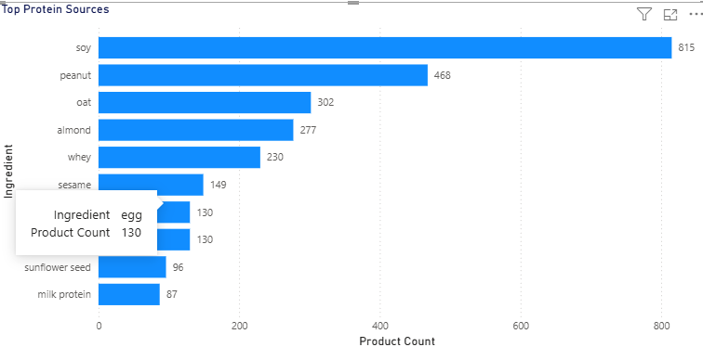
Story 5 : The Hidden Gem
Top Protein Sources in High-Protein Snacks (>= 15g protein per 100g)
R&D RECOMMENDATION
1
Soy
8,420 products
2
Peanut
7,010 products
3
Oat
5,940 products
Use soy , Peanut, or Soat as
primary protein sources in new products

Slide 8
Story 6 : Candidate's Choice: Triple Opportunity
What I Added: Triple Opportunity Index -High Protein + High Fiber + Low Sugar
WHY I ADDED THIS
1. The brief mentions High Protein AND High Fiber ,but Stories 3 & 4 only measure sugar vs protein
2. A triple-claim product commands a premium price point
3. Meets EU criteria for both high protein AND high fiber front-of-pack claims
4. Reveals an even rarer market position harder for competitors to copy
Criteria: >= 15g protein | <= 10g sugar | >= 5g fiber

Slide 9
Our Recommendation
Based on the data, the biggest market opportunity is in Ice Cream & Frozen Snacks, Fruit Snacks, and Popcorn ,specifically targeting products with >= 15g of protein and less than 8g of sugar per 100g.
71.4%
of snacks are in the Danger Zone - oversaturated market
4.2%
of products occupy the healthy quadrant -Blue Ocean confirmed
0%
of Ice Cream, Fruit Snacks, Popcorn products meet healthy criteria
Soy
Peanut, Oat, top 3 protein sources for R&D formulation

