Slide 1
Datebase Management System of the Schine Student Center for SU indoor & outdoor App
IST 659
Angela Xu
2015-11-30

Slide 2
Goals
Goals: to support SU indoor & outdoor App’s functions at the location of the Schine Student Center
Major Functions: to provide app users with easy access to the Schine Student Center’s resources, including information of all departments/offices, services, events, and facilities
Scope of Data: to collect basic information of all departments/offices, services, events, and facilities housed in the Schine Student Center, including hours, location, etc.
Two types of users of this Database:
Database Administrator: SU indoor & outdoor App Team, including me
App User: users of SU indoor & outdoor App can only query the data (but not change the data), and this database applies no access control on data queries

Slide 3
Goals – Major Data Questions
What departments/offices are housed in the Schine?
What services are provided in the Schine?
What events are hosted in the Schine?
What facilities are available in the Schine?
What services are provided by a specific department/office?
What are the Hot Search Ranking in category department/office?
What are the Hot Search Ranking in category service?
What are the Hot Search Ranking in category event?
What are the Hot Search Ranking in category facility?

Slide 4
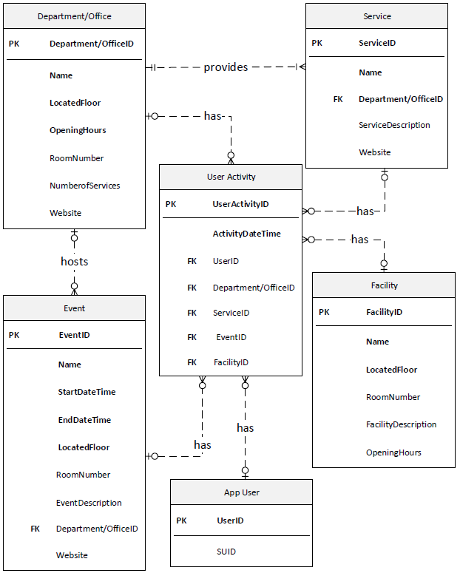
ERD

Slide 5
Forms
6 Tables: Department/Office, Service, Event, Facility, App User, User Activity
17 Forms: corresponding 17 forms to the above 6 tables and major data questions

Slide 6
Major Queries
Departments/Offices in Schine Student Center Report-Both Admin & User View (Y)
Services in Schine Student Center Report-Both Admin & User View (Y)
Events in Schine Student Center Report-Both Admin & User View (Y)
Facilities in Schine Student Center Report-Both Admin & User View (Y)
App User Report-Admin View (Y)
User Activity Report-Admin View (Y)
Hot Search Ranking in category department/office Report-User View (Y)
Hot Search Ranking in category service Report-User View (Y)
Hot Search Ranking in category event Report-User View (Y)
Hot Search Ranking in category facility Report-User View (Y)

Slide 7
Trigger - Logic
When the Service information is modified (INSERT, DELETE, or UPDATE), we need to automatically update our “Number of Services” field in Department/Office Table. Because values in field “Number of Services” are calculated based on records in Service Table. Also, subform in the Department/Office Form-Admin should change correspondingly.

Slide 8
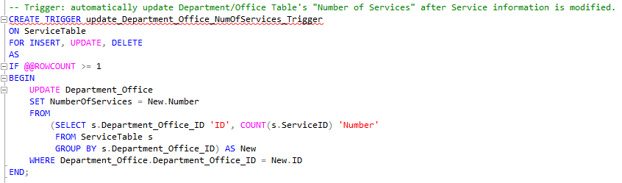
Trigger - Code

Slide 9
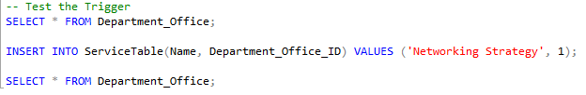
Trigger – Test Code

Slide 10
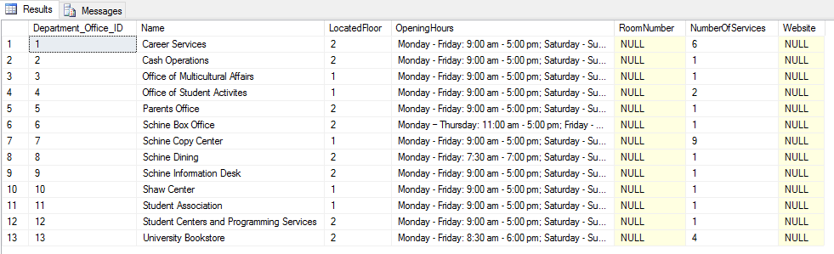
Trigger – Before

Slide 11
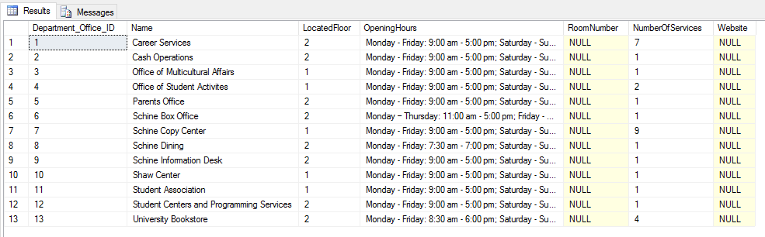
Trigger – After

