Slide 1
MCU, Accelerometer, and Wireless Module Schematic
By Daniel Knapp

Slide 2
ANT
GND
Wireless Module RFM22B-S
GND
SDN
RX_ANT
NIRQ
Only one of the GND pins needs to connected to ground
TX_ANT
NSEL
VCC
SCK
GPIO0
SDA
GPIO1
IC
SDO
GPIO2
GND

Slide 3
Accelerometer
ADXL 345
SCL
SDA
The pull up resistors used on the SCL and SDA pins are necessary for the I2C/TWI communication to work correctly
SDO
INT2
INT1
CS
VCC
GND

Slide 4
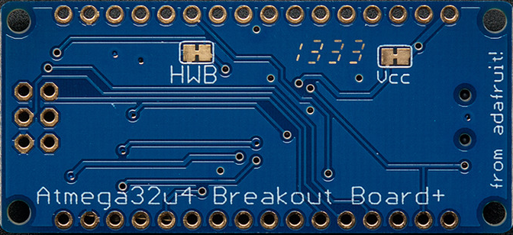
MCU
Adafruit Atmega32u4
3V
5V
E6
A
B0
F0
B1
F1
The picture below shows (using the red line) that you need to cut the connection between the two pads of VCC on the back of the MCU to be able to power VCC with our desired voltage (3.3V) rather than powering VCC from the board’s mini-B USB connection (5V)
B2
F4
B3
F5
D0
F6
D1
F7
D2
C7
D3
C6
D4
B7
D5
B6
D6
B5
D7
B4
GND
GND
RST
VCC

Slide 5
ANT
GND
Wireless Module RFM22B-S
GND
GND
SDN
SPI connection
B6
RX_ANT
NIRQ
B4
3V
5V
B0
E6
A
B5
TX_ANT
NSEL
B0
B0
F0
VCC
SCK
B1
B1
F1
VCC
B1
B2
B2
MCU
Adafruit Atmega32u4
F4
GPIO0
SDA
B2
B3
B3
F5
D0
D0
F6
GPIO1
IC
SDO
B3
D1
D1
F7
GPIO2
GND
GND
D2
C7
D3
C6
D4
B7
B6
VCC
D5
B6
B5
Resistor ~4.7kΩ
D6
B5
B4
Resistor ~4.7kΩ
GND
D7
B4
GND
GND
GND
SCL
D0
RST
VCC
VCC
SDA
D1
SDO
GND
Accelerometer
ADXL 345
I2C/TWI connection
INT2
INT1
CS
VCC
VCC
GND
GND

