Slide 1
Cryptocurrency Prediction using Social Media Sentiment & Volume
Spring 2019 | Data engineering & platforms for analytics
GROUP 5

Slide 2
Outline
Executive Summary
Business Use Case
Tech Stack – Data and Tools
Design Considerations
Enhanced Entity Relationship Model
Dimensional Model

Slide 3
Executive Summary
Background:
The cryptocurrency market is very nascent and volatile. This makes the asset class very risky but also potentially lucrative.
Understanding the impact of social media on price direction can provide a cryptocurrency trader a better trading strategy.
Objective: To collect market information and social media engagement data for the major cryptocurrencies and tokens to create a platform for short-term trading strategy.
Notes:
- trading strategy
- platform
Background:
Objective: To collect market information and social media engagement data for the major cryptocurrencies and tokens to create a platform for trading analysis.
Strategy:
*Scope:

Slide 4
Business Use Case
A price prediction model based on metrics and sentiments from multiple online resources and incorporate it into larger system that automatically and intelligently manages a cryptocurrency portfolio.
Users:
Day-traders can use our database to build complex trading models based on social media sentiment and volume
Long-term investors can find established/safer assets to diversify their portfolio
Industry experts can use the dataset to analyze the publics knowledge and interest in their specific cryptocurrency/blockchain technology
Notes:
Hypothesis
Strategy:
Why is this useful?

Slide 5
Business Use Case
Question:
Is there a close relationship between social media and price fluctuations in cryptocurrency?
If so, can we predict short-term returns from activity and sentiments on various social media platforms such as Reddit, Twitter, Google Trends, etc. ?
Our goal is to build a price prediction model based on metrics and sentiments from multiple online resources and incorporate it into larger system that automatically and intelligently manages a cryptocurrency portfolio.
Notes:
Hypothesis
Strategy:
Why is this useful?

Slide 6







Data/tools
Data sources
ETL
Storage& database
Analysis
Reporting

Slide 7
Database Design Considerations
Application Type: Online Analytical Processing for Business Intelligence and end users (OLAP)
Data Format and Size: Cryptocurrency Financial Data
Data Maintenance and Support: Open Source Project
Hardware and Software: Google Cloud compute and virtual machines, and Google Cloud buckets for storage
Number of Users:
Location: Distributed System (as run through GCP's VM)
Schedule and Budget:

Slide 8
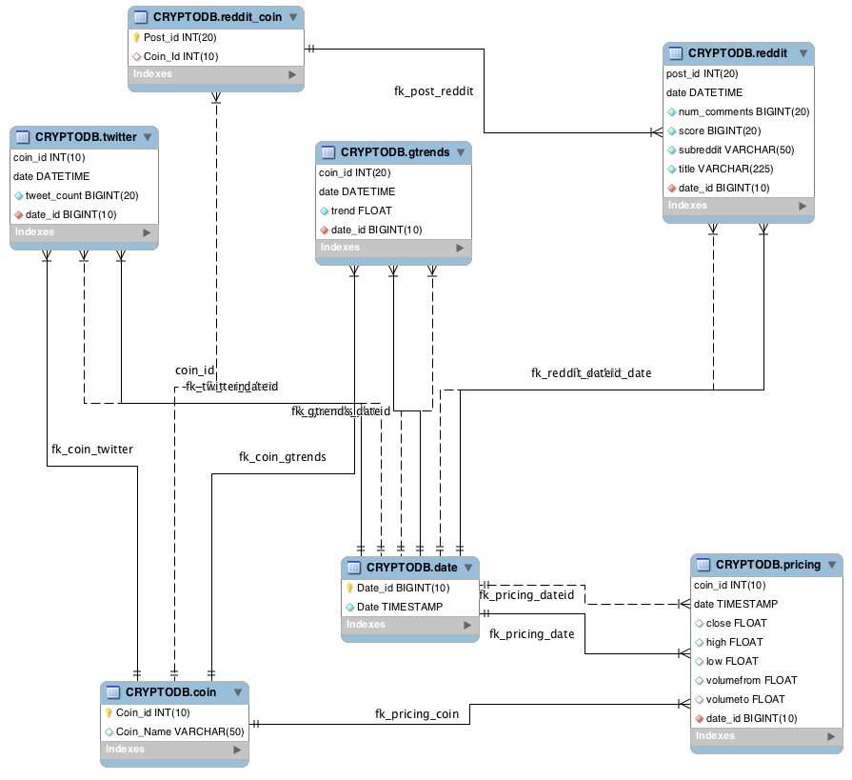
Enhanced Entity Relationship Diagram
Entities:
- Reddit: stores Reddit webscraped data
- Pricing: stores data about cryptocurrency prices
- Twitter: stores Twitter data of coin mentions
- Gtrends: stores Google trend data by coin
Tables:
- Reddit_Coin: links Reddit data with Coin data on coin ID
Relationship & Cardinality: <-- not sure if we need this since the arrows already show it
Datatypes: <-- also already shown in the table ?

