Slide 1
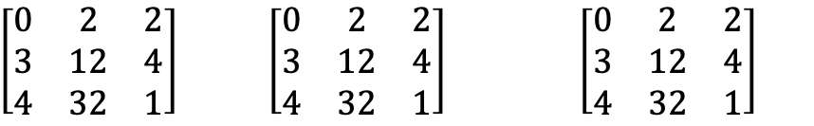
LINEAR ALGEBRA APPLICATION
$\left[\begin{matrix}0 & 2 & 2 \\ 3 & 12 & 4 \\ 4 & 32 & 1\end{matrix}\right]$ $\left[\begin{matrix}0 & 2 & 2 \\ 3 & 12 & 4 \\ 4 & 32 & 1\end{matrix}\right] \left[\begin{matrix}0 & 2 & 2 \\ 3 & 12 & 4 \\ 4 & 32 & 1\end{matrix}\right]$
Steps to perform traffic sign recognitions
Linear combination:
Dot product of matrix
Combine matrices
Normalization
Prepare Image data set
Perform Convolution
Pooling
Normalization reLU
Regularization
Probability conversion
Choose most likely label

Slide 2
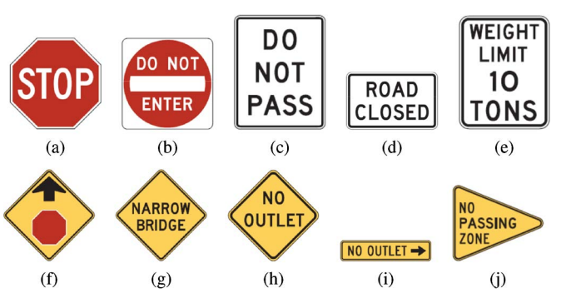
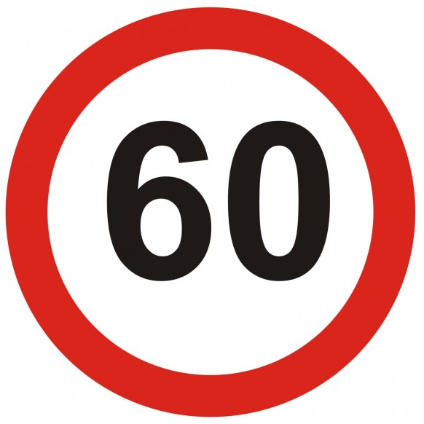
01
Prepare Image dataset
Depth: 3 color channels
4 | 13 | 0 | 2
0
2
9
9 | 14 | 25 | 11
3
5
7
12 | 35 | 25 | 6
9 | 22 | 16 | 53
0 | 8 | 7 | 10
0 | 1 | 3 | 5
Height: 4 units
(Pixels)
Height: 4 units
(Pixels)
Width: 4 units
(Pixels)
Width: 4 units
(Pixels)
Collect a dataset of traffic sign images: XXX traffic signs
Each image is considered as a matrix of pixel values with 2 dimensions: width and height
A single pixel values can be ranged between 0 and 255 (commonly, we have 8 bit or 1 byte-sized pixels)
For color images, especially RGB (Red, Green, and Blue), the presence of separate color channels introduces an extra dimension: ‘depth’, making a three-dimensional input.
Three dimensional pixel: width, height, and depth. For a given RGB image, we will have 3 matrices associated with the image, one of each: color channels

Slide 3
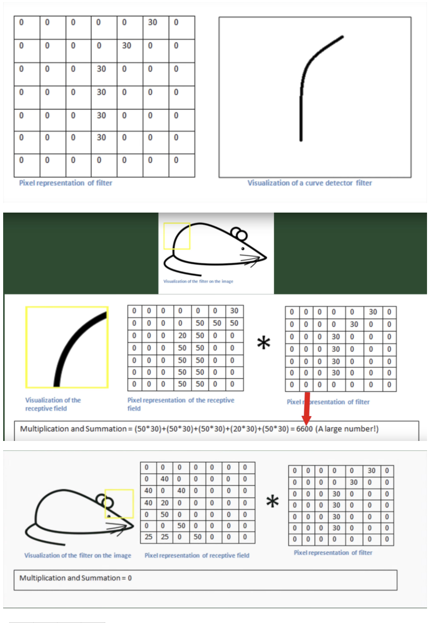
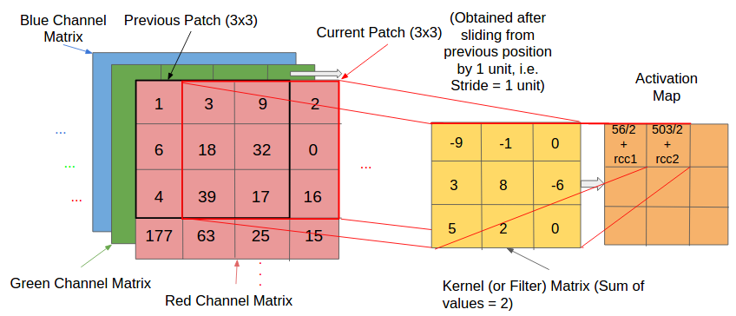
02
Convolution
Convolution – orderly procedure where 2 sources of information are intertwined
Kernel (filter) – smaller-sized matrix
Kernels are convolved with input volume to get activation maps (feature maps)
Compute the dot product between the kernel and input matrix.
We get the ”convolved” value by summing the dot product and entering that value in the activation matrix
We do this for all the color channels.
After specifying a receptive field, which comprises regions that are connected to the input layer, we apply this same methodology to produce an activation map (which reduces computational complexity)
Notes:
Activation maps indicate ‘activated’ regions, i.e. regions where features specific to the kernel have been detected in the input.
The real values of the kernel matrix change with each learning iteration over the training set, indicating that the network is learning to identify which regions are of significance for extracting features from the data.
the activation matrix.
The patch selection is then slided (towards the right, or downwards when the boundary of the matrix is reached) by a certain amount called the ‘stride’ value, and the process is repeated till the entire input image has been processed. - The process is carried out for all colour channels.

Slide 4
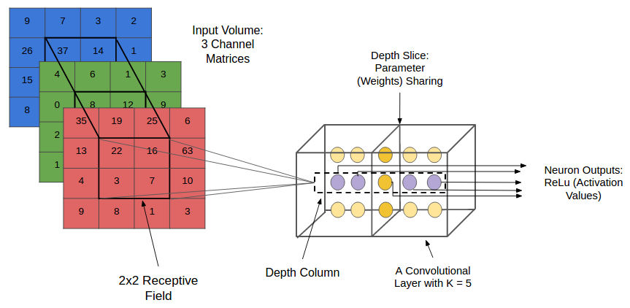
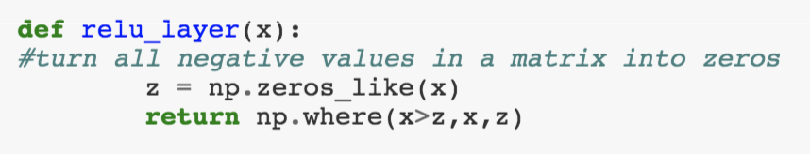
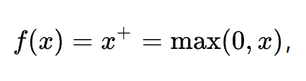
04
ReLU Normalization
ReLU = Rectified Linear Units
ReLU is a classification function used in deep neural networks.
Normalization keeps the math behind the matrices from breaking by turning all the negative numbers to 0.
We go from a stack of images to a stack of images with no negative values.
Repeat steps 2-4 and we get smaller images, by creating feature maps at every layer
For more context, rectifiers in artificial neural networks are defined as the positive part of the below argument, where x is the input to a neuron.
This is also known as the ramp function, and is one of the most widely used activation functions in neural networks
Notes:
https://arxiv.org/pdf/1803.08375.pdf
A unit employing the rectifier is also called a rectified linear unit (ReLU).^{[7]}
Rectified linear units find applications in computer vision^{[3]} and speech recognition^{[8][9]} using deep neural nets.
https://en.m.wikipedia.org/wiki/Rectifier_(neural_networks)

