Slide 1
ANALYZING CARDIAC MEDICAL DEVICE FAILURES WITH A MACHINE LEARNING APPROACH By Angela K. Baltes, MPA, MS A Dissertation Proposal Submitted in Partial Fulfillment of the Requirements for the Degree of Doctor of Philosophy in Biomedical Informatics Department of Biomedical Informatics School of Health Related Professions Rutgers, the State University of New Jersey November 2019

Slide 2
Presentation Roadmap
Introduction
Background
Goals of Study/Relevance of Research
Initial Findings
Hypotheses
Limitations
Methodology
Approach
Data
Data Preparation
Models
Preliminary Results
Conclusion

Slide 3
Introduction

Slide 4
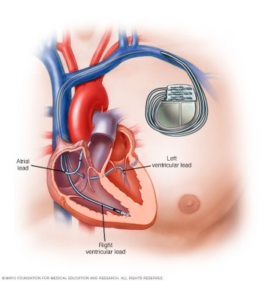
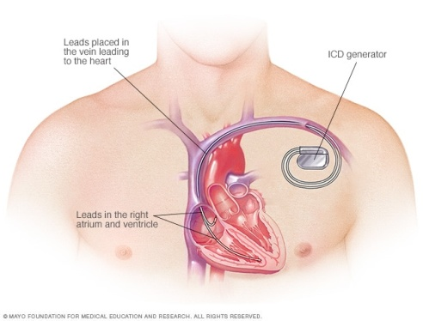
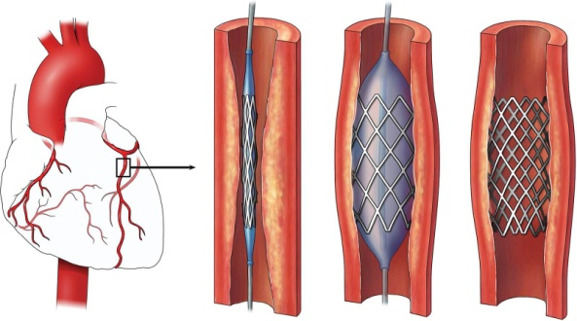
Background
Medical devices consists of a wide range of applications and potential uses.
Medical devices refers to instruments, machines or apparatuses that aid in various aspects of healthcare such as, but not limited to: prevention, diagnosis, treatment, therapy, monitoring, correction or management of a disease or illness.
Cardiovascular Disease is the global leading cause of death. In The United States, this disease affects 1 in 4 people. Cardiovascular disease refers to the numerous conditions that affect the heart, arteries, veins, and capillaries, while heart disease refers to conditions that affect the heart and its functioning. Given the reach of cardiac disease, this research focuses upon cardiac medical devices (National Heart, Lung, and Blood Institute).
Stent
iData Research, 2017
Pacemaker
Mayo Clinic
Implantable Cardioverter Defibrillator
Mayo Clinic

Slide 5
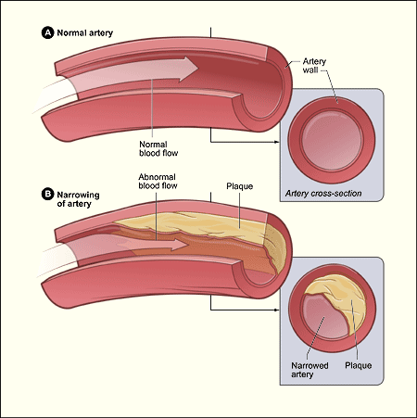
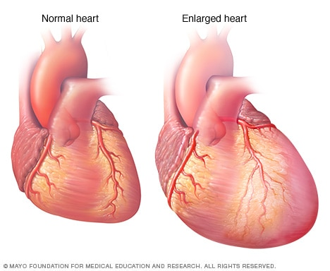
Background Cont’d.
Heart disease and cardiovascular disease is often used interchangeably, but cardiovascular disease refers to the numerous conditions that affect the heart, arteries, veins, and capillaries, while heart disease refers to conditions that affect the heart and its functioning. It is important to note, all heart diseases are cardiovascular diseases, but not all cardiovascular diseases are heart diseases (National, Heart, Lung and Blood Institute).
Coronary Heart Disease-Accumulation of plaque buildup in the coronary arteries, resulting in decreased blood flow to the heart. Buildup is referred to atherosclerosis.
Atrial Fibrillation-Irregular heartbeat.
Congestive Heart Failure-The heart’s inability to pump blood to meet the demands of the body (American Heart Association).

Slide 6
Background Cont’d.
Cardiac medical devices are useful in healthcare, at many times providing life-saving intervention, but they are not without the risk of failure. There is a lack of information and data available for review regarding cardiovascular medical devices.
The Manufacturer and User Facility Device Experience Database - (MAUDE)
The MAUDE database consists of data regarding adverse events involving medical devices, and is part of The Food and Drug Administration's requirement to provide surveillance for device malfunctions, injuries or deaths.
The MAUDE database contains voluntary reports since 1993, user facility reports 1991, distributor reports since 1993, and manufacturer reports since August 1996. https://www.fda.gov/medical-devices/mandatory-reporting-requirements-manufacturers-importers-and-device-user-facilities/manufacturer-and-user-facility-device-experience-database-maude (U.S. Food & Drug Administration, 2019).

Slide 7
Background Cont’d.
Research focused upon date range from 1997 through 2017, nearly 6.1 million records. Each record is pipe delimited and contains a unique key. There are multiple files that must be downloaded in order to create a more comprehensive analysis.
MAUDE Data File | Description
Master Event Data | Collection of all adverse events.
Device | Information regarding the device involved in event.
Patient | Patient treatment and outcome.
Text | Narrative field describing adverse event.
Device Problem Codes | Codes to describe device failures and accompanying crosswalk.
Master Event Changes | Changes to master event reports.

Slide 8
Goals of Study and Relevance of Research
Goals
Within a 20-year period (1997-2017), this study is aiming to address cardiac device expulsion, extrusion and migration and examine the volume or frequency in which these failures occur. This study also aims to examine how harmful these failures are to patients.
Relevance
There is limited data regarding medical devices as whole, and an even limited amount of research regarding cardiac specific medical devices. This has led to less informed patients, and a lack of information that can be shared.
Performing research such as this will aid others while creating a standard for research and information about devices.
The goal is that this will spur initiatives in creating structure around medical data and information in general that is accurate and reliable.
Having data that is openly available and structured will allow for more knowledge transfer and analysis to share with the larger community.

Slide 9
Failures of Interest
In this research we have isolated seven (7) codes that are associated to three (3) specific failures:
Migration -The undesired device has moved from its original intended location (FDA). This includes any part of the device, such as leads or electrodes.
Expulsion - The unintended movement of the device from within the body to outside the body.
Extrusion – The device is fully or partially exposed.
Device Problem Code | Description
1203 | Electrode(s), migration of
1395 | Migration or Expulsion of Device
2154 | Implant extrusion
2618 | Extrusion, impending
2933 | Expulsion
2934 | Extrusion
2979 | Material Protrusion/Extrusion

Slide 10
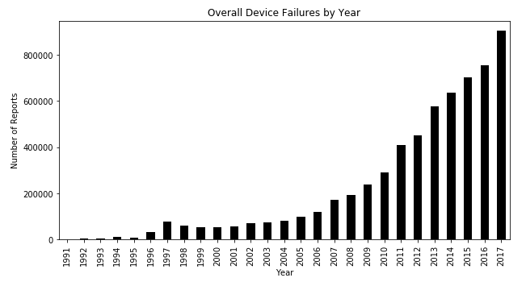
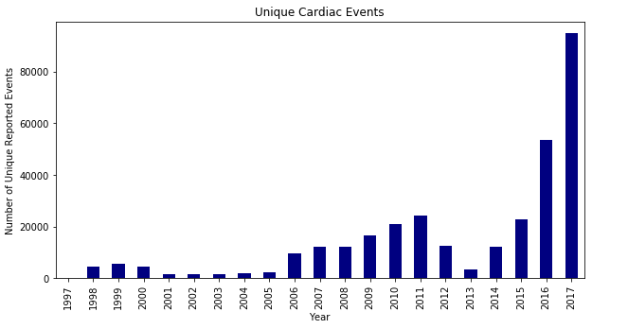
Initial Findings
For the years of interest (1997-2017), there has been an obvious upward trend in the number of device failures overall. We believe this is largely due to improved reporting and oversight.
Of the total proven device failures, only 5% were cardiac-related devices.
Using problem codes for failures of interest have proven to be unreliable-of the identified cardiac events, only 1% were migration, extrusion and expulsion. There were several years in which the reported failures were few.

Slide 11
Initial Findings Cont’d.

Slide 12
Hypotheses
There are three (3) hypotheses that were identified during this research:
We hypothesize that a larger percentage of cardiac devices should include the failures of migration, expulsion and extrusion.
We hypothesize that a larger number of cardiac devices exist within the data, and we expect to identify more devices than the initial 5%.
We hypothesize patient outcomes related to cardiac migrations, extrusions and expulsions to be largely fatal.

Slide 13
Limitations
Limitation
Lack of Reporting
Limitation
Limitation
Missing Data
Unreliable Device Problem Codes

Slide 14
Methodology

Slide 15
Data
Field | Entails
MDR_REPORT_KEY | Unique identifier for each record. This field was used as the unique key in order to associate records across datasets.
REPORT_SOURCE_CODE | Used to denote the source of the report.
REPORT_NUMBER | Report number for each record. A report number may be associated with more than one failure.
DATE_RECEIVED | Date report was received.
ADVERSE_EVENT_FLAG | This field indicates if an adverse event occurred. Y = Yes N = No U = Unknown * = No answer provided
EVENT_TYPE | This relates to the outcome. Only relevant for REPORT_SOURCE_TYPE =M. D = Death IN = Injury IL = Injury IJ = Injury M = Malfunction O = Other * = No answer provided
FOI_TEXT | Narrative text field containing information regarding the event.
GENERIC_NAME | The generic name of the device involved in the failure. This field will be used to classify the cardiac devices.
Data originated from The Manufacturer and User Facility Device Experience Database (MAUDE), representing reports of adverse events regarding medical devices starting in 1991.
Three sets of files used to create foundational file: narrative text files, master record and device information. Device problem codes were excluded due to the limitation it had on dataset.
“|” pipe delimited values.
MDR_REPORT_KEY was used as the unique identifier.
Multiple text files associated with unique key

Slide 16
Approach
Goals
Classes Positive 1, Negative 0
Goal 1: To identify cardiac medical devices.
Goal 2: To identify cardiac device failures: expulsion, extrusion and migration.
Goal 3: To identify patient outcomes associated with device failures.
*Using a python Jupyter environment, a supervised machine learning approach was chosen as the process in order to identify and classify devices of interest.
Cardiac Devices
Class One: cardiac device
Class Two: non-cardiac device
Extrusion
Class One: extrusion
Class Two: non-extrusion
Expulsion
Class One: expulsion
Class Two: non-expulsion
Migration
Class One: migration
Class Two: non-migration

Slide 17
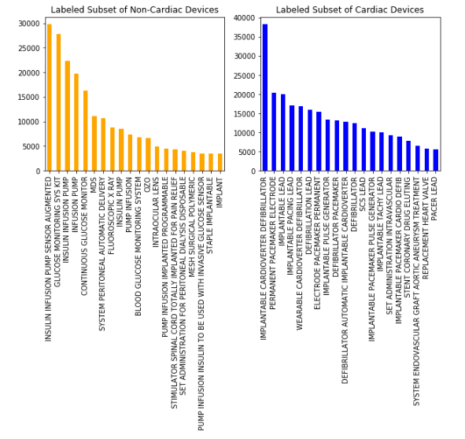
Data Preparation
Columns that contained an extreme amount of null values were dropped from foundational dataset.
GENERIC_NAME was used as a target and had 349,166 null values, so these records were dropped from analysis.
Textual records were concatenated to form one large record for a 1:1 association.
Punctuation was dropped from textual field.
Labeled subsets were combined to form one column consisting of a total of 0’s and 1’s. 1 million records were labeled for data training.

Slide 18
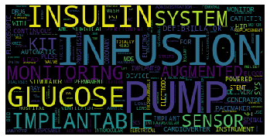
Models
Naïve Bayes-Classifier
Was chosen due to its simplicity and ability to work with textual data and promising results with similar datasets.
Linear Discriminant Analysis shown promise specifically with textual analysis.
BoW technique and removed know stopwords (The, And, To, etc).
Data was split into training and testing sets (20% test, 80% train)

Slide 19
Preliminary Results

Slide 20
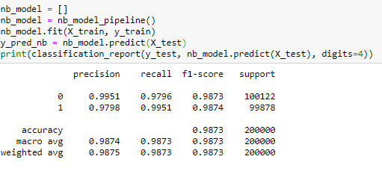
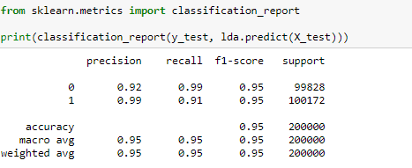
Initial Results
A Naïve Bayes classifier and Linear Discriminant Analysis model was used on a clean, tokenized dataset.
Bayes overall accuracy was 98%
Linear Discriminant Analysis 95%
Precision=The accuracy of positive predictions.
Recall=Known as sensitivity. The ability of classifier to identify all positive instances.
F1=A metric that gives a harmonious overall of precision and recall of classifier models. F1 = 2 x (precision x recall)/(precision + recall)
Support=Number of occurrences of the class.

Slide 21
Patient Outcomes
Within the migration group: injury accounted for 76% of cases, injury 18% and death at 4.6%. Extrusion was a rare failure, with 6.7% of patients died.
Injury and Malfunction designations were most common in all groups.
Although many devices are safe and never malfunction-if a device does, the risk of injury or death is not insignificant.
Outcome | Migration | Extrusion | Expulsion
Malfunction | 2,093 | 3,650 | 82
Injury | 8,695 | 526 | 57
Death | 523 | 18 | 11

Slide 22
Overall
We hypothesize that a larger percentage of cardiac devices should include the failures of migration, expulsion and extrusion.
The preliminary results have proven these failures are perhaps .8 or .9% of the data overall. In speaking of specifically cardiac devices, the percentage of the data is .2%.
We hypothesize that a larger number of cardiac devices exist within the data, and we expect to identify more devices than the initial 5%.
Cardiac medical devices contribute to roughly 20% of the overall data.
We hypothesize patient outcomes related to cardiac migrations, extrusions and expulsions to be largely fatal.
Fatalities account for roughly 3% of migration and nearly 7% of expulsions. However, injuries within these failure groups are high.

Slide 23
Conclusion

Slide 24
Conclusion
Cardiovascular devices do in fact reflect a larger percentage of the data than earlier results. The level of accuracy that can be achieved is suboptimal due to there being a large amount of non labeled devices and other pieces of missing data. Medical device failures must be labeled correctly.
Certain medical device failures carry a higher risk of injury or even death, and it is imperative that potential patients are aware of this. Although migration, expulsion and extrusion are relatively rare, the outcomes with those particular failures are poor.
Machine learning and other advanced forms of data analysis are useful in conducting research of this nature, to disseminate large amounts of information.
The most important thought to remember is that there needs to be more awareness around the risks involved with medical devices.

Slide 25
Recommendation
It is crucial that further research is conducted regarding the safety and efficacy of medical devices as well as ensuring that the public has access to this information in a user friendly manner, such as visualizations on FDA”s website, or a dashboard. It is important to empower the patient.
Certain failures within cardiac medical devices carry a higher risk of injury, and the public may be uninformed of this reality.
It is highly recommended to The FDA and device manufacturers that reporting and data collection for the MAUDE database become mandatory for not only the general public, but for research as well.

Slide 26
Acknowledgements
Committee Members
Dr. Frederick Coffman, Dr. Memory Ndanga and Dr. Shankar Srinivasan
My Home
My Husband Mike
Family
Quasar and Owl

