Slide 1


AN INTRODUCTION TO MULE ESB FOR BEGINNERS
Davide Zaza

Slide 2
WHY MULE ESB?
WHAT IS MULE ESB? MULE ESB IS …
それは単に人間が荷物を運ぶのに使う動物です

Slide 3





WHY MULE ESB?
WHAT DOES NOT IT MEAN INTEGRATION?
MARGINALIZATION
ISOLATION
DIVISION
We never had a communication
The question is
«DO WE NEED TO TALK TO EACH OTHER?»

Slide 4


WHY MULE ESB?
WHAT DOES IT MEAN INTEGRATION?
DO WE NEED TO TALK TO EACH OTHER?
INTEGRATION WHEN:
I NEED YOU
BUT YOU DON’T SPEAK THE SAME
LANGUAGE
BECAUSE WE ARE DIFFERENT
CAN WE FIND A WAY TO COMMUNICATE
AND HELP EACH OTHER?

Slide 5
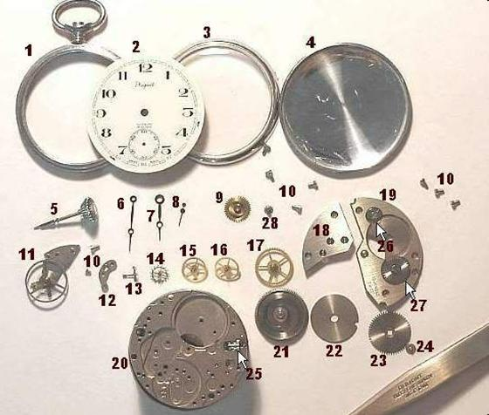
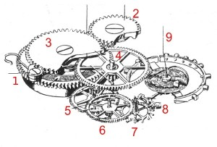
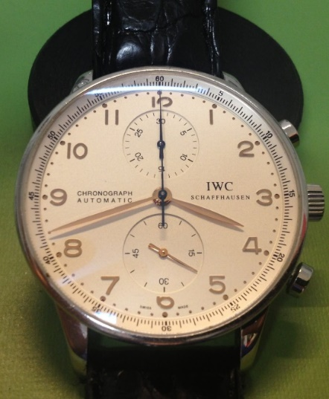
WHY MULE ESB?
WHAT DOES IT MEAN SYSTEM INTEGRATION?
System integration is a process concerned with joining different systems as one large system.
It ensures that each integrated subsystem of the whole system functions as required.
System integration is also used to add value to a system through new functionalities provided
by connecting functions of different systems.

Slide 6





WHY MULE ESB?
HOW WE CAN PERFORM SYSTEM INTEGRATION?
Think about many different System. What does it mean?
It’s mean that we have various System that may use different data formats built-in different languages.
How we can joint these different Systems?
Using a common language

Slide 7
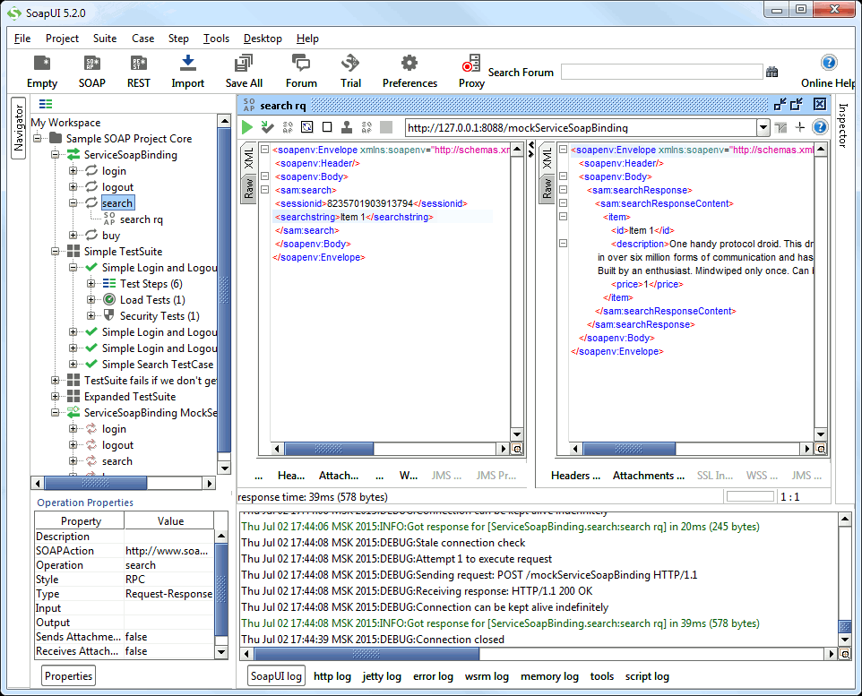
WHY MULE ESB?
HOW WE CAN JOIN TWO SYSTEMS? AN EXAMPLE
CLIENT
SERVER
For example
Using a common
language lile XML
t0: PHP SEND REQUEST
t1: Java Server elaborate
The request and prepare
The response
t2: JAVA SEND RESPONSE
SOAP UI is a Client
that allows us to send request
in xml
through http channel
and
recieve response
from the Server
always in xml data format

Slide 8







WHY MULE ESB?
POINT TO POINT SYSTEM INTEGRATION

Slide 9
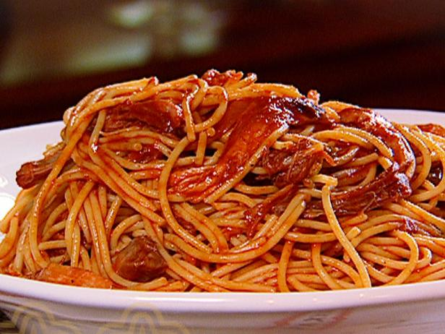
WHY MULE ESB?
POINT TO POINT SYSTEM INTEGRATION IS EVIL
The SPAGHETTI Network
Point to point System integration works fine only
if we have two or three system to connect
In n is the number of the system we can have
n(n-1)/2 links
Unmanageable
Tight coupling between the sender and the receiver

Slide 10

WHY MULE ESB?
ESB VS POINT TO POINT INTEGRATION
LET’S DO EVERYTHING TO MULE!

Slide 11
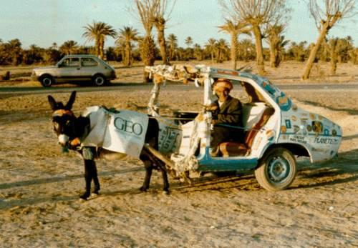
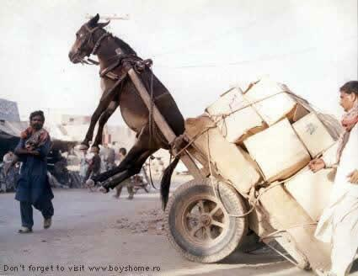
WHY MULE ESB?
MULE IS
NO POINT TO POINT INTEGRATION
THERE IS ONLY A BUS
ESB STANDS FOR ENTERPRISE SERVICE BUS
TRANSPORT DEVICE …
… THAT TRANSPORT INFORMATIONS …
… AND MESSAGES PROCESSOR …
… AND AND AND AND AND …
…
…
…
INTEGRATION PLATFORM THAT ALLOWS
DIFFERENT SYSTEM TO COMMUNICATE WITH EACH OTHER

Slide 12


WHY MULE ESB?
MULE ORCHESTRATION
The mule manages the exchange of information between all the systems and coordinates them
The client doesn’t care what Mule does and even
doesn’t care about all the systems that interfacing with Mule

Slide 13
MULE FEATURES
CONNECTORS
TRANSFORMERS
COMPONENTS
ROUTERS
FILTERS
EXCEPTION STRATEGIES

Slide 14




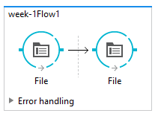




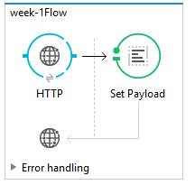
MULE FEATURES
MULE CONNECTORS
INBOUND CONNECTORS
OUTBOUND CONNECTORS
Connectors handle the complexities of message translation, integration and any other relating messages operations used to access the application features

Slide 15

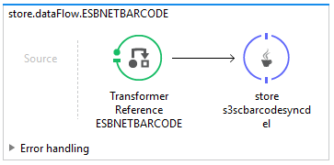
MULE FEATURES
MULE TRANSFORMERS
Transformer prepares a message for further processing by enhancing or altering the contents of the message

Slide 16
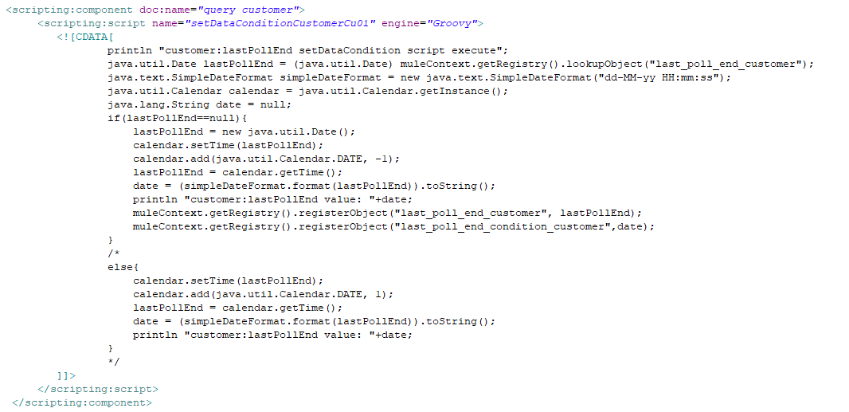

MULE FEATURES
MULE COMPONENTS
Components are message processors which execute business logic on messages. Into a flow to perform almost any customized task within your Mule application

Slide 17
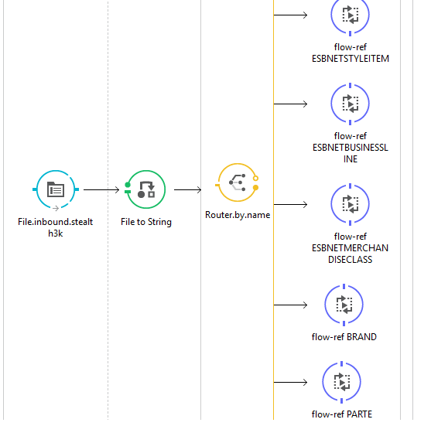

MULE FEATURES
MULE ROUTERS
Routers Flow Controls
route messages to various destinations

Slide 18


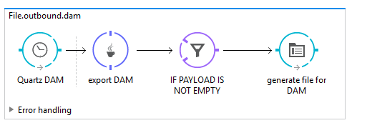
MULE FEATURES
MULE FILTERS
Filters determine whether a message can proceed through an application flow.
and, or, and not
Custom filter to specify a precise set of conditions a message must satisfy before it can continue through the flow

Slide 19
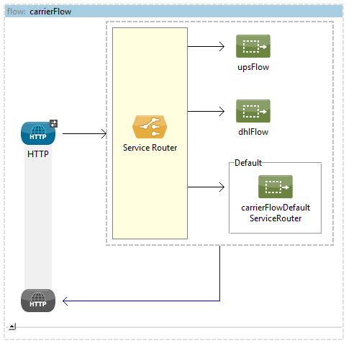
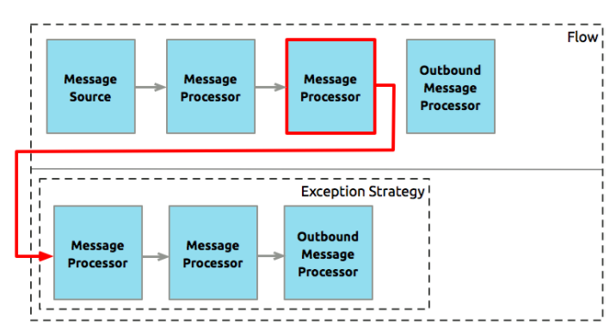
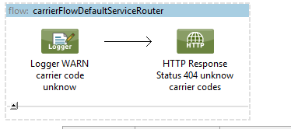
MULE FEATURES
MULE EXCEPTION STRATEGIES
Messaging Exception Strategy
whenever an exception is thrown within a flow

Slide 20
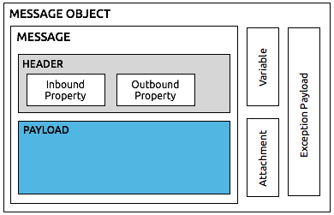
MULE FEATURES
MULE THE MESSAGE PAYLOAD

Slide 21
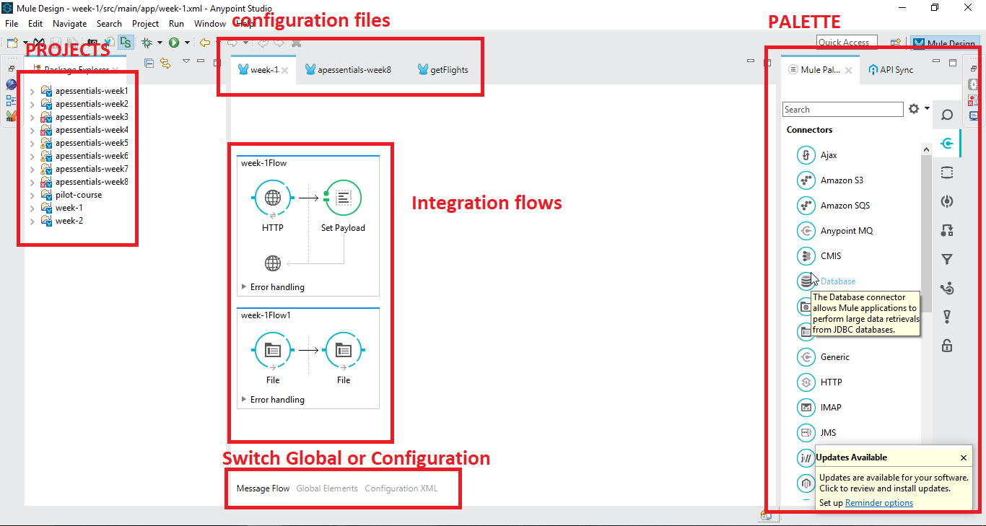
TOOLS
ANYPOINT PLATFORM

Slide 22
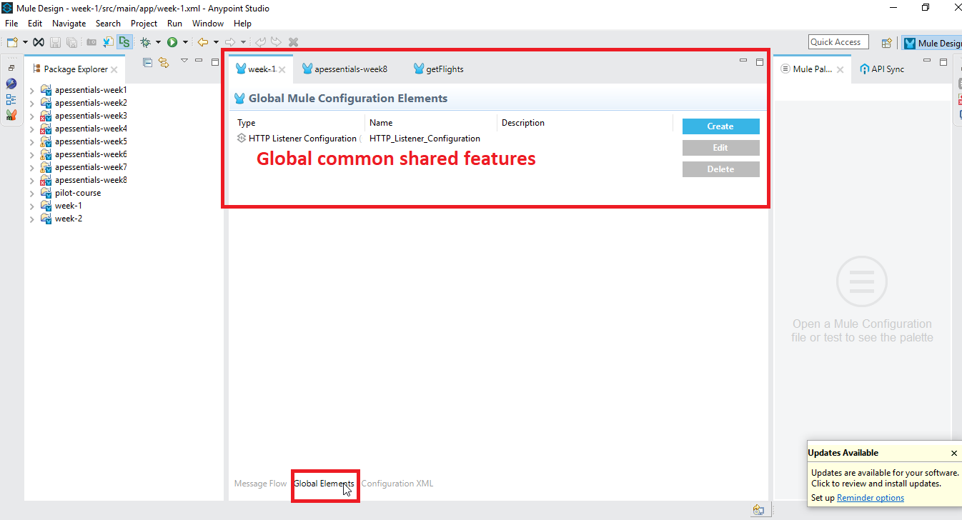
TOOLS
ANYPOINT PLATFORM GLOBAL ELEMENTS

Slide 23
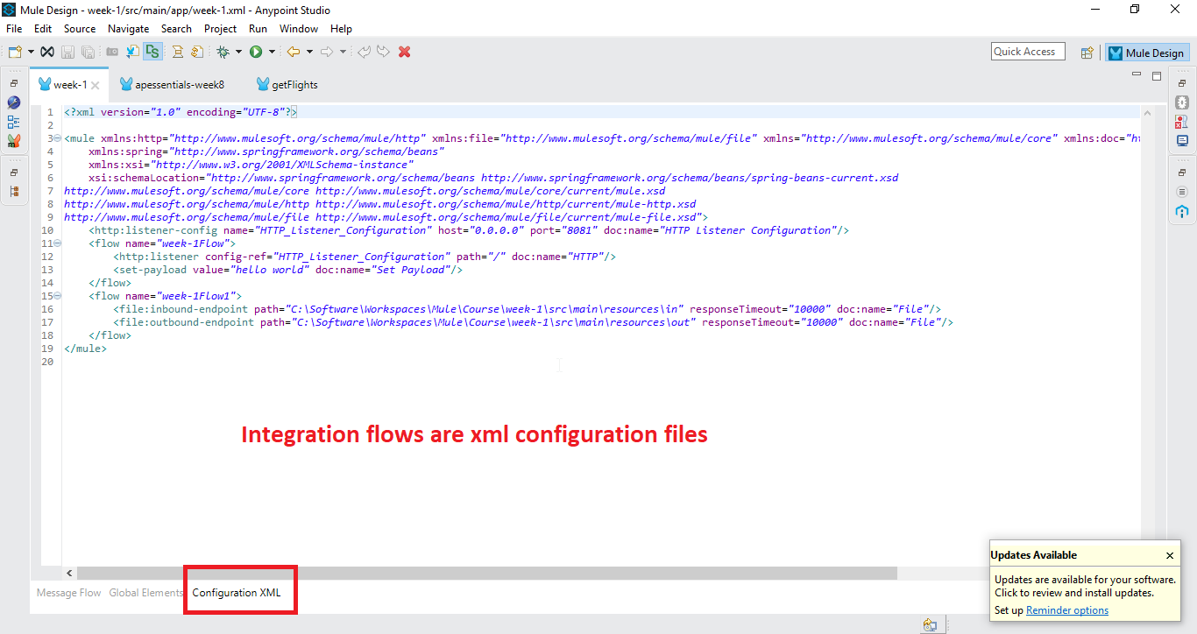
TOOLS
ANYPOINT PLATFORM GLOBAL ELEMENTS

Slide 24
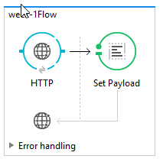
MULE SYNCH AND ASYNCH FLOWS
MULE SYNCHRONOUS FLOW
SYNCHRONOUS
EXCHANGE PATTERN REQUEST RESPONSE

Slide 25
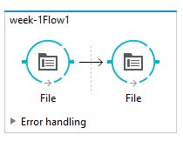
MULE SYNCH AND ASYNCH FLOWS
MULE ASYNCHRONOUS FLOW
ASYNCHRONOUS
EXCHANGE PATTERN ONE-WAY

