Slide 1



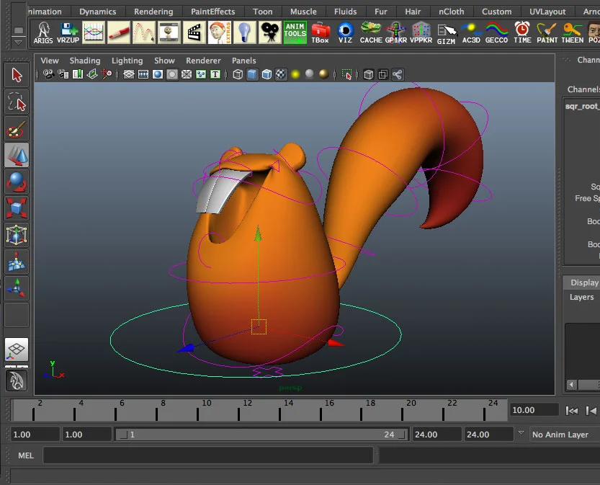
BUSA611:
Maya Website Independent Study Project with Autodesk
Anqi Chen (261044081)
December, 2022

Slide 2
Agenda
Executive Summary
Value Proposition – Strategy
Prototyping – UX/UI
Website Development – Technical
Appendices

Slide 3
Executive Summary
Autodesk is a software company that produces software products for architecture, constructions, entertainment industries and so on
Maya is one of Autodesk’s product, which is a 3D computer graphics application
The Maya data is collected as waypoint, attributes, and commands**, which keep tracks of user actions and command usages
The Maya team currently is lacking a centralized tool where internal stakeholders such as project managers (PM) can easily determine if data that they need is available without complex querying
The internal users need a tool that can be easily used to help them understand what information is available in their decision making process and what can be done to improve the product
Original scope:
45% Solution Architect
33% UX/UI design
12% Business strategy
10% Project Management (Creating slides, etc)
Changed scope***:
20% Solution Architect
40% UX/UI design
30% Business strategy
10% Project Management
Communicate with stakeholders to understand the business requirement
Obtain a static data source for the project
Create a prototype design using Figma* for designing the webpage and prototyping better visual
Develop the website, and will deliver a folder containing website development scripts
The website should include a search bar where users can input required keywords
A filtering menu to choose categories in case users might not have keywords, but instead they only have a set of rules to filter
It will also show all the waypoint, attribute, and command prior to any filtering
*Figma is a collaborative web application for interface design
** The detailed definition of waypoint, attribute, and command will be in the appendix
*** Detailed reasoning will be discussed on page 7: Website Development – Front-end
What is Maya and Autodesk?
Pain Point
Change of Scope
Approaches
Recommendations

Slide 4
Value Proposition
Objective & Insights
To deliver a proof of concept stage of website that generates important Maya data points for internal users. These data points can be used to product usage information that could be used to help improve product quality and understand customers’ needs better. Therefore, the goal is to provide an easy to use platform to quickly access data availability without complex querying.
Quantitative value
On average, help internal users save 1 hour per simple requirement, and 4 hours per complicated requirement
Reduce the needs to run repeated or unnecessary SQL queries
The new platform can save roughly $10,000 annually with a maintenance cost of $1000
Qualitative value
Improve productivity and accessibility, and thus enhance performance
Reduce potential error when sharing information, and increase autonomy and accuracy
Provide technical driven solutions help to innovate in the technical field

Slide 5
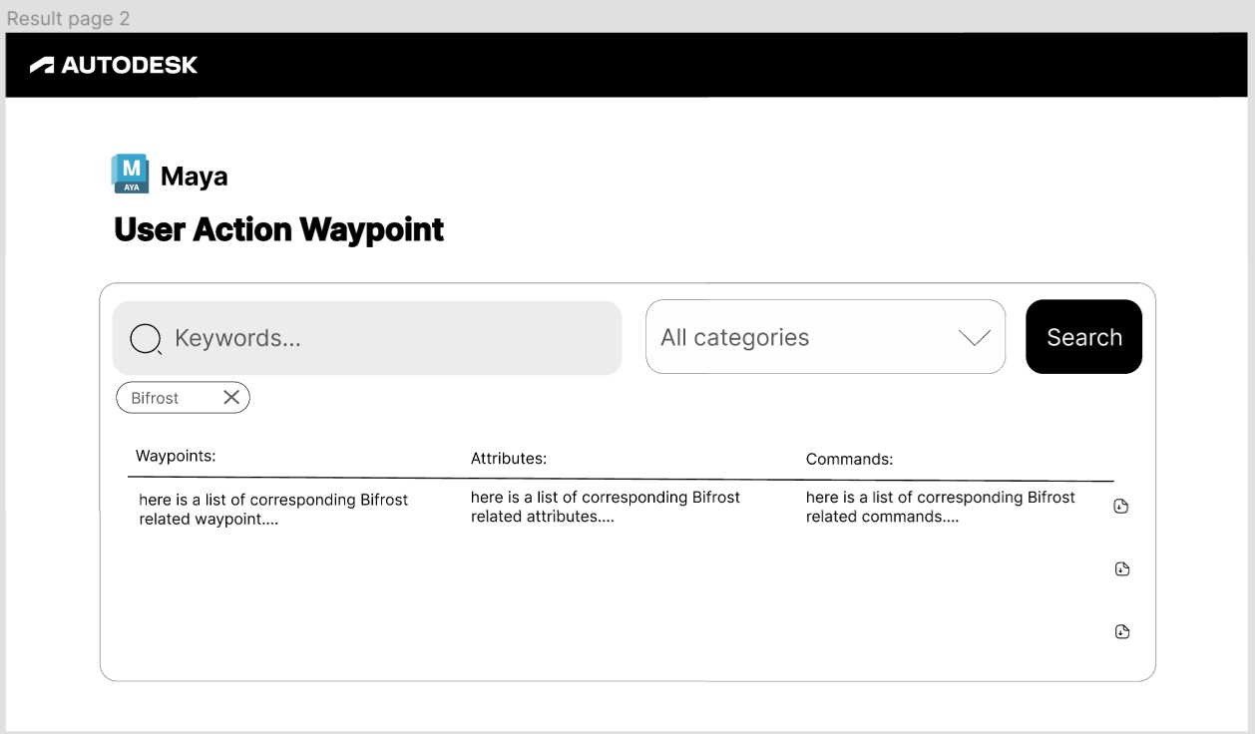
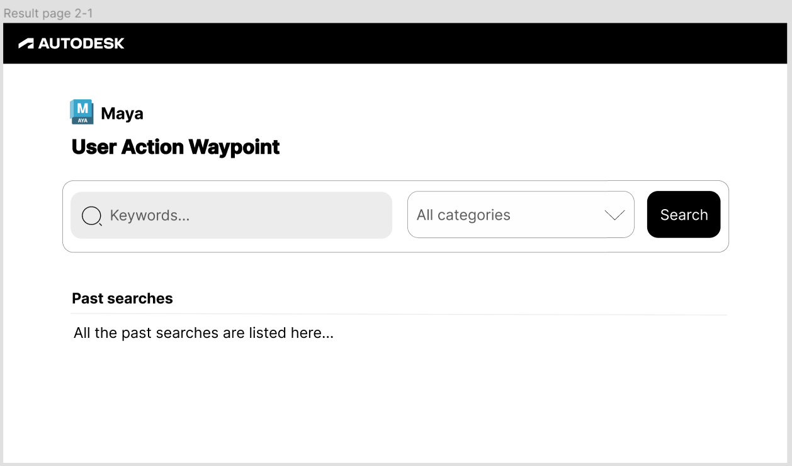
Prototyping*
*Please refer to the BUSA611_UX_Demo for detailed explanation of the prototype and the individual features
Search bar - Where stakeholders input the key words
List of data - Output of the available data after the search
User persona
Internal stakeholders within the EMS team at Autodesk who want to check data availability quickly without going through complex querying
Filtering - If no keyword is available, the data can also be filtered by major categories, such as plug-in, functionality, etc.
Current filter - Indicates what is being inputted
Information architecture
The website should display all the available Maya datapoints, as well as the ability to filter and search for keywords; The data should be easy and fast to find
Past searches - These can be saved in cache to avoid repeated calls
Wireframe
In total, three versions of wireframes were created. The best version is shown on the right hand side. The tool used for the wireframing process was Figma

Slide 6
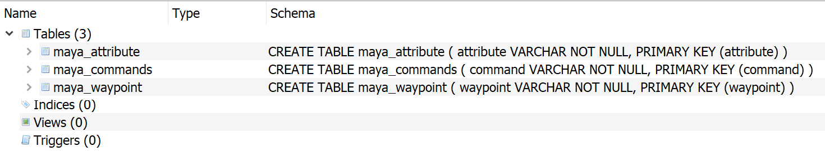
Website Development – Backend
Sample Data
Provided by the stakeholder (Autodesk)
Json format
Has three major features: waypoint, attributes, and command (more detail in the appendix)
Contains roughly 1000 records
Can be stored in separate relational database
Tools & Methodology
For the backend, Flask was majorly used for development because it is a more accessible framework and provides great flexibility
For database, instead of creating a server based SQL database, SQLite was used because it is a serverless database engine and provide easier use
More packages were used such as SQLAlchemy and Marshmallow
Result & Recommendation
By implementing the basic backend structure, the server can reach to the database that stores the static data source and return all the data points
A route to filter out based on users’ keywords will also be implemented
More work will be done to connect it to the front-end of the website
Figure 1: Database design

Slide 7
Website Development – Front-end
Planning and Tech Stack
The front-end was planned to be built using Typescript/React (with Yarn, ESlint, and Prettier)
The storybook would be a good resource and tool kit to start building components
Due to the change in scope, this section was only on the planning phase. The POC was only being planned but not yet completed.
To improve, a front-end for the website can be built using the tools mentioned above and integrate it with the back-end script
Next Step
Once the POC website is completed, the team can assess its usability and functionality, and improve it as needed
The next step would be to connect it to the live data source on either Hive or Snowflake
Then, test the code to ensure it passes all the requirements and edge cases, and eventually push it to production if needed as an internal helper tool
Maintain the website and additional features can be added if needed in the future
Future Perspectives and Valuation
This website project is just one aspect of how we can improve internal stakeholders’ productivity; Some processes and tasks can be automated and allow employees to focus on the real problem
It also provides ideas for how the team can improve internal productivity and to create other tools in the future

Slide 8
Appendices
More background information on Maya and Autodesk
Definition of waypoint, attribute, and command
Scope Adjustment and its benefits
Supplementary files
Study resources & websites references

Slide 9
Autodesk & Maya
Autodesk is a global leader in design and make technology. With expertise across architecture, engineering, construction, design, manufacturing, and entertainment, Autodesk help innovators everywhere solve today’s pressing challenges.
Maya is a professional 3D software for creating realistic characters and blockbuster-worthy effects. It brings believable characters to life with engaging animation tools.
More about Autodesk: https://www.autodesk.ca/en
More about Maya: https://www.autodesk.com/products/maya/overview?term=1-YEAR&tab=subscription

Slide 10
Definition of some key data
Waypoint: It captures more data than a command. It refers to specific instrumentation in the code that provides data for specific features or functions. For instance, a waypoint can tell if a feature is used
Attribute: Attributes are related to the waypoint/feature, and it keeps track of additional information to the feature
Command: Referring to a specific command executed by the user

Slide 11
Scope Adjustment & its Benefit
% change in the scope based on each section
Business Strategy
UX/UI
Architecture
The current stage and outcome of the project is at a satisfactory level, as the initial prototype and the planning of the implementation is completed.
The scope of the project was changed due to unexpected longer time took on prior steps and change of tech stack used in the backend section. To the current stage, the working hour has already fulfilled the course requirement, and it has proven its value to the industry partner. With planned future steps and its valuation, I believe the project will be valuable to the partner, and it satisfy the project requirement itself.
The benefit of the change is that there is detailed explanation for the sections that has been completed, and there are also researches on the sections that are in the planning phase, leaving room for implementation if the project can deem its value from this POC stage model.
12%
33%
45%
30%
40%
20%

Slide 12
Supplementary Files
Strategy supplementary file: McGill Independent Study Business Implication Writeup
UX/UI files are in the BUSA611_UXUI_supplementary folder
Video demo: BUSA611_UI_Demo.mp4
Web development files are in the BUSA611_WebDev_supplementary folder
GitHub
Main web dev file: “main.py”
Env & requirement file: requirements.txt; venv
LinkedIn learning resources: course_example/Exercises Files
Executive Summary & Slides: BUSA611_AnqiChen_MayaWebProject
Contribution file: BUSA611_613-ProjectContributions-20220901-ForStudents.xlsx

Slide 13
Study Resources & Websites References
Various Youtube videos such as Import your JSON file to MYSQL DATABASE using python - YouTube
All videos from Weblab (MIT): https://weblab.mit.edu/schedule/
Typescript: Easy start of a Typescript/React project (w/ Yarn, ESlint and Prettier) - DEV Community 👩‍💻👨‍💻
Storybook: Introduction to Storybook
LinkedIn learning course:
Learning TypeScript
Full Stack Web Development with Flask
Introduction to Web Design and Development

