Slide 1
METS 1.x Data Model
Derived Implicitly from the XML Schema

Slide 2
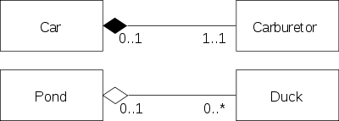
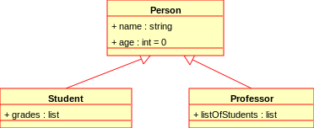
Abstract data model based the
current METS 1 XML schema
UML Class Diagram
Aggregation and Composition
Generalization
Notes:
UML = Unified Modeling Language
Aggregation = Pond and Duck – child can exist without the parent
Composition = Car and Carburetor – child cannot exist without parent

Slide 3
InformationPackage
<mets>
<metsHdr>
InformationEntity
Content
<binData>
<xmlData>
Pointer to content
<mdRef>
<Flocat>
<stream>
<transformFile>
InformationGrouping
Common @GROUPID
Nesting
<fileGrp>
<fileGrp>
<file>
<amdSec>
<techMD>
<rightsMD>
<sourceMD>
<digiprovMD>

Slide 4
InformationEntity
MetadataEntity
<dmdSec>
<amdSec>
<techMD>
<rightsMD>
<sourceMD>
<digiprovMD>
FileStreamEntity
<file>
<file>
<stream>

Slide 5
StructuralDivision
<structMap> root <div>
DivisionRelationships
Hierarchy
<div>
<div>
Directed Graph
@xlink:label
<structLink>
@LABEL
@ORDER
@ORDERLABEL
@TYPE
…
Manifestation (abstract)
<div>
<mptr>
<fptr> <fptr>
<par>
<seq>
<area>

Slide 6
MetadataDescribes…
InformationPackage
<metsHdr> @ADMID
StructuralDivision
<div> @DMDID
<div> @ADMID
FileArea
<area> @ADMID
InformationGrouping
<fileGrp> @ADMID
InformationEntity
<dmdSec> @ADMID
<techMD> @ADMID
<sourceMD> @ADMID
<rightsMD> @ADMID
<digiprovMD> @ADMID
<file> @DMDID
<file> @ADMID

Slide 7
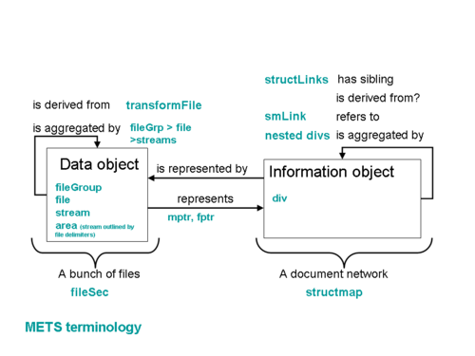
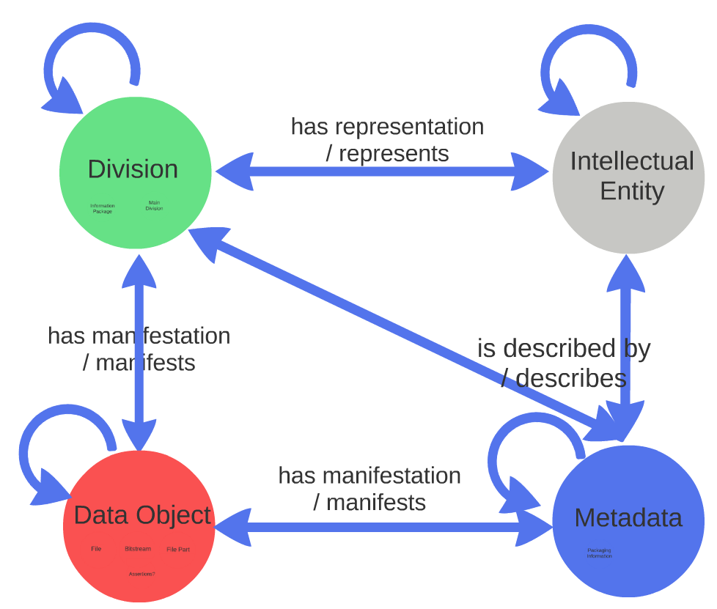
Preview of possible METS 2 Model

