Slide 1
Treatment of Key IEEE RAMLET Information Entities Important to METS
For iPres 2015 Workshop: Testing a Proposed METS 2.0 Data Model against Use Cases and Complementary Data Models: Presentations and Community Discussion
Monday, November 2nd, 2015
By Nancy J. Hoebelheinrich, Knowledge Motifs LLC

Slide 2
IEEE RAMLET
IEEE Standard 1484.13.1-2012
IEEE Standard for Learning Technology—Conceptual Model for Resource Aggregation for Learning, Education, and Training

Slide 3
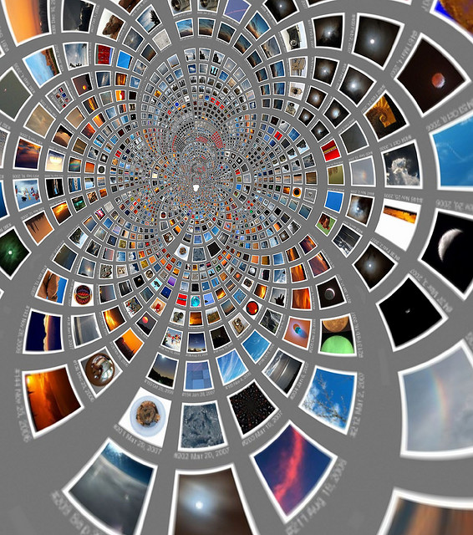
fdecomite; CCBy 2.0;
https://www.flickr.com/photos/artmakesmesmile/3158189914/in/photolist-FemHJ-5P5xQf-5NZran-5P5jsE-5P4Ns5-fEHboN-5P17on-dnc8an-4n5tPp-dUAiXL-fcXUsG-hZPFmK-fcHAaF-2yGAZP-5P5wMC-34t9yw-5HxvD9-iqgygN-5fpUyC-348N2e-2yGAZr-5P5pjm-2Y2h48-8FFnKB-Uqbj2-ecKLaQ-eD5EEv-2yGB1r-5P1hdi-5P1fV4-5NZp2M-dnc2DK-5P3ULo-dnc4J3-4YW1fb-5NYD5p-dncaWK-dncbQS-5P3WiQ-5P5r6m-5P1awV-5P1dG8-5P1eCD-5P1cST-dnbDWW-5P1fnD-5P19VV-5P18gg-2tnypN-47MoGE/
Purpose of RAMLET:
Transformation
from one Aggregation
Format to another

Slide 4
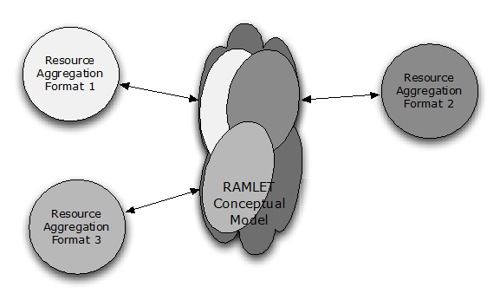
Basis of Conceptual Model: a focus upon structures analyzed by functional characteristics
https://mentor.ieee.org/ramlet/dcn/11/ramlet-11-0001-00-Docs-ramlet-conceptual-overview.pdf, Figure 1, p. 3.
Notes:
“The conceptual model describes the functional similarities of and the relationships among the components of the data models of various aggregation formats. It focuses on the structures of aggregation formats by analyzing and describing the functional characteristics of common structural elements, then abstracting and expressing them in ontological form as a core ontology.”
From Annex B to the standard, Conceptual Overview, pp. 64 – 65.

Slide 5
Aggregation Formats analyzed
IMS Content Packaging
METS v1.7
MPEG-21 DID (Digital Item Declaration)
Atom
OAI-ORE
“Domains”:
Education
Libraries
Archives
Museums
AV content industry
Content syndication
Object reuse & exchange

Slide 6
Scope set by Use Cases
Example
Use Case 4 of 8:
Retrieving resources from a variety of digital repositories that each use different resource aggregation formats,
Interpreting the different formats,
Storing the resource packages in a single format, and
Providing the resource aggregates in multiple formats by
Interpreting to the user’s preferred resource aggregation format
https://mentor.ieee.org/ramlet/dcn/11/ramlet-11-0002-00-Docs-the-ramlet-project-use-cases.pdf, Figure 4, p. 6.

Slide 7
Expressed as OWL Lite ontologies
RAMLET Core
Recommended Practices & Mappings:
Approved as IEEE standard in 2012
Print standard available for purchase from IEEE
Available for free download as RDF & Turtle
Approved:
Xlink (2012)
Atom (2013)
METS (2013)
MPEG-21 DID (2013)
OAI-ORE (2014)
In process:
IMS-CP (ballot closed)
RAMLET URI Registry: https://mentor.ieee.org/ramlet/bp/RAMLET_URI_Registry

Slide 8
RAMLET functions & concepts key to our discussion
Functions:
RAMLET concepts:
Packaging a discrete aggregation
Differentiating “digital resources” w/in a pckg
Describing the structure of a digital resource
Subdividing structures
Grouping components
Relating components
Associating metadata
topNode
digitalResource
staticStructure & dynamicStructure
structureNode
resourceGroup, functionalResourceGroup
hasOrder / parallel
descriptorObject

Slide 9
Ramlet or “borrowed” properties key to our discussion
Properties
Definitions
describes & isdescribedby
hasPart & isPartOf (dcterms:)
includes & isincludedby
references & isreferencedby
A component describes another & vice versa
One resource is included in another, either physically or logically & vice versa
Implies parent-child relationship & vice versa (sub property of hasPart & isPartOf from dcterms)
Describes an association b/w components signaled by an identifier & vice versa (sub property of has Part & isPartOf from dcterms)
Notes:
From standard, 8.8 ramlet:references, p. 59:
Scope note: An arbitrary association between components signaled by an identifier reference to an identifier elsewhere. The component with the references property carries the reference
to an identifier or identifiers of one or more other components.
Has inverse: ramlet:isReferencedBy
NOTE—Semantically, this property is a refinement of the Dublin Core (DC) relation metadata term (Dublin Core Metadata Initiative [B3]). The relation metadata element defined by IEEE Std 1484.12.1–2002 [B5] is semantically equivalent to DC’s relation metadata term.

Slide 10
Ramlet or “borrowed” properties key to our discussion
Properties
Definitions
describes & isdescribedby
hasPart & isPartOf (dcterms:)
includes & isincludedby
references & isreferencedby
A component describes another & vice versa
One resource is included in another, either physically or logically & vice versa
Implies parent-child relationship & vice versa (sub property of hasPart & isPartOf from dcterms)
Describes an association b/w components signaled by an identifier & vice versa (sub property of has Part & isPartOf from dcterms)
Notes:
From standard, 8.8 ramlet:references, p. 59:
Scope note: An arbitrary association between components signaled by an identifier reference to an identifier elsewhere. The component with the references property carries the reference
to an identifier or identifiers of one or more other components.
Has inverse: ramlet:isReferencedBy
NOTE—Semantically, this property is a refinement of the Dublin Core (DC) relation metadata term (Dublin Core Metadata Initiative [B3]). The relation metadata element defined by IEEE Std 1484.12.1–2002 [B5] is semantically equivalent to DC’s relation metadata term.

Slide 11
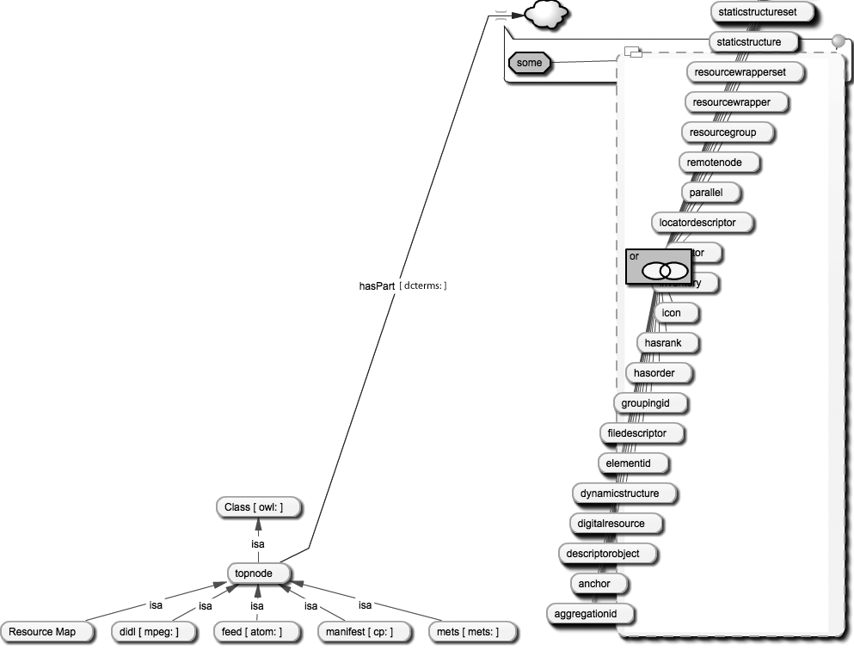
NO concept of “intellectual entity” from any of the aggregation formats analysed
Function: Packaging a discrete aggregation
ramlet:topNode
11
Reprinted with permission from IEEE. Copyright IEEE 2012. All rights reserved.
11
Notes:
Meaning of “or”: From Std., p. 55 of print copy, “NOTE—Because ramlet:topNode is the highest class level defined by an aggregation format, it has all other classes as
its potential constituent parts.” That is, topnode could have one or more of any of the classes in the list.

Slide 12
ramlet:topNode
From scope note: The highest class level of an aggregation defined by an aggregation format.
12
Reprinted with permission from IEEE. Copyright IEEE 2012. All rights reserved.
12
Notes:
Meaning of “or”: From Std., p. 55 of print copy, “NOTE—Because ramlet:topNode is the highest class level defined by an aggregation format, it has all other classes as
its potential constituent parts.” That is, topnode could have one or more of any of the classes in the list. Scope note: The highest class level of an aggregation defined by an aggregation format.

Slide 13
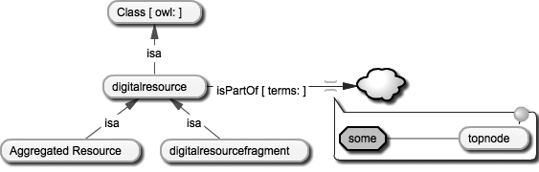
Function: Differentiating digital resources within a package
ramlet:digitalresource
Scope note: Refers to a digital resource contained in an aggregation instance; Example: oai-ore:aggregatedResource
Reprinted with permission from IEEE. Copyright IEEE 2012. All rights reserved.

Slide 14
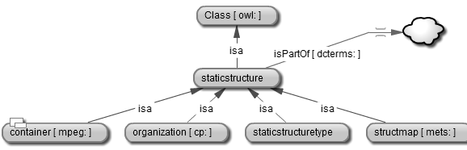
Function: Describing the structure of a digital resource
ramlet:staticStructure
From scope notes: Describes the relationships among nodes within a structure.
Reprinted with permission from IEEE. Copyright IEEE 2012. All rights reserved.

Slide 15
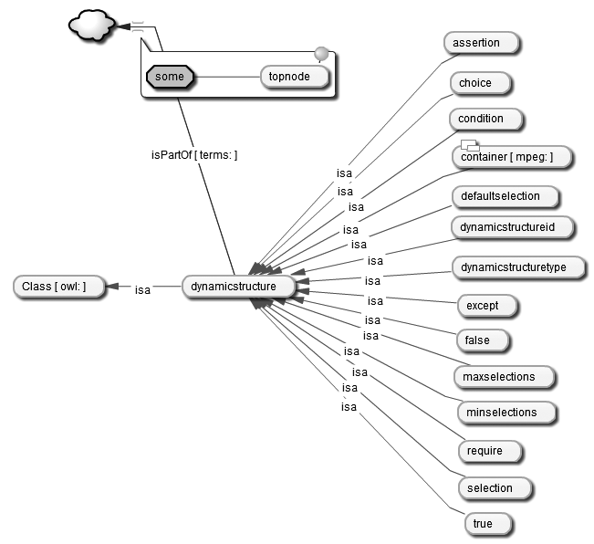
Function: Describing the structure of a digital resource
ramlet:dynamicStructure
Reprinted with permission from IEEE. Copyright IEEE 2012. All rights reserved.

Slide 16
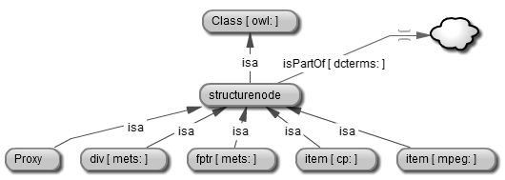
Function: Dividing structures
From scope notes: This class represents a node in a structure that organizes the digital resource(s) within the package.
ramlet:structureNode
Reprinted with permission from IEEE. Copyright IEEE 2012. All rights reserved.

Slide 17
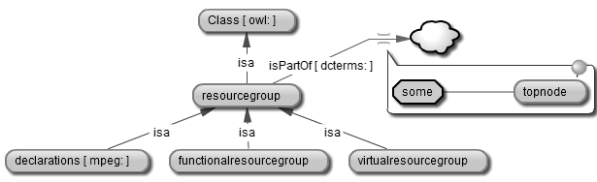
Function: Grouping componets
ramlet:resourceGroup
Allows files to be “collected” for different purposes; Linked to ramlet:fileDescriptor, i.e., mets:file.
Reprinted with permission from IEEE. Copyright IEEE 2012. All rights reserved.
Reprinted with permission from IEEE. Copyright IEEE 2012. All rights reserved.

Slide 18
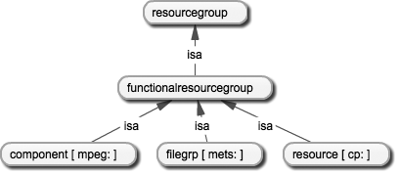
Function: Grouping components
ramlet:resourceGroup
ramlet:functionalResourceGroup
All images reprinted with permission from IEEE. Copyright IEEE 2012. All rights reserved.

Slide 19
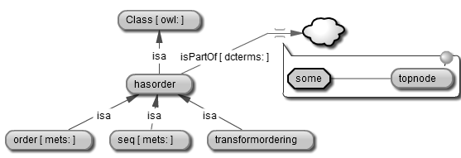
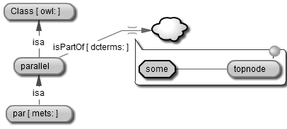
Function: Relating components
From scope notes: Provides a preferred order by sequence for digital resources and/or parts of resources
From scope notes: Establishes parallel relationships among digital resources
ramlet:hasOrder (+subclass of ramlet:transformOrdering, not shown)
ramlet:parallel
Reprinted with permission from IEEE. Copyright IEEE 2012. All rights reserved.
(+subclass of ramlet:transformOrdering, not shown, for default ordering)
Reprinted with permission from IEEE. Copyright IEEE 2012. All rights reserved.

Slide 20
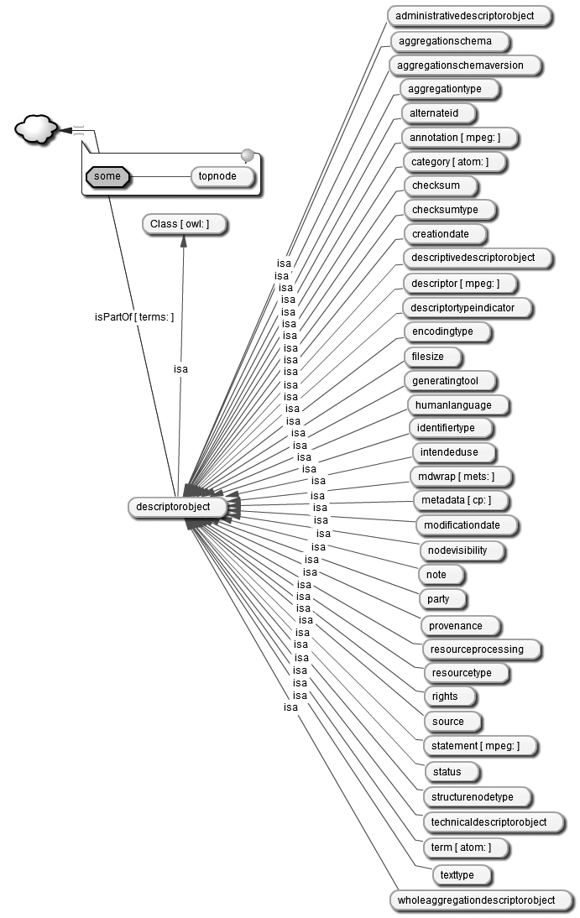
Function:
Associating metadata
From scope notes: Information that helps the finding, identifying, selecting, and obtaining of a digital resource
ramlet:descriptorObject
Reprinted with permission from IEEE. Copyright IEEE 2012. All rights reserved.

Slide 21
Re-using the IEEE RAMLET standard
The RAMLET classes that have been illustrated are usually top level classes that can be re-used, but need to meet the conformance requirements for them because of the rigorous vetting process associated with the approval of an IEEE standard.
Use of an IEEE standard implies both rigor and obligation
Options for re-using RAMLET classes & properties: mapping or extending the core ontology
Mappings:
If a concept is already expressed as a class or property, the identifiers for those classes or properties need to be used
Extensions:
If a concept is not already expressed as a class or property, a new one can be added & identified in the form of an extension to the core ontology., i.e., in a new ontology. The new identifier should not be used for a concept that already exists in the core ontology.

Slide 22
Acknowledgements / References
RAMLET URI Registry at IEEE: https://mentor.ieee.org/ramlet/bp/RAMLET_URI_Registry
The RAMLET Project Conceptual Overview:
https://mentor.ieee.org/ramlet/dcn/11/ramlet-11-0001-00-Docs-ramlet-conceptual-overview.pdf
The RAMLET Project – Use Cases: https://mentor.ieee.org/ramlet/dcn/11/ramlet-11-0002-00-Docs-the-ramlet-project-use-cases.pdf
RAMLET Implementation Study Report (Kraan):
http://ubir.bolton.ac.uk/id/eprint/310

Slide 23
thank you!
questions???
Nancy J. Hoebelheinrich
Information analyst / Principal
Knowledge Motifs LLC
nhoebel@kmotifs.com

