Slide 2
METS with docWorks
Joachim Bauer Senior System Engineer, CCS

Slide 3
What is docWorks?
How is METS used in docWorks?
How does the data model look like?

Slide 4
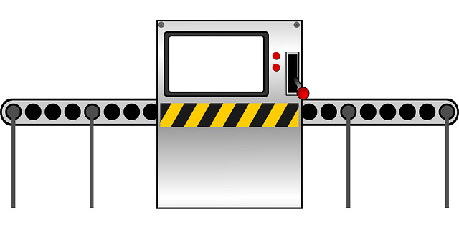
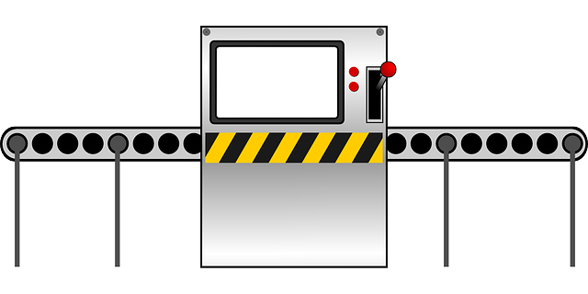











Illustration of docWorks
Notes:
docWorks îs a conversion software
typically integrated into a full digitization workflows
cropping / OCR-ing / structuring / exporting
Manuscripts -> no OCR
Digital born -> no cropping
Catalog cards -> recording of metadata (MARC records) with METS in total different scope
Newspaper reals -> splitting into single issues
illustration of a production line matches very good
Is used for detailed and precised metadata enrichment by libraries as well as by service providers for mass digitization
Automated processes by background services (servers)
Manual quality control / correction / enrichment by client application

Slide 5
Role of METS within docWorks
internal data model used within docWorks to keep intermediate data
METS is used as output format
One METS file for each digital object
Newspaper issue
Book
Journal issue
Default output
METS
ALTO
Master images
Derivatives (PDF, ePUB, lossy images)
Notes:
METS not used within docWorks
METS is used as standard output format

Slide 6


How the dW - METS files look like
METS
METS header <metsHdr>
Descriptive metadata section <dmdSec>
Administrative metadata section <amdSec>
File inventory section <fileSec>
Structural map <structMap>
Structural map linking <structLink>
Not used in default output of docWorks.
Behavior section <behaviorSec>

Slide 7
METS
ORDER
1
2
3
4
5
6
7
8
9
10
11
12
…
LABEL
II
III
IV
V
VI
2
3
4
…
ORDERLABEL
I
II
III
IV
V
VI
1
2
3
4
…
Structural map <structMap TYPE=„PHYSICAL“>
<div ID=„DIVL1" type="Newspaper">
<div ID="DIVP2" type=„PAGE">
<div ID="DIVP3" type=„PAGE">
<div ID="DIVP4" type=„PAGE">
Physical structMap
- recording page level reference - recording page numbering (printed page numbers)

Slide 8
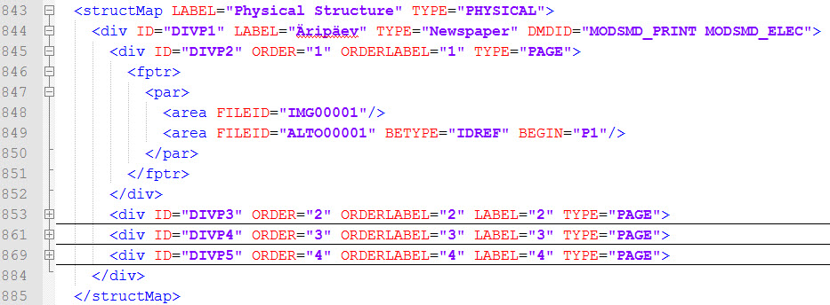
METS
Structural map <structMap TYPE=„PHYSICAL“>
structMap
Physical structure of a newspaper with four pages
Notes:
Sample XML: Physical structure of a newspaper with four pages

Slide 9
METS
Structural map <structMap TYPE=„LOGICAL“>
<div ID=„DIVL1" type="Newspaper">
<div ID="DIVL2" type="Issue">
<div type="Article" label="My first article">
<div type="Article" label="My second article">
Logical structMap
Reading sequence reference to ALTO content
Segmentation into articles, chapters, ...

Slide 10
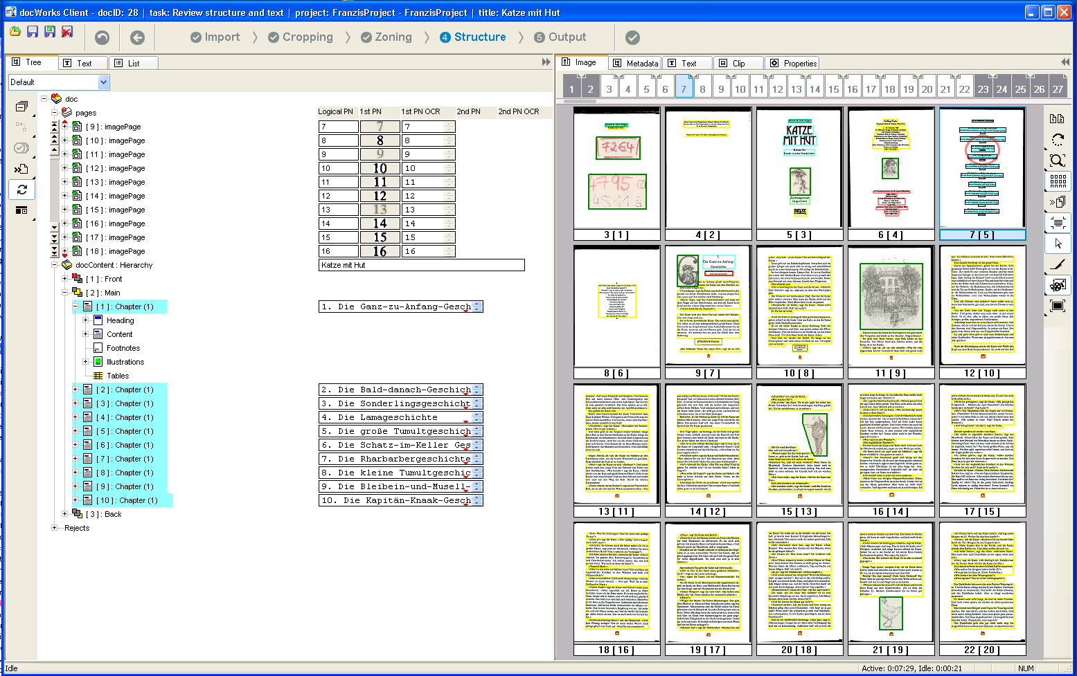

Slide 11
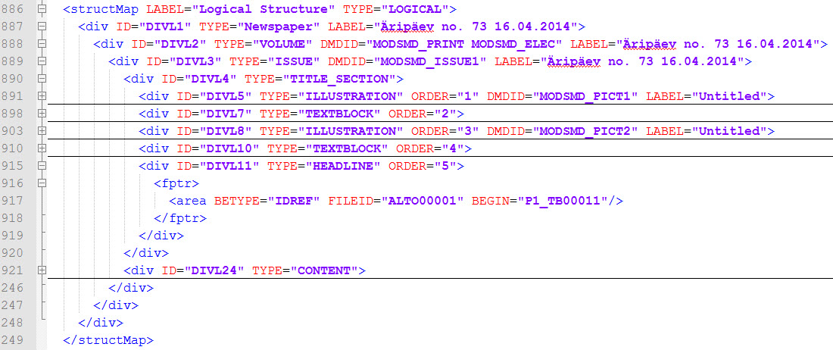
METS
Structural map <structMap TYPE=„LOGICAL“>
structMap
Logical structure of a newspaper issue with several elements in its title section
Notes:
Sample XML: Logical structure of a newspaper issue with several elements in its title section

Slide 12
METS
File inventory section (fileSec)
fileSec references to all files of the digital object
One filegroup for each file type
Master images
ALTO xml
further derivatives / thumbnails
PDF (per page / whole doc)
ePUB
Adaptions based on customer requirements of repository / presentation system (ID and USE attribute)

Slide 13
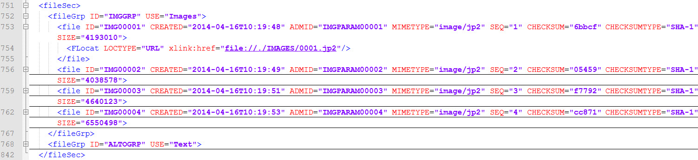
METS
File inventory section (fileSec)
fileSec
File section with two file groups
Notes:
Sample XML: File section with two file groups

Slide 14
METS
Administrative metadata sections (amdSec)
One amdSec for each master image
mix metadata embedded
Adaptions based on customer requirements, e.g.
scanner details out of workflow recordings,
PREMIS for copyright details or detailed recording of processing steps or

Slide 15
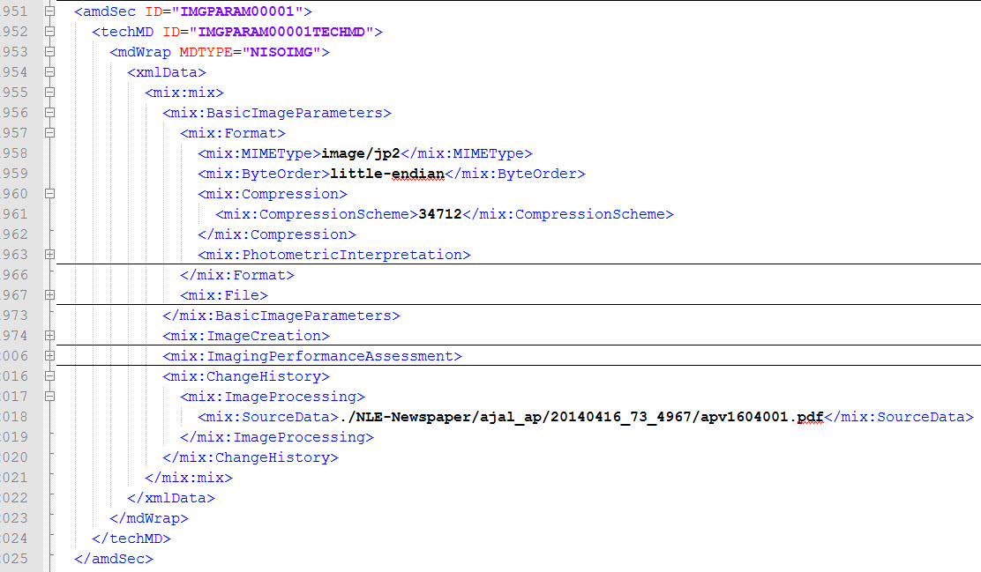
METS
Administrative metadata sections (amdSec)
amdSec
Administrative metadata integration into the METS file (here: MIX)
Notes:
Sample XML: Administrative metadata integration into the METS file (here: MIX)

Slide 16
METS
Descriptive metadata section <dmdSec>
One dmdSec for whole item (book, newspaper issue, object)
MODS / MARC / DC
<dmdSec> for each structural unit down to any level Typically:
Chapter (books)
Articles (newspapers)
Illustrations
Advertisements

Slide 17
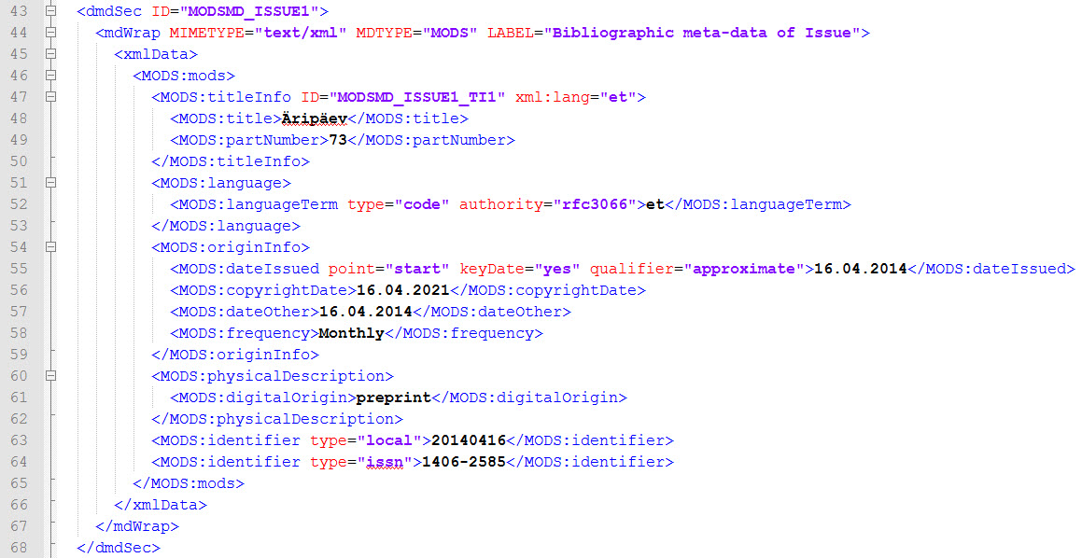
METS
Descriptive metadata section (dmdSec)
dmdSec
Descriptive metadata integration into the METS file (here: MODS)
Notes:
Sample XML: Descriptive metadata integration into the METS file (here: MODS)

Slide 18
METS
METS header <metsHdr>
METS header containing by default
Identifier
Agent for CREATOR software
Agent for CREATE library / company
Often customized to client needs
Specified by repositories / presentation systems

Slide 19
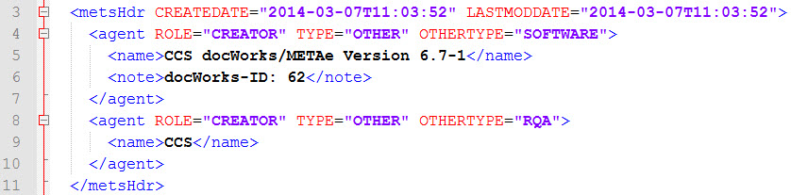
METS
METS header (metsHdr)
metsHdr
Header with basic document metadata
Notes:
Sample XML: Header with basic document metadata

Slide 20
How the dW-METS look like
METS
METS header (metsHdr)
1 x <metsHdr>
Descriptive metadata section (dmdSec)
1 x <dmdSec> for whole unit 1 x <dmdSec> for each structural unit
Administrative metadata sections (amdSec)
1 x <amdSec> for each page (master)
File inventory section (fileSec)
1 x <fileGrp> for each file type
Structural map (structMap)
1 x <structMap TYPE=PHYSICAL>
1 x <structMap TYPE=LOGICAL>
Structural map linking (structLink)
Behavior section (behaviorSec)

Slide 21

Summary dW - METS data model
METS as main digital object container
Each newspaper issue / book / journal issue one METS
All files referenced from METS
Metadata embedded with MODS, MARC or DC
Two <structMap> elements for physical and logical structure
All text content in ALTO
Sample METS
http://www.content-conversion.com/docworks/data/sample-mets.xml
Notes:
- all transformations for other formats done out of standard METS/ALTO output, e.g. PDF, EPUB,

Slide 22
www.content-conversion.com
Sample METS
http://www.content-conversion.com/docworks/data/sample-mets.xml

Slide 23
Disclaimer
All of the information in this document is the property of CCS Content Conversion Specialists GmbH (CCS). It may NOT, under any circumstances, be distributed, transmitted, copied, or displayed without the written permission of CCS.
The information contained in this document has been prepared for the sole purpose of providing information about theme described in the following title. The material herein contained has been prepared in good faith; however, CCS disclaims any obligation or warranty as to its accuracy and/or suitability for any usage or purpose other than that for which it is intended.
© CCS Content Conversion Specialists GmbH, 2014

